Slide 1

PRESENTATION AT SCHOOL

Slide 2
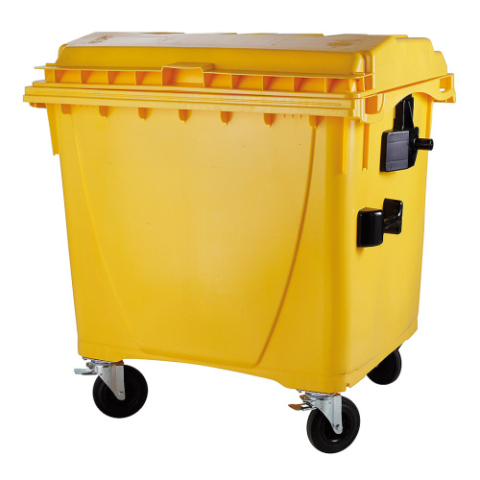


DATA FROM EKO-KOM IN CZECH REPUBLIC 2020
39% CERTIFIED FUEL
69% CLASIFIED AS RECYCLED
30% MATERIAL RECYCLING
Notes:
Source Czech TV: https://ct24.ceskatelevize.cz/ekonomika/3289301-recyklace-plastu-v-cesku-nefunguje-vetsina-odpadu-se-spali#:~:text=P%C5%99esto%C5%BEe%20zm%C4%9Bny%20v%20z%C3%A1kon%C4%9B%2C%20kter%C3%A9,roku%202030%20pak%2055%20procent.

Slide 3

Notes:
Source: Precious Plastic promo V2

Slide 4
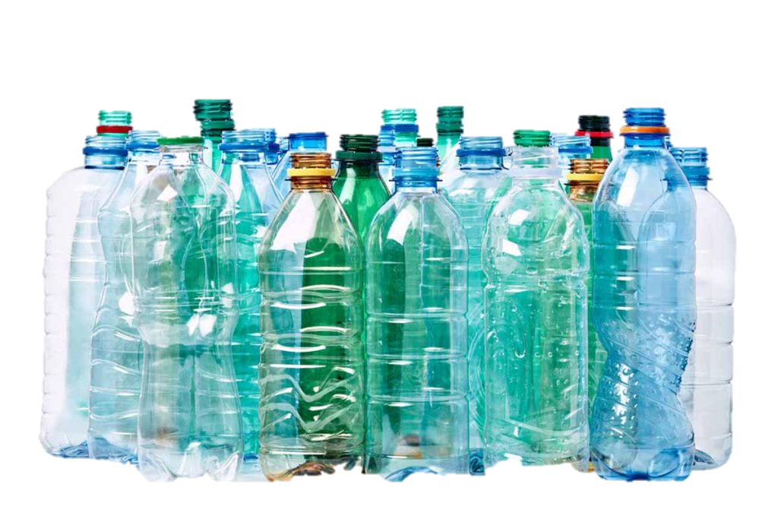
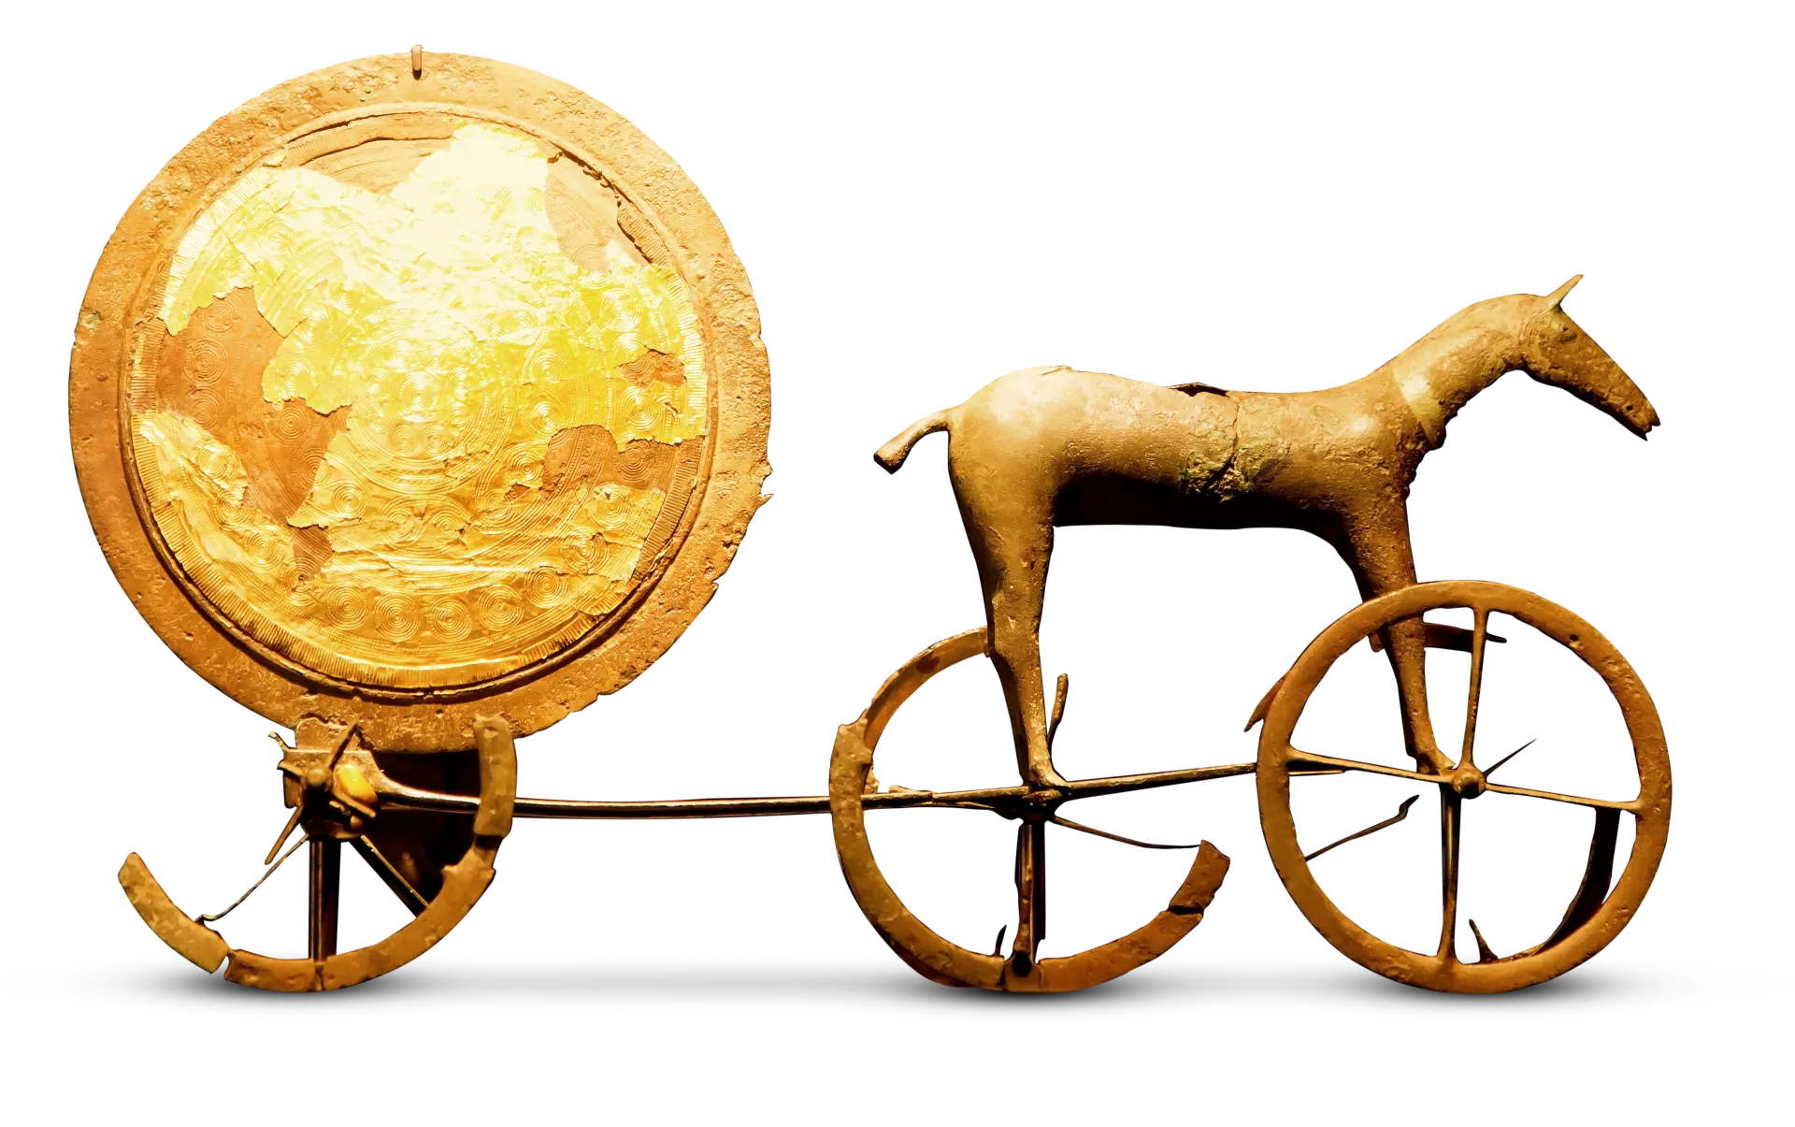
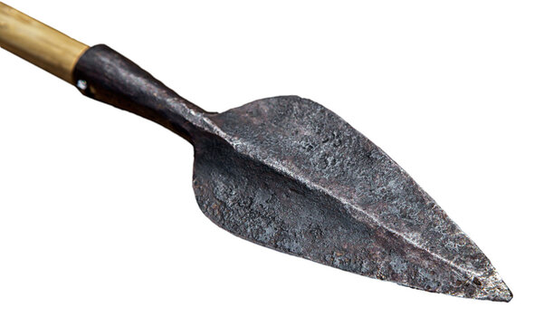
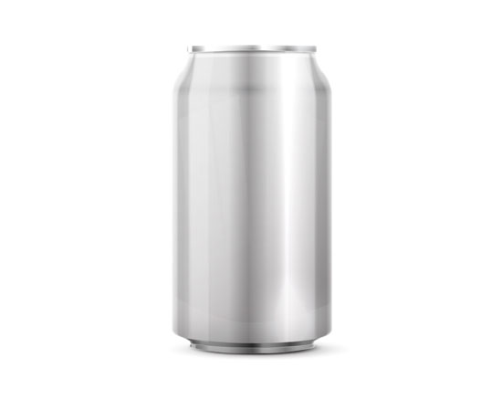
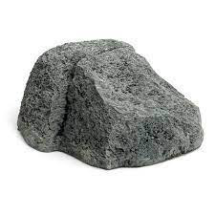
WHAT ABOUT PLASTIC?
STONE AGE
3 mil. - 4 000 BC
BRONZE AGE
4 000 – 3 200 BC
3500 – man made glass
IRON AGE
3 200 BC – 1 200 BC
3000s – first paper
STEEL AND ALUMINIUM
1800s – present
PLASTIC AGE
1900s - PRESENT
Notes:
where would you put plastics in human history?
Source: https://eandt.theiet.org/content/articles/2019/09/the-seven-ages-of-materials/

Slide 5
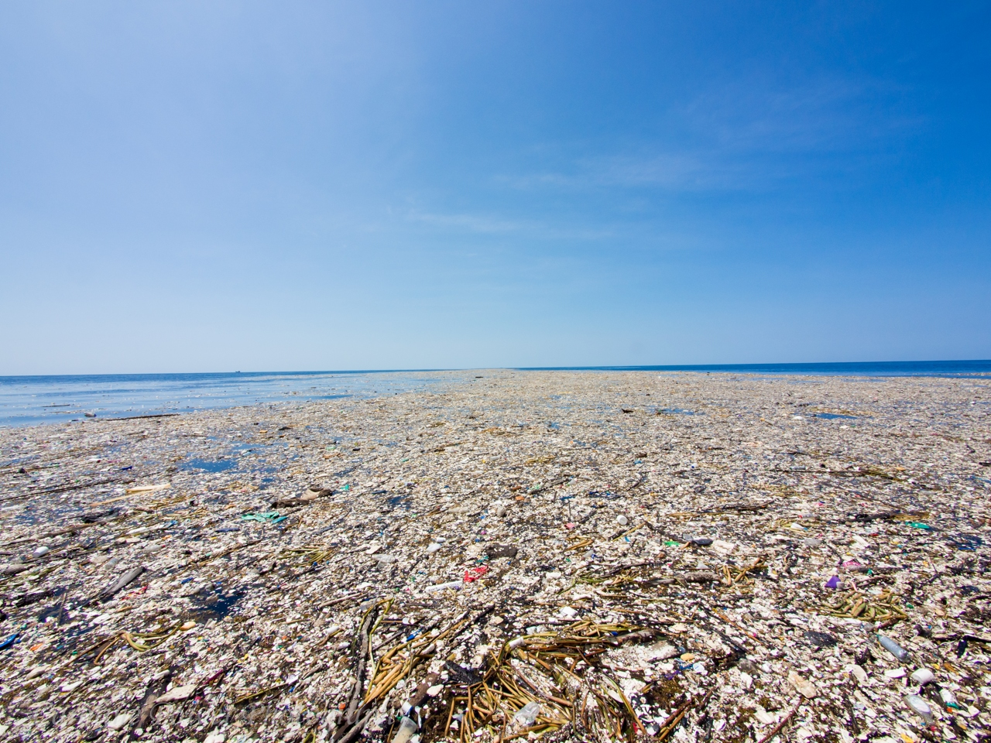



WHO WAS THE BIGGEST PLASTIC POLLUTER IN THE WORLD IN 2021?
Notes:
LOOK WHAT HAVE WE DONE IN LESS THEN 100 YEARS
Biggest plastic polluters source:
https://waste-management-world.com/artikel/the-top-plastic-polluters/#:~:text=The%20Coca%2DCola%20Company%20and,for%20fueling%20the%20climate%20crisis.

Slide 6
WHO WAS THE BIGGEST PLASTIC POLLUTER IN THE WORLD IN 2021?
Notes:
LOOK WHAT HAVE WE DONE IN LESS THEN 100 YEARS
Biggest plastic polluters source:
https://waste-management-world.com/artikel/the-top-plastic-polluters/#:~:text=The%20Coca%2DCola%20Company%20and,for%20fueling%20the%20climate%20crisis.

Slide 7
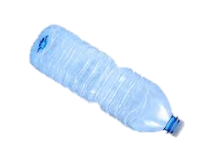
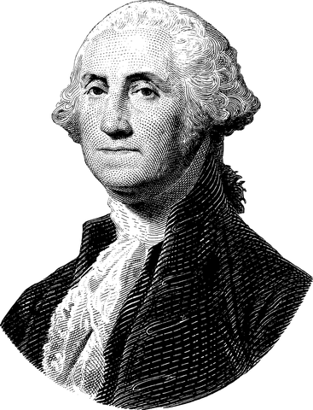
GEORGE WASHINGTON
1732 – 1799
Notes:
FUNNY FACT – IMAGINE – IF GEORGE WASHINGTON COULD DRINK WATER FROM PET BOTTLE, YOU COULD STILL FIND THIS BOTTLE :-D

Slide 8
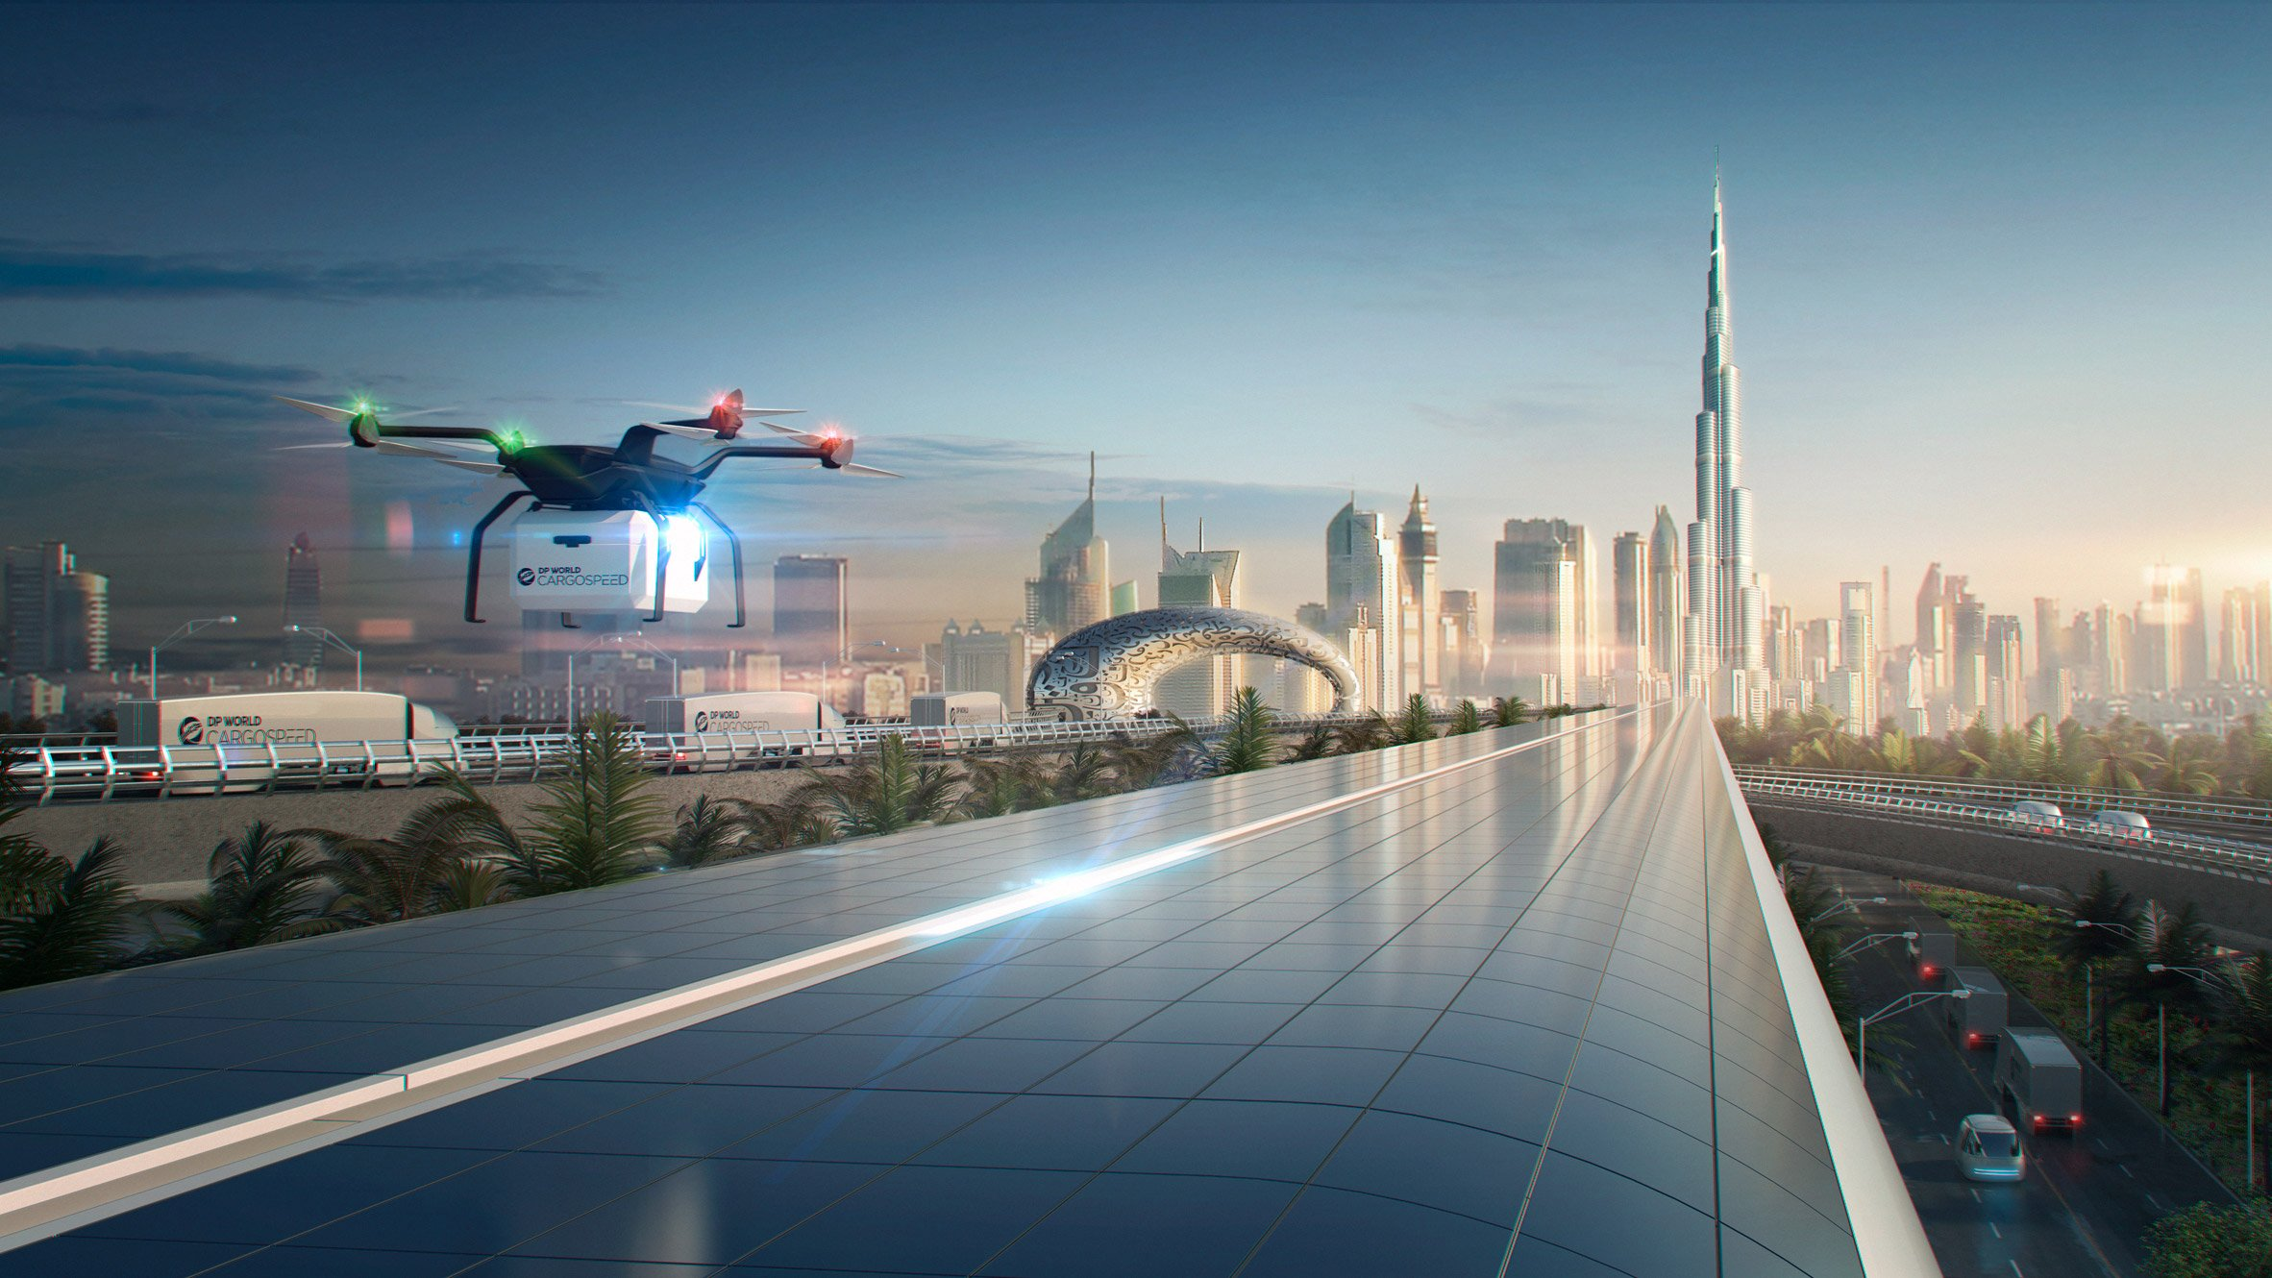
THE ACTIONS WE DO TODAY WILL AFFECT SEVERAL GENERATIONS AFTER US.
Notes:
Picture source: https://www.dezeen.com/2018/05/03/foster-partners-hyperloop-cargo-network-dp-world-cargospeed/

Slide 9
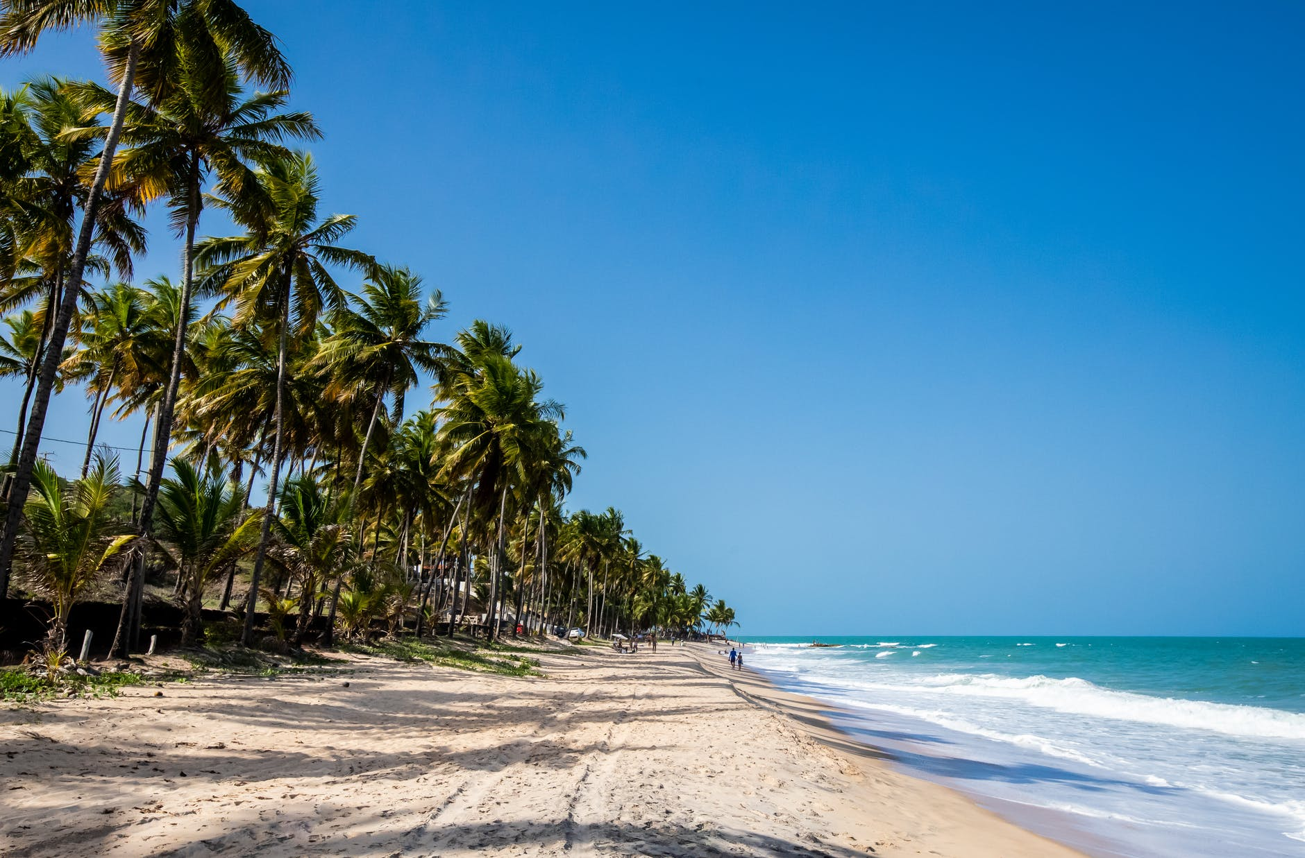
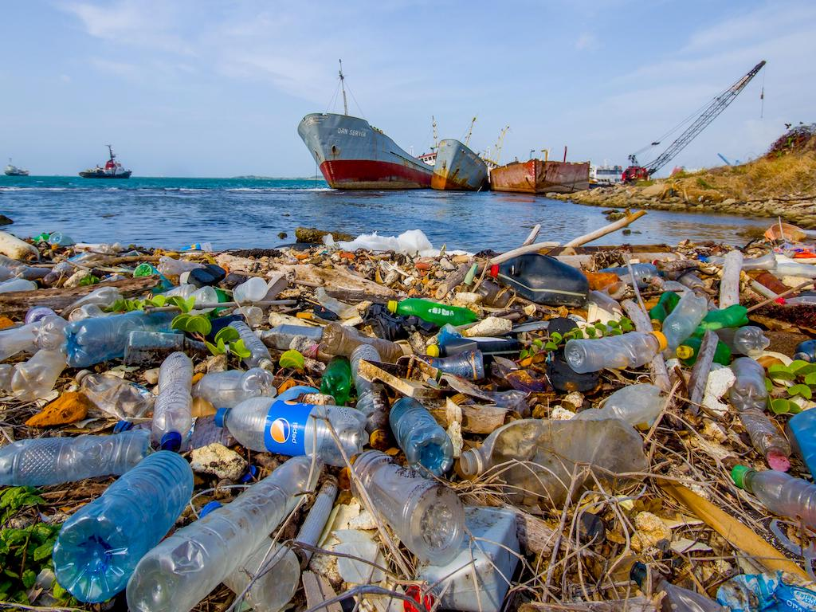
Notes:
Picture source: https://www.greenqueen.com.hk/u-s-top-contributor-to-global-coastal-plastic-pollution-new-study-finds/

Slide 10
REMEMBER:
PLASTIC MATERIAL ≠ PROBLEM.
PROBLEM IS FOR WHAT AND HOW WE USE PLASTIC.

Slide 11
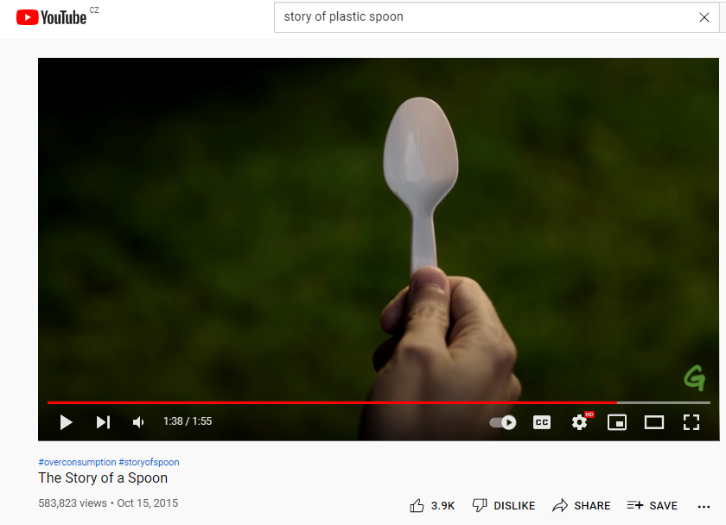

Notes:
IN CASE YOU HAVE A TIME – PLAY VIDEO: https://www.youtube.com/watch?v=eg-E1FtjaxY

Slide 12
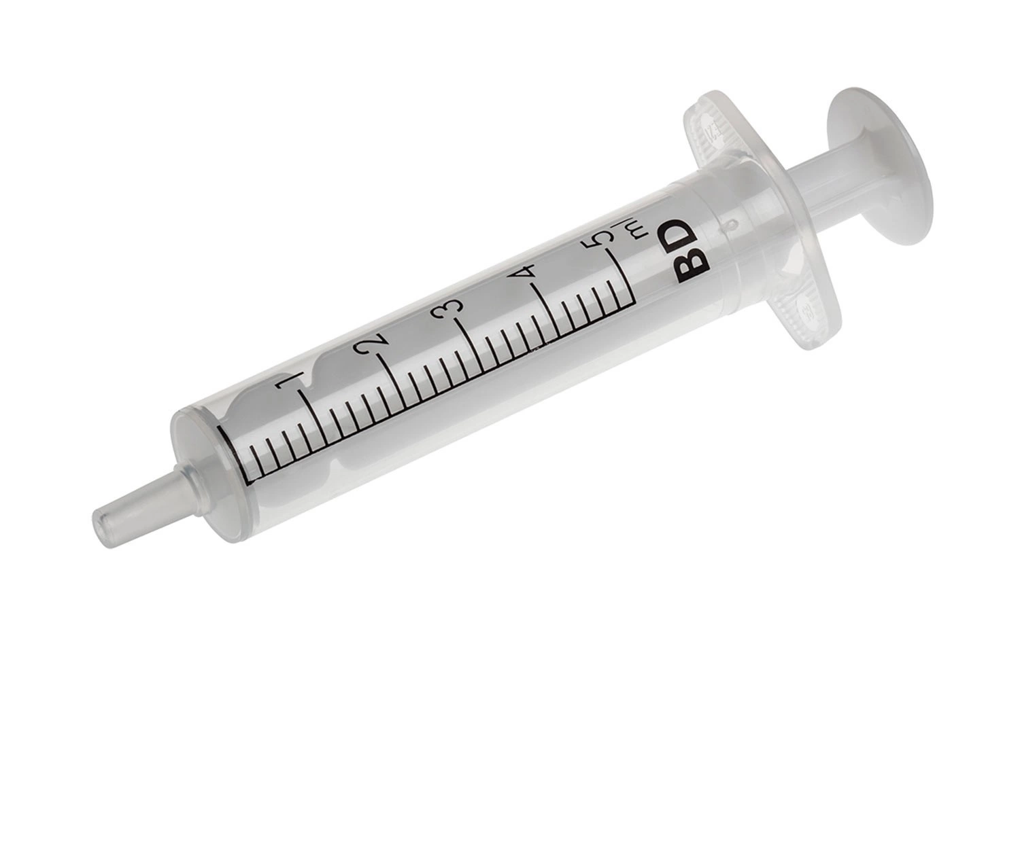
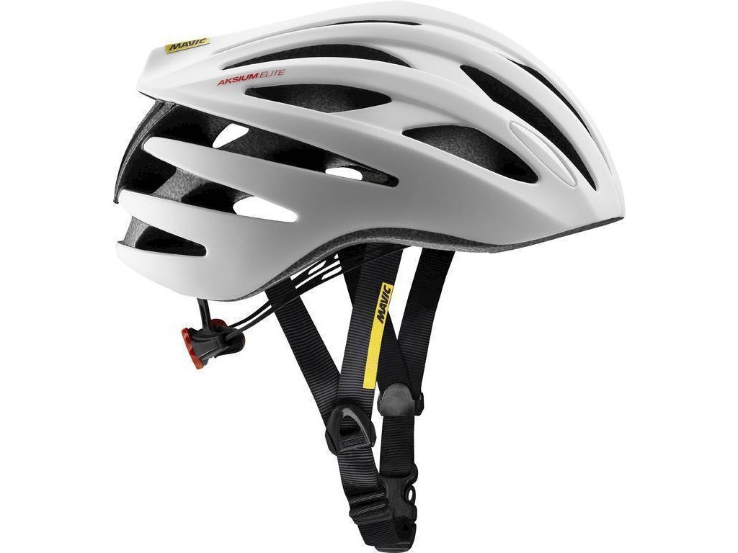
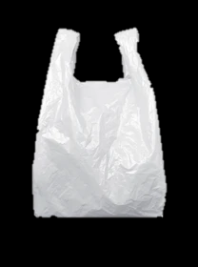
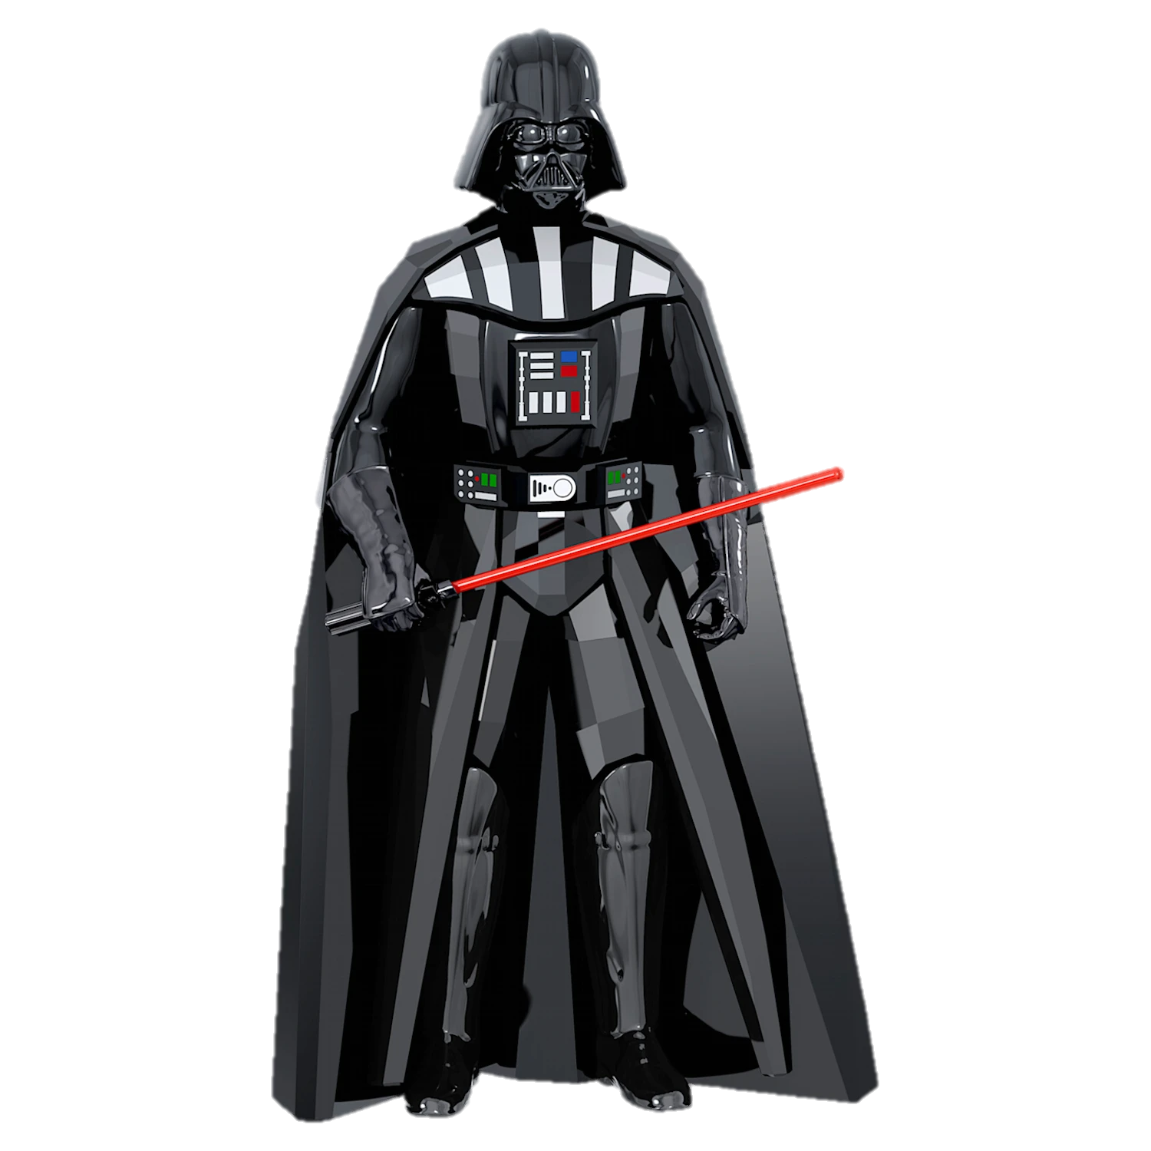

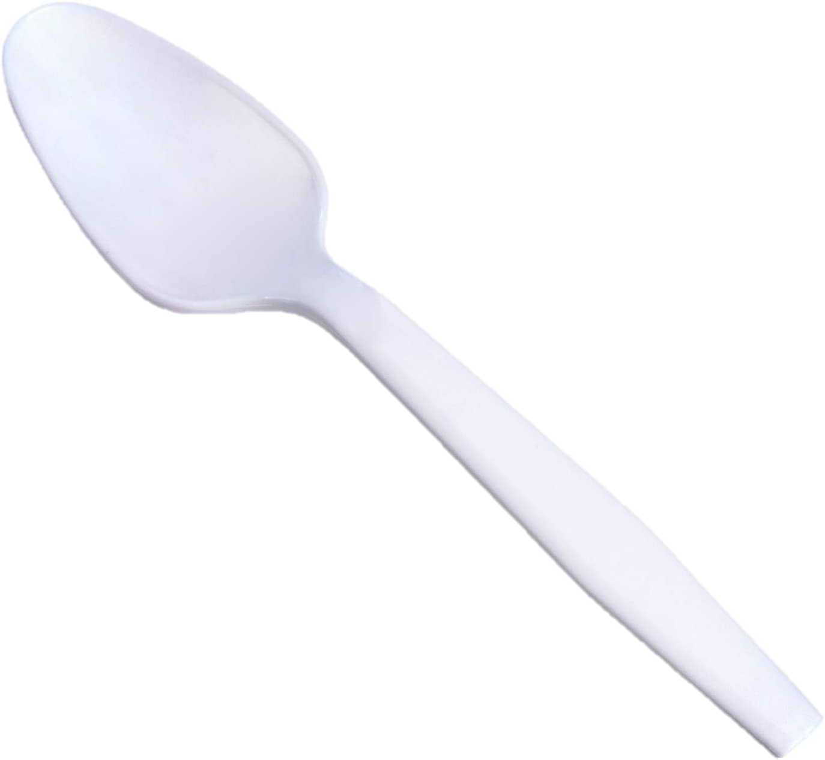
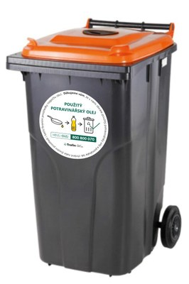
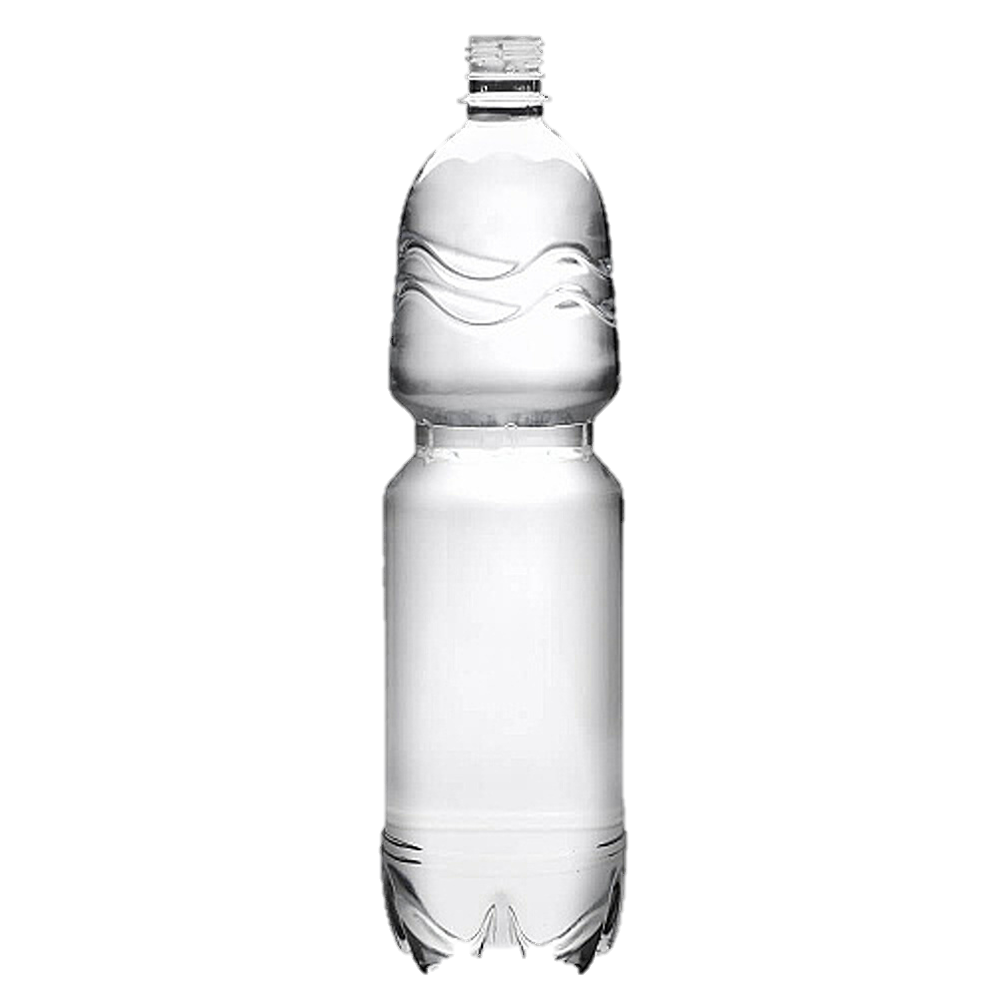
GOOD EXAMPLES OF PLASTIC PRODUCTS
BAD EXAMPLES OF PLASTIC PRODUCTS
Notes:
LET PUPILS NAME AT LEAST 3 GOOD AND 3 BAD EXAMPLES

Slide 13
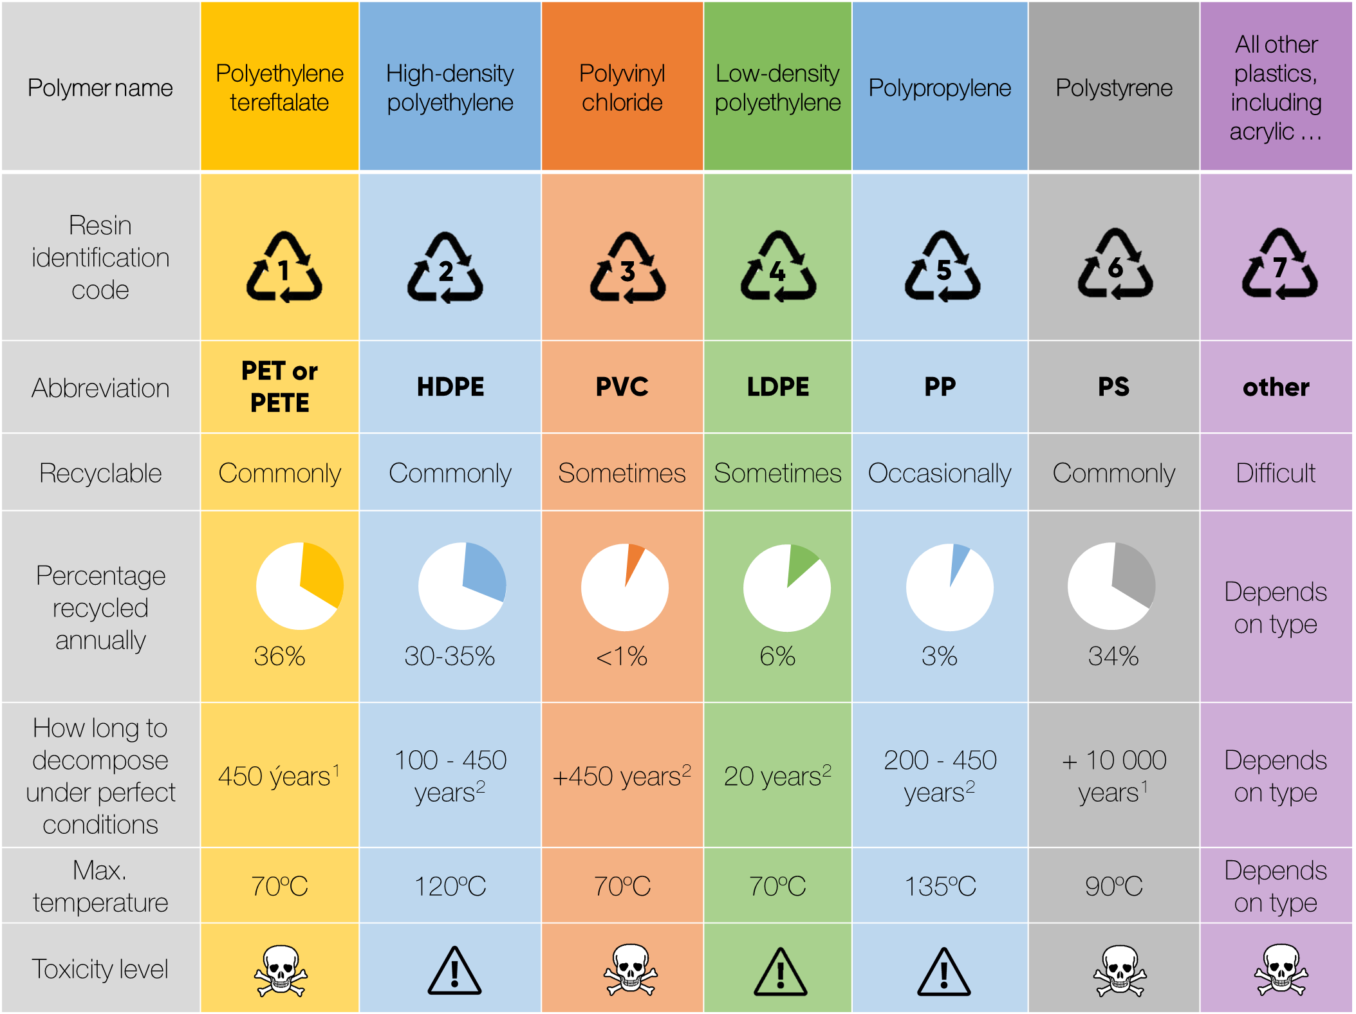
Notes:
Source: https://alansfactoryoutlet.com/7-types-of-plastics-their-toxicity-and-most-commonly-used-for/
[1] https://www.e15.cz/magazin/infografika-jak-dlouho-se-rozklada-odpad-pet-lahvi-to-trva-skoro-pul-tisicileti-1347264#
[2] https://maesindopaperpackaging.com/does-plastic-decompose-how-long-does-it-take/

Slide 14
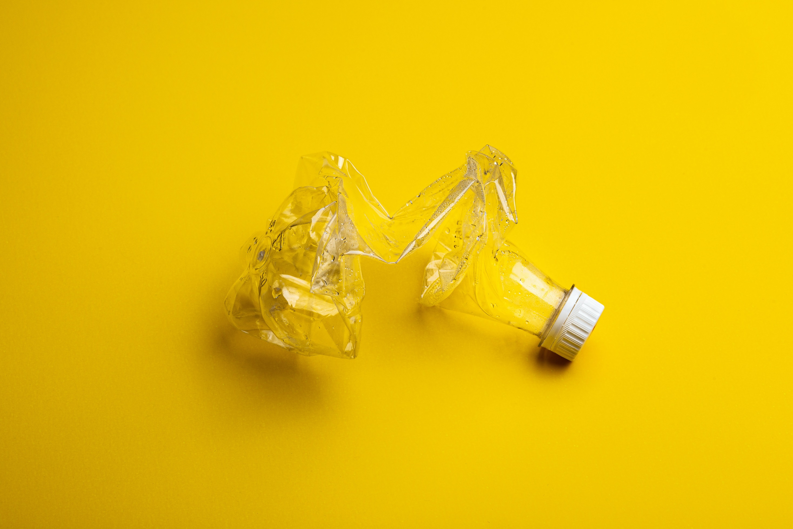
HOW TO SEPARATE BOTTLE FROM ITS CAP ON LARGE SCALE?
Notes:
EXPLAIN HOW TO SEPARATE PET FROM HDPE – ONLY BASED ON DIFFERENT MATERIAL DENSITY. SHREDDED PET WILL SINK, BUT HDPE WILL SWIM ON THE LEVEL

Slide 15
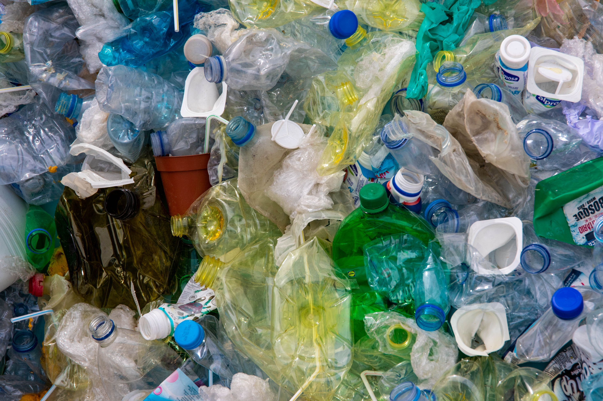
HOW TO SEPARATE BOTTLE FROM ITS CAP ON LARGE SCALE?
Notes:
THERE ARE MANY PLASTIC PRODUCTS OUT THERE. CAN YOU IDENTIFY THEM? AND WHICH OF THEM ARE EASY TO RECYCLE AT HOME?

Slide 16
QUICK TEST

Slide 17
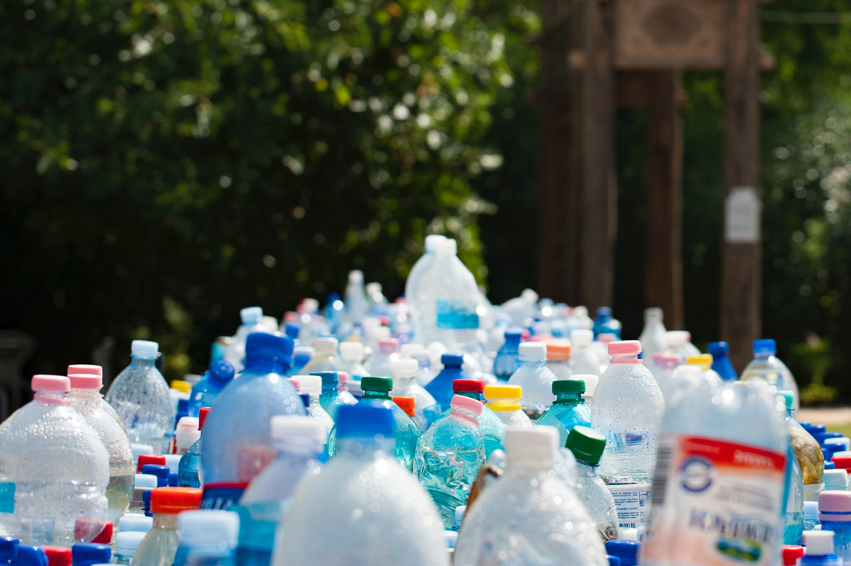
1/5 HOW MANY KGS OF PLASTIC WASTE PRODUCED AVERAGE PERSON IN CZECH REPUBLIC ANNUALY IN 2020?
5 kg
27 kg
114 kg
Notes:
Source EKO KOM, Czech Republic, 2020

Slide 18
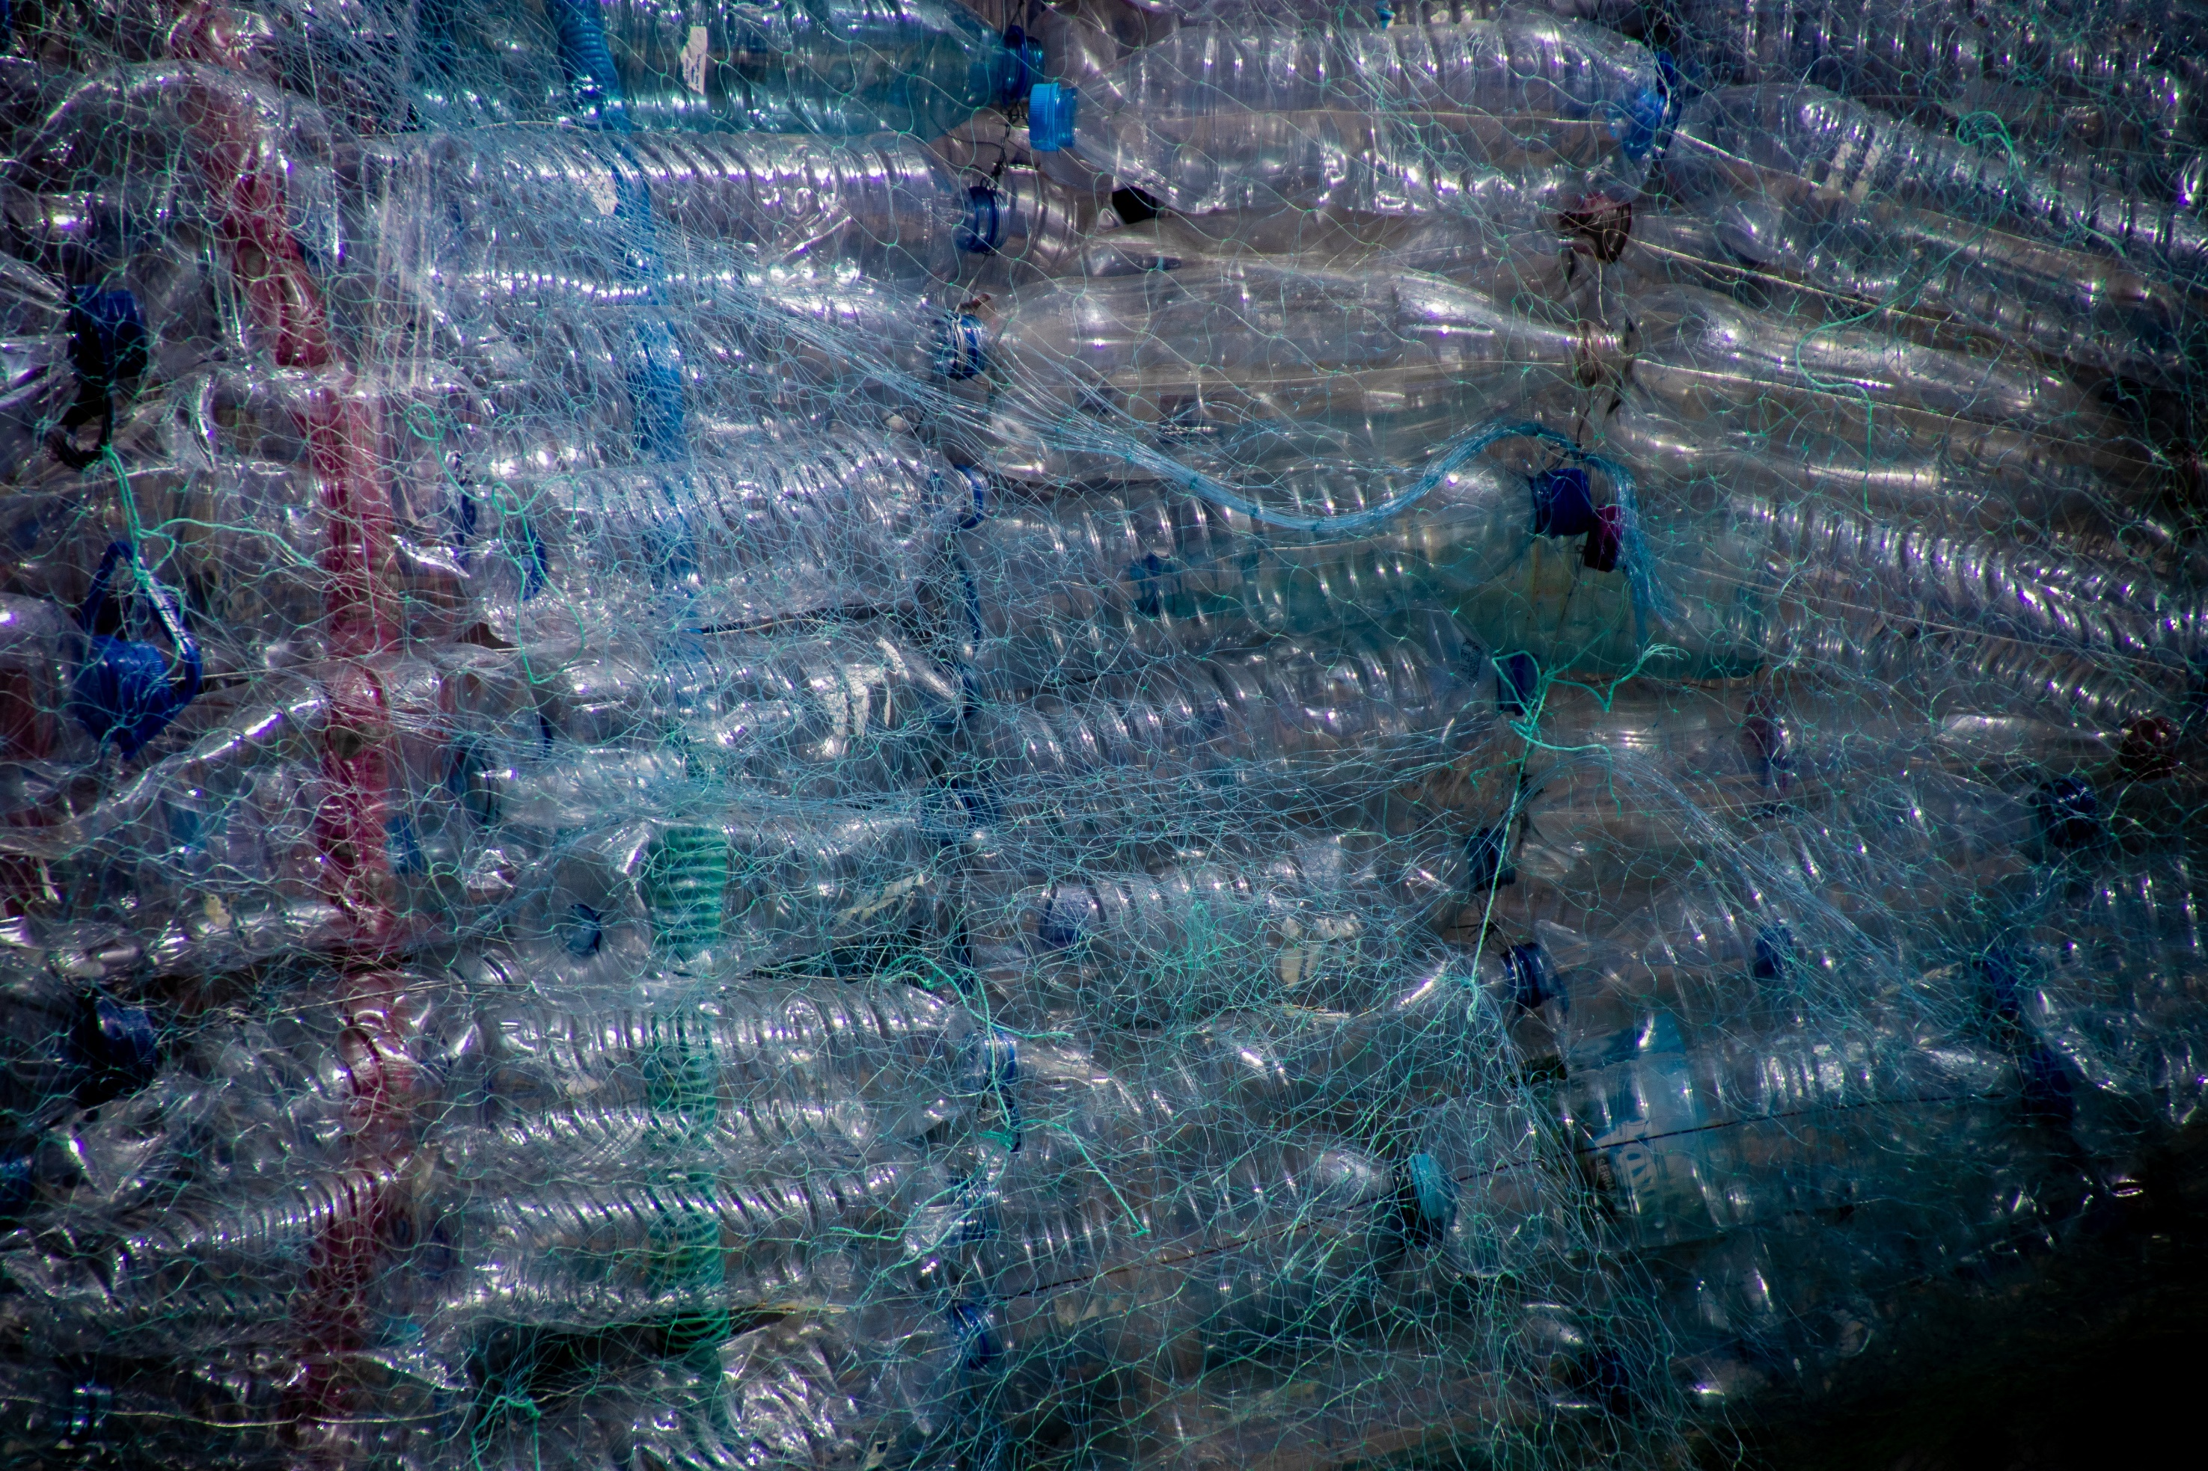
2/5 APPROX. HOW MANY % OF PLASTIC MATERIAL WAS RECYCLED (NOT BURNED) IN CZECH REPUBLIC IN 2020?
30%
60%
80%

Slide 19
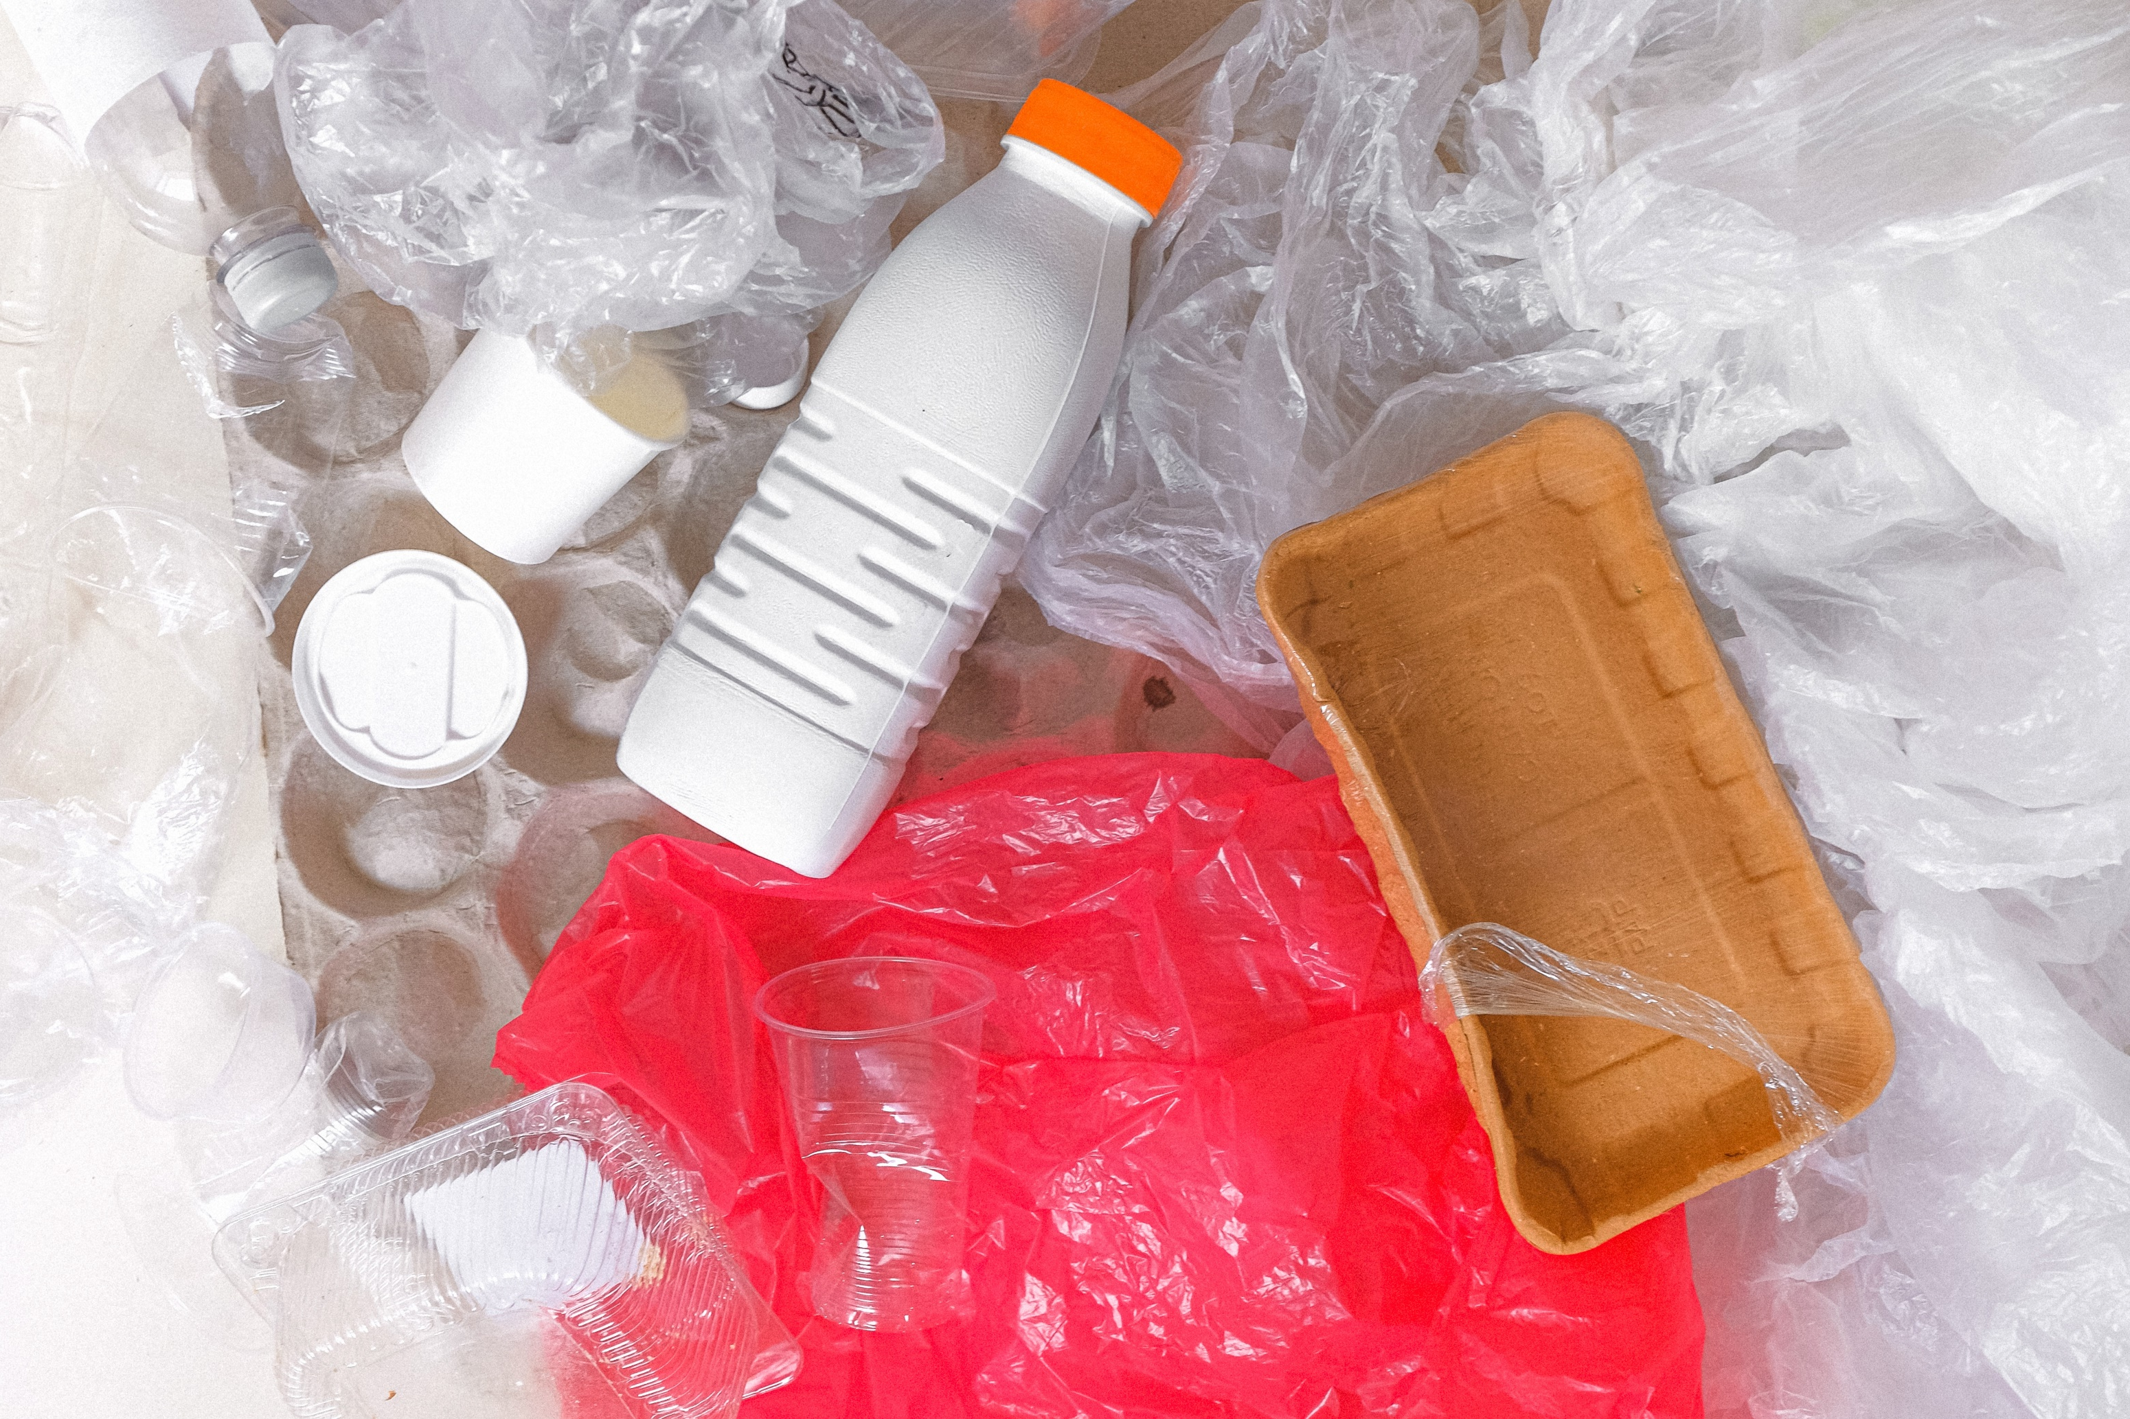
3/5 WHAT IS THE MOST WANTED TYPE OF PLASTIC MATERIAL FOR BIG RECYCLING COMPANIES IN CZECH REPUBLIC?
PET
HDPE
PP

Slide 20
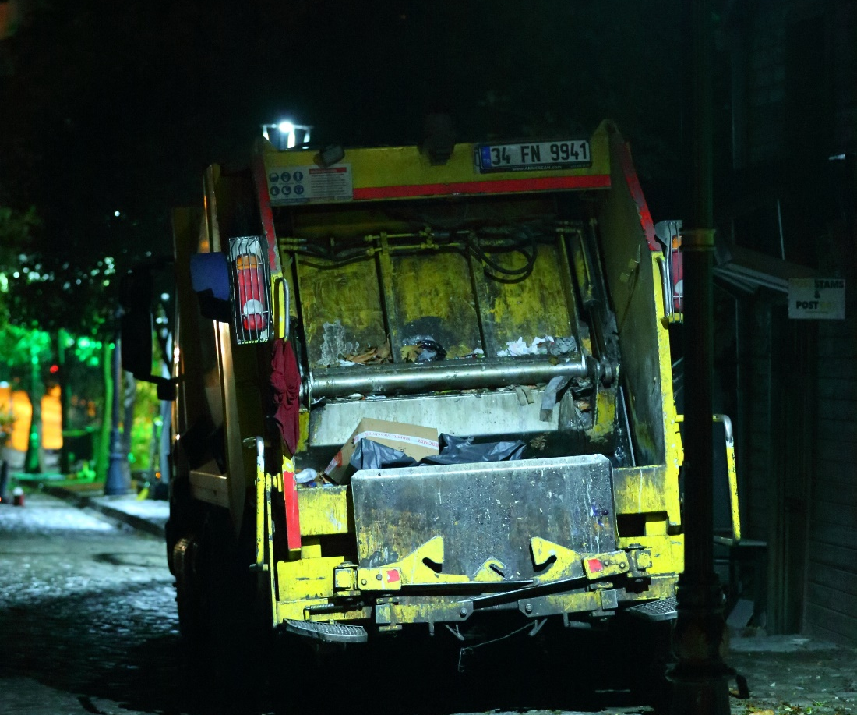
4/5 HOW MUCH DID IT COST ON AVERAGE TO TRANSPORT ONE FULL PLASTIC CONTAINER TO SORTING POINT IN THE CZECH REPUBLIC IN 2020?
2,5 EUR
12,5 EUR
25 EUR

Slide 21
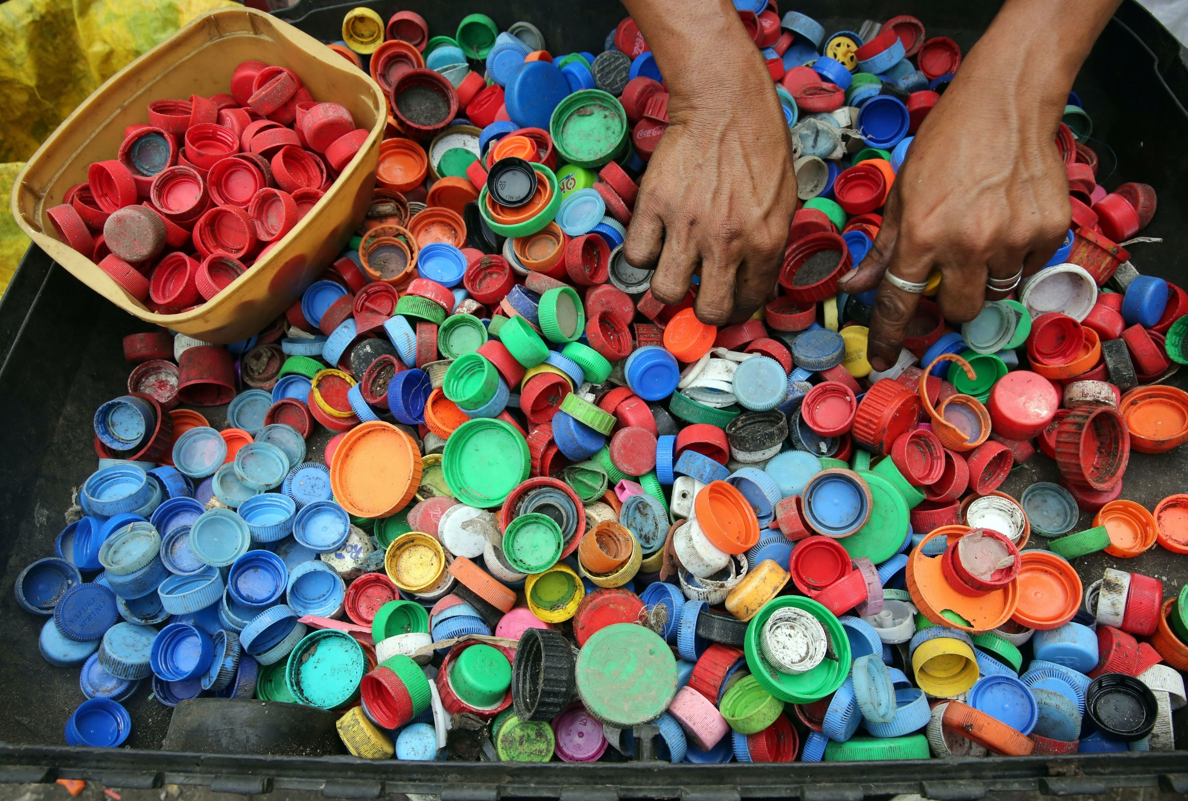
5/5 HOW MUCH WAS PURCHASE PRICE FOR 1KG COLLECTED HDPE BOTTLE CAPS IN 2021 IN CZECH REPUBLIC?
0.25 EUR
1 EUR
12 EUR
Notes:
SOURCE: PLASTOŽROUT.CZ

Slide 22
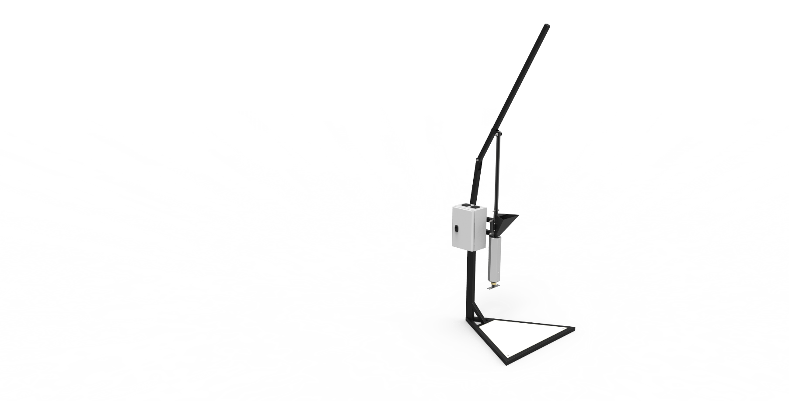
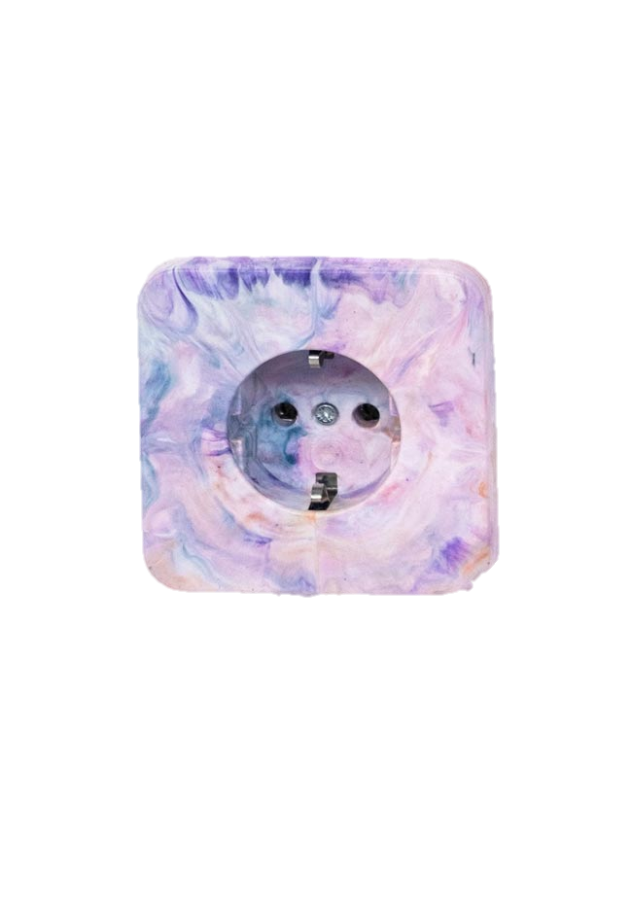

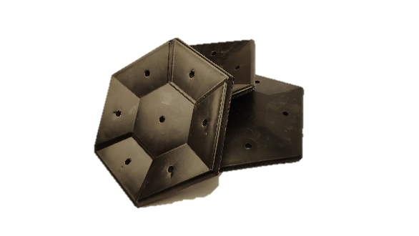

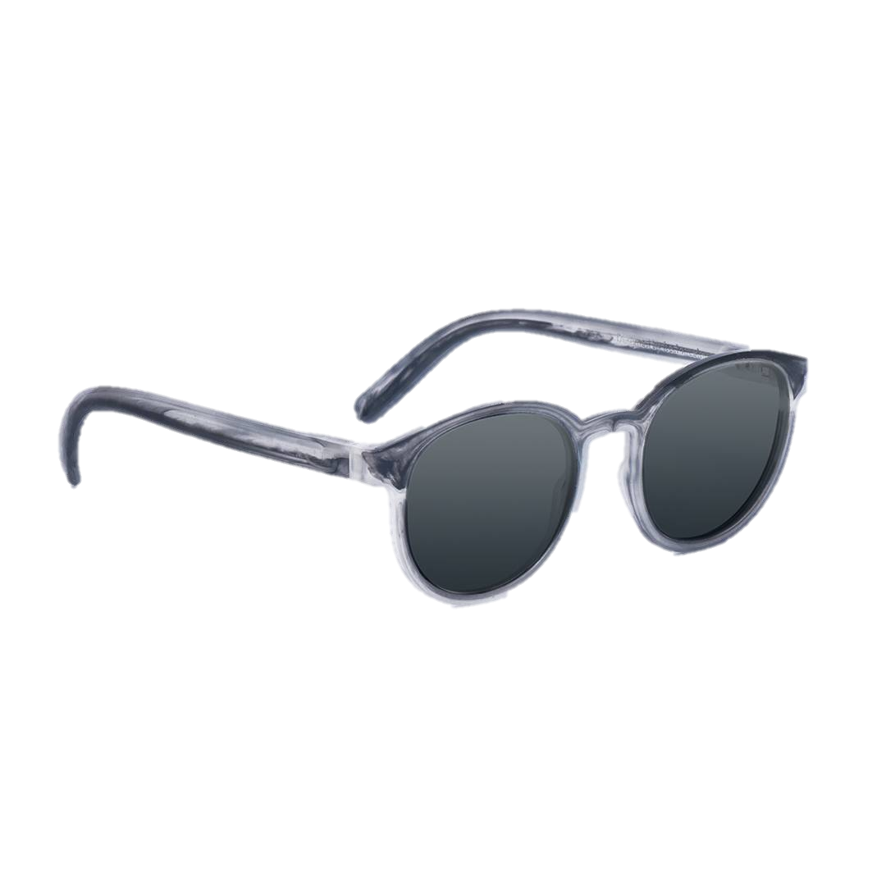
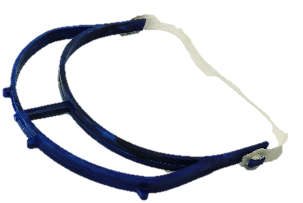
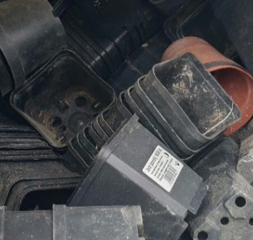
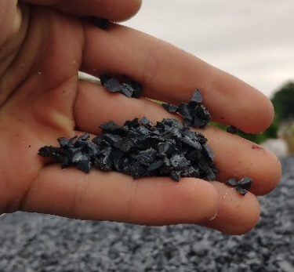
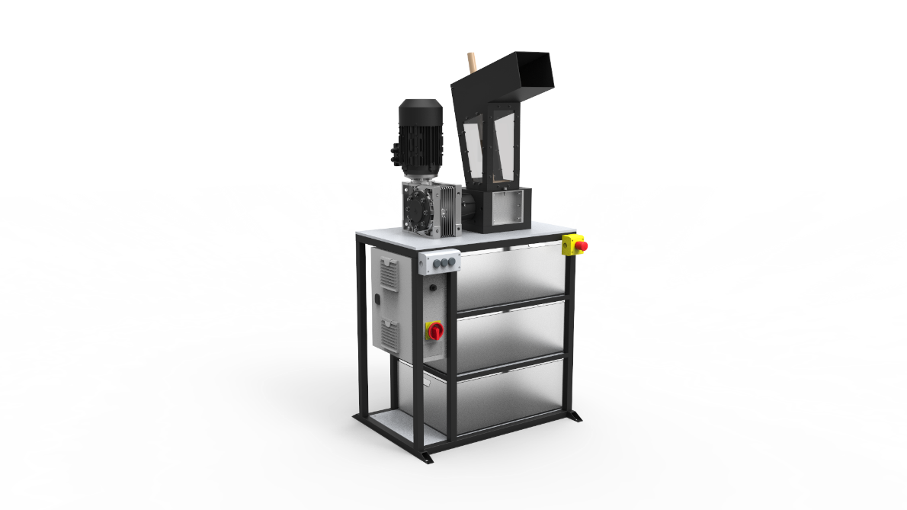
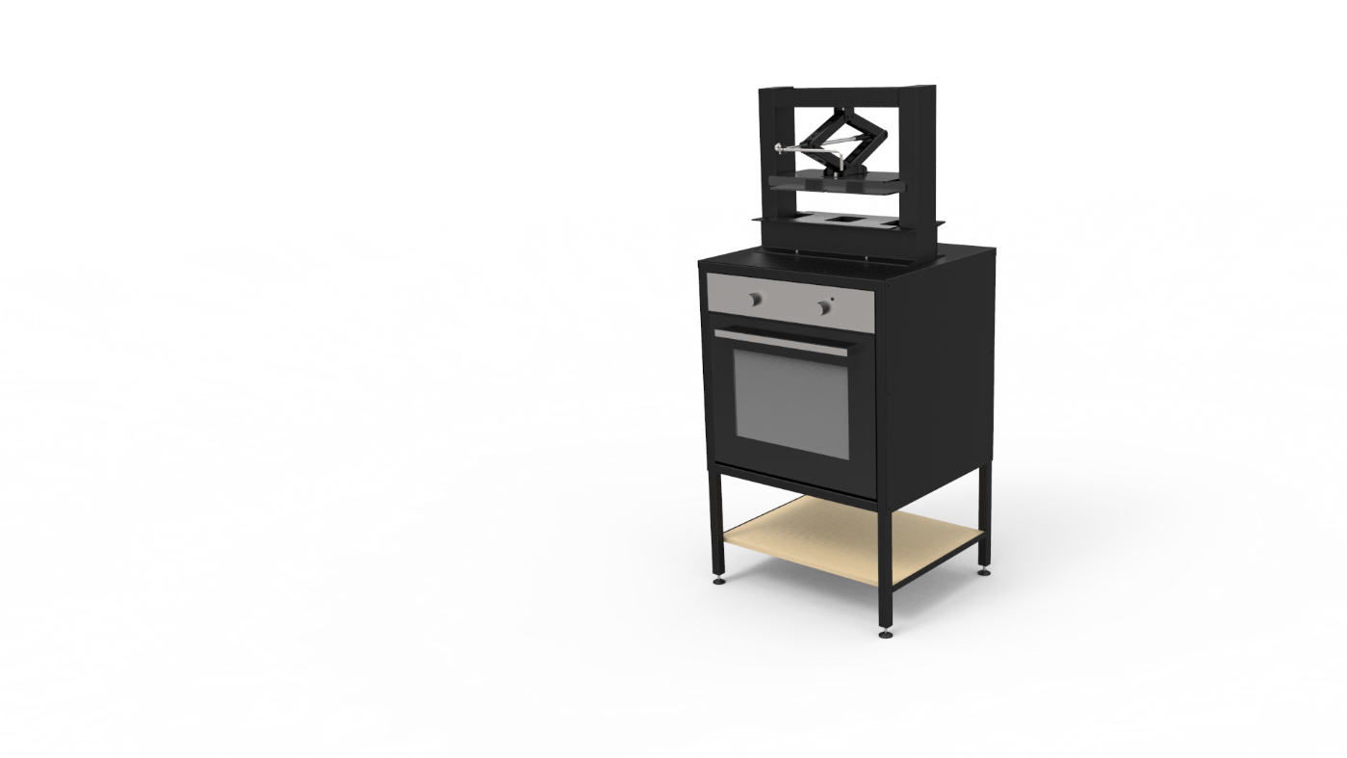
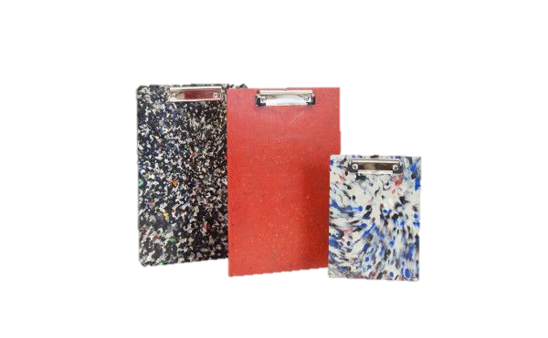

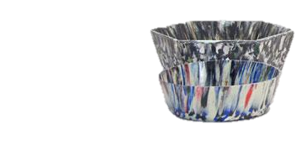

INJECTION
MOULDING
INDUSTRIAL SHREDDING
PLASTIC WASTE
CRUSHED PLASTIC
HOME SHREDDING
COMPRESSION MOULDING
Notes:
OK, SMALL RECAP. WE HAVE ALREADY TALKED ABOUT PLASTIC HISTORY, TYPES, ADVANTAGES AND DISADVANTAGES. NOW IT IS TIME TO DESCRIBE MATERIAL RECYCLING METHODS.

Slide 23
SHREDDING PLASTIC
Notes:
Demonstration of shredding technology.

Slide 24
INJECTION MOULDING
Notes:
Demonstration of injection moulding

Slide 25
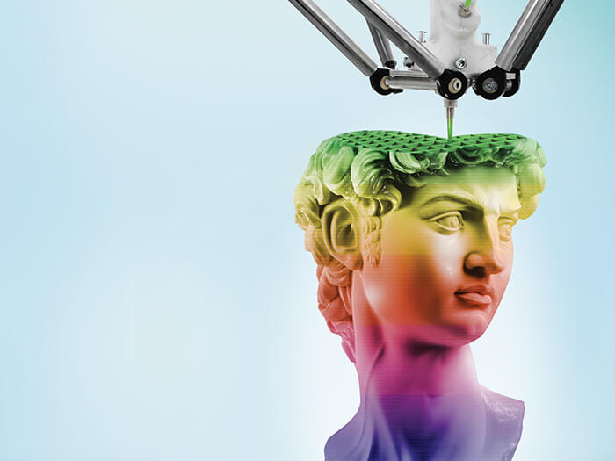
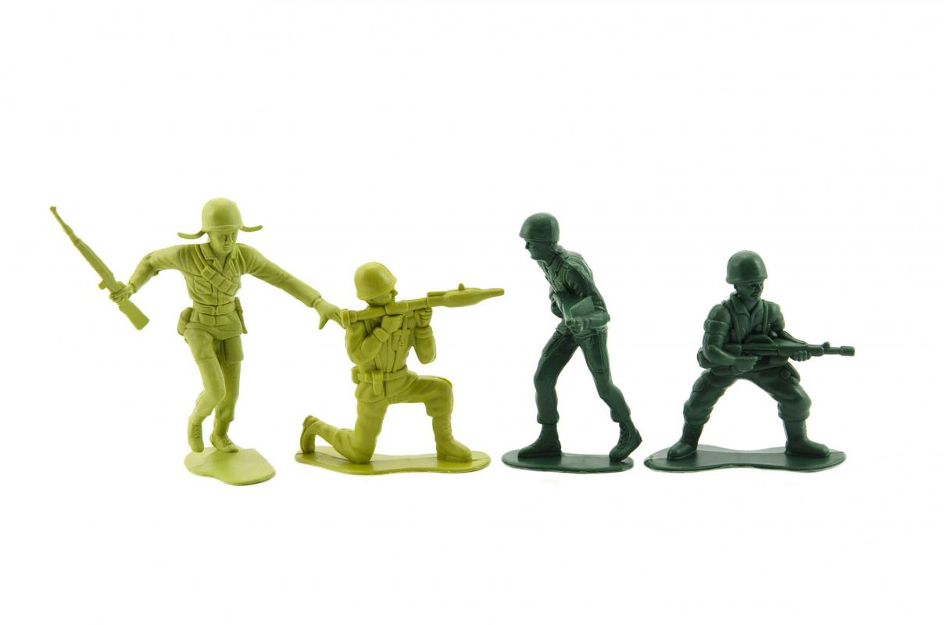
ADVANTAGES OF 3D PRINTING
Notes:
COMPARATION 3D PRINTING AND INJECTION MOULDING:
CYCLE TIME,
PROTOTYPING
MATERIALS

Slide 26
COMPRESSION MOULDING
Notes:
Demonstration of compression moulding

Slide 27
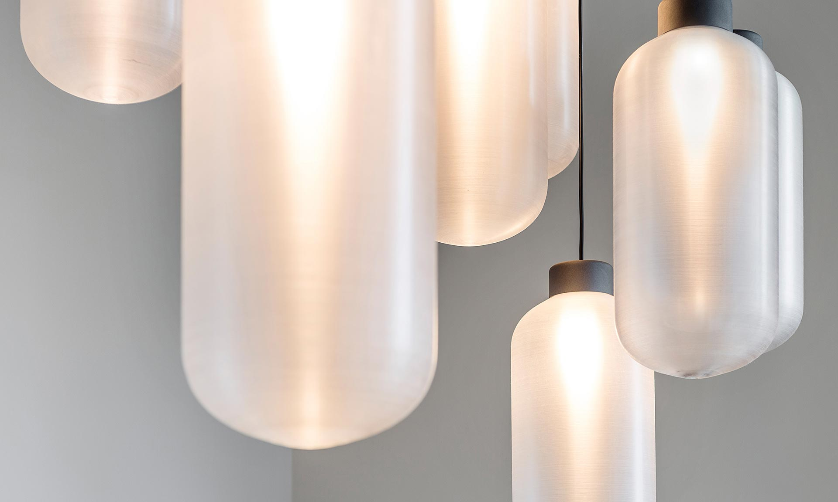
Notes:
Source: Studio Na Haku Brno (Czech Republic) upcycling empty PET bottles from Proseco into design lighting.
Upcycling can be beautifull.

Slide 28
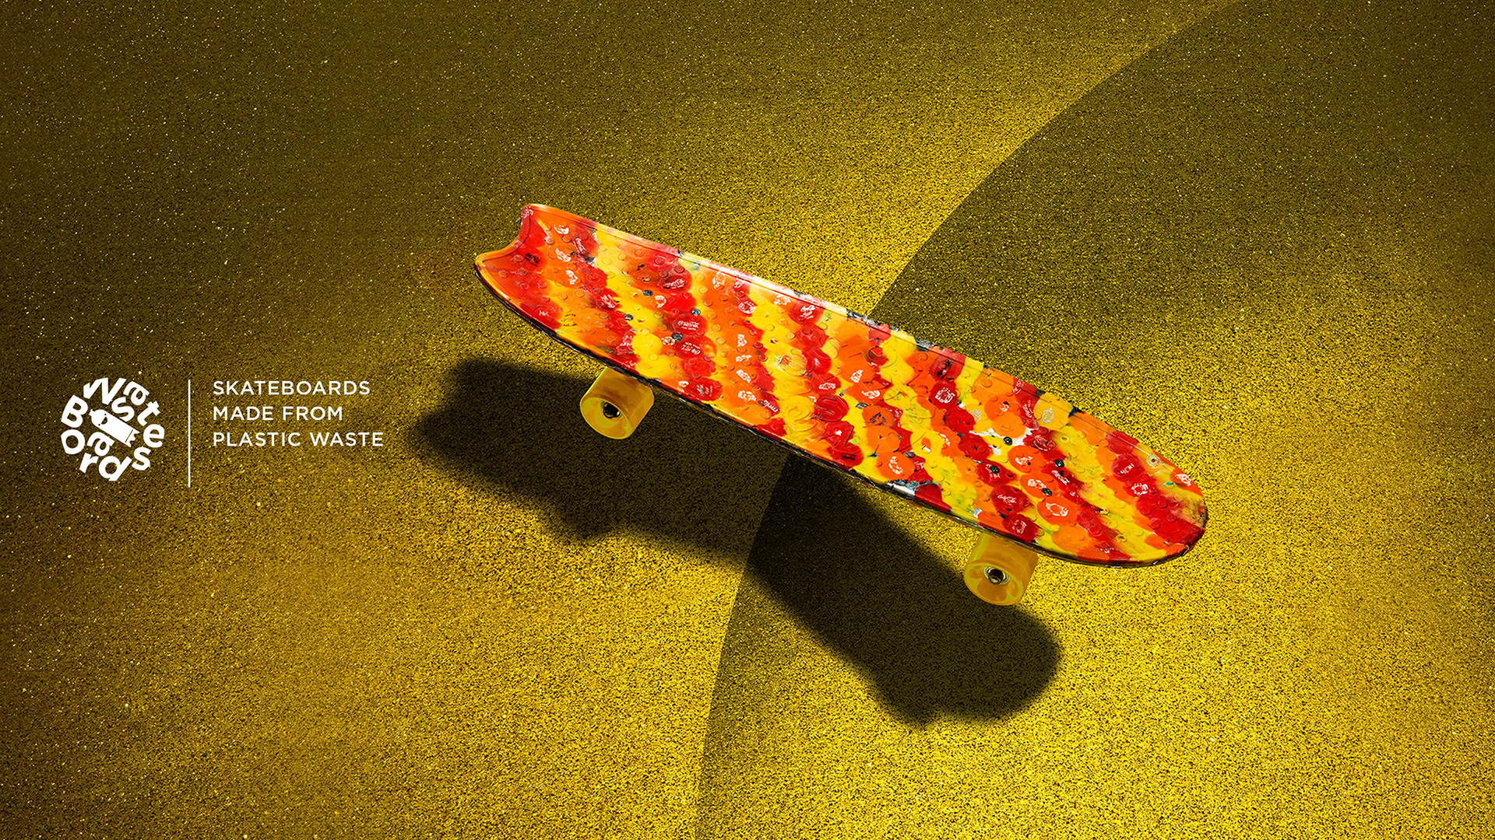
Notes:
Source: Wasteboard – company in Netherlands, recycling bottle caps

Slide 29
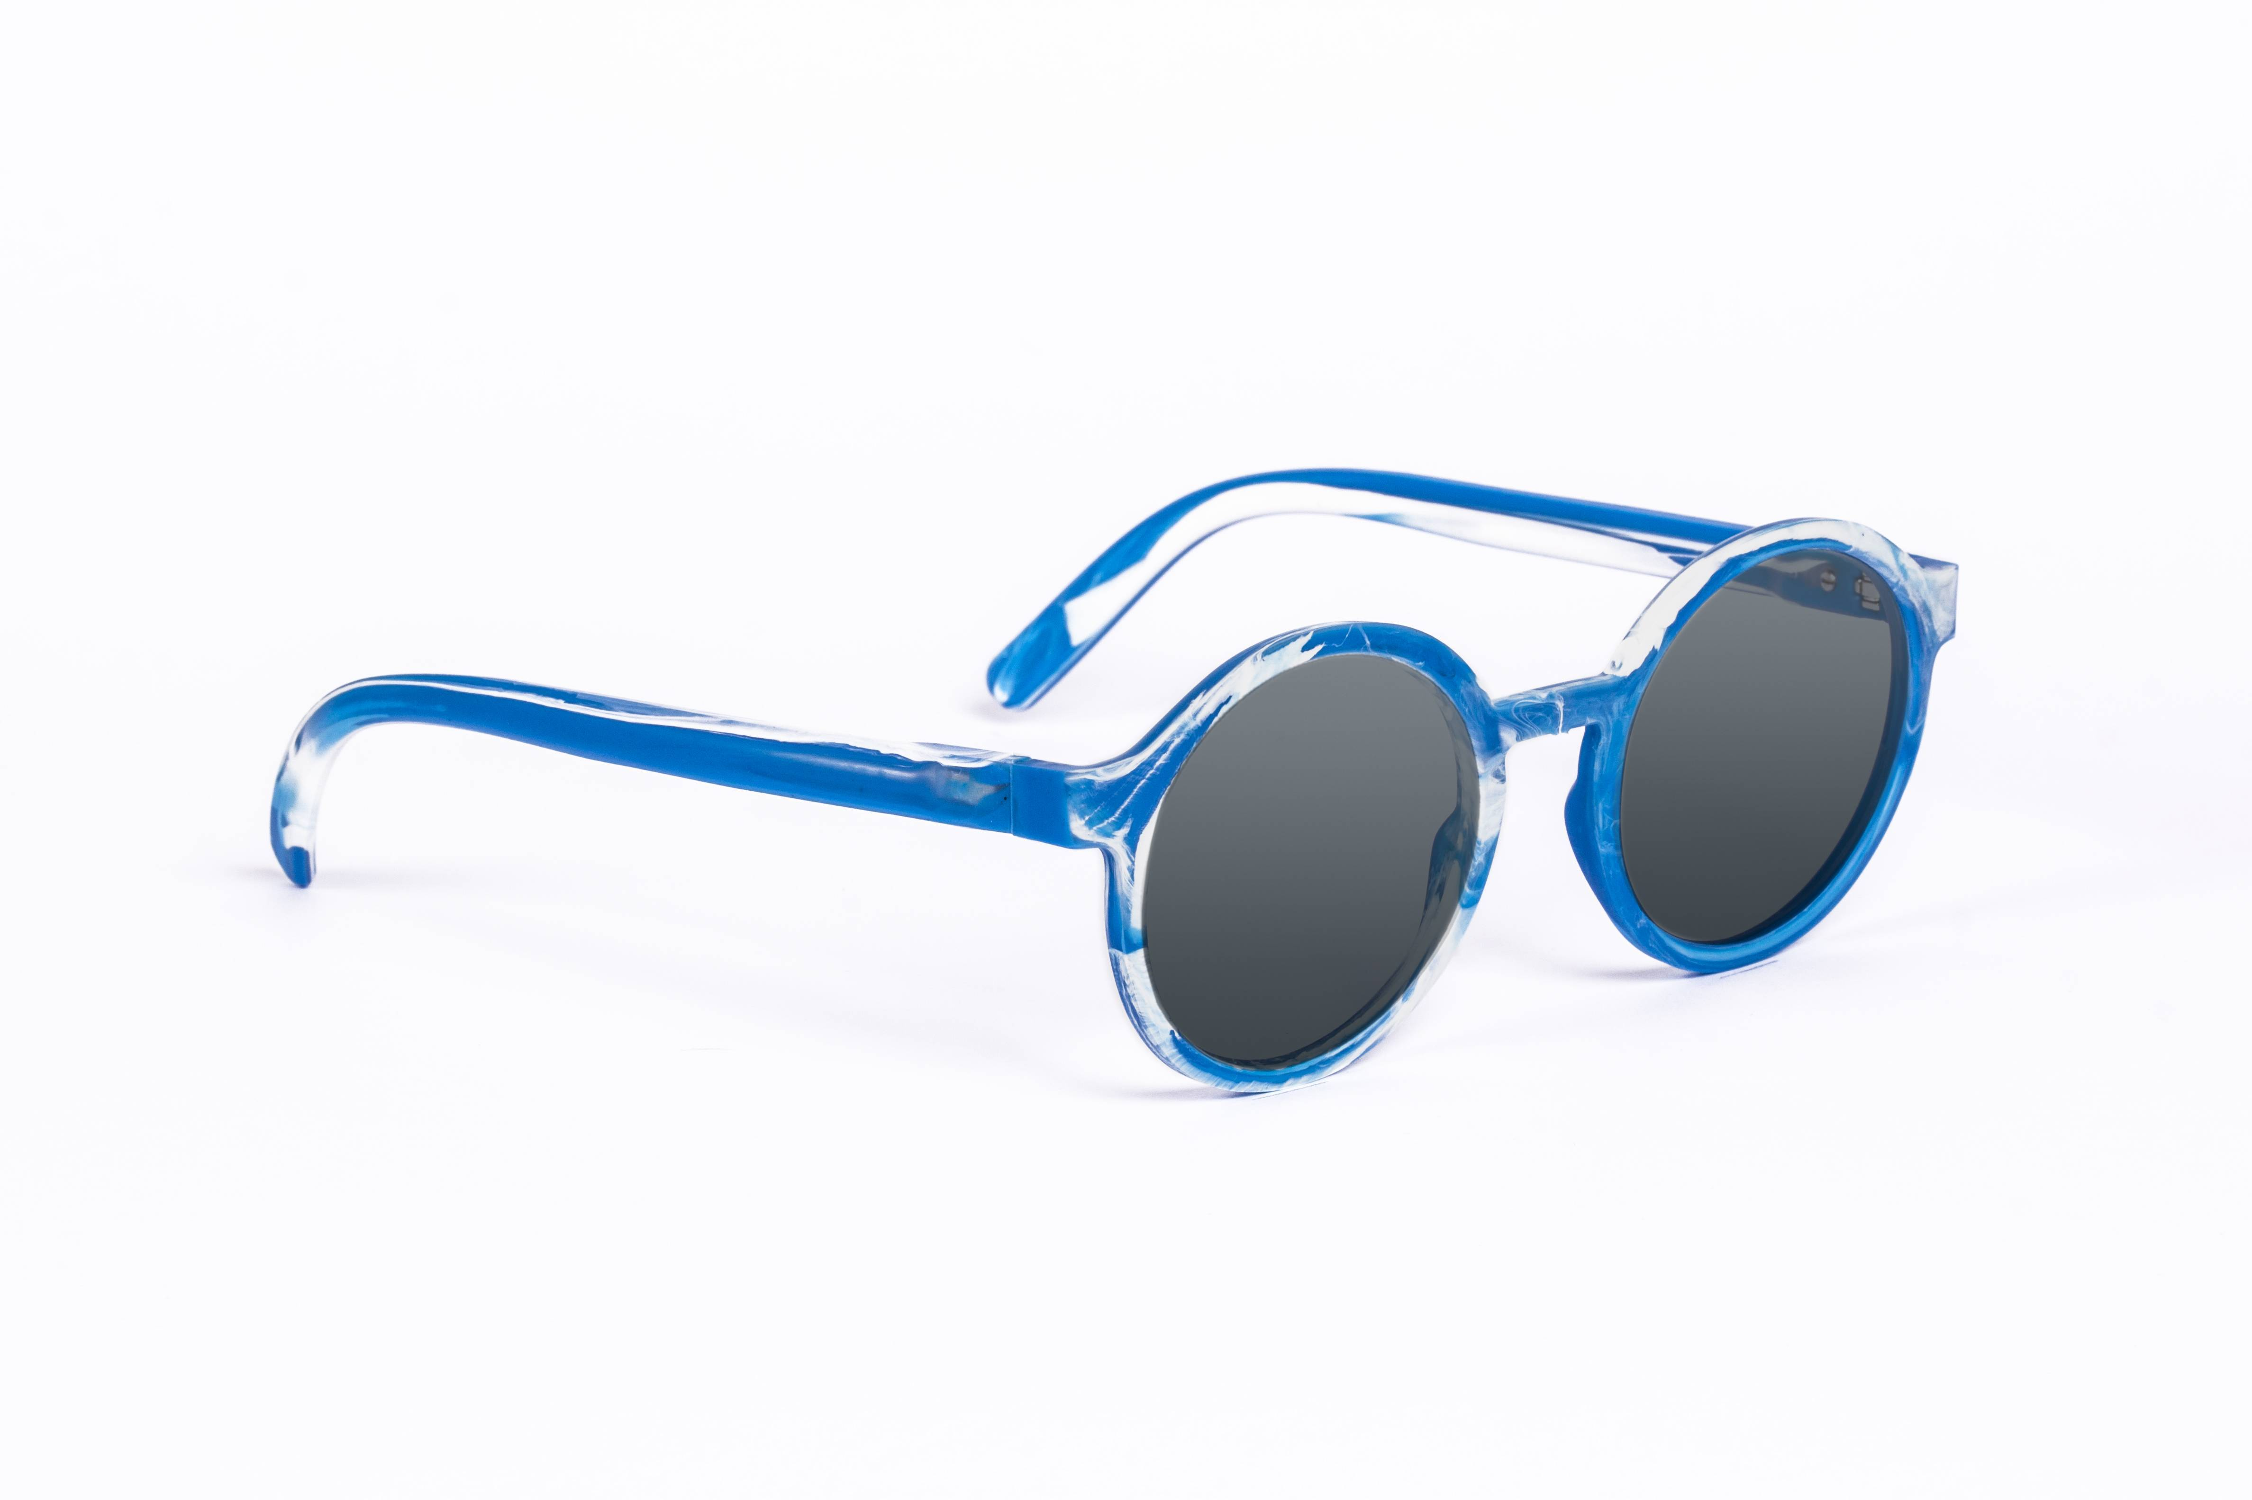
Notes:
Source: Precious Plastic bazar: Baiau - FOS Eyewear

Slide 30
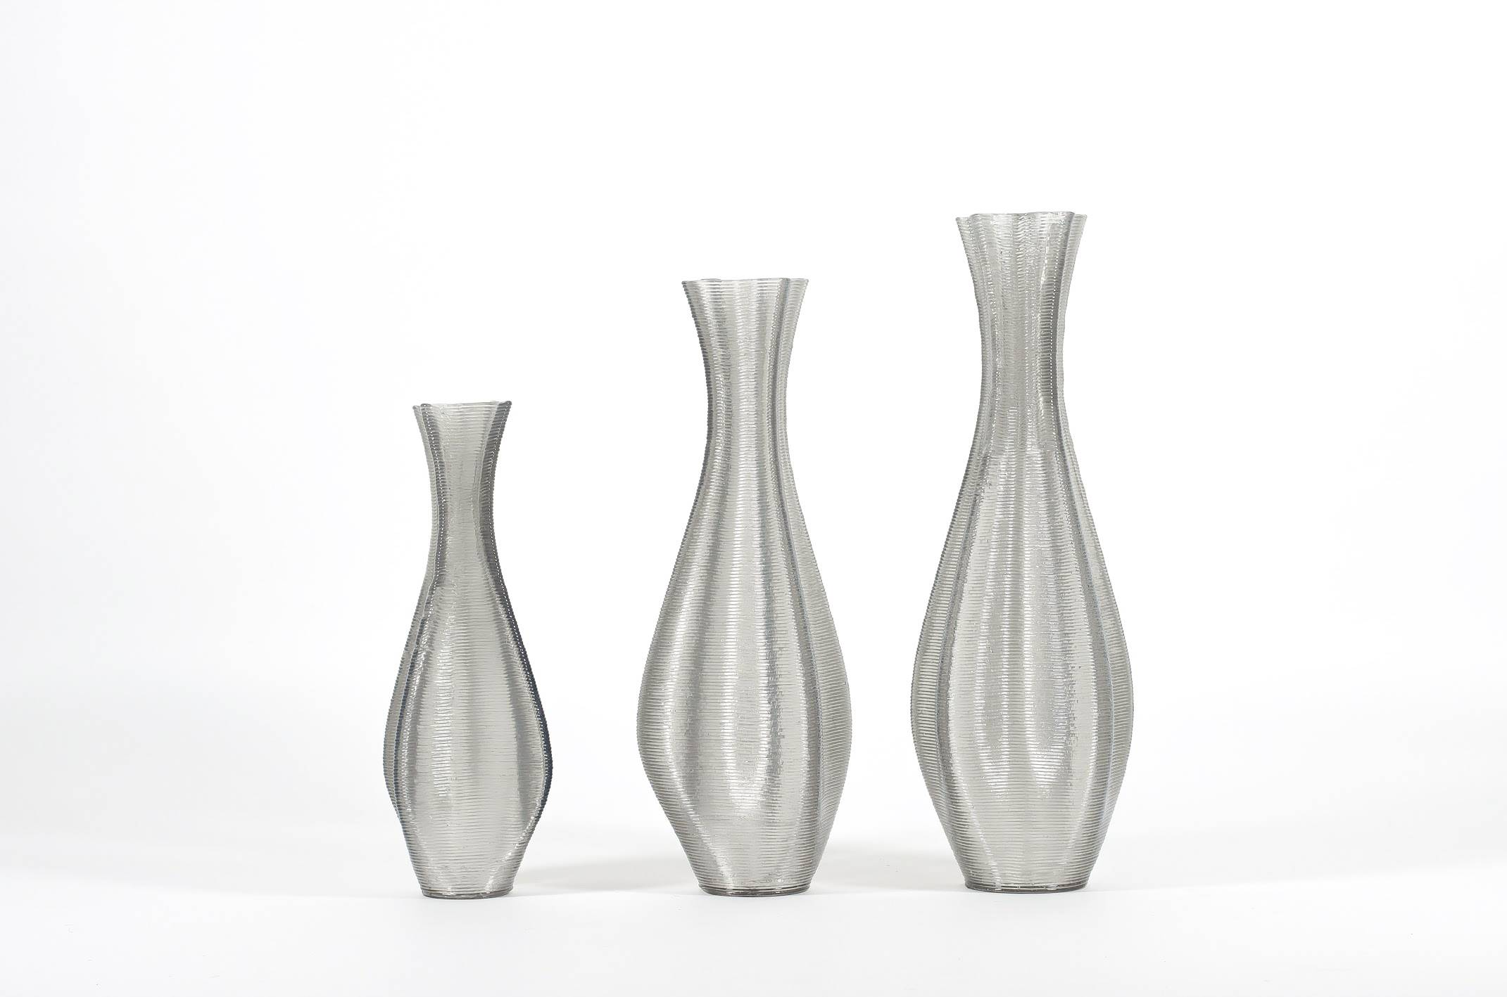
Notes:
3d printed vases from vanPlestik, source: Precious plastic bazar: Euler (medium) - 3D printed floorvase by vanPlestik

Slide 31
CONCLUSION

Slide 32
SORTING OF PLASTIC WASTE MAKE SENCE
TRY TO REDUCE CONSUMPTION OF SINGLE USE PLASTIC (DO NOT BUY WATER IN PLASTIC BOTTLES, DO NOT USE PLASTIC BAGS. REDUCE CONSUMPTION OF OTHER SINGLE USE PLASTICS
FIND IDEA HOW TO RECYLE PLASTIC WASTE INTO VALUABLE PRODUCT

Slide 33
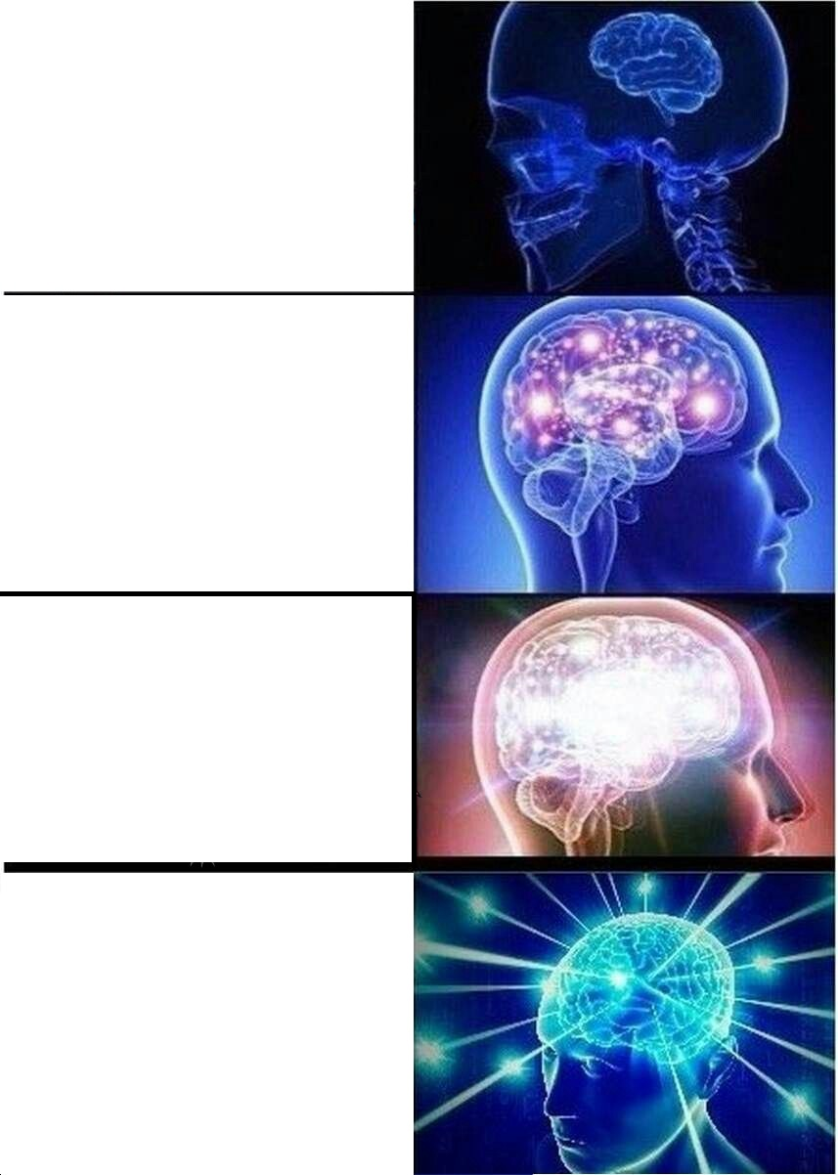
THROWING PLASTIC WASTE INTO NATURE
SORTING PLASTIC WASTE
RECYCLING PLASTIC WASTE INTO NEW PRODUCTS
NOT BUYING SINGLE USE PLASTIC
CLEANING ENVIRONMENT
RECYCLING PLASTIC

Slide 34
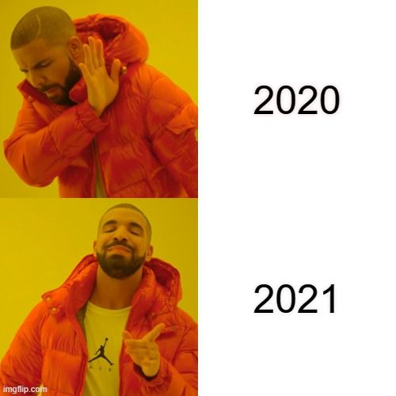
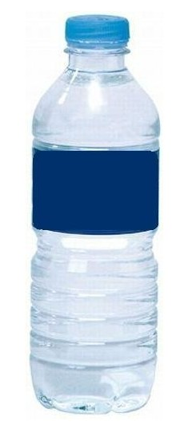
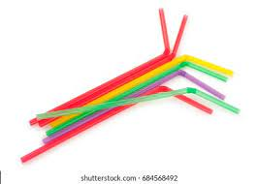
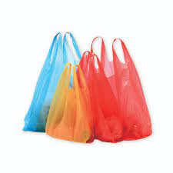





Slide 35

„WHEN YOU DO NOT PRODUCE PLASTIC WASTE, YOU SAVE MONEY AND ENVIRONMENT.“

Slide 36


THANK YOU FOR YOUR ATTENTION
Notes:
For more information visit Precious Plastic.
Free tutorials, open source design and world wide community of great open-minded people.

Slide 37


ING. TOMAS KOLECAR
INFO@PLASTMAKERS.COM
WWW.PLASTMAKERS.COM
+420 739 122 662
CZECH REPUBLIC - EUROPE
CONTACT

