Slide 1
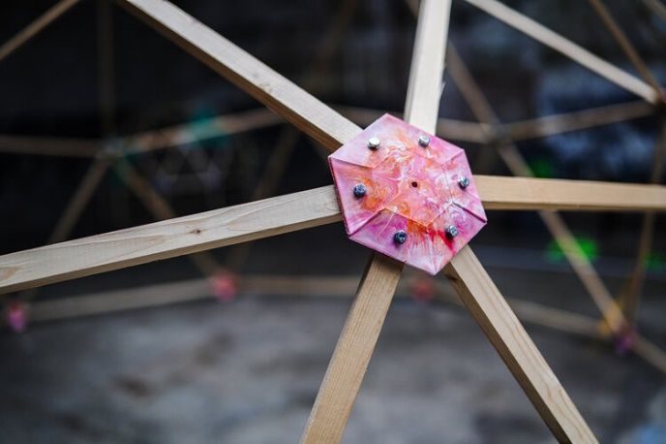

GEODESIC DOME
10/10
Notes:
Picture: Precious plastic

Slide 2
SMALL RECAP OF PREVIOUS LESSON
LESSON 10 – GEODESIC DOME

Slide 3
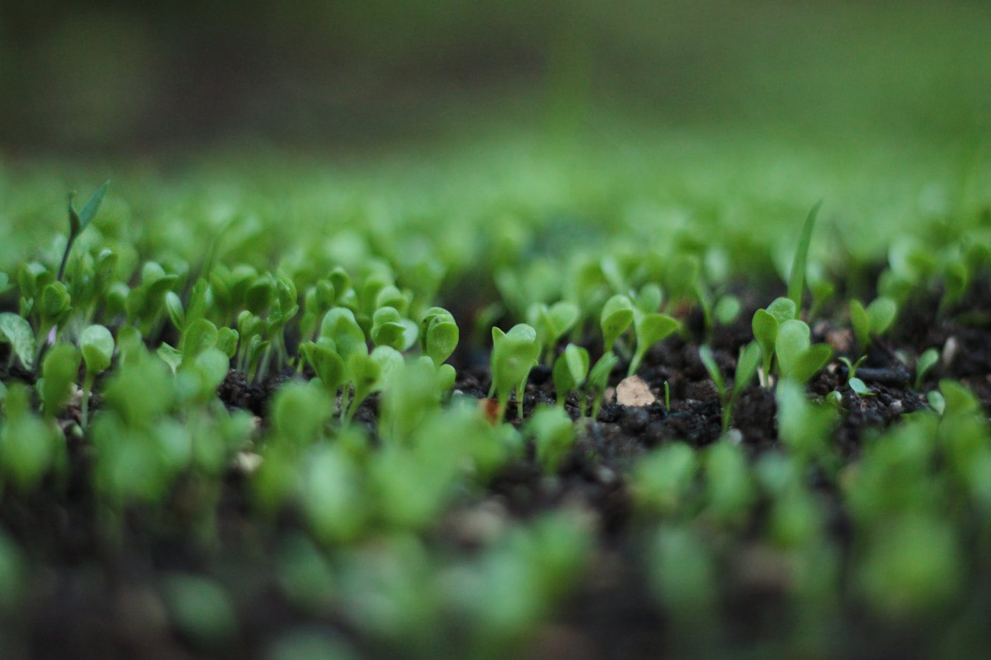
DESCRIBE DIFFERENCE BETWEEN BIOPLASTIC AND BIODERADABLE PLASTIC.
LESSON 10 – GEODESIC DOME

Slide 4
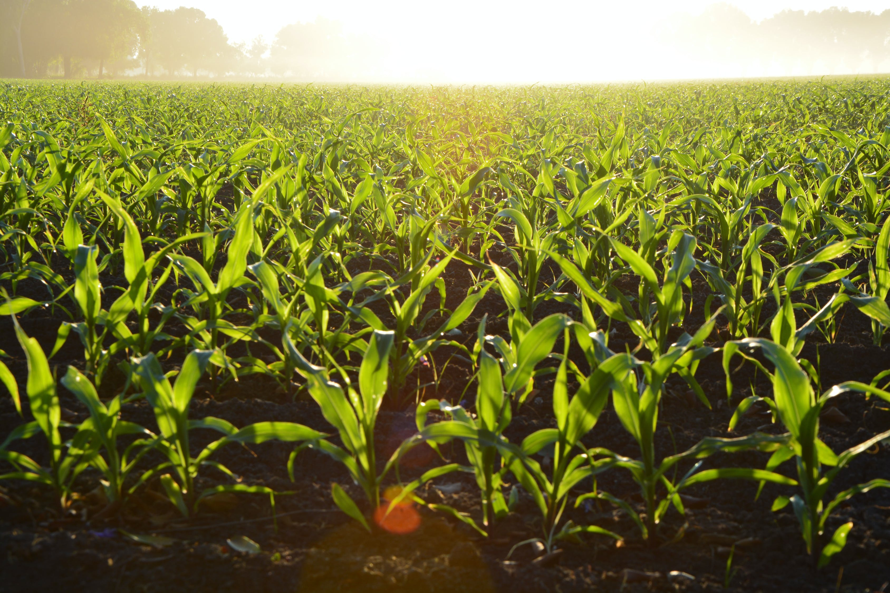
WHEAT BRAN, COFFEE GROUNDS AND ORANGE PEELS, OR AGRICULTURAL WASTE LIKE LEAVES AND PINE NEEDLES..
WHICH NATURAL SOURCES ARE SUITABLE FOR PRODUCTION OF BIODEGRADABLE PLASTICS?
LESSON 10 – GEODESIC DOME

Slide 5
POSSIBILITY TO CONSULT THE LAUNCH OF YOUR OWN COMMUNITY PLACE
LESSON 10 – GEODESIC DOME

Slide 6
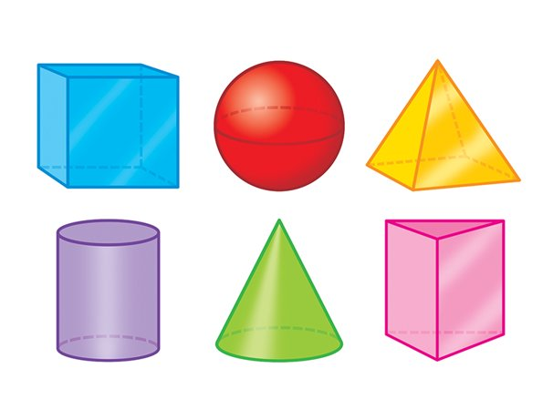

WHAT 3D OBJECT HAS THE LARGEST VOLUME RELATIVE TO ITS SURFACE?
LESSON 10 – GEODESIC DOME

Slide 7

LESSON 10 – GEODESIC DOME
Notes:
Picture: Daniel Kux, Pexels.com

Slide 8
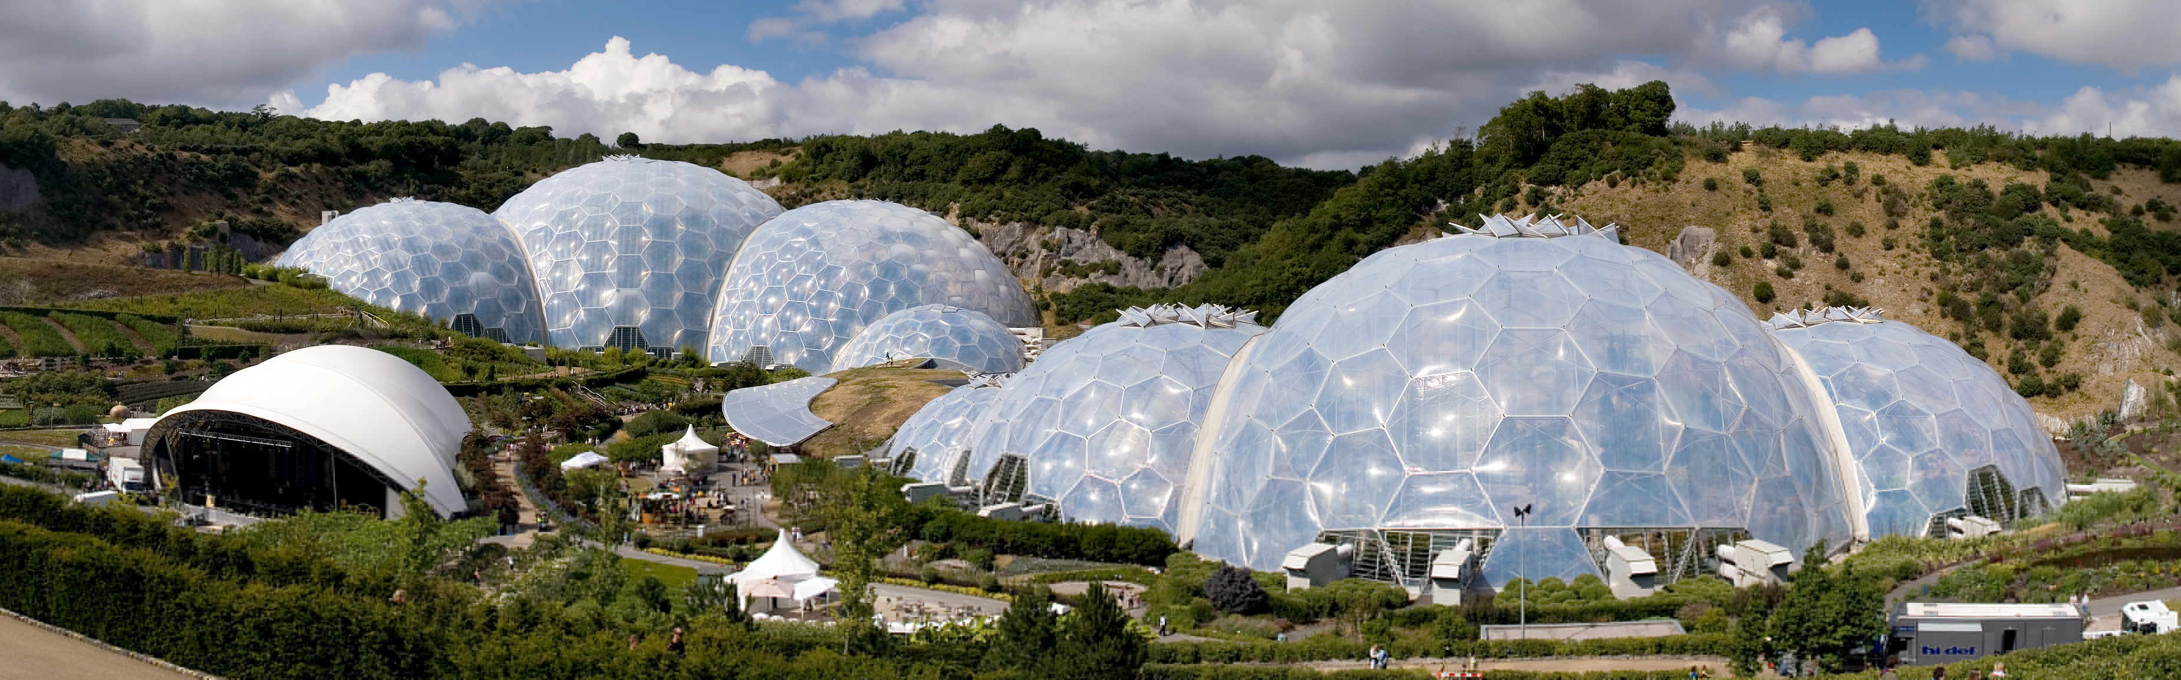
GEODESIC DOME
LESSON 10 – GEODESIC DOME
Notes:
Eden Project, Source Wikipedia
United Kingdom

Slide 9
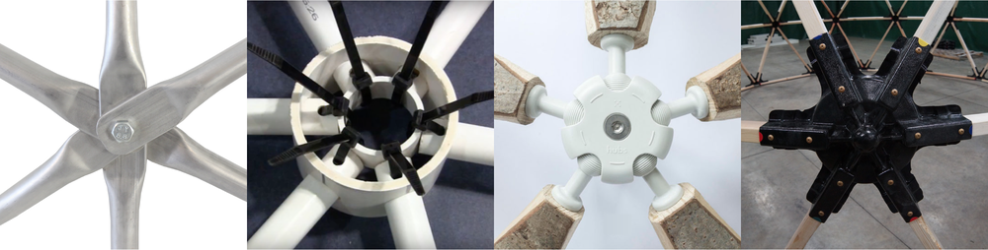
DIFFERENT JOINT TYPES
LESSON 10 – GEODESIC DOME

Slide 10
JOINT TYPE DEVELOPED BY PRECIOUS PLASTIC TEAM
LESSON 10 – GEODESIC DOME
Notes:
Source: Precious Plastic

Slide 11
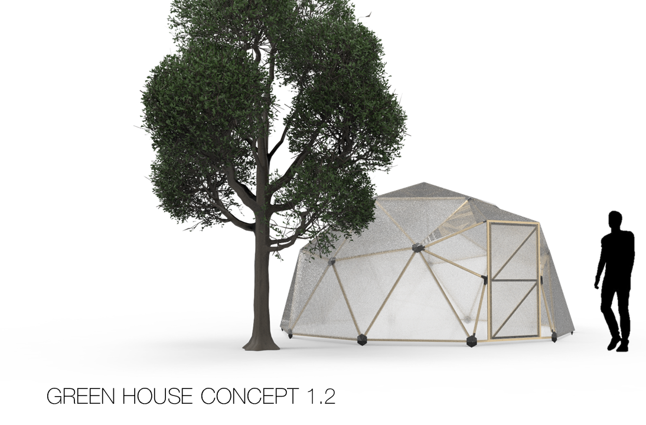
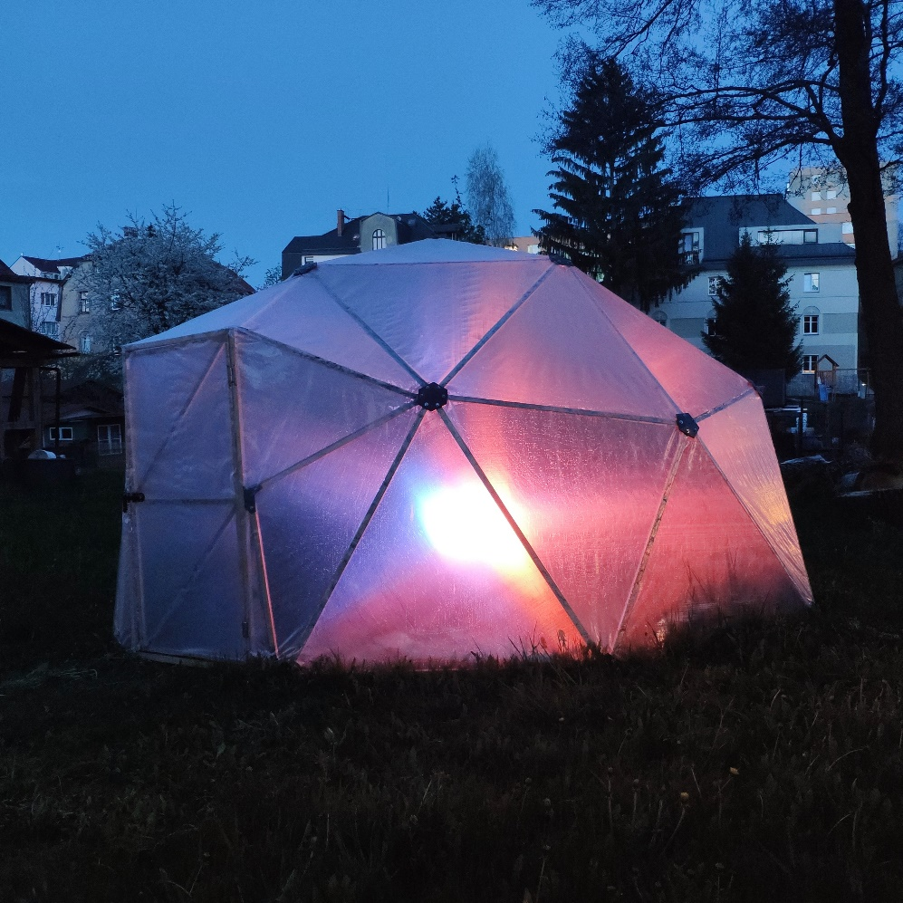
3D MODEL
REALITY
LESSON 10 – GEODESIC DOME

Slide 12
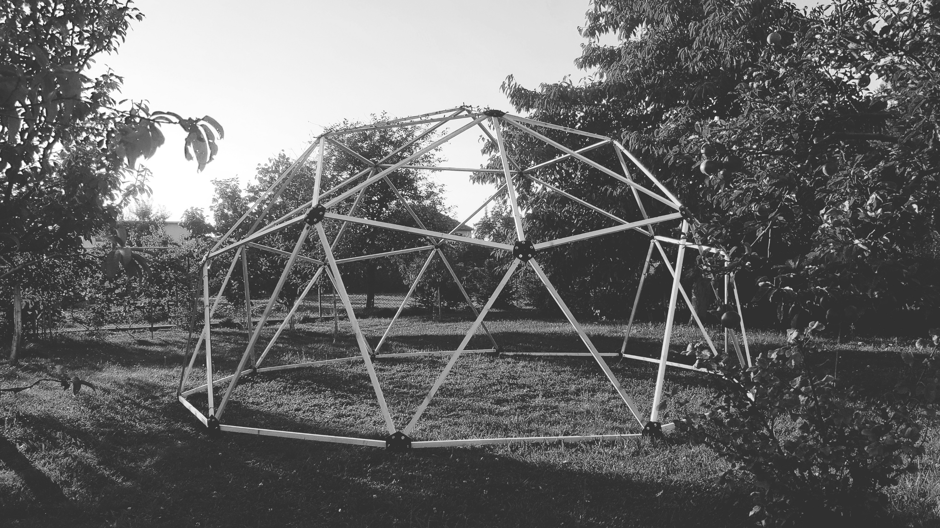
LETS BUILD ONE
LESSON 10 – GEODESIC DOME
Notes:
Eden Project, Source Wikipedia
United Kingdom

Slide 13


ING. TOMAS KOLECAR
INFO@PLASTMAKERS.COM
WWW.PLASTMAKERS.COM
+420 739 122 662
CZECH REPUBLIC - EUROPE
CONTACT

