Slide 1
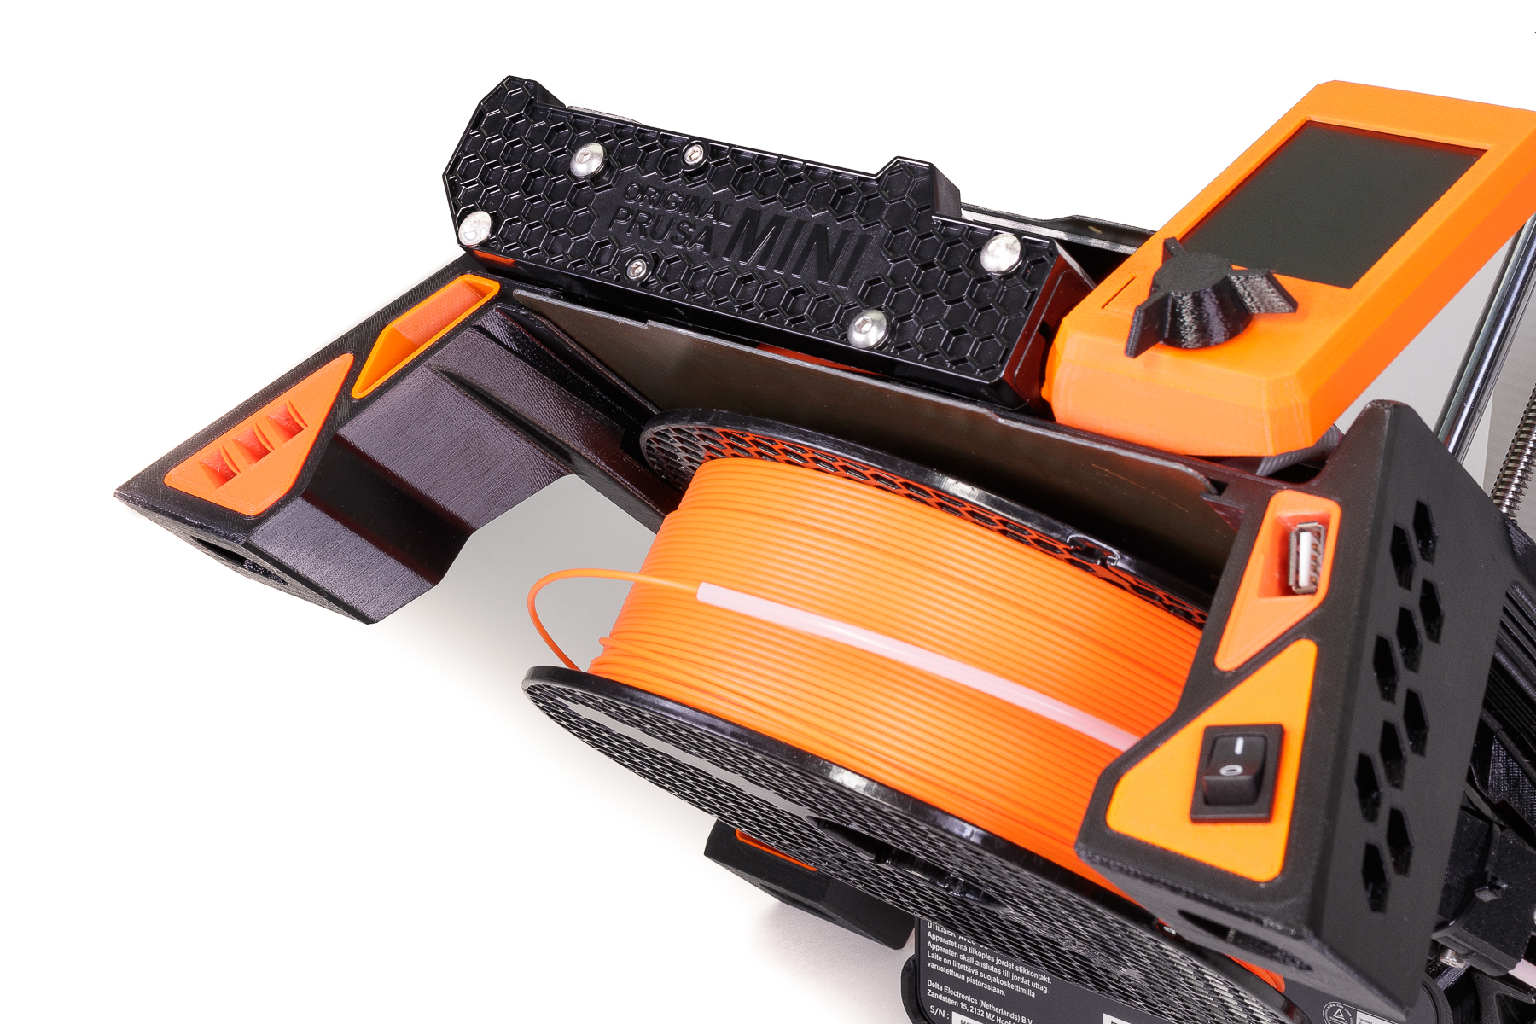

3D PRINTING WORLD
8/10
Notes:
Picture: Prusa

Slide 2
QUICK PRODUCT DESIGN REMINDER
LESSON 8 – 3D PRINTING WORLD

Slide 3
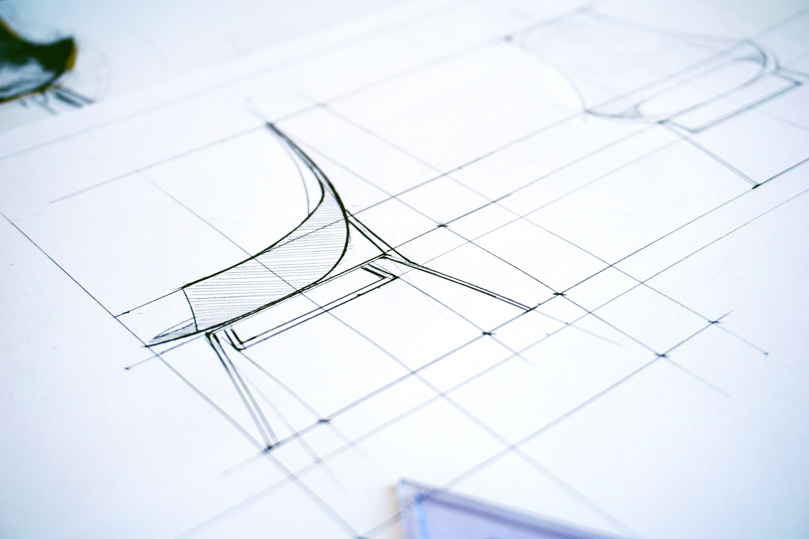
EXPLAIN WHY IS PRODUCT DESIGN SO IMPORTANT?
LESSON 8 – 3D PRINTING WORLD
Notes:
Picture source: Tembela Bohle

Slide 4
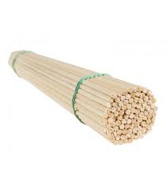
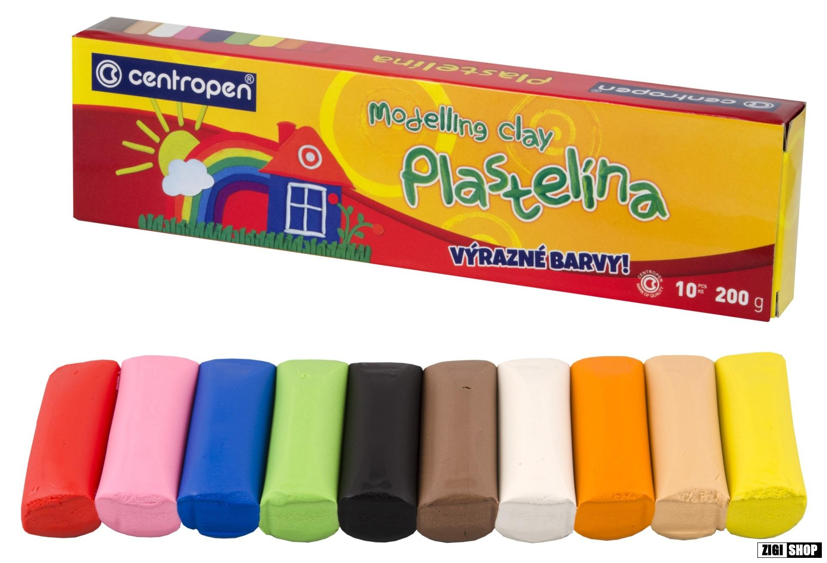
DESCRIBE DIFFERENCE BETWEEN MAKING A PROTOTYPE AND MASS PRODUCTION
LESSON 8 – 3D PRINTING WORLD
Notes:
Picture source: Tembela Bohle

Slide 5
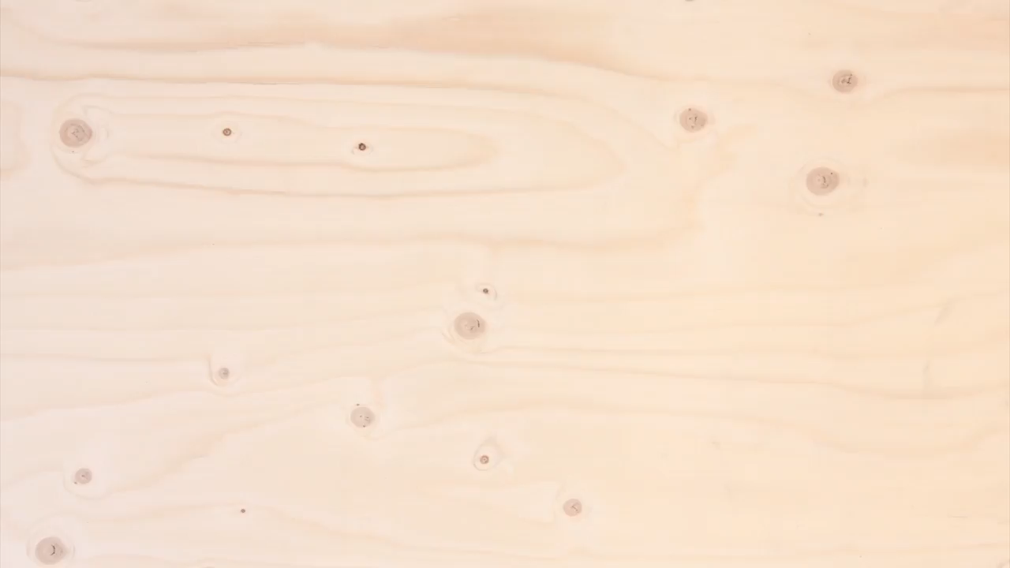
Notes:
Source: Youtube

Slide 6
HOW DOES A 3D PRINTER WORK?
LESSON 8 – 3D PRINTING WORLD

Slide 7

THERE ARE SEVERAL TYPES OF 3D PRINTING, WHICH INCLUDE:
STEREOLITHOGRAPHY (SLA)
SELECTIVE LASER SINTERING (SLS)
FUSED DEPOSITION MODELING (FDM)
DIGITAL LIGHT PROCESS (DLP)
MULTI JET FUSION (MJF)
POLYJET
DIRECT METAL LASER SINTERING (DMLS)
ELECTRON BEAM MELTING (EBM)
LESSON 8 - 3D PRINTING WORLD
Notes:
Source: https://www.protolabs.com/resources/blog/types-of-3d-printing/
There are more 3d printing technologies, but in this lesson we will work only with FDM type.

Slide 8
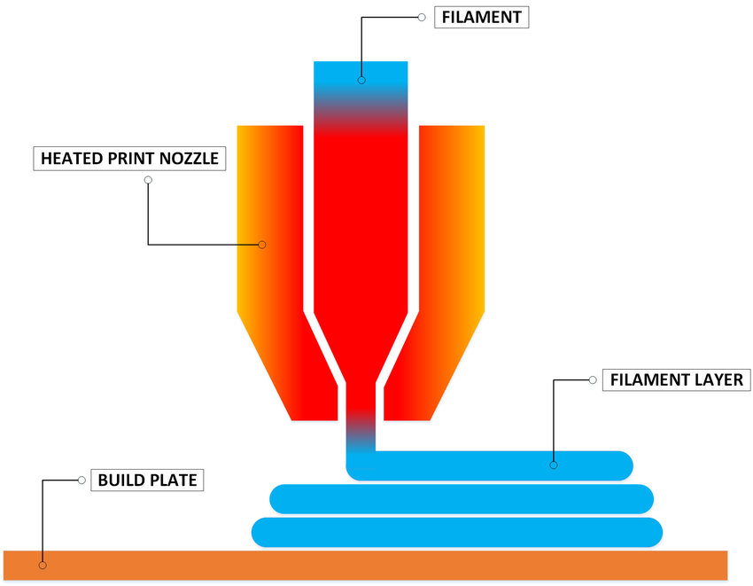
FILAMENT
HOT END
FILAMENT LAYER
PRINT BED
LESSON 8 - 3D PRINTING WORLD

Slide 9
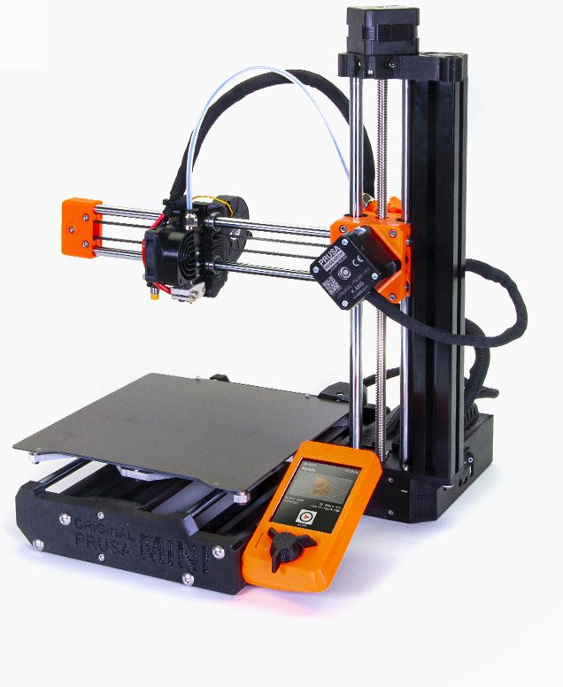
EXTRUDER
HOT END
PRINT BED
CONTROL PANEL
LESSON 8 - 3D PRINTING WORLD

Slide 10
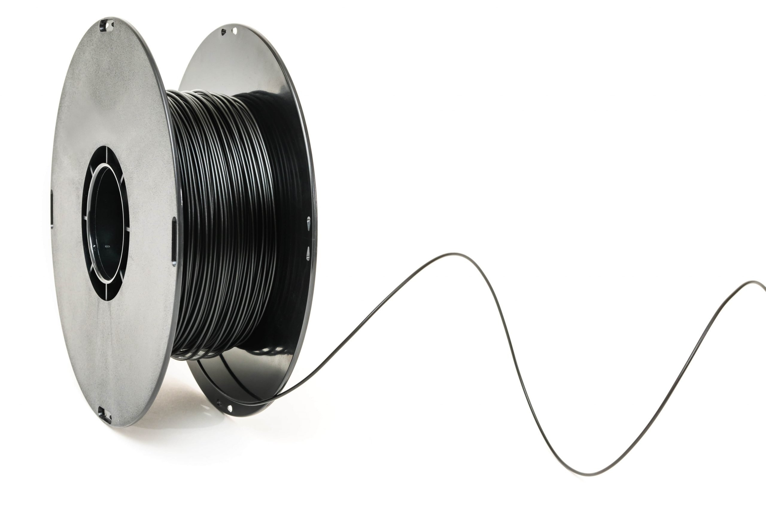
COMMON 3D PRINTING MATERIALS FOR FDM
PLA PET PETG PC ABS
LESSON 8 – 3D PRINTING WORLD
Notes:
More information on Prusament.com

Slide 11
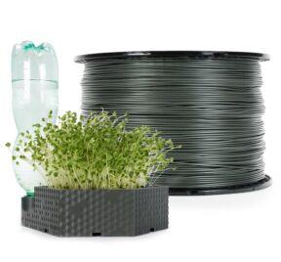
RECYCLED FILLAMENTS ARE ALREADY AVAILABLE ON MARKET
LESSON 8 - 3D PRINTING WORLD
Notes:
Source: Prusament.com – recycled PLA (Czech Republic)
Another fillament producer is EKO MB (Czech Republic)

Slide 12


IS 3D PRINTING SAME?
LESSON 8 - 3D PRINTING WORLD
Notes:
THIS IS PROCESS HOW TO PRINT A PDF FILE

Slide 13
MAKE YOUR OWN 3D MODEL
MODEL LIBRARY
SELECT MATERIAL
USE SLICER SOFTWARE
THAT GENERATES G-CODE
3D PRINTING
LESSON 8 - 3D PRINTING WORLD
Notes:
SIMPLE Process how to prepare model for printing

Slide 14

TIME TO PRINT
LESSON 8 – 3D PRINTING WORLD
Notes:
Foto: Rostislav Uzunov - Pexels

Slide 15
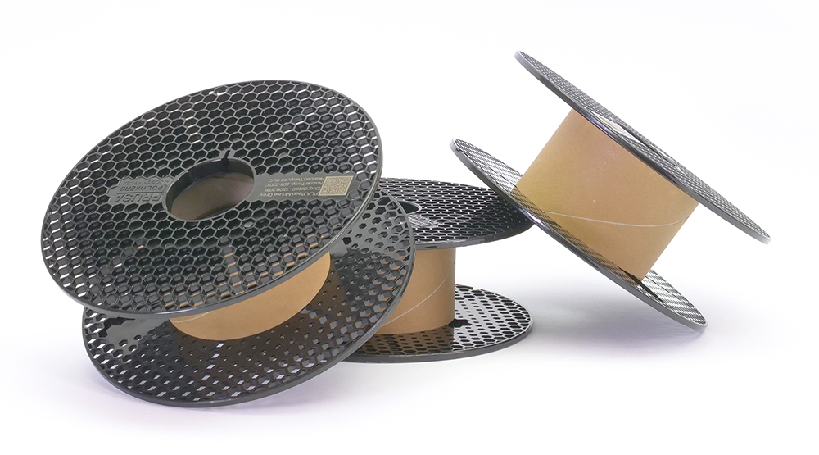
REUSING EMPTRY SPOOLS
LESSON 8 – 3D PRINTING WORLD
Notes:
Foto: Rostislav Uzunov - Pexels

Slide 16

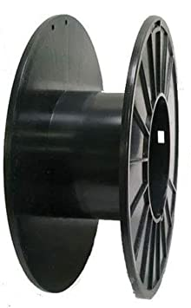
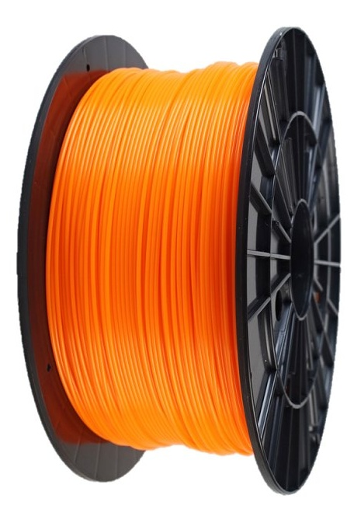

LESSON 8 - 3D PRINTING WORLD
Notes:
If every user of 3d printer will buy on average 5 spools of filament per year, that will be almost 3 min kg of empty spools per year. (2 942 500 kg per year). This is already a large amount of material and energy consumed in their production.

Slide 17
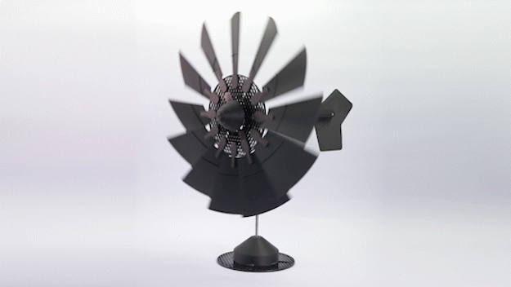
LESSON 8 - 3D PRINTING WORLD
Notes:
More information: https://blog.prusaprinters.org/prusament-spools-reuse-ideas_8875/

Slide 18
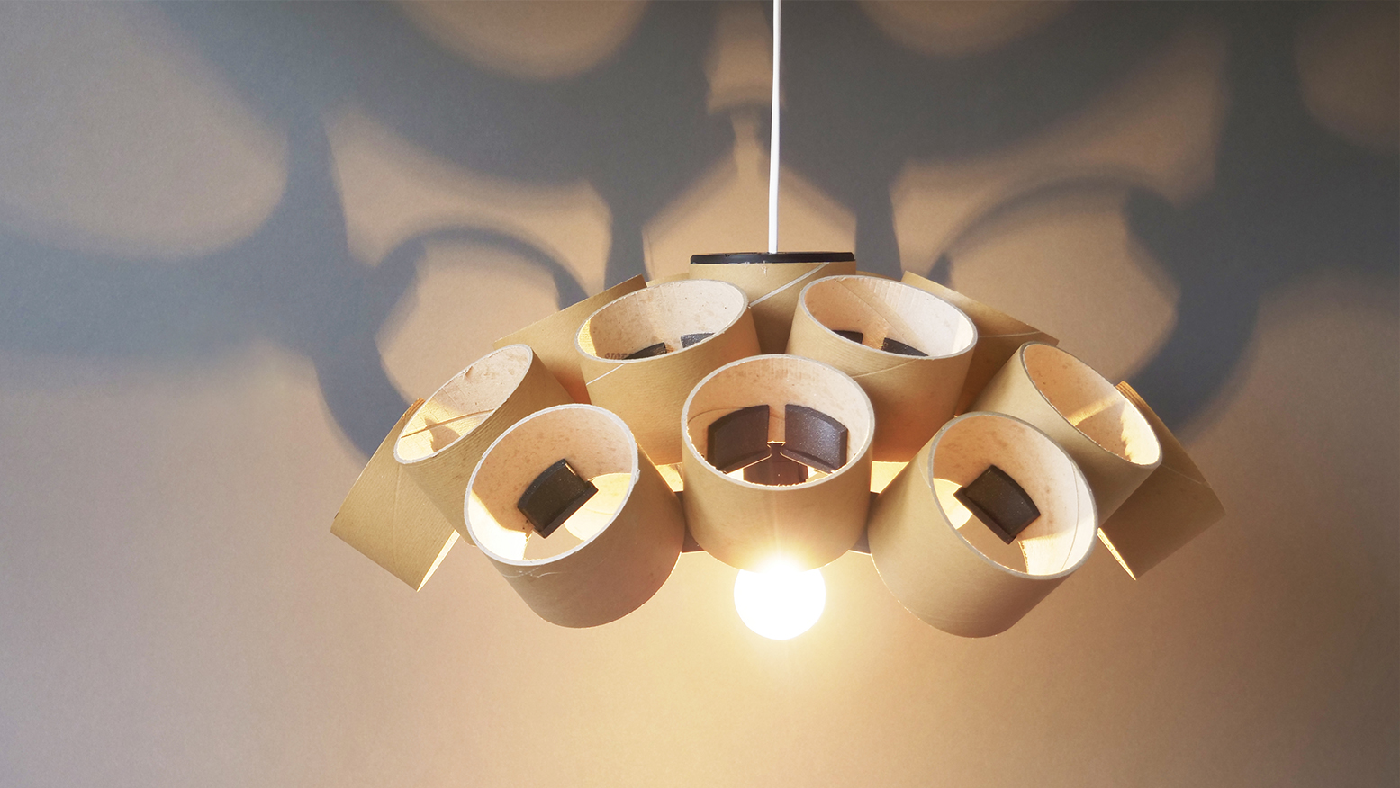
LESSON 8 – 3D PRINTING WORLD
Notes:
More information: https://blog.prusaprinters.org/prusament-spools-reuse-ideas_8875/

Slide 19
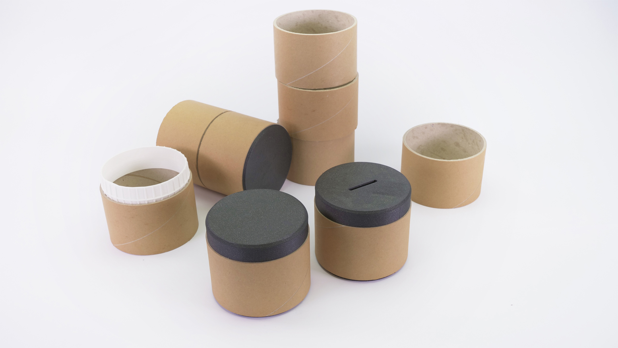
LESSON 8 - 3D PRINTING WORLD
Notes:
More information: https://blog.prusaprinters.org/prusament-spools-reuse-ideas_8875/

Slide 20
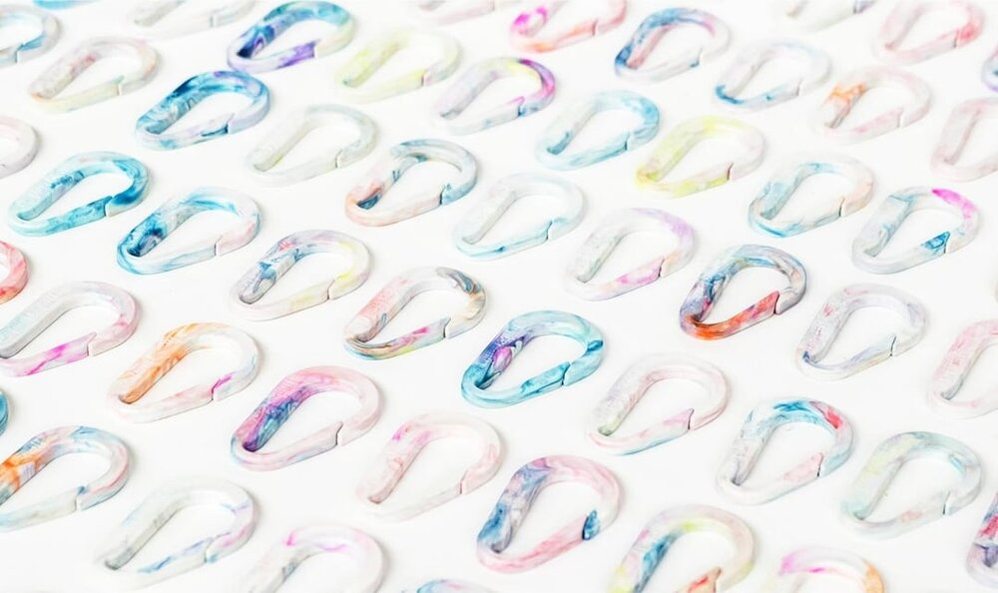
3D PRINTING VS. INJECTION MOULDING
LESSON 8 – 3D PRINTING WORLD

Slide 21
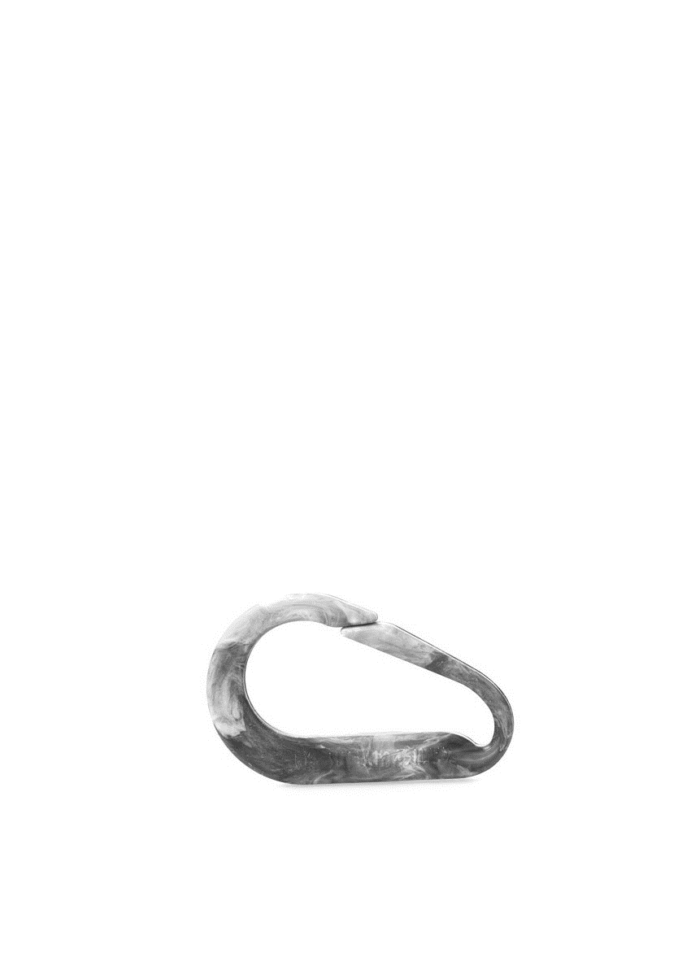
COMPARATION | 3D PRINTING | INJECTION MOULDING
Production time [min]
Max. loading [kg]
LESSON 8 - 3D PRINTING WORLD

Slide 22
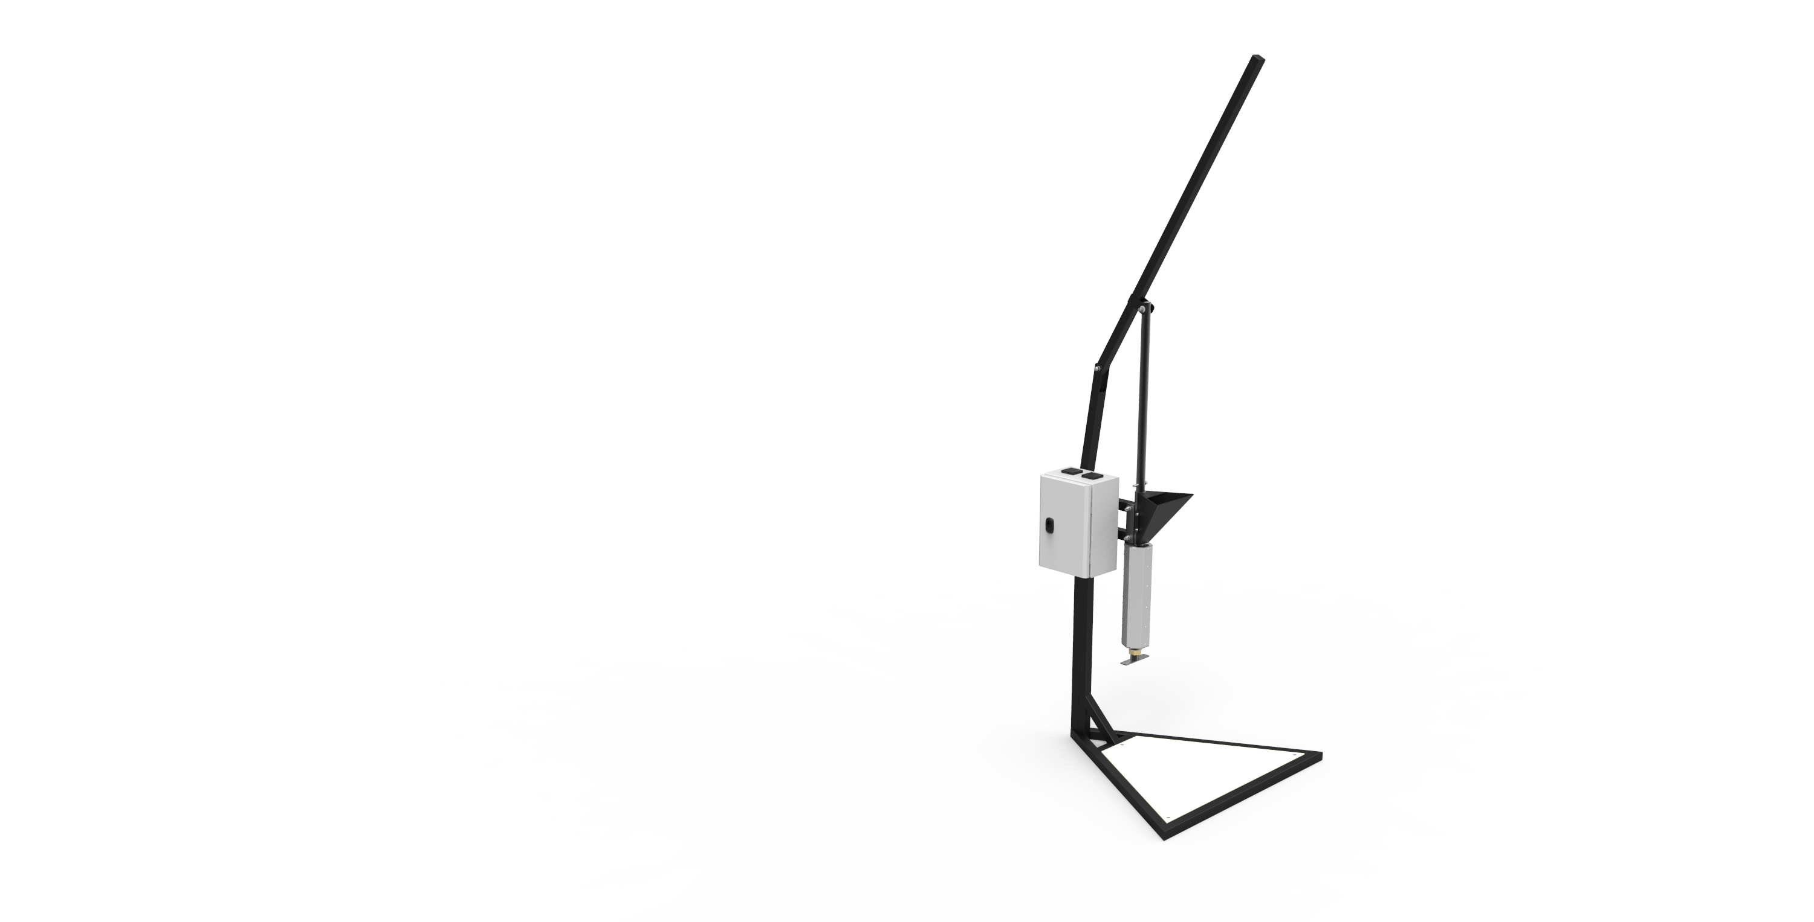
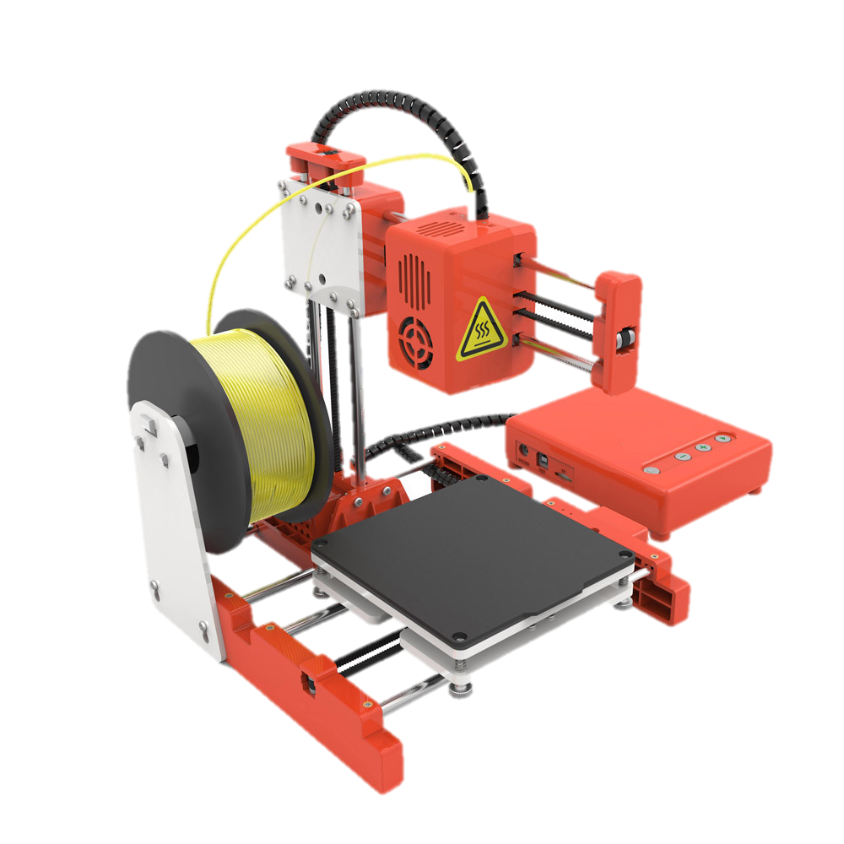
LESSON 8 – 3D PRINTING WORLD
Notes:
Compare advantages and disadvantages of 3D Printing and Ijnection moulding.
When is better to use 3d printer and when is better to start injection moulding production?
3d printer picture source: 3Dandprint, 3D Printer Easythreed Model X1

Slide 23
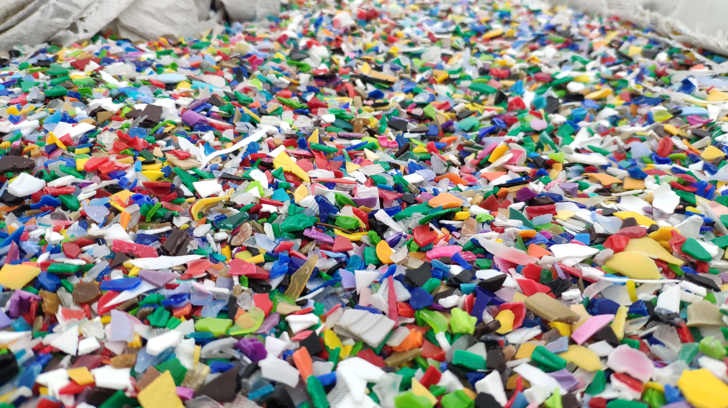
GRANULAT 3D PRINTING
LESSON 8 – 3D PRINTING WORLD

Slide 24
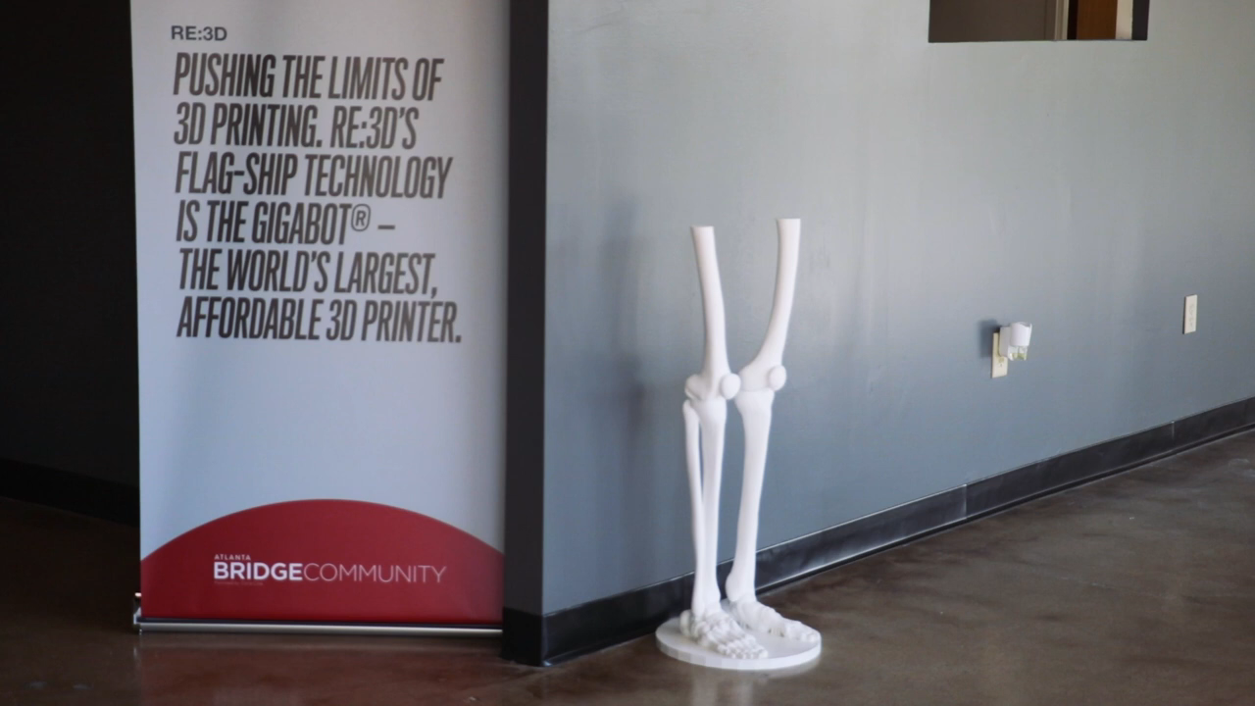

Slide 25
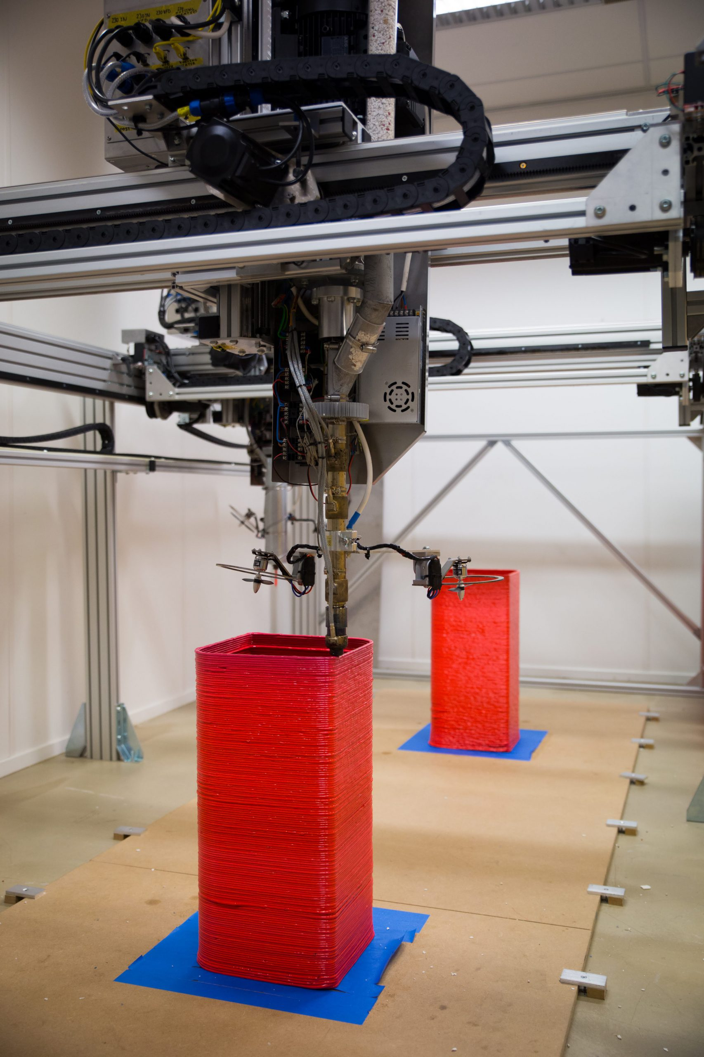
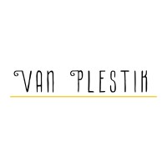
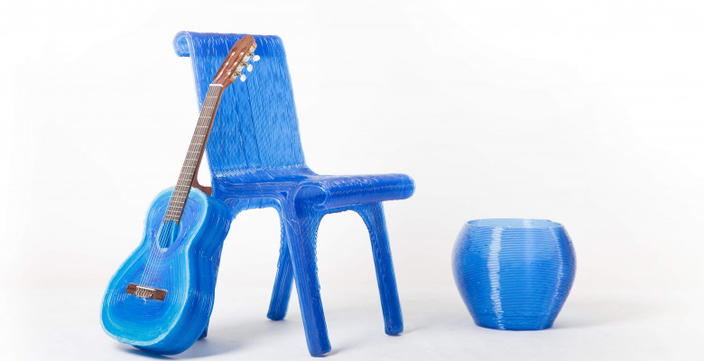
LESSON 8 – 3D PRINTING WORLD
Notes:
Source: Van Plestik

Slide 26
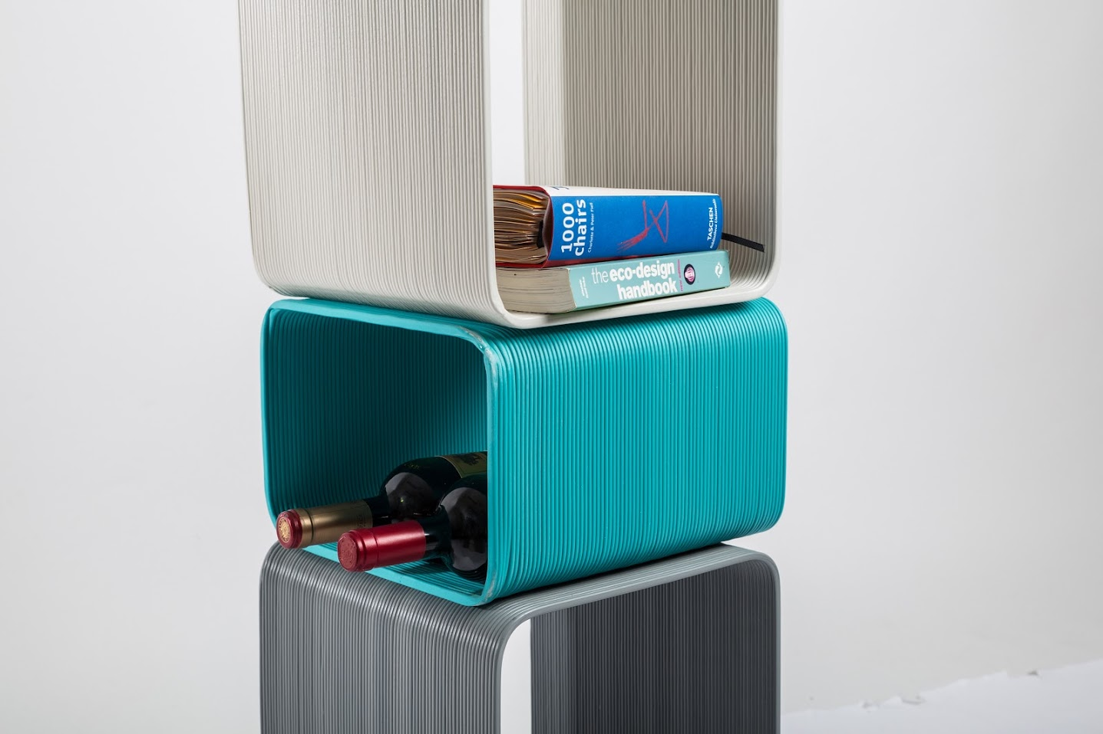
LESSON 8 – 3D PRINTING WORLD
Notes:
Source: Van Plestik

Slide 27
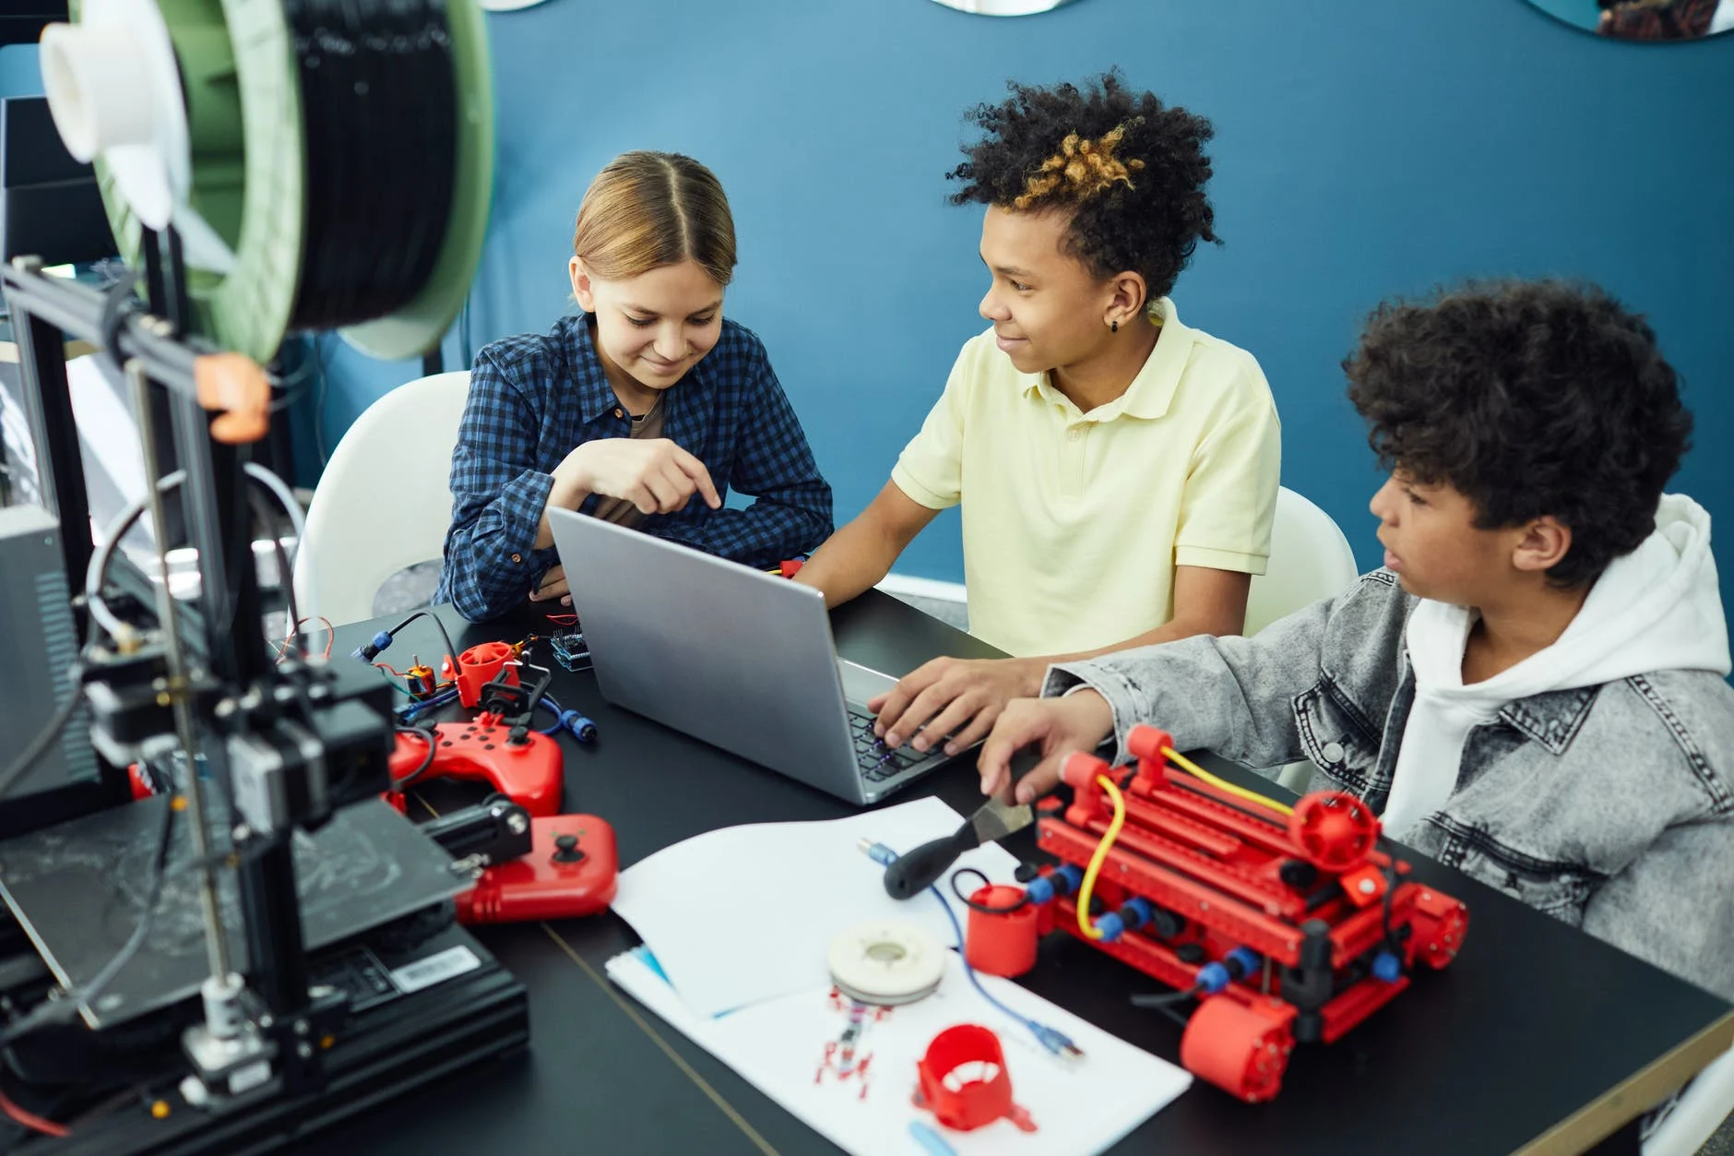
INVENT PRODUCT FOR 3D PRINTING
LESSON 8 – 3D PRINTING WORLD
Notes:
Source: Vanessa Loring – Pexels.com

Slide 28
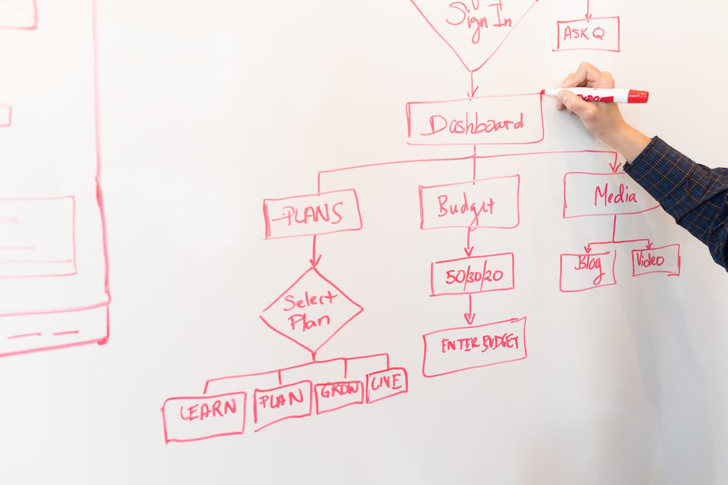
PRESENTATION OF YOUR IDEAS
LESSON 8 – 3D PRINTING WORLD
Notes:
Source: Christina Morillo – Pexels.com

Slide 29
SEE U NEXT TIME
LESSON 8 – 3D PRINTING WORLD
Notes:
MAKE A RECAP

Slide 30


ING. TOMAS KOLECAR
INFO@PLASTMAKERS.COM
WWW.PLASTMAKERS.COM
+420 739 122 662
CZECH REPUBLIC - EUROPE
CONTACT

