Slide 1
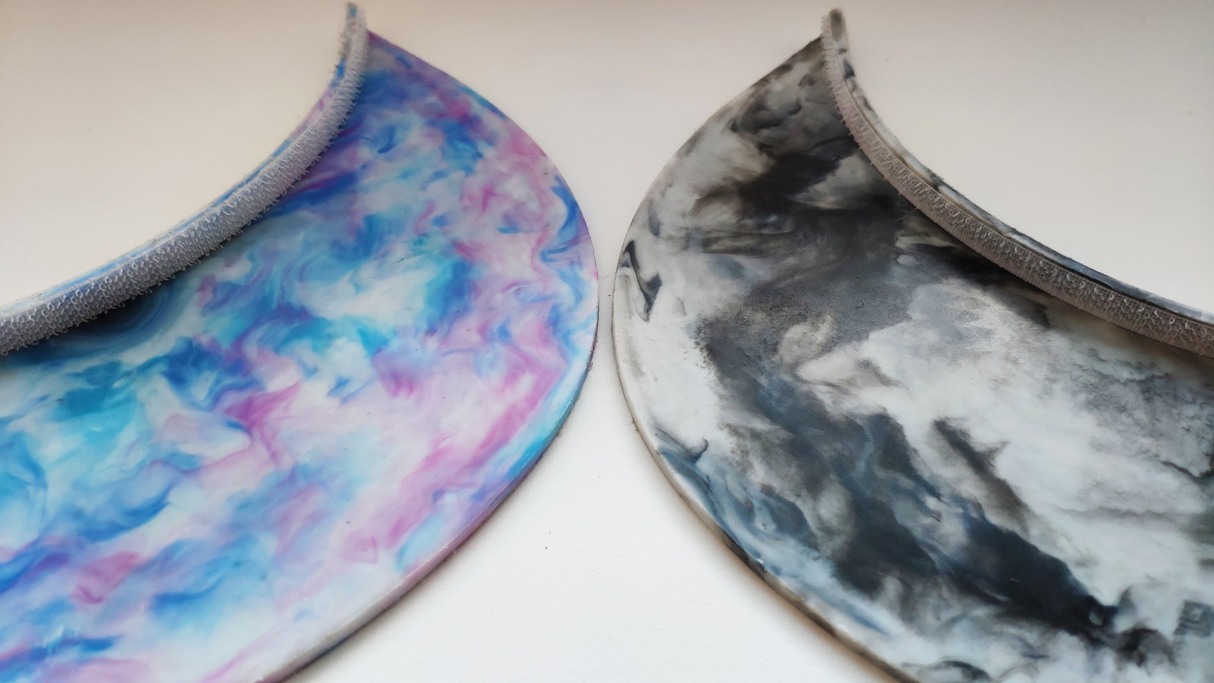

PRODUCT
DEVELOPMENT
7/10

Slide 2
WHAT DO YOU KNOW ABOUT SUSTAINABILITY IN SPORT?
LESSON 7 – PRODUCT DEVELOPMENT

Slide 3
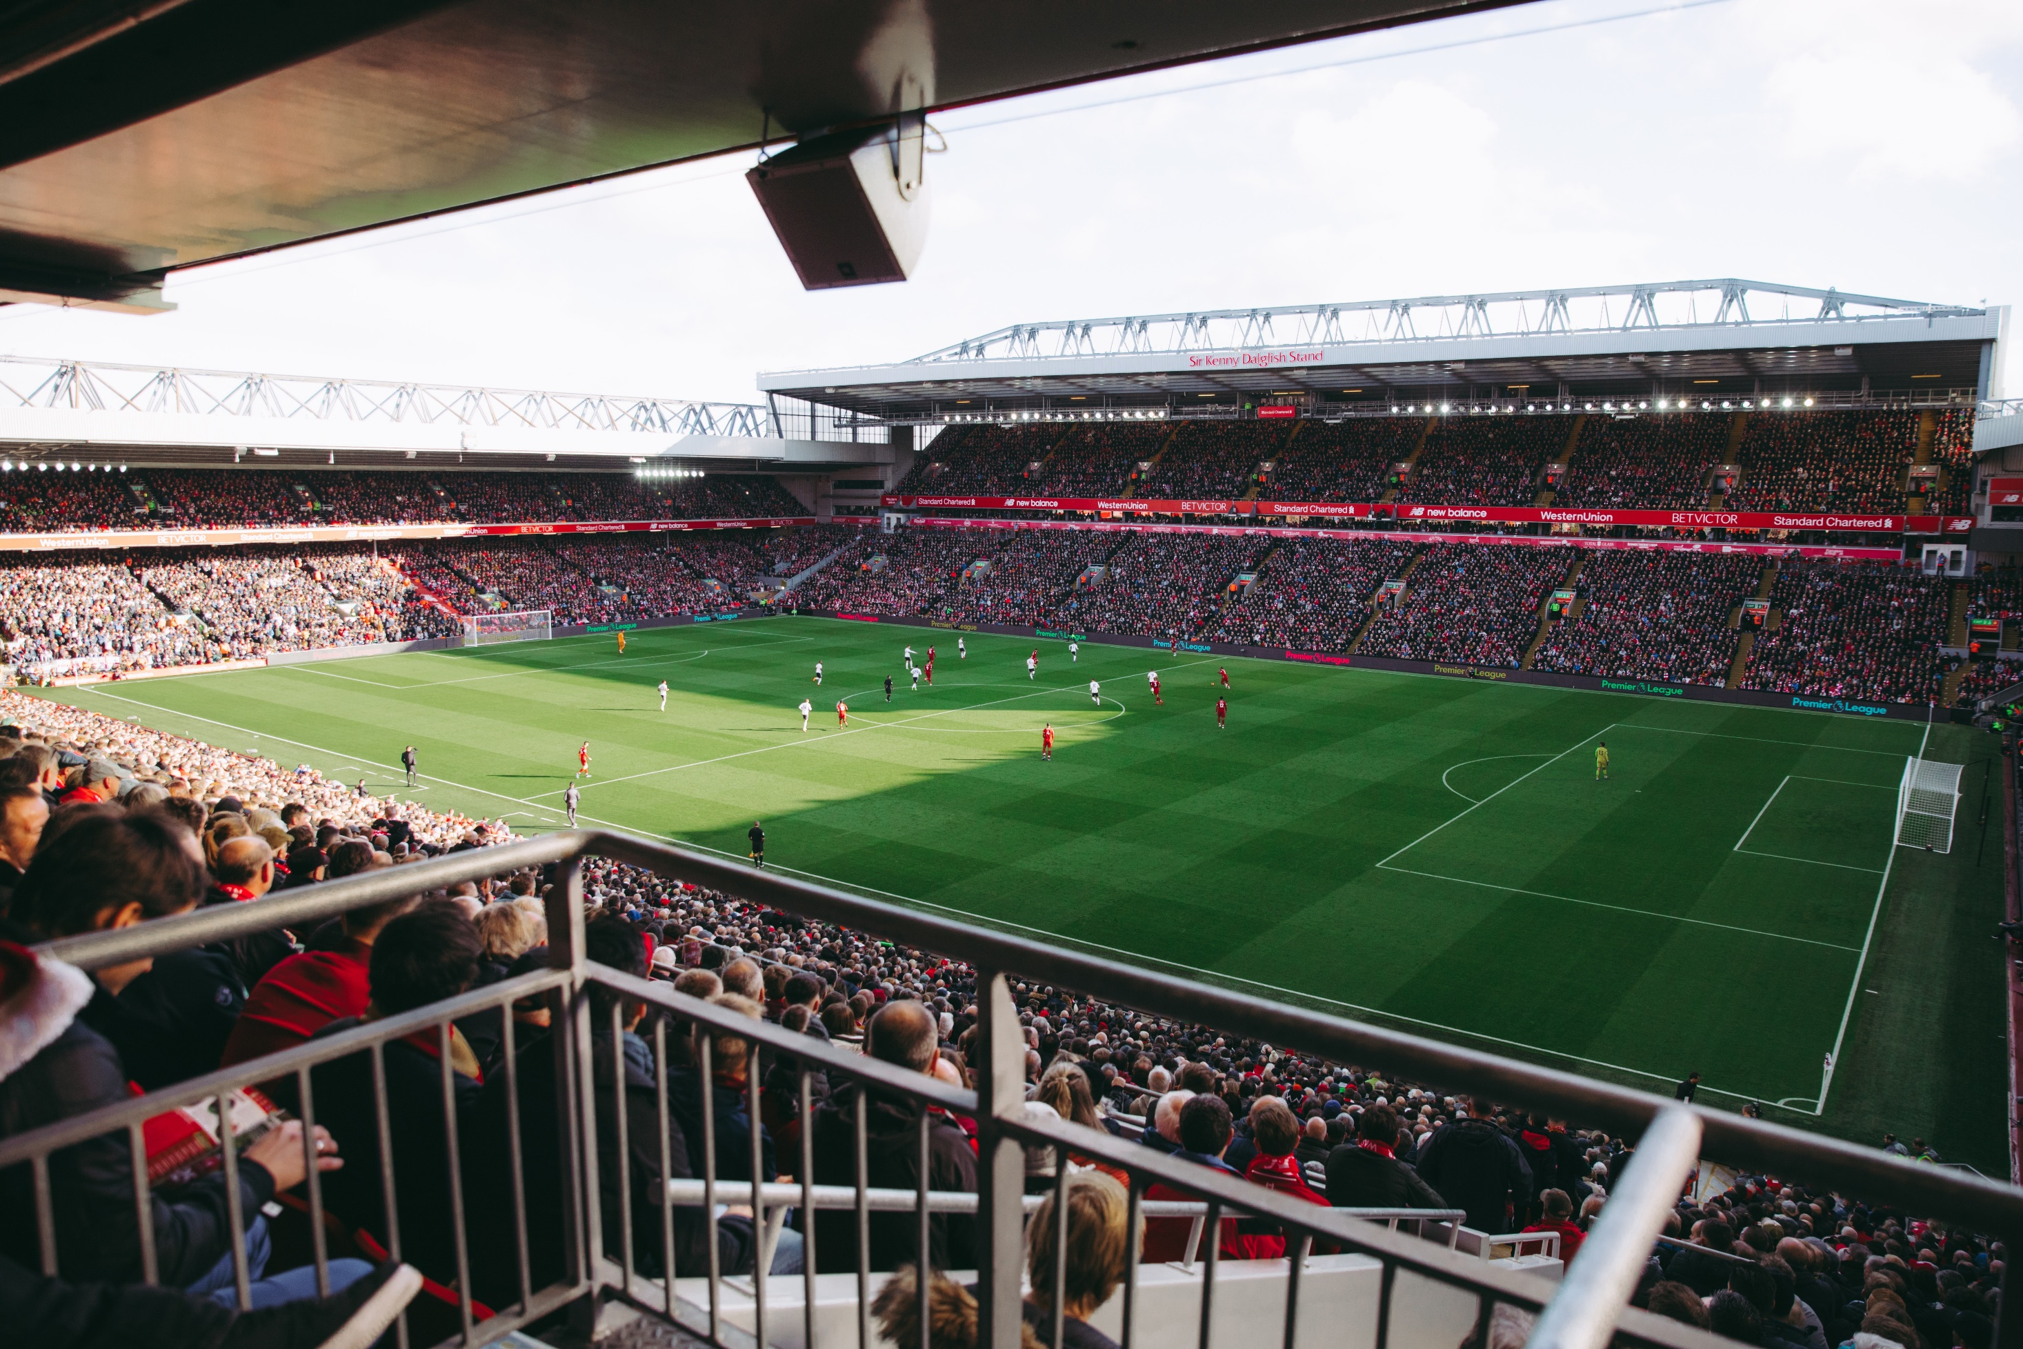
DESIGN AND BUILD LOW ENERGY BUILDINGS
TRANSPORT OPTIONS FOR VISITORS – MASS TRANSPORT PREFERED
REDUCTION OF SINGLE USE PLASTIC ON EVENT
DESIGN ENOUGH SORTING SPOTS FOR WASTE
FIND A SUPPLIER WHICH REUSE PLASTIC WASTE FROM EVENT
REDUCE AMMOUNT OF SOUVENIR MADE FROM VIRGIN MATERIAL
REUSING MATERIAL FOR MERCHENDISE
DIGITALIZATION = REDUCTION AMOUNT OF PRINTED MATERIAL
OFFSETTING CARBON FIBRE FOOTPRINT OF EVENT
NAME 3 WAYS HOW TO REDUCE IMPACT OF SPORT EVENT ON EVIRONMENT
LESSON 7 – PRODUCT DEVELOPMENT
Notes:
Picture source: Tembela Bohle

Slide 4
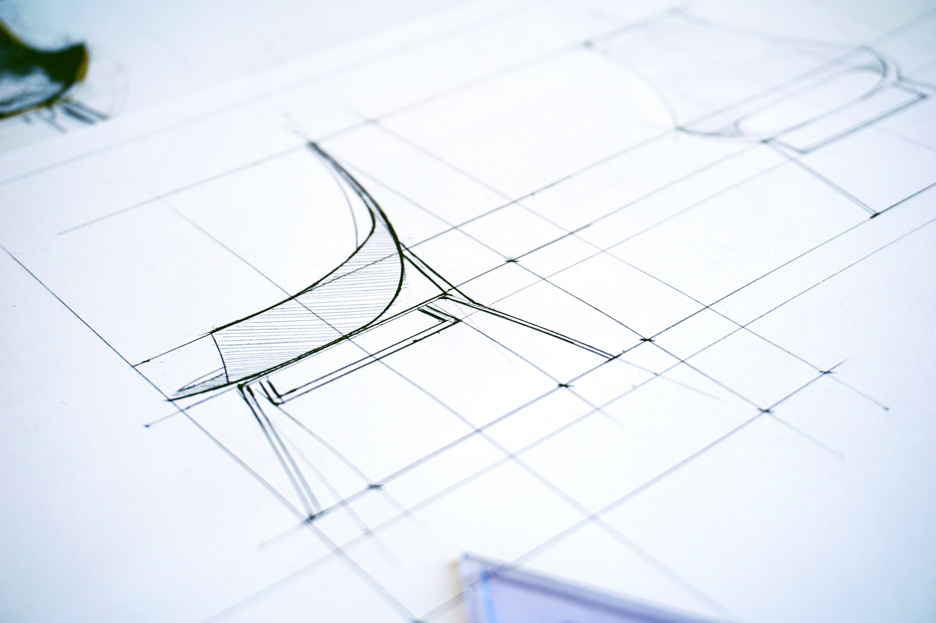
PRODUCT DESIGN
LESSON 7 – PRODUCT DEVELOPMENT
Notes:
Source: Karol D – PEXELS.COM

Slide 5


Slide 6
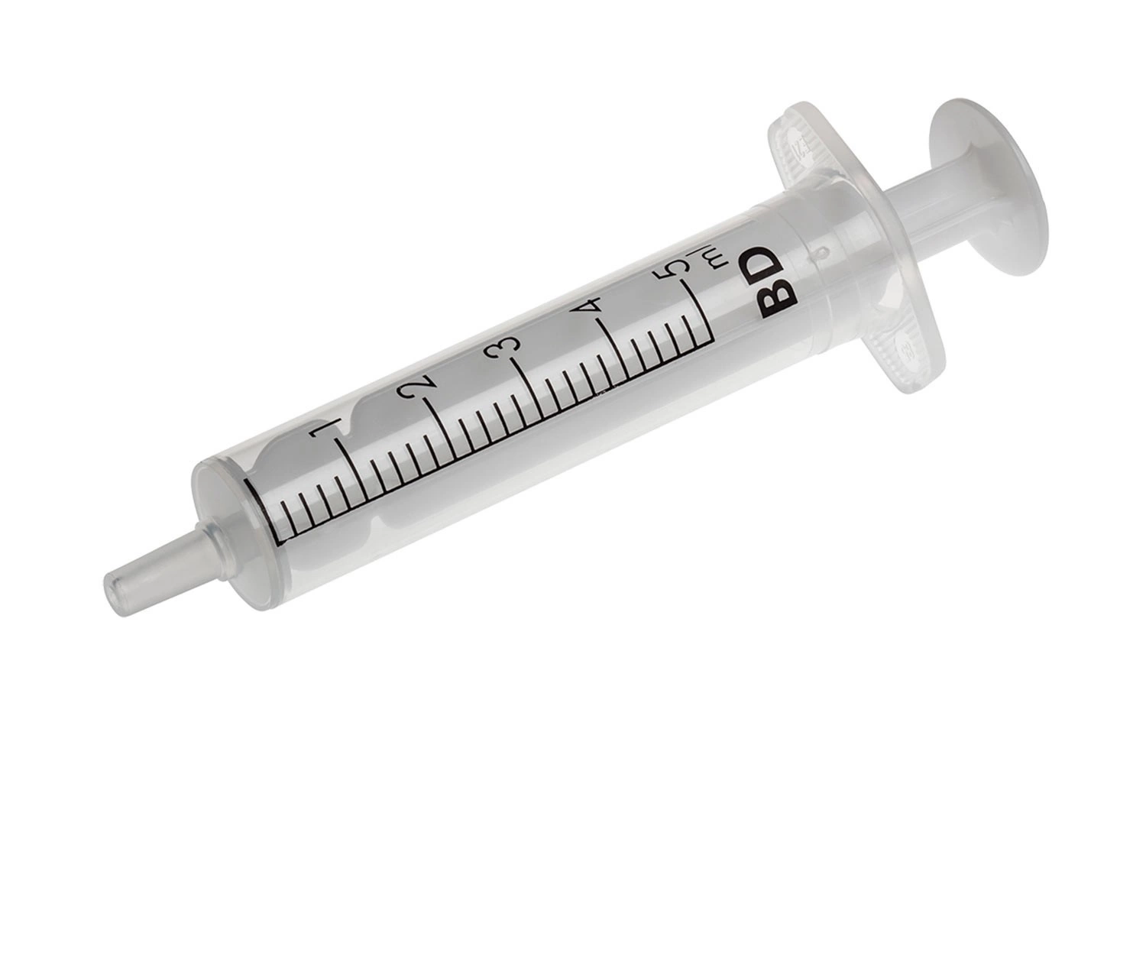
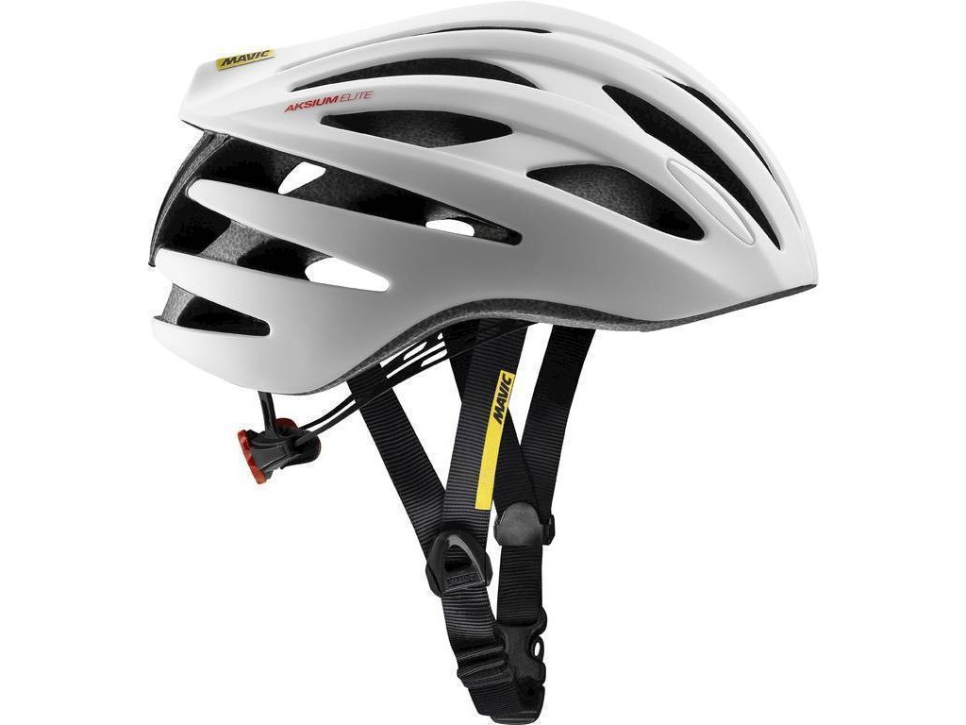
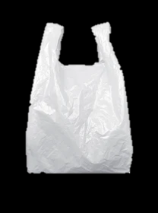
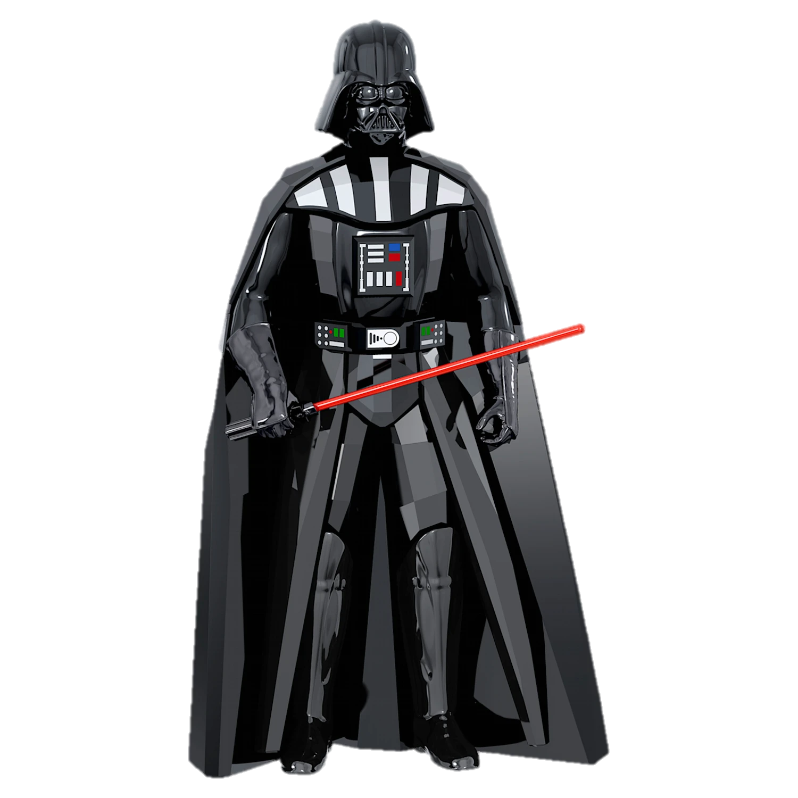




GOOD PLASTIC APPLICATIONS
BAD PLASTIC APPLICATIONS
Notes:
Let children say 3 examples for each category

Slide 7

MATERIAL RESOURCES
DESIGN
PROTOTYPE
MASS PRODUCTION
END OF PRODUCT LIFE
LESSON 7 – PRODUCT DEVELOPMENT
Notes:
Source: Karol D – PEXELS.COM

Slide 8
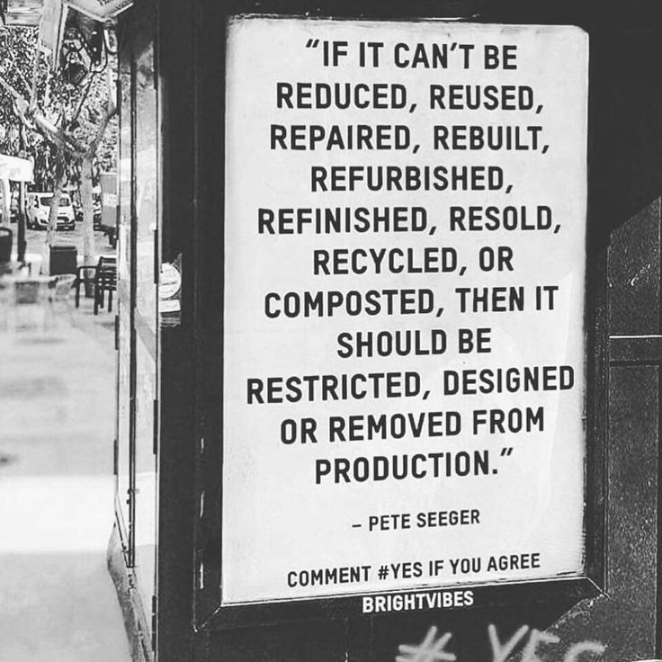

LESSON 7 – PRODUCT DEVELOPMENT
Notes:
Source: Pinterest

Slide 9
WHY IS DESIGN PHASE SO IMPORTANT?
LESSON 7 – PRODUCT DEVELOPMENT

Slide 10

Notes:
Source: Youtube

Slide 11
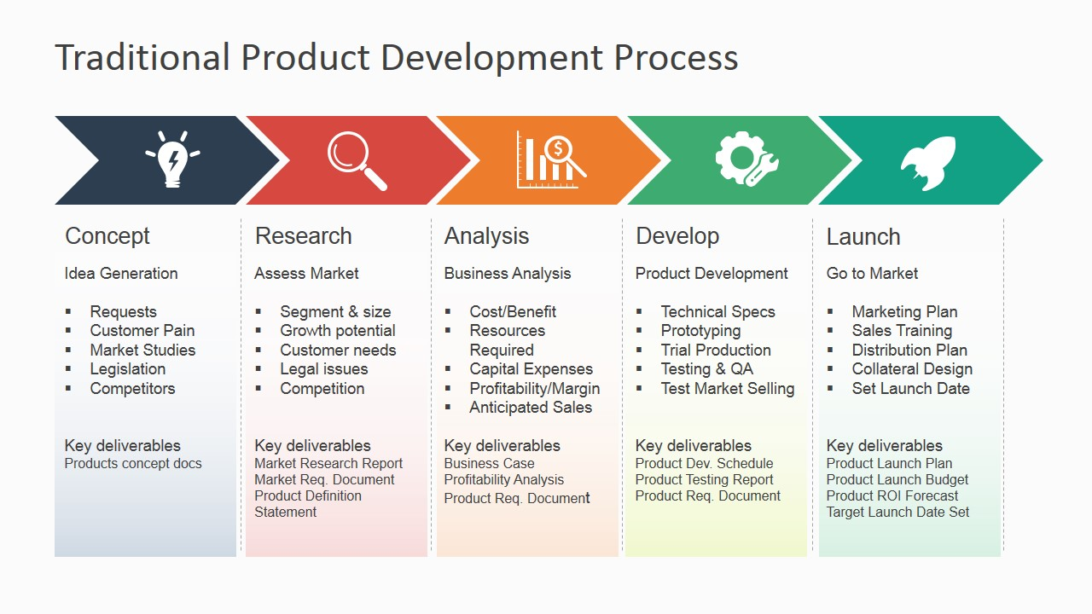
TRADITIONAL PRODUCT DEVELOPMENT PROCESS
LESSON 7 – PRODUCT DEVELOPMENT
Notes:
Picture source: https://slidemodel.com/templates/traditional-product-development-process-for-powerpoint/6855-01-traditional-product-development-process-powerpoint-2/

Slide 12
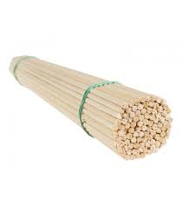
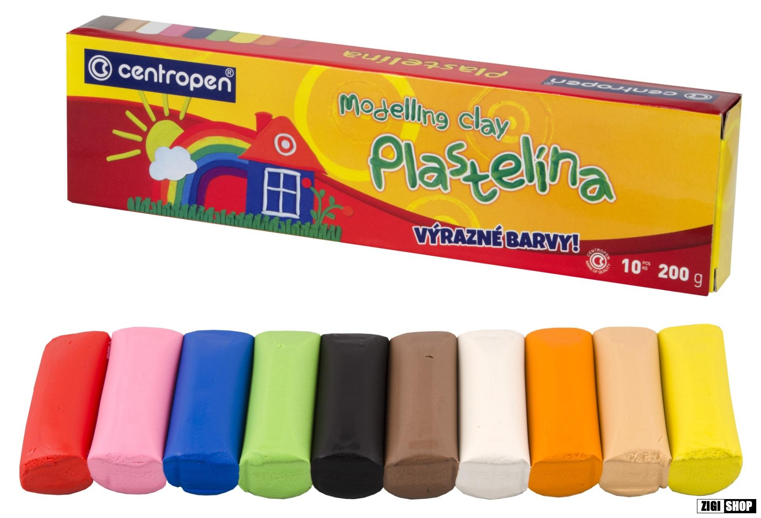
ACTIVITY: BUILD A TOWER AS HIGH AS POSSIBLE
LESSON 7 – PRODUCT DEVELOPMENT
Notes:
SET UP SIMPLE AND CLEAR RULES HOW TO BUILD TOWER IN TIME LIMIT

Slide 13
WHAT TO CHANGE, IF YOU WANT BUILD
100
OF THESE CONSTRUCTIONS?
LESSON 7 – PRODUCT DEVELOPMENT

Slide 14
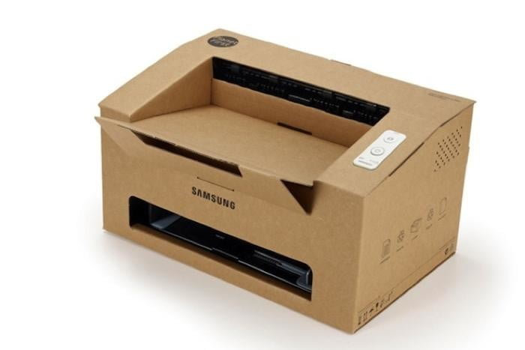
MAKE YOUR OWN PROTOTYPE
LESSON 7 – PRODUCT DEVELOPMENT
Notes:
Source: Karol D – PEXELS.COM

Slide 15
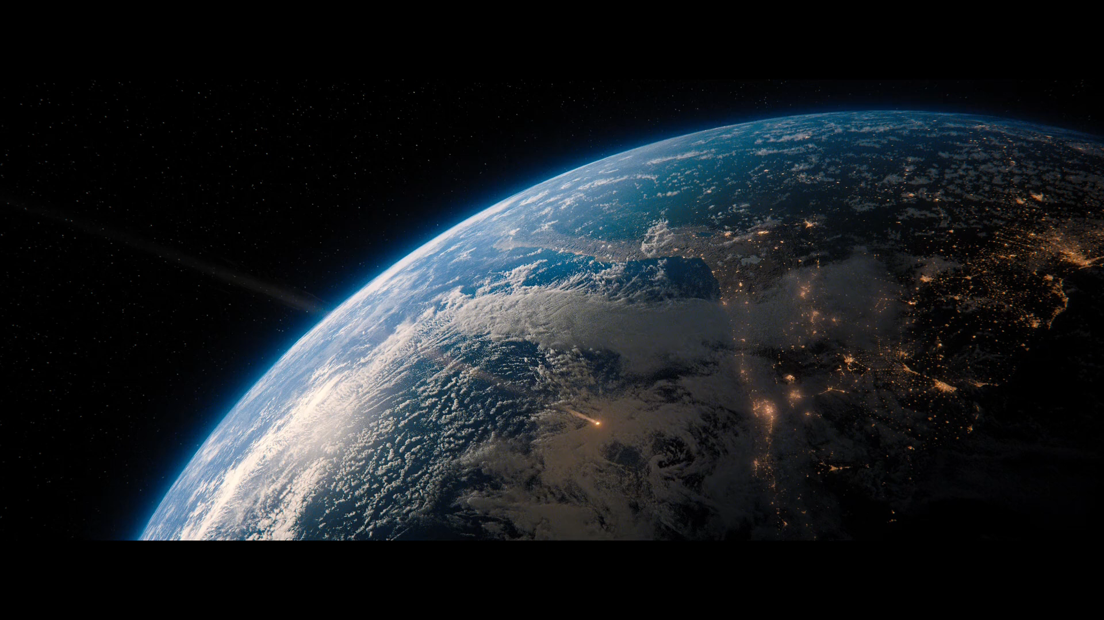
MOVIE: DON´T LOOK UP (2021) – ENDING SCENE

Slide 16
„WE REALLY DID HAVE EVERYTHING, DIDN´T WE?“
DON´T LOOK UP (2021)
LESSON 7 – PRODUCT DEVELOPMENT
Notes:
MAKE A RECAP

Slide 17
SEE U NEXT TIME
LESSON 7 – PRODUCT DEVELOPMENT
Notes:
MAKE A RECAP

Slide 18


ING. TOMAS KOLECAR
INFO@PLASTMAKERS.COM
WWW.PLASTMAKERS.COM
+420 739 122 662
CZECH REPUBLIC - EUROPE
CONTACT

