Slide 1
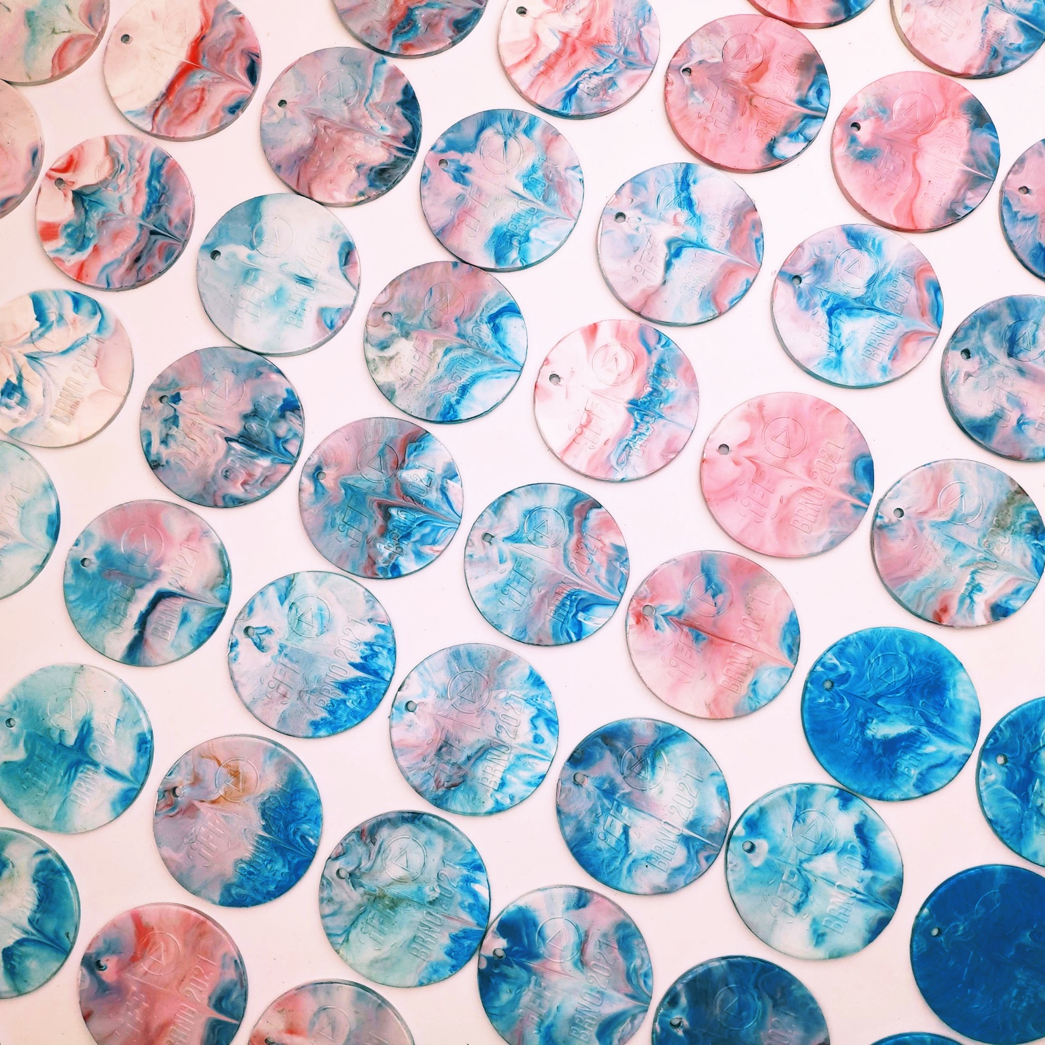

SUSTAINABILITY
IN SPORT
6/10
Notes:
Picture: Magda Ehlers, source: Pexels.com

Slide 2
QUICK RECAP OF THE LAST LESSON
LESSON 6 – SUSTAINABILITY IN SPORT

Slide 3

MATCH TERM WITH ITS DEFINITION
„ ____________, is a form of marketing spin in which green PR and green marketing are deceptively used to persuade the public that an organization's products, aims and policies are environmentally friendly.“ Wikipedia
DEPOSIT REFUND SYSTEM
„ _________ is a set of principles focused on waste prevention that encourages the redesign of resource life cycles so that all products are reused. The goal is for no trash to be sent to landfills, incinerators or the ocean. Currently, only 9% of plastic is actually recycled.“ Wikipedia
GREENWASHING
ZEROWASTE
„ ________ are systems where consumers pay a small amount of money upfront, to be reimbursed to them when they bring the container to a collection point once they have finished using it. The container can then be recycled and transformed into secondary raw materials.“
LESSON 6 – SUSTAINABILITY IN SPORT

Slide 4

LESSON 6 – SUSTAINABILITY IN SPORT
Notes:
IOC Sustainability Report highlights 2017-2020 achievements across the Olympic Movement
https://olympics.com/ioc/news/ioc-sustainability-report-highlights-2017-2020-achievements-across-the-olympic-movement

Slide 5
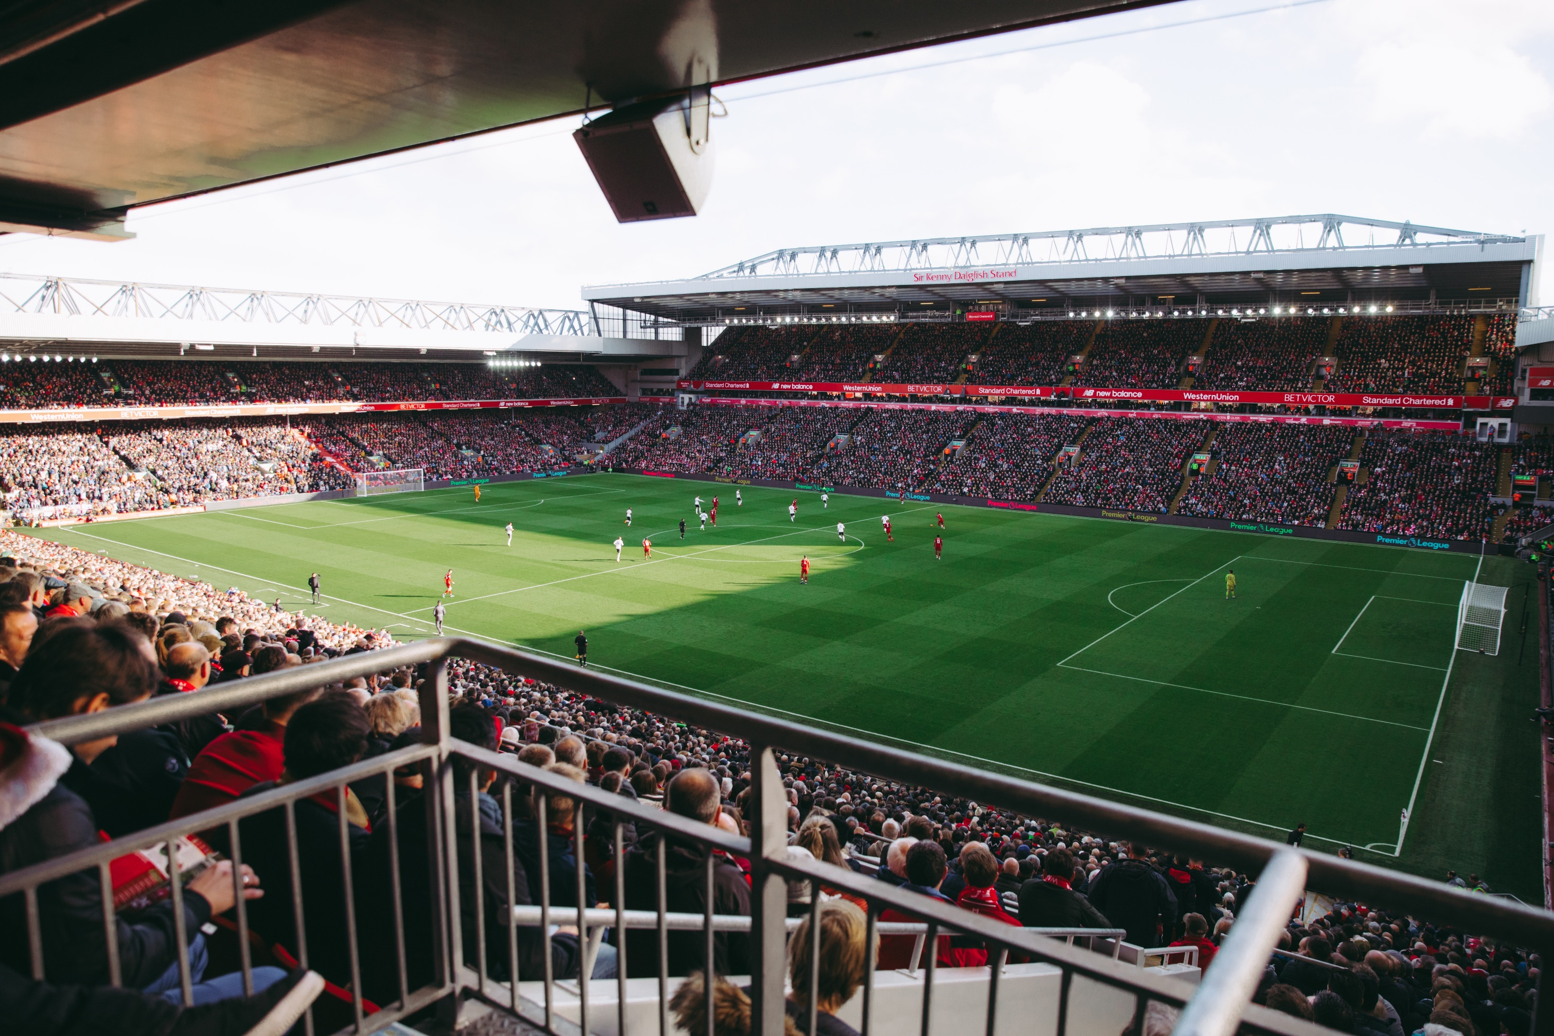
DESIGN AND BUILD LOW ENERGY BUILDINGS
TRANSPORT OPTIONS FOR VISITORS – MASS TRANSPORT PREFERED
REDUCTION OF SINGLE USE PLASTIC ON EVENT
DESIGN ENOUGH SORTING SPOTS FOR WASTE
FIND A SUPPLIER WHICH REUSE PLASTIC WASTE FROM EVENT
REDUCE AMMOUNT OF SOUVENIR MADE FROM VIRGIN MATERIAL
REUSING OLD SPORT EQUIPMENT
DIGITALIZATION = REDUCTION AMOUNT OF PRINTED MATERIAL
OFFSETTING CARBON FIBRE FOOTPRINT OF EVENT
LESSON 6 – SUSTAINABILITY IN SPORT
Notes:
Picture source: Tembela Bohle

Slide 6

3 DIFFERENT EXAMPLES
FROM CZECH REPUBLIC
LESSON 6 – SUSTAINABILITY IN SPORT

Slide 7
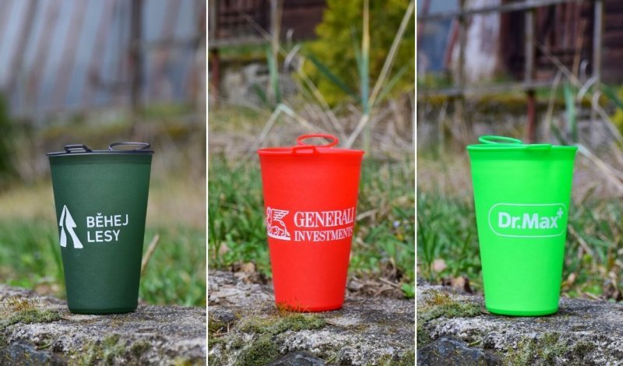
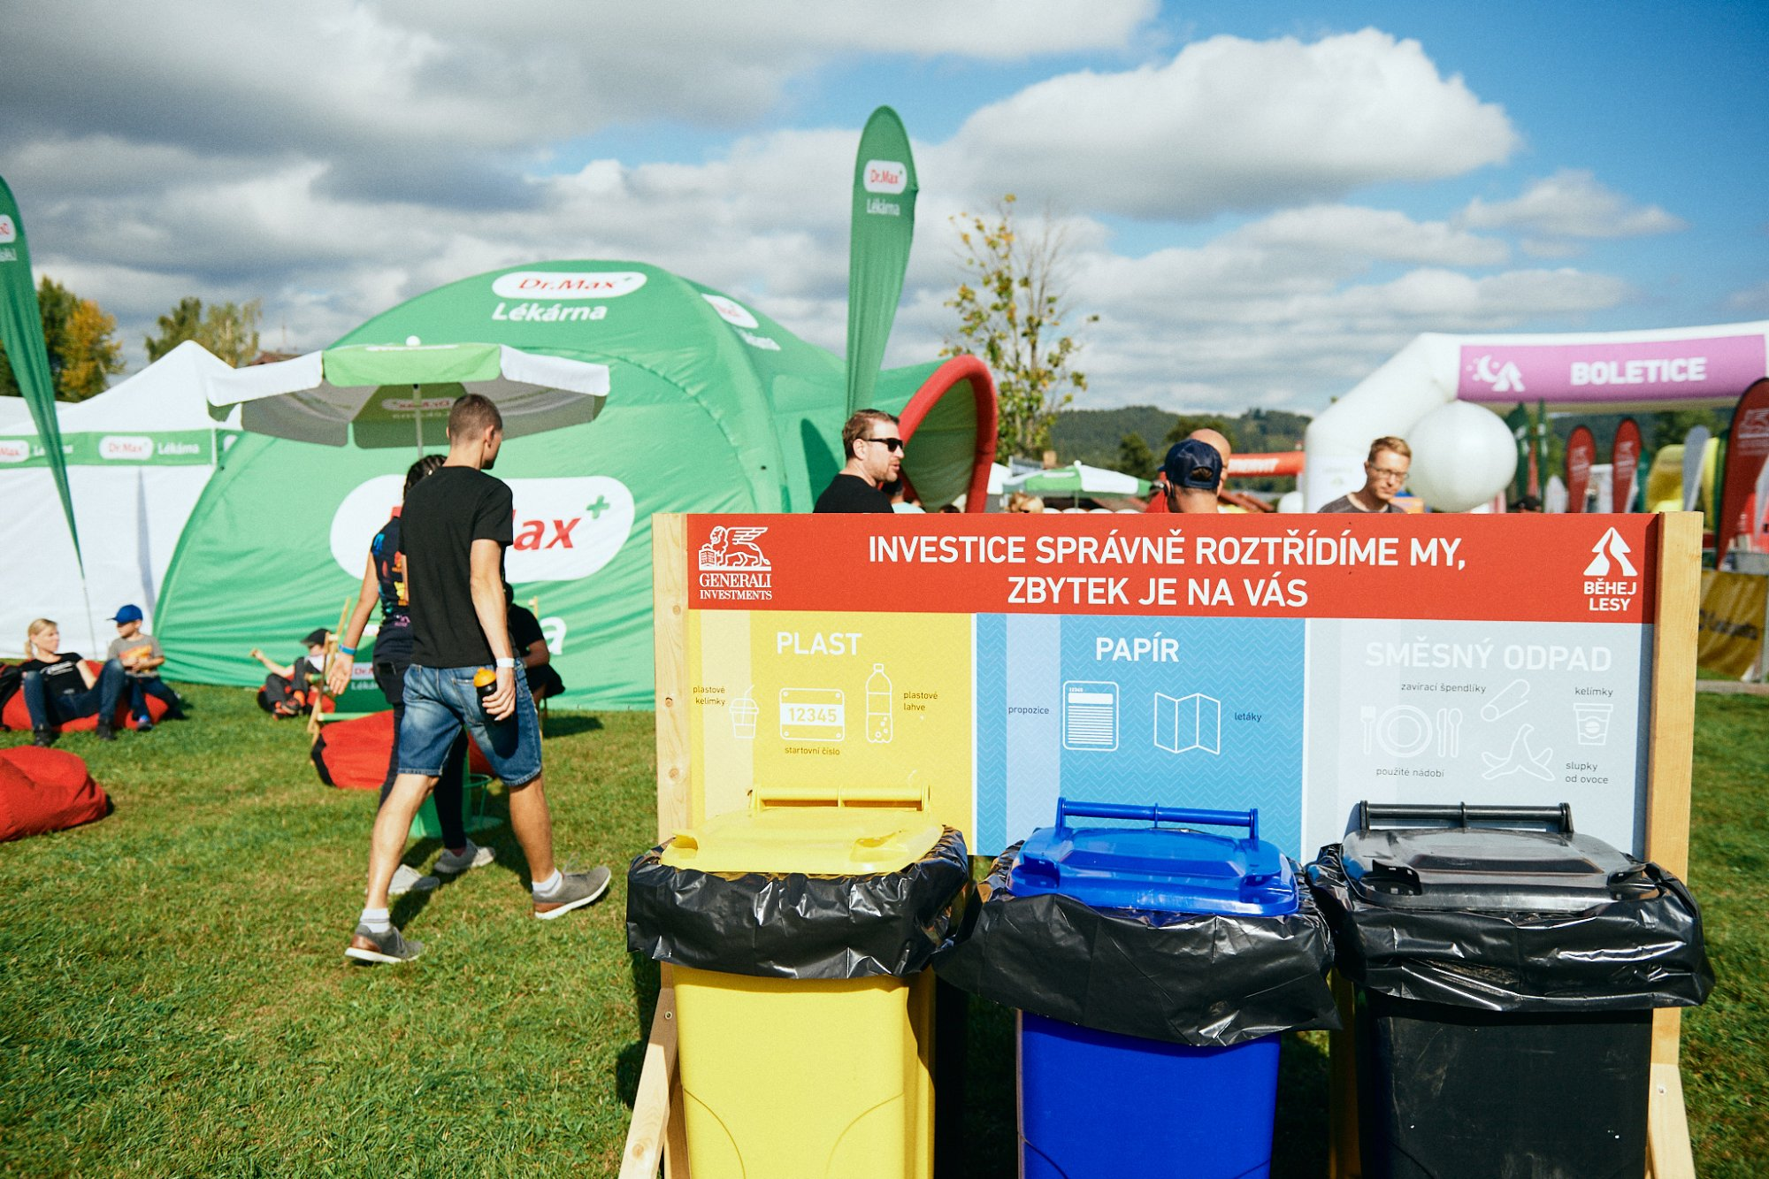
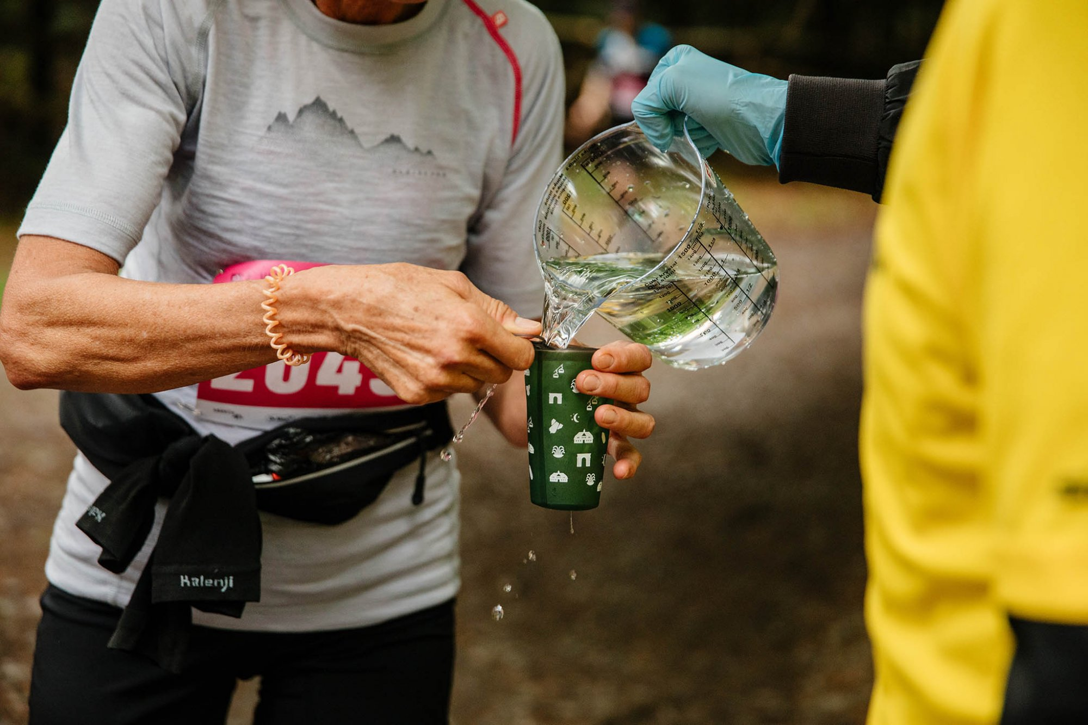

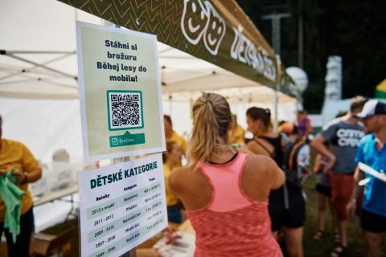
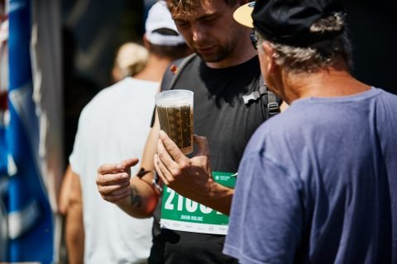
Notes:
Source and more information: https://behejlesy.cz/cms.front.page/page/625

Slide 8

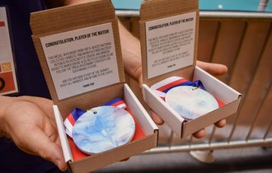
DESIGNED ENOUGH SORTING SPOTS FOR WASTE
DIGITALIZATION REDUCED PRINTING BY AS MUCH AS 80%
IFF BRNO 2021
VISITORS COULD BRING OLD SPORT EQUIPMENT FOR ITS REUSING
MEDALS PLAYER OF THE MATCH MADE FROM RECYCLED PLASTIC
MASS TRANSPORT AND CARSHARING
LESSON 6 – SUSTAINABILITY IN SPORT

Slide 9
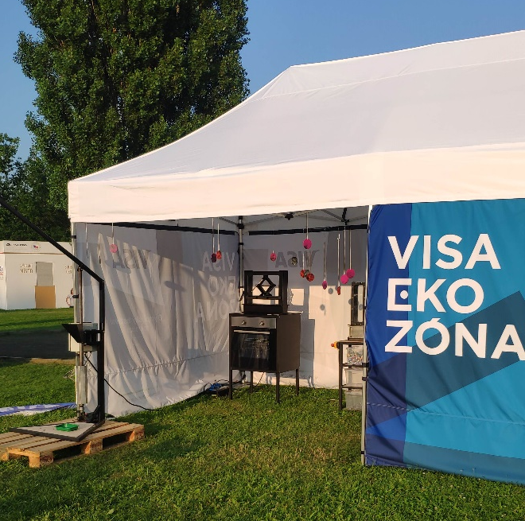
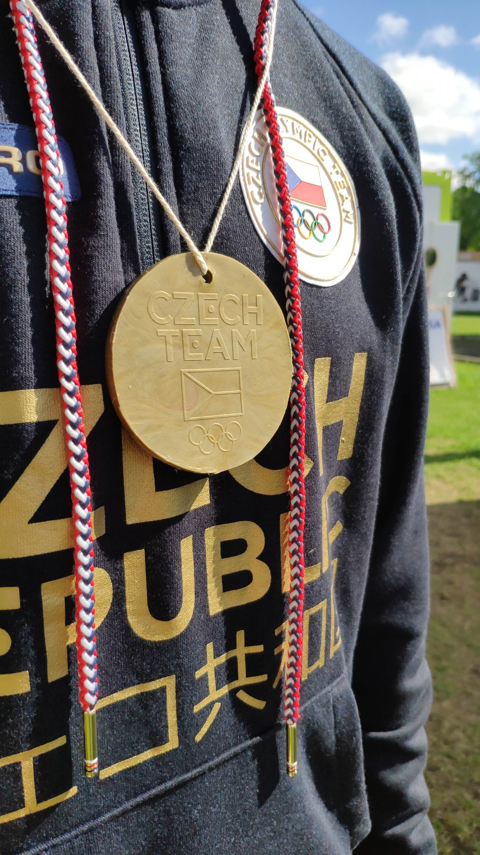

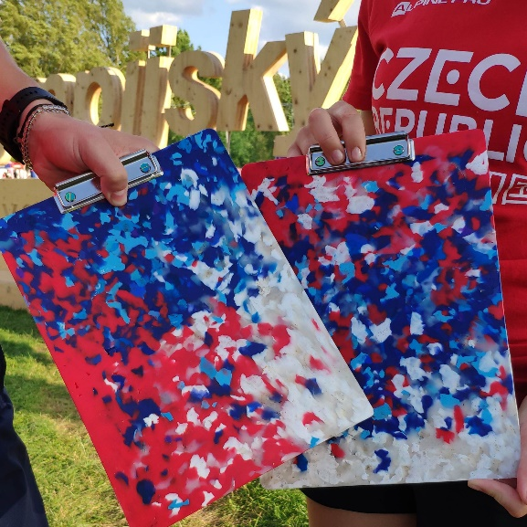
PROGRAM FOR CHILDREN AND PUBLIC
EDUCATION PUBLIC ABOUT PLASTIC RECYCLING
ON-SITE DEMONSTRATION OF SORTING, SHREDDING, INJECTION AND COMPRESSION MOULDING
OVER 1 000 PLASTIC MEDALS WAS PRODUCED IN 14 DAYS

Slide 10
EVALUATION OF THE IMPACT OF PLASTIC WASTE DURING A SPORTING EVENT
LESSON 6 – SUSTAINABILITY IN SPORT
Notes:
TRY TO IDENTIFY PLASTIC USED ON SPORT EVENT YOU KNOW, TRY TO PROPOSE IMPROVEMENTS AND EVALUATE THEIR IMPACT

Slide 11
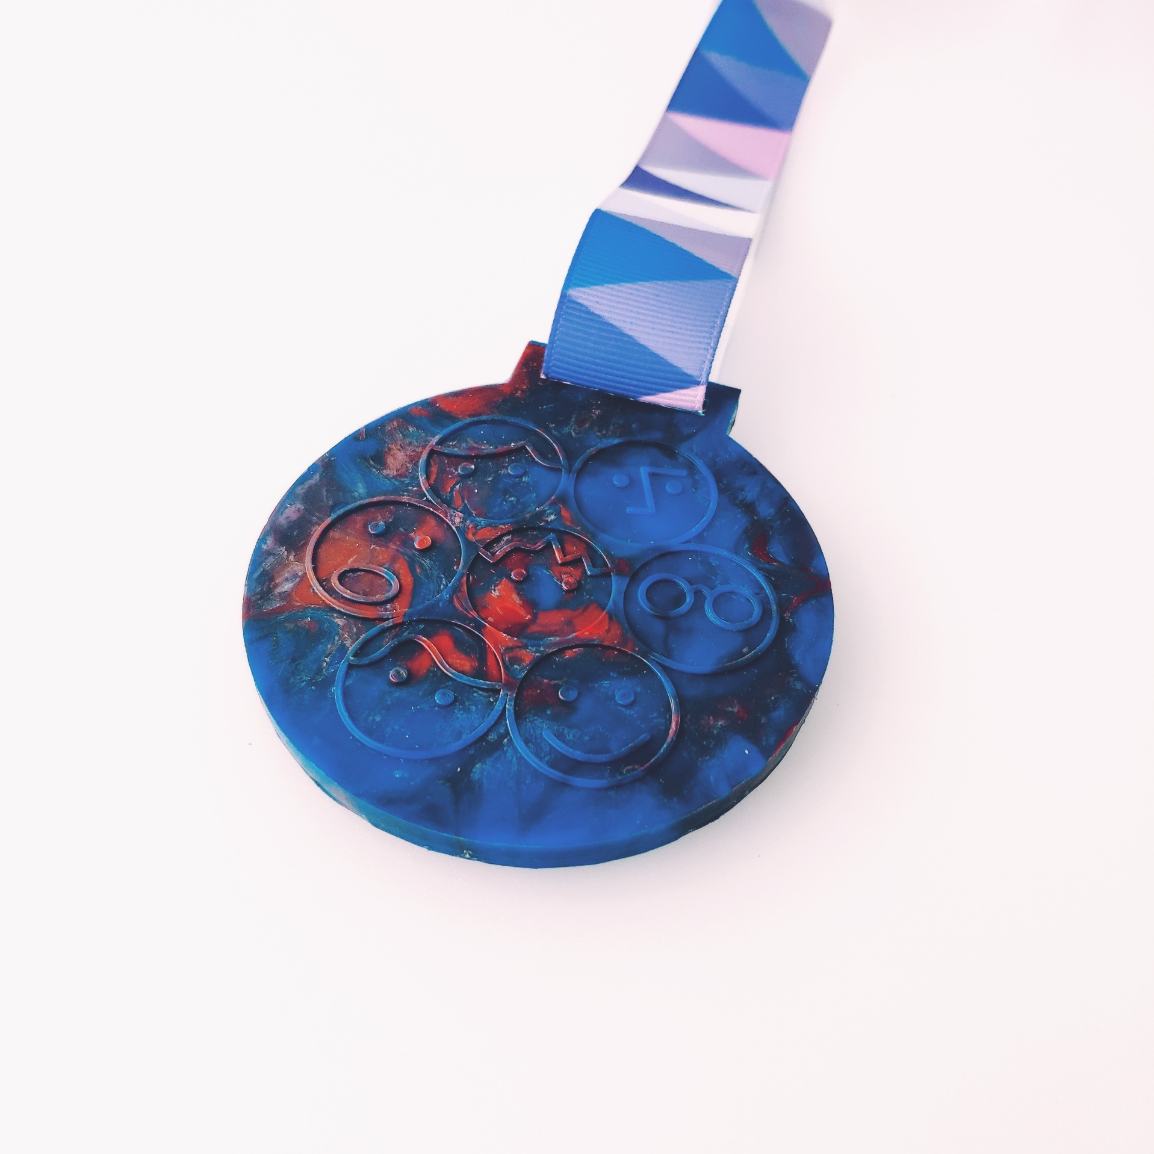

ACTIVITIES:
PRODUCTION OF PLASTIC MEDALS
FINISH LEAF LAMP ASSEMBLY
LESSON 6 – SUSTAINABILITY IN SPORT

Slide 12
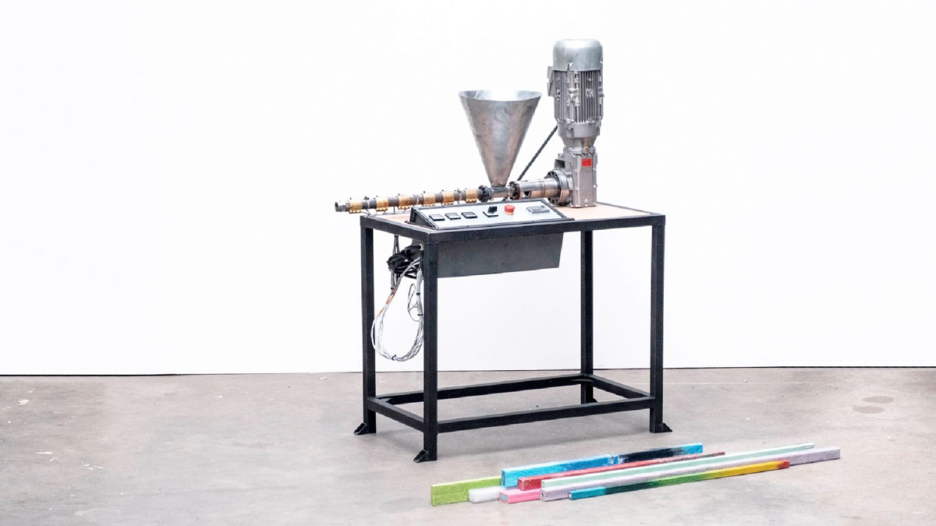
LESSON 6 – SUSTAINABILITY IN SPORT
Notes:
Source: Precious Plastic extrusion machine

Slide 13
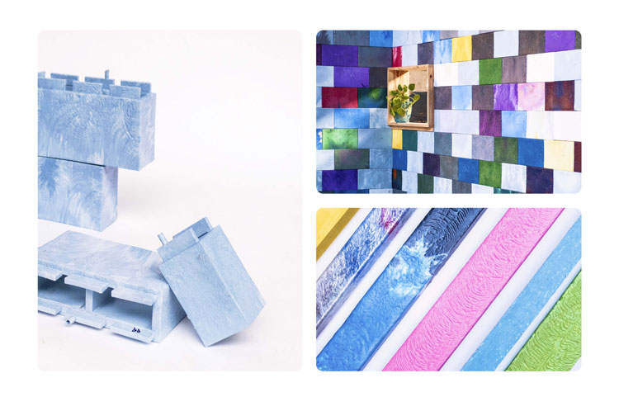
LESSON 6 – SUSTAINABILITY IN SPORT
Notes:
Source: https://www.designweek.co.uk/issues/17-23-february-2020/precious-plastic/

Slide 14
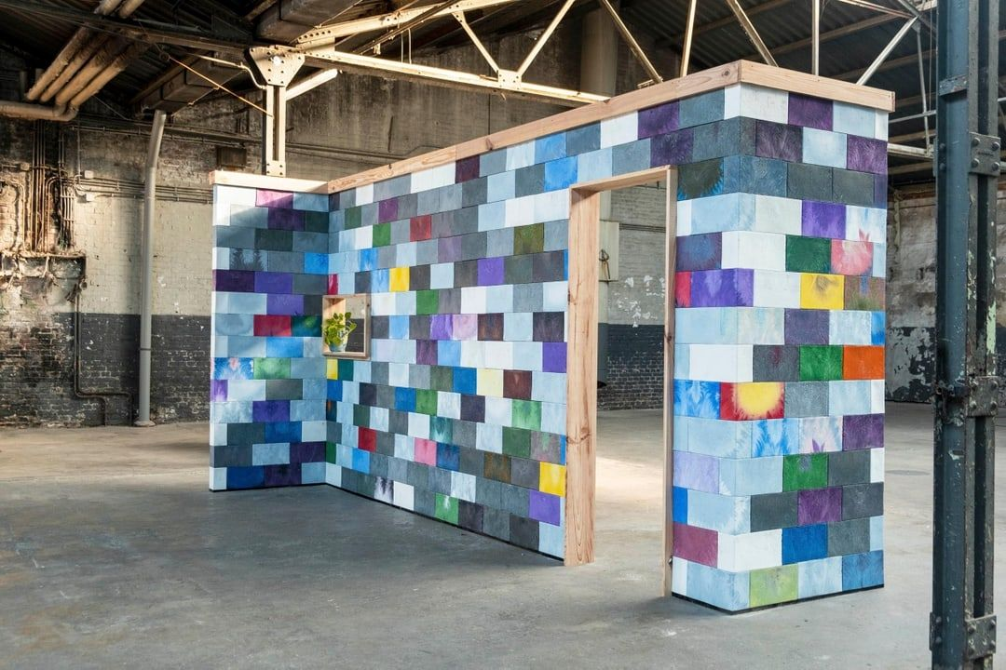
LESSON 6 – SUSTAINABILITY IN SPORT
Notes:
Source: Precious Plastic – brick wall

Slide 15
VIDEO: HOW TO MAKE A PLASTIC BEAM?
LESSON 6 – SUSTAINABILITY IN SPORT

Slide 16
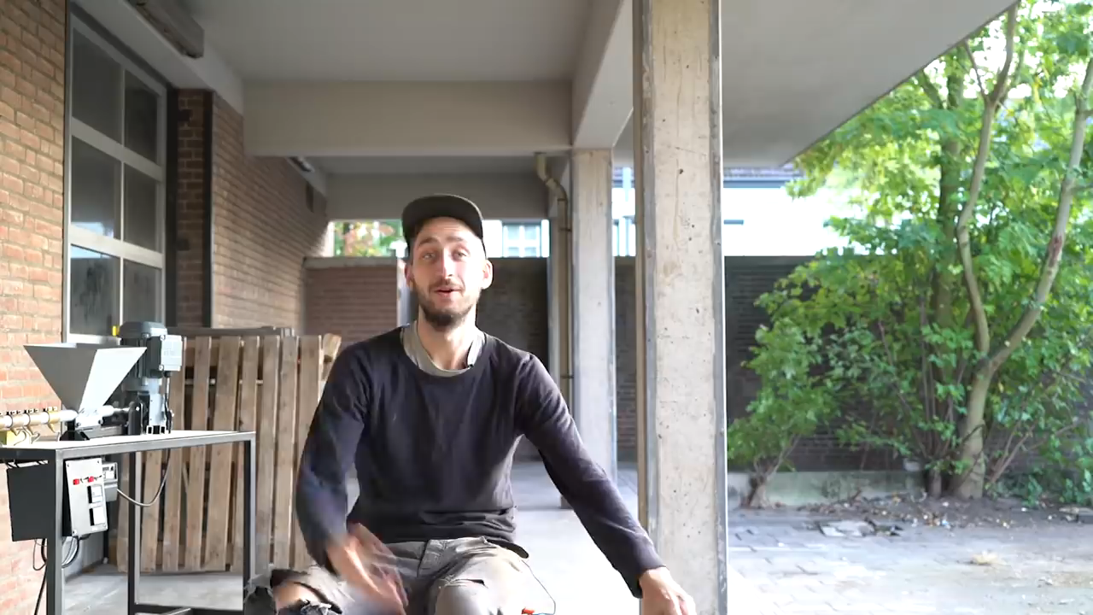

Slide 17

LESSON 6 – SUSTAINABILITY IN SPORT
Notes:
Source: Benchtop Extrusion Machine
ZEPHYR BROS. – PRECIOUS PLASTIC AUSTRALIA

Slide 18
SEE U NEXT TIME
LESSON 6 – SUSTAINABILITY IN SPORT
Notes:
MAKE A RECAP

Slide 19


ING. TOMAS KOLECAR
INFO@PLASTMAKERS.COM
WWW.PLASTMAKERS.COM
+420 739 122 662
CZECH REPUBLIC - EUROPE
CONTACT

