Slide 1
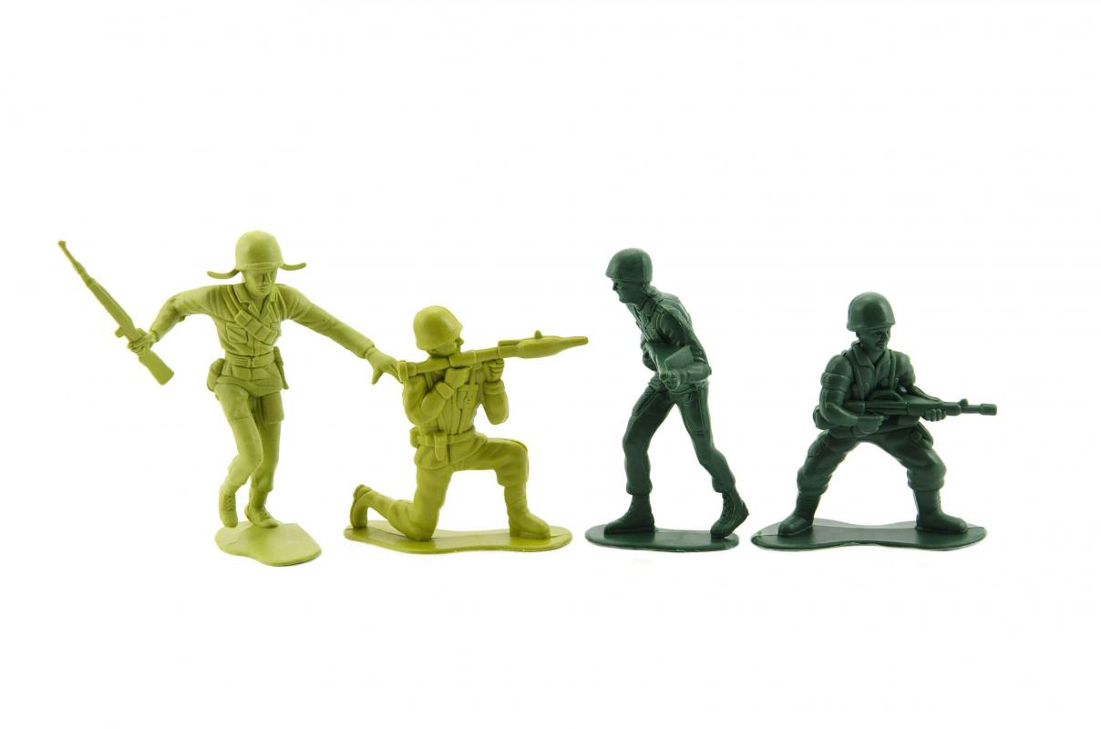

PLASTIC INJECTION
MOULDING
4/10
Notes:
Picture: Magda Ehlers, source: Pexels.com

Slide 2
QUICK RECAP OF COMPRESSION MOULDING
LESSON 4 – INJECTION MOULIDING

Slide 3
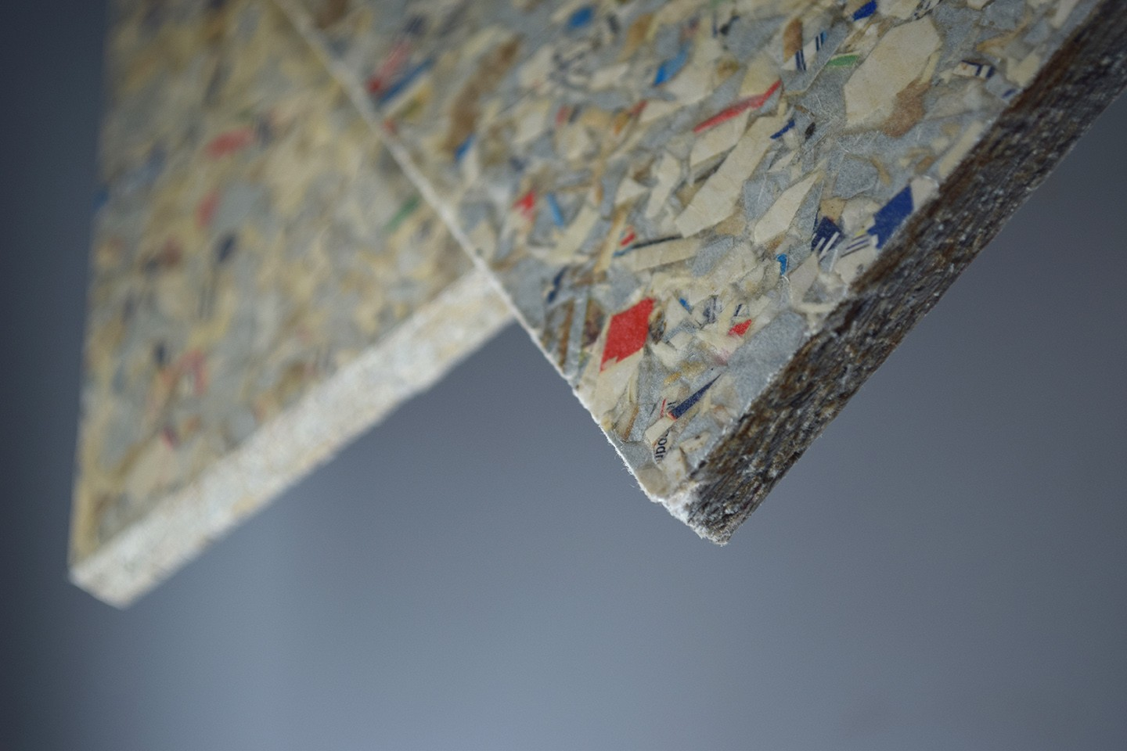
1/4 WHICH MATERIALS DOES NOT CONSIST TETRAPAK FOOD PACKAGE?
plastic layers
cardboard
aluminium
rubber
LESSON 4 – INJECTION MOULIDING

Slide 4
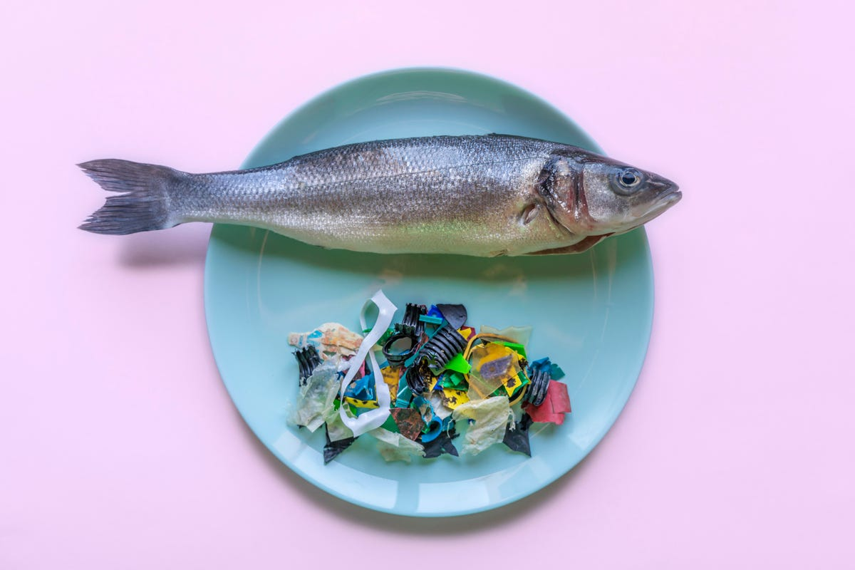
2/4 MICROPLASTICS ARE FRAGMENTS OF ANY TYPE OF PLASTIC LESS THAN ____ IN LENGTH
5mm
10mm
15mm
LESSON 4 – INJECTION MOULIDING
Notes:
„Microplastics are fragments of any type of plastic less than 5 mm in length, according to the U.S. National Oceanic and Atmospheric Administration and the European Chemicals Agency. They cause pollution by entering natural ecosystems from a variety of sources, including cosmetics, clothing, and industrial processes.“ Wikipedia

Slide 5
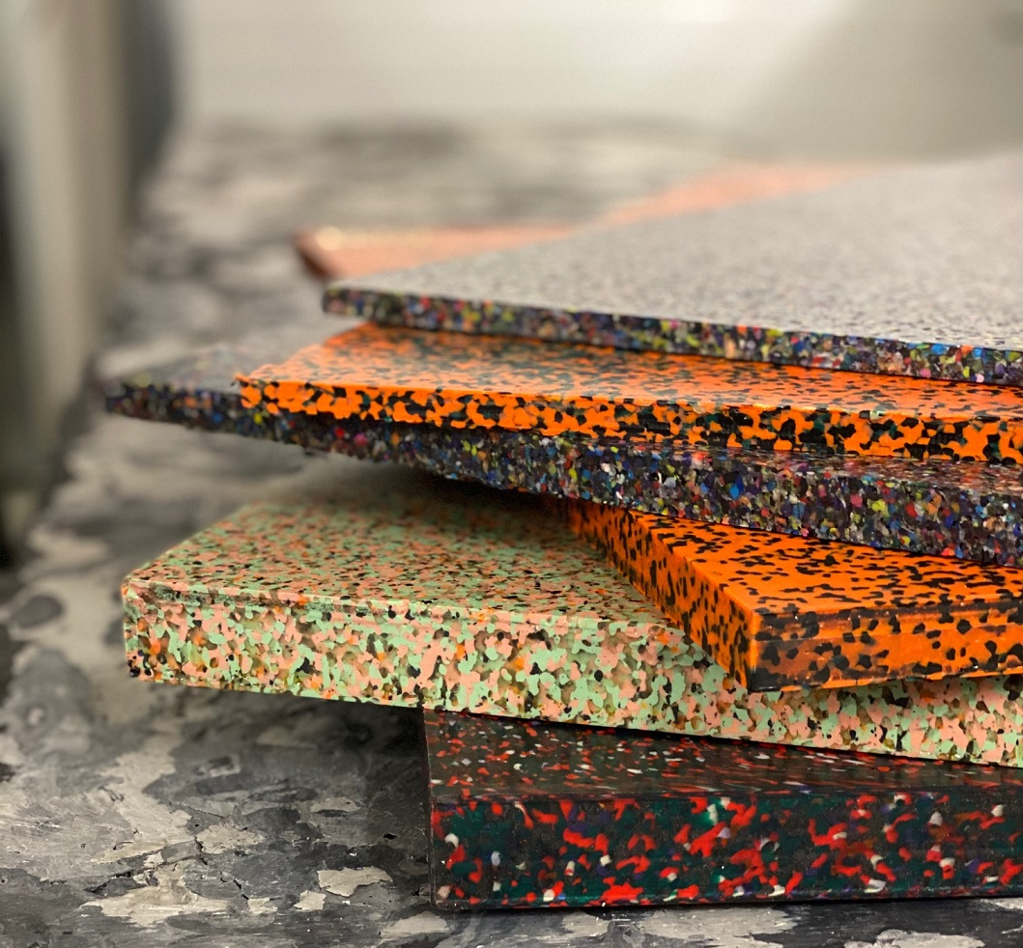
3/4 HOW WOULD YOU DESCRIBE COMPRESSION MOULDING OR SHEETPRESS TECHNOLOGY?
LESSON 4 – INJECTION MOULIDING
Notes:
Picture: Plastic guys

Slide 6
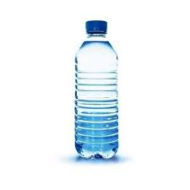
4/4 WHICH COMPANY FROM THE LIST IS NOT BASED ON „OPEN SOURCE“?
PRECIOUS PLASTIC
COCA COLA
WIKIPEDIA
LESSON 4 – INJECTION MOULIDING
Notes:
SOURCE: Zálohujme.cz

Slide 7

PREPARATION OF MATERIAL AND TOOLS FOR COMPRESSION MOULDING (CLOCK + CLIPBOARD)
LESSON 4 – INJECTION MOULIDING

Slide 8
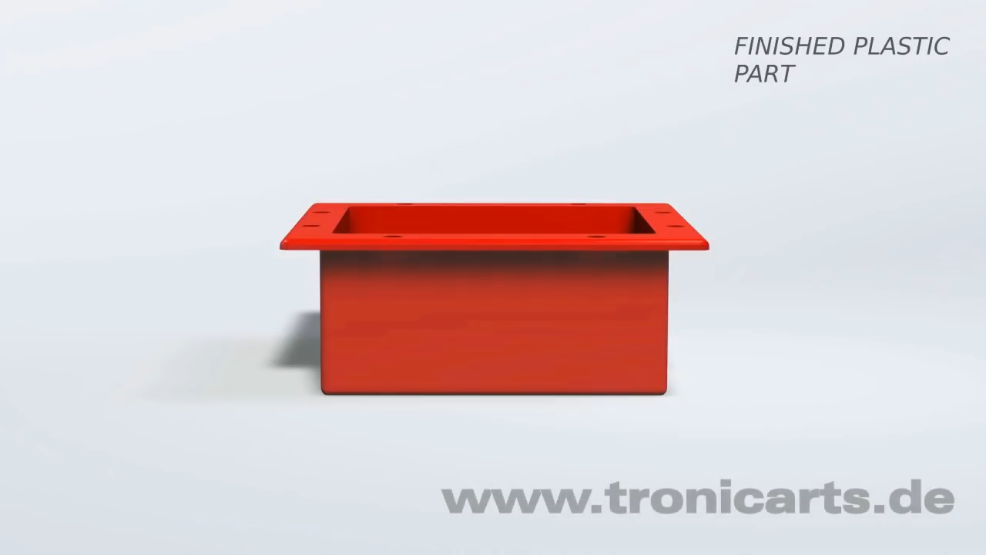
Notes:
Source: A tronicarts 3D-animation which shows the injection molding process.

Slide 9
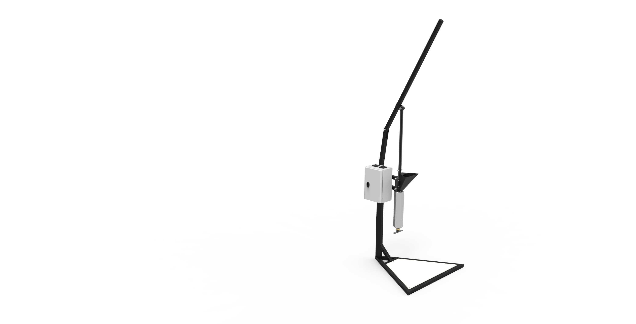
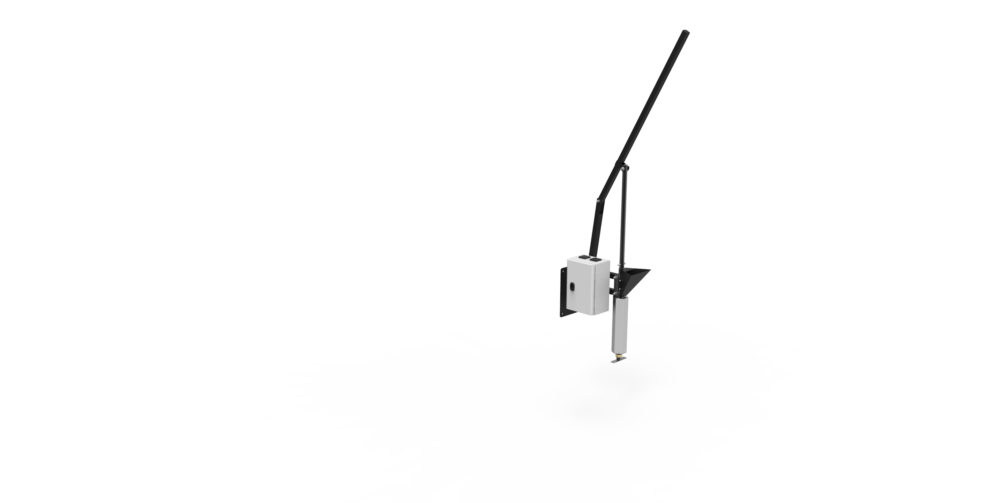
LEVER
ELECTROBOX
FEEDING INLET
BARREL
FRAME ON WALL
FRAME ON FLOOR
LESSON 4 – INJECTION MOULIDING

Slide 10
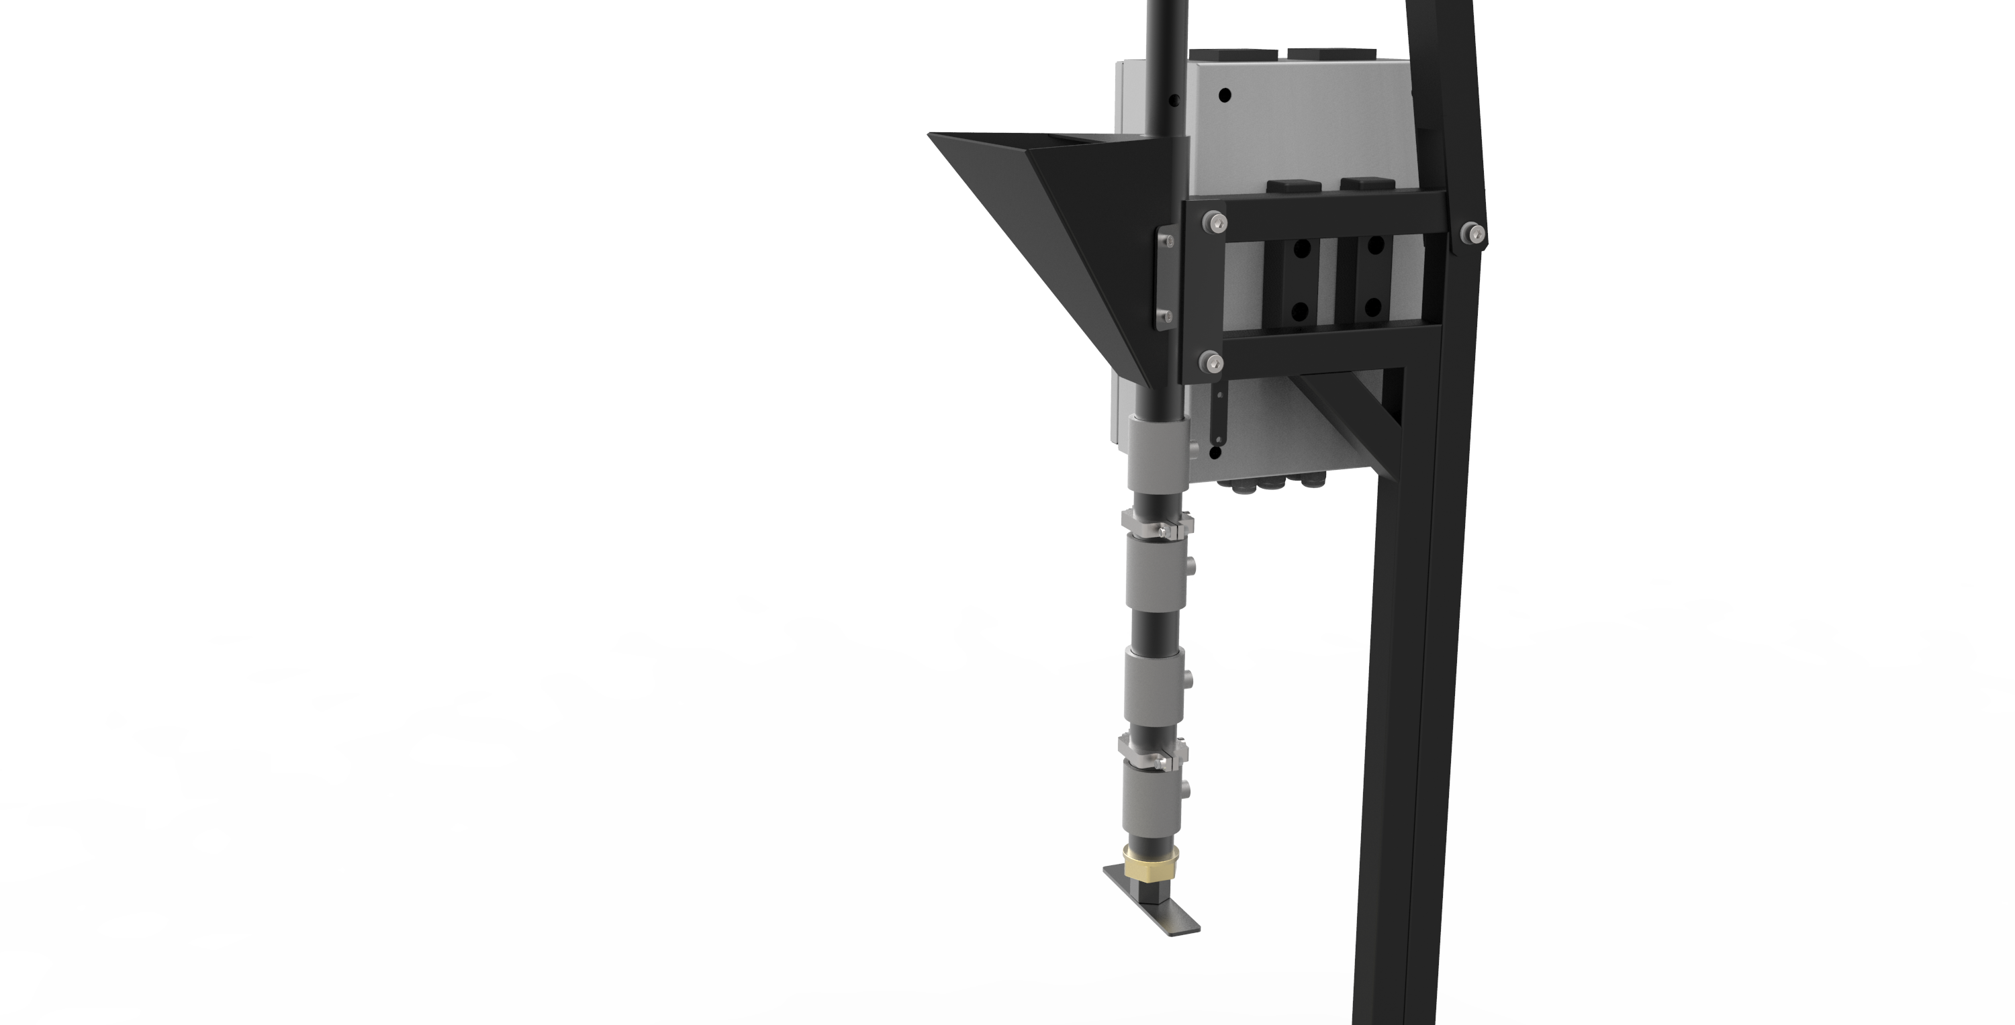
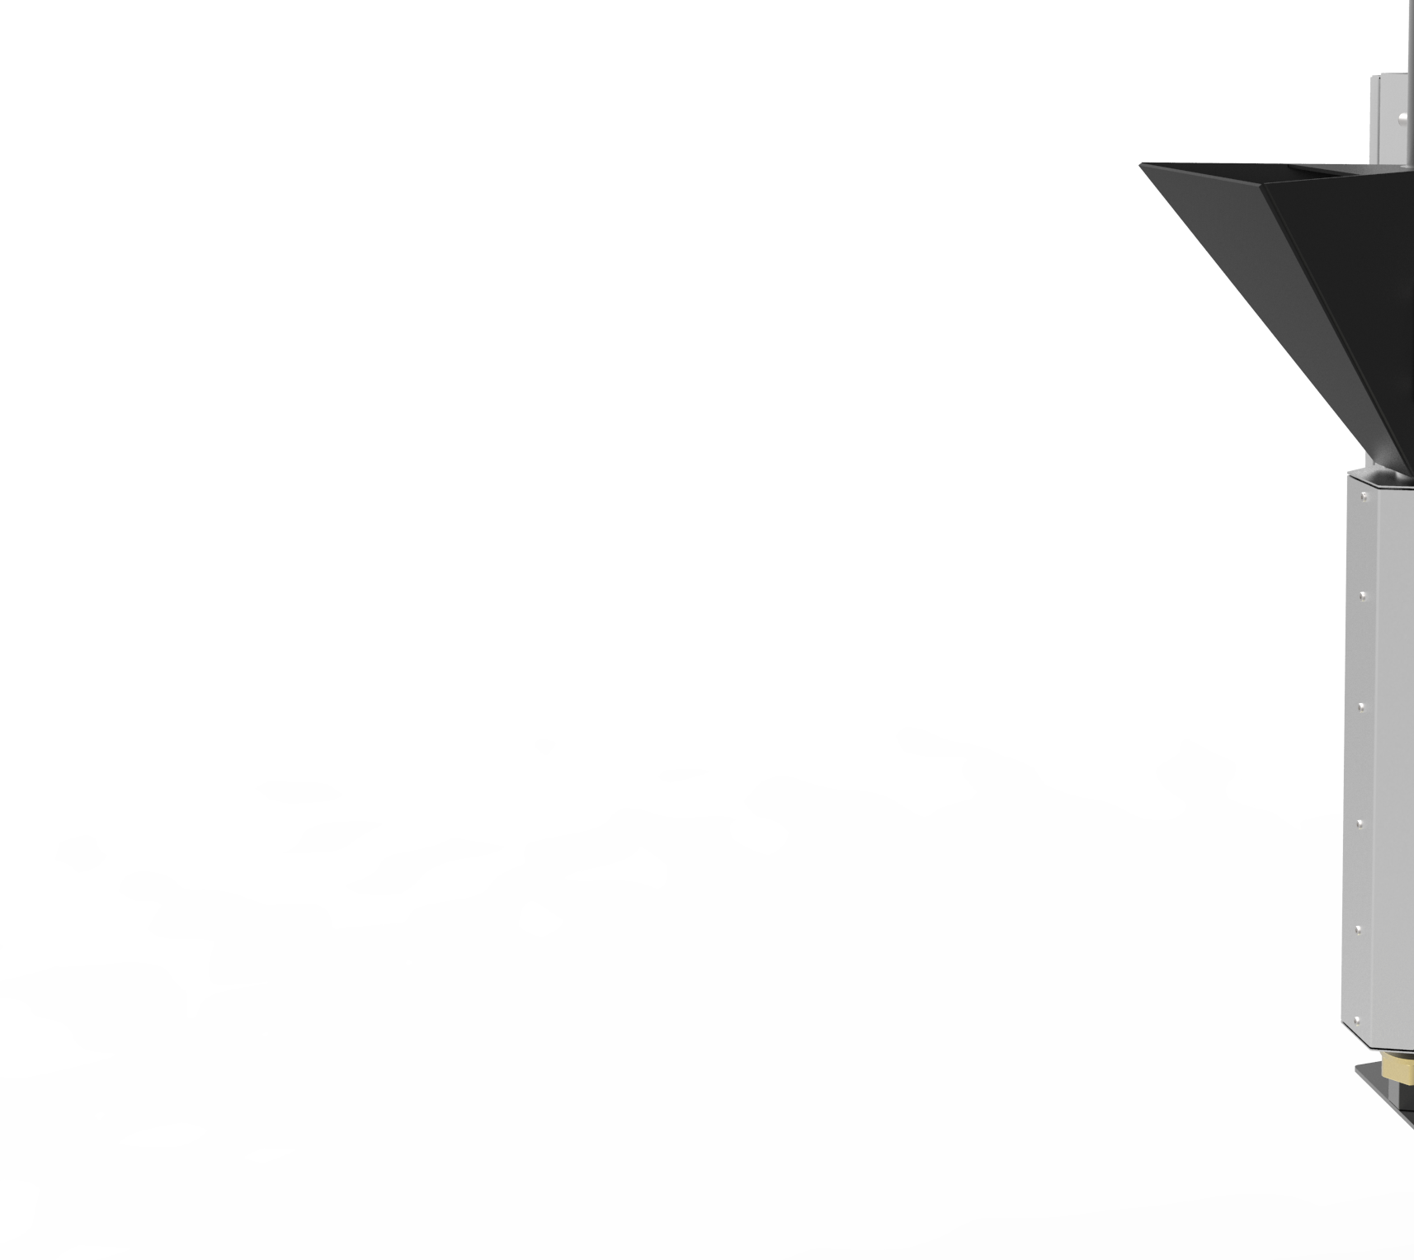
HEATING ELEMENTS
THERMOCOUPLES
NOZZLE
LESSON 4 – INJECTION MOULIDING

Slide 11
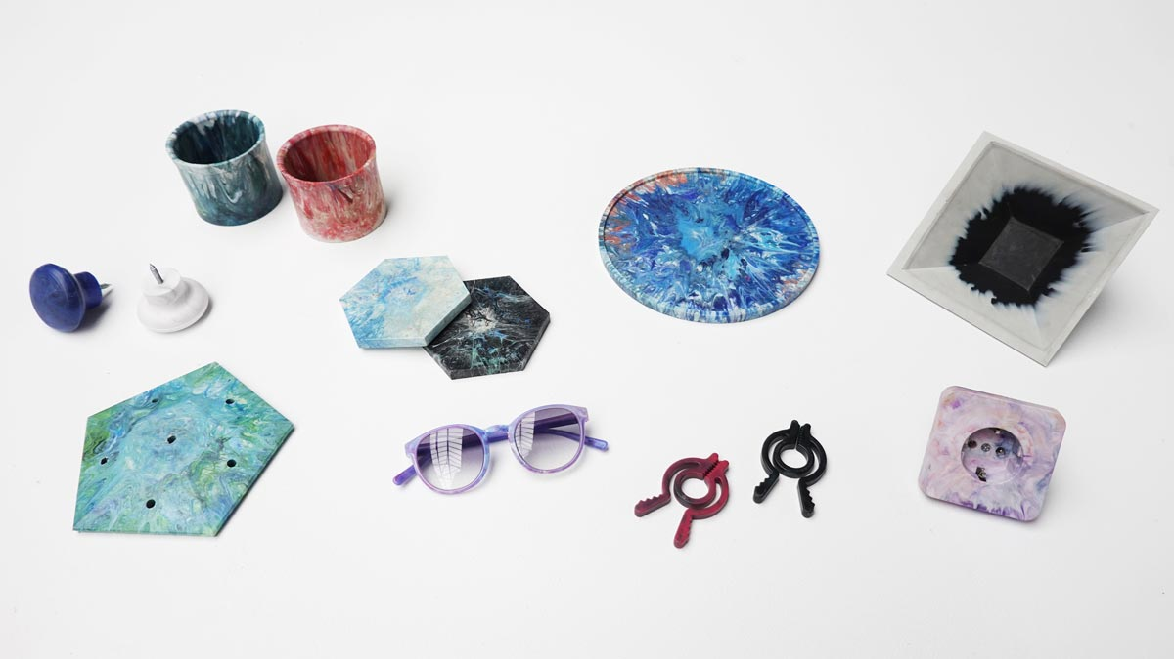
Notes:
Source: Precious Plastic

Slide 12
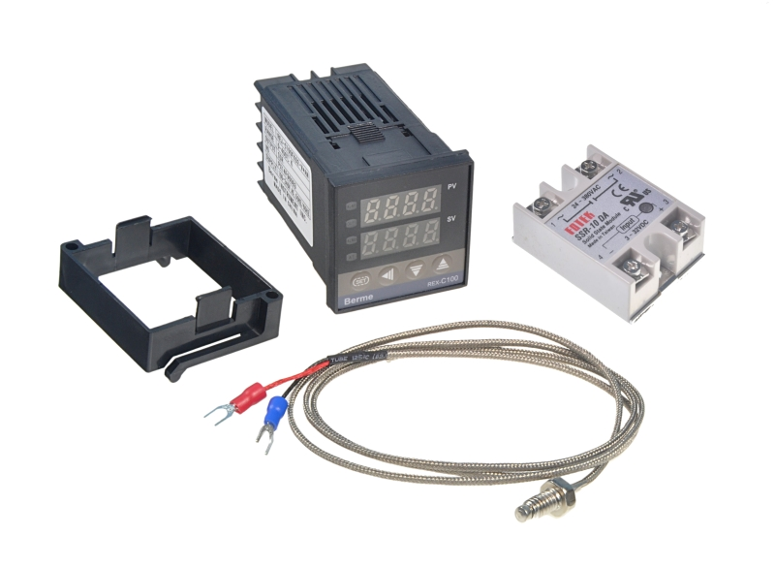
EXPLANATION OF WIRING DIAGRAM
LESSON 4 – INJECTION MOULIDING

Slide 13
PRODUCTION OF INJECTED MOULDED PARTS
LESSON 4 – INJECTION MOULIDING

Slide 14
DESCRIPTION OF DIFFERENT MOULD CONSTRUCTION PRESS VS. INJECTION
LESSON 4 – INJECTION MOULIDING

Slide 15
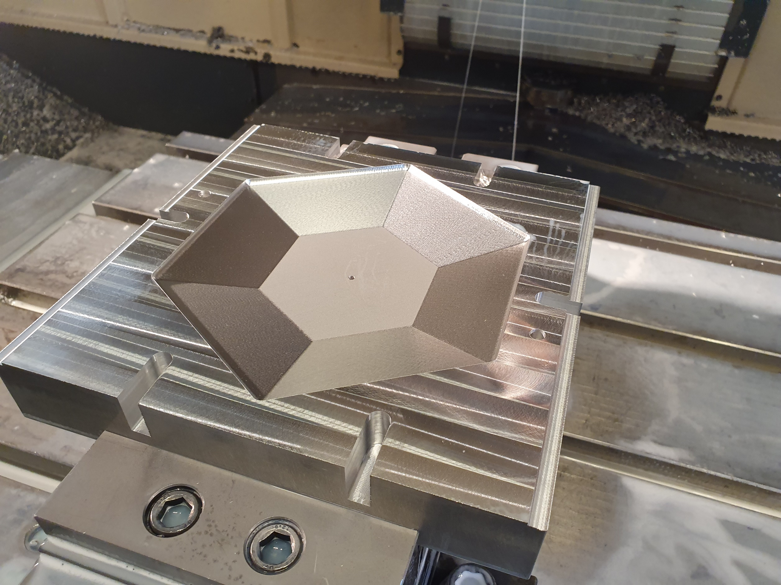
PRESS
INJECTION
LESSON 4 – INJECTION MOULIDING
Notes:
Name advantages and disadvantages of open source compared to corporate environment.

Slide 16
PRESS
INJECTION
GOOD STIFFNESS
PRODUCTION OF BIGGER PARTS
SIMPLE PART SHAPE
GOOD HEAT TRANSFER
GOOD STIFFNESS
USUALLY MAX. PART WEIGHT 130g
COMPLEX SHAPE
AIR VENTING SYSTEM
LESSON 4 – INJECTION MOULIDING
Notes:
Name advantages and disadvantages of open source compared to corporate environment.

Slide 17


Slide 18
ASSEMBLY CLOCK AND CLIPBOARD A4
LESSON 4 – INJECTION MOULIDING

Slide 19
RECOMMENDED MATERIALS FOR INJECTION MOULDING ARE: PP, HDPE
LESSON 4 – INJECTION MOULIDING
Notes:
SHOW REPORT FROM MATERIAL TESTING AND DESCRIBE

Slide 20
SEE U NEXT TIME
LESSON 4 – INJECTION MOULIDING
Notes:
MAKE A RECAP

Slide 21


ING. TOMAS KOLECAR
INFO@PLASTMAKERS.COM
WWW.PLASTMAKERS.COM
+420 739 122 662
CZECH REPUBLIC - EUROPE
CONTACT

