Slide 1


PLASTIC COMPRESSION
MOULDING (PART 2)
3/10

Slide 2
SMALL RECAP OF PREVIOUS LESSON
LESSON 3 – COMPRESSION MOULDING (PART 2)

Slide 3
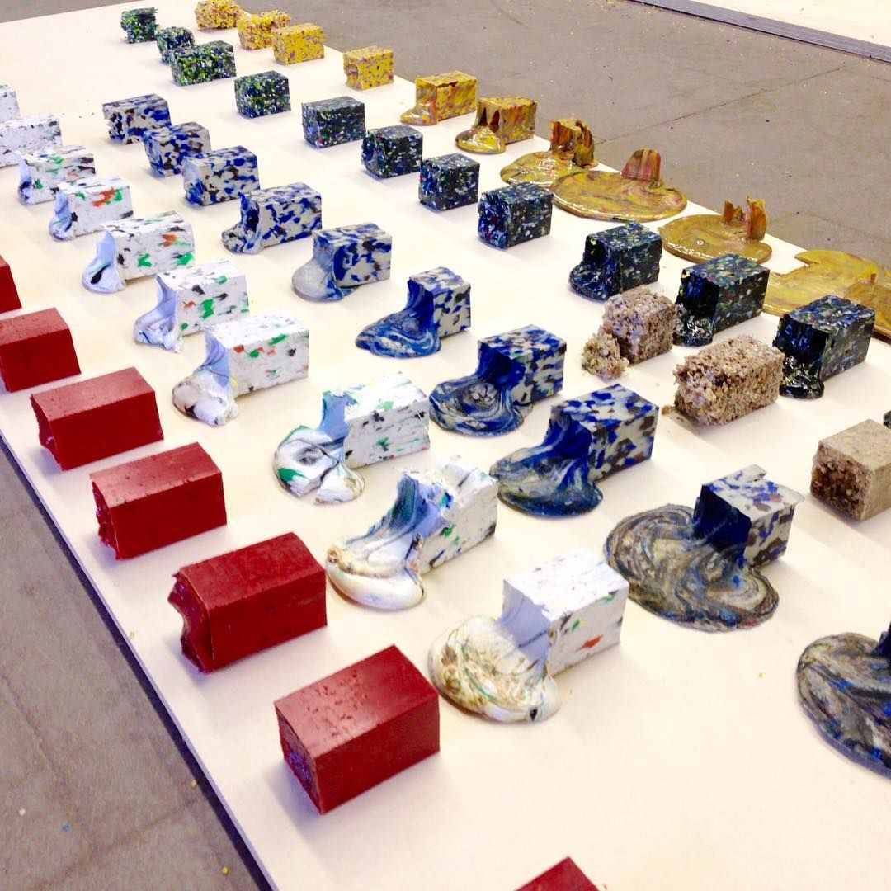
1/5 WHAT TEMPERATURE IS RECOMMENDED FOR MELTING PP?
100 °C
200 °C
300 °C
LESSON 3 – COMPRESSION MOULDING (PART 2)

Slide 4
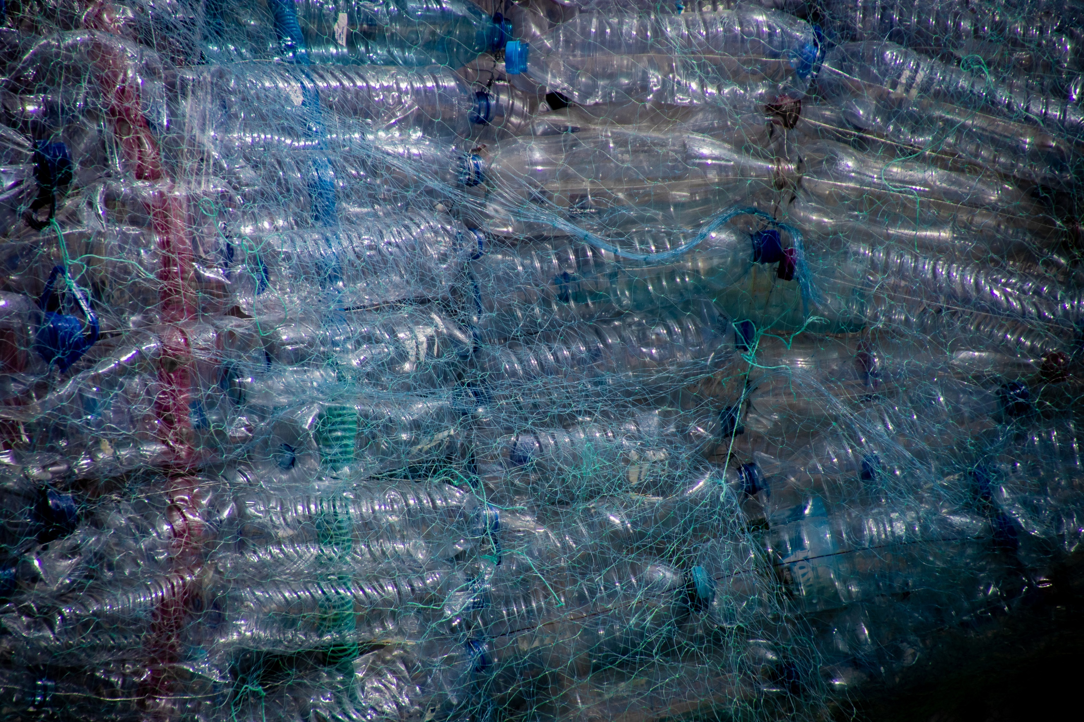
2/5 WHAT CAN YOU USE FOR MOULD SEPARATION?
LESSON 3 – COMPRESSION MOULDING (PART 2)
Notes:
Baking paper, 2 stroke oil, kitchen oil …

Slide 5
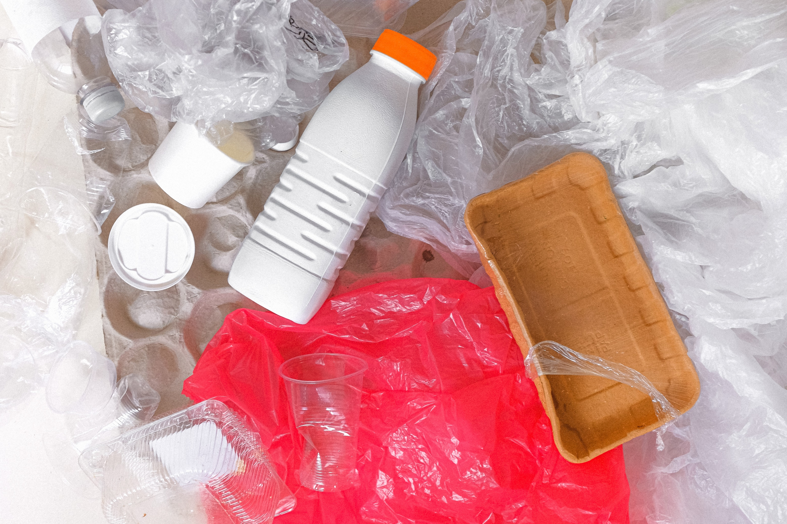
3/5 WHICH PLASTIC TYPE HAS A RESIN IDENTIFICATION CODE 2?
PET
PP
HDPE
LESSON 3 – COMPRESSION MOULDING (PART 2)

Slide 6
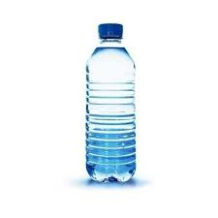
4/5 HOW MANY % OF PRODUCED PET BOTTLES END UP IN NATURE IN CZECH REPUBLIC?
5%
20%
33%
LESSON 3 – COMPRESSION MOULDING (PART 2)
Notes:
SOURCE: Zálohujme.cz

Slide 7
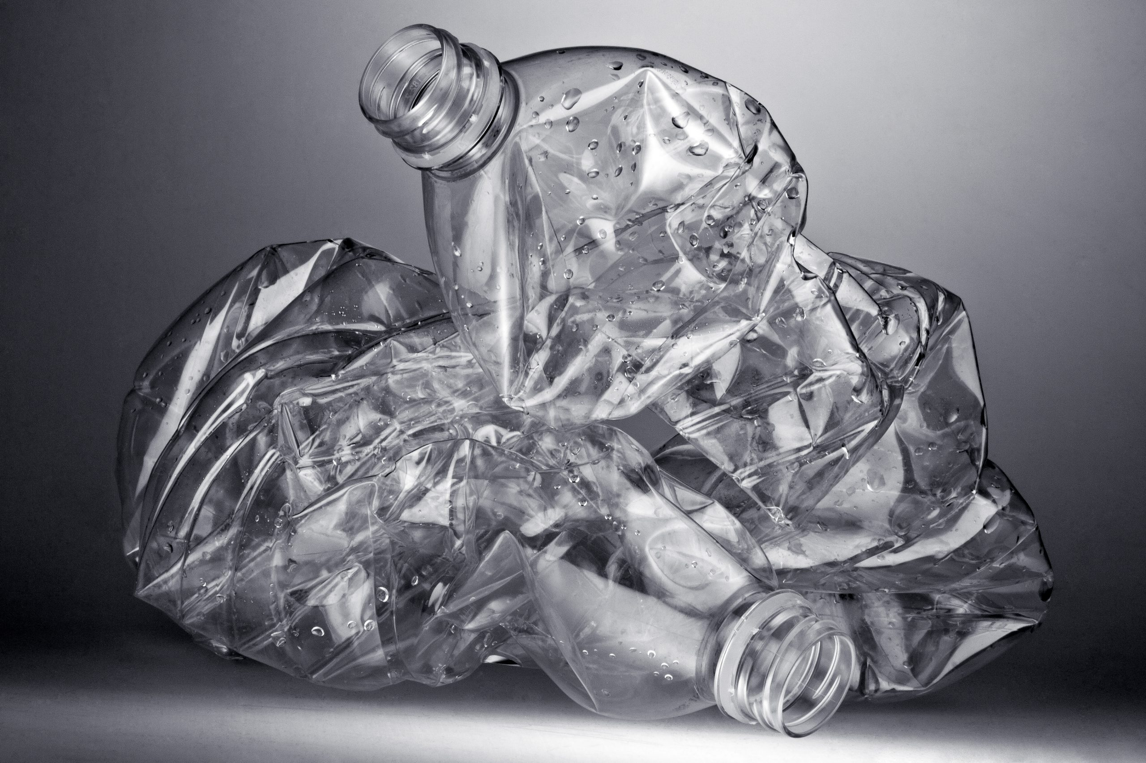
5/5 EXPLAIN WHAT IS PRINCIPLE OF BOTTLE DEPOSIT SYSTEM
LESSON 3 – COMPRESSION MOULDING (PART 2)

Slide 8

PREPARATION OF MATERIAL AND TOOLS FOR COMPRESSION MOULDING (CLOCK + CLIPBOARD)
LESSON 3 – COMPRESSION MOULDING (PART 2)

Slide 9
ASSEMBLY CLOCK AND CLIPBOARD
LESSON 3 – COMPRESSION MOULDING (PART 2)

Slide 10

HOW TO MAKE A WASTEBOARD
LESSON 3 – COMPRESSION MOULDING (PART 2)

Slide 11
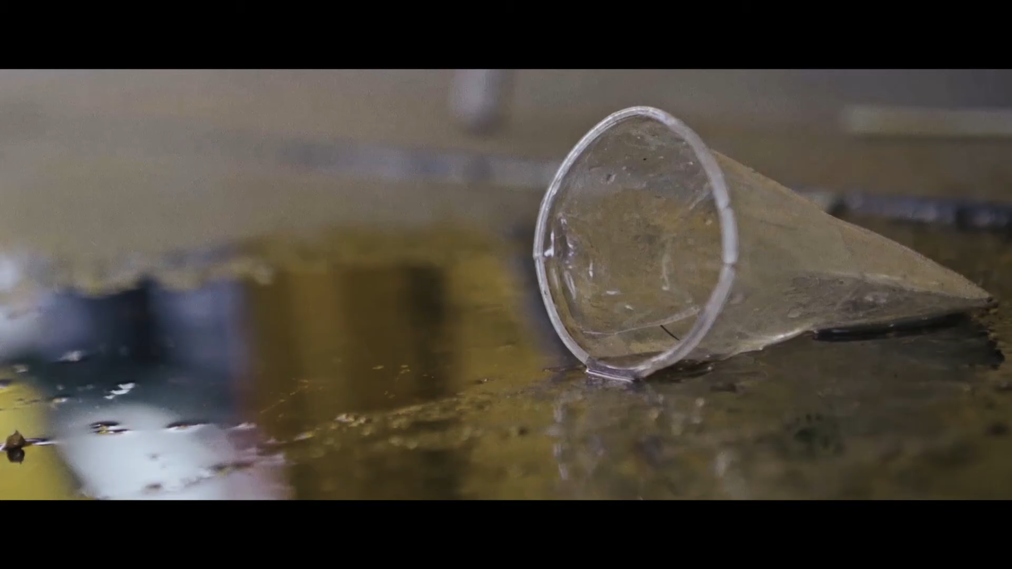
Notes:
Source: Wasteboard NL

Slide 12
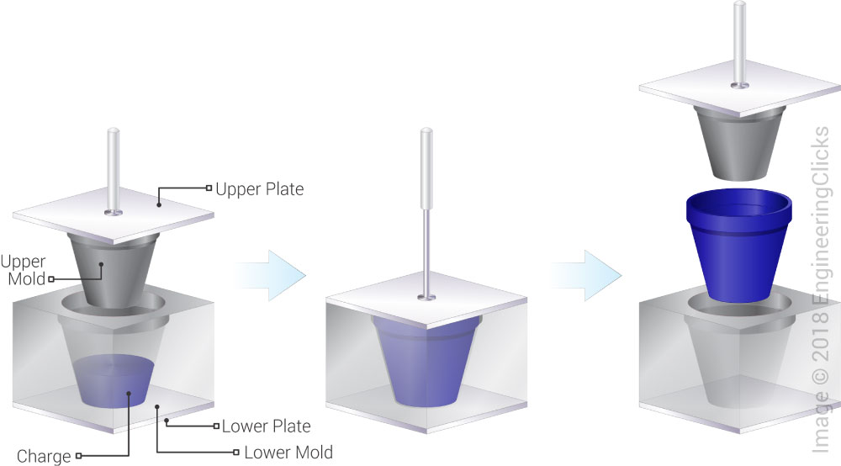
LESSON 3 – COMPRESSION MOULDING (PART 2)

Slide 13
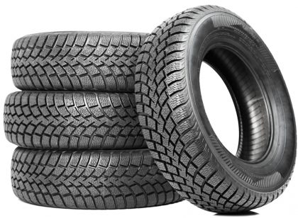
COMPRESSION MOLDING PRODUCTS
CAR TYRES / RUBBER TYRES
RUBBER GASKETS OR SEALS
HANDLES
ELECTRICAL COMPONENTS
AUTOMOTIVE PARTS
OTHER VARIOUS POLYMER MATRIX COMPOSITE PARTS
LESSON 3 – COMPRESSION MOULDING (PART 2)
Notes:
More advanced compression moulds
Source: https://www.engineeringclicks.com/compression-molding/

Slide 14
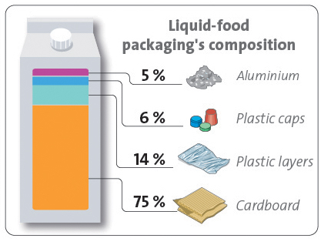
LESSON 3 – COMPRESSION MOULDING (PART 2)

Slide 15
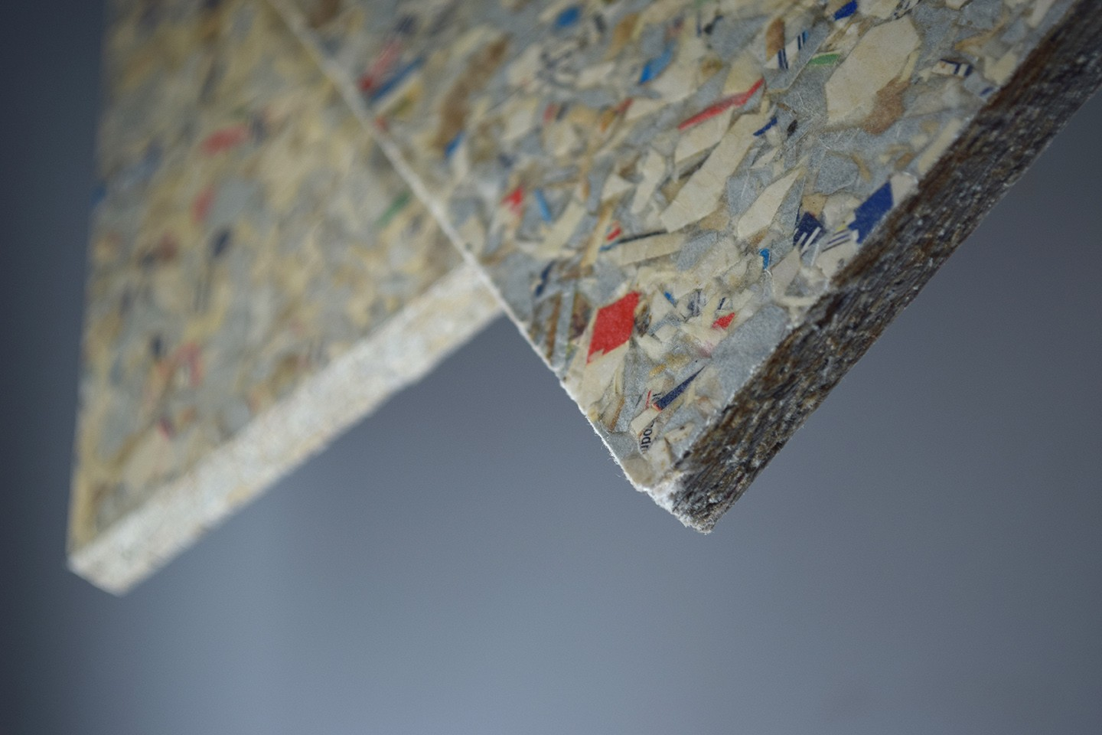
LESSON 3 – COMPRESSION MOULDING (PART 2)
Notes:
Source: Packwall.cz

Slide 16
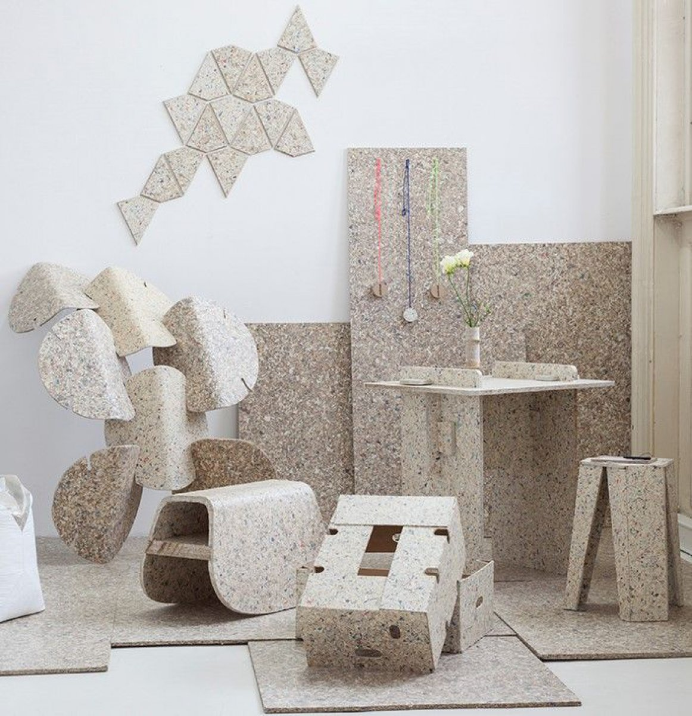
LESSON 3 – COMPRESSION MOULDING (PART 2)
Notes:
Source: Packwall.cz

Slide 17

LESSON 3 – COMPRESSION MOULDING (PART 2)
Notes:
Source: Smile Plastic

Slide 18
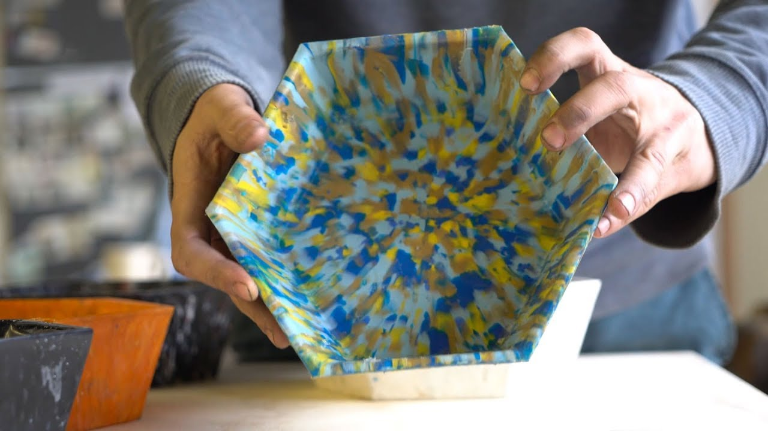
LESSON 3 – COMPRESSION MOULDING (PART 2)
Notes:
Source: Precious Plastic – how to make a bowl

Slide 19
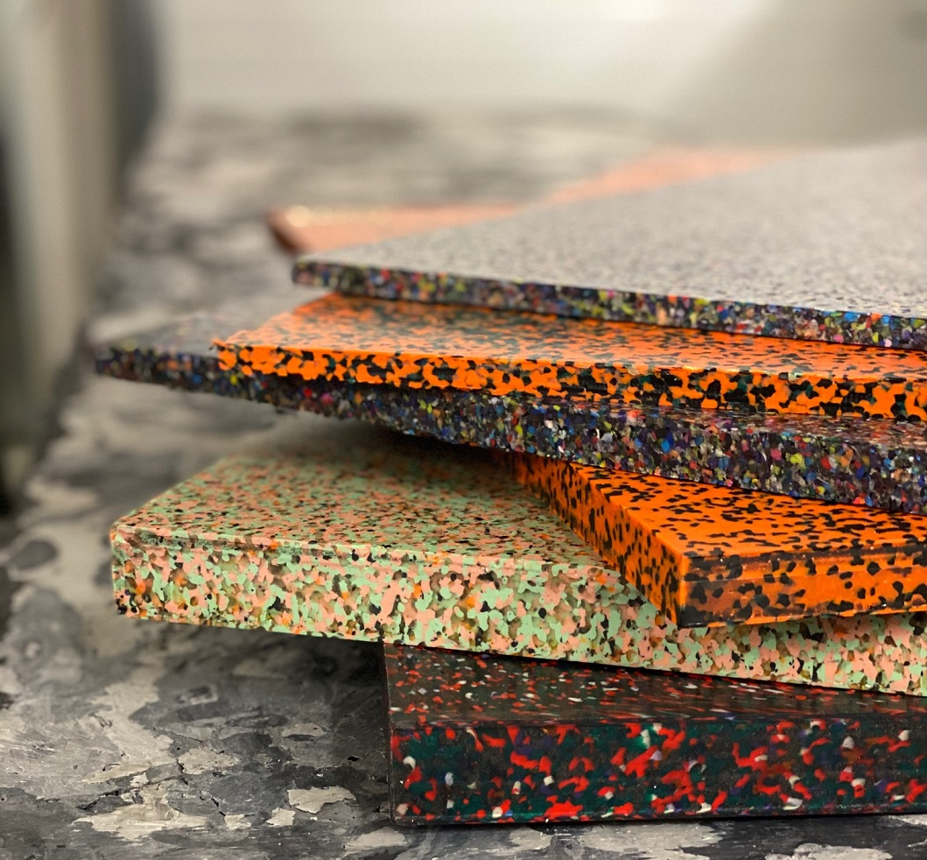
LESSON 3 – COMPRESSION MOULDING (PART 2)
Notes:
Source: Plastic Guys – Brno Czech Republic
Recycled plastic sheets

Slide 20
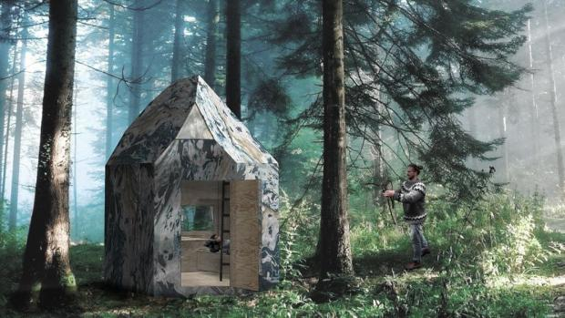
LESSON 3 – COMPRESSION MOULDING (PART 2)
Notes:
Source: Plastic Guys – Brno Czech Republic
Shelter in nature

Slide 21
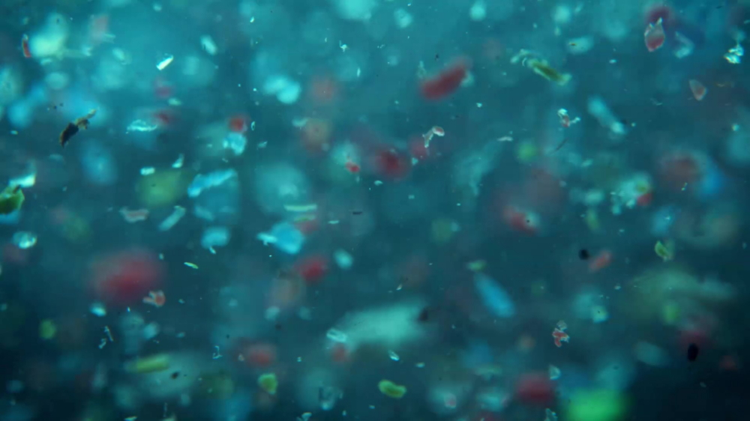
„Microplastics are fragments of any type of plastic less than 5 mm in length, according to the U.S. National Oceanic and Atmospheric Administration and the European Chemicals Agency. They cause pollution by entering natural ecosystems from a variety of sources, including cosmetics, clothing, and industrial processes.“ Wikipedia
MICROPLASTICS
LESSON 3 – COMPRESSION MOULDING (PART 2)
Notes:
Picture source: https://www.google.com/url?sa=i&url=https%3A%2F%2Fnews.samsung.com%2Fglobal%2Fsamsung-collaborates-with-patagonia-to-keep-microplastics-out-of-our-oceans&psig=AOvVaw1vvoasoPuib2ieJTsVxkdI&ust=1643742651461000&source=images&cd=vfe&ved=0CAwQjhxqFwoTCLD9v9zY3PUCFQAAAAAdAAAAABAW

Slide 22
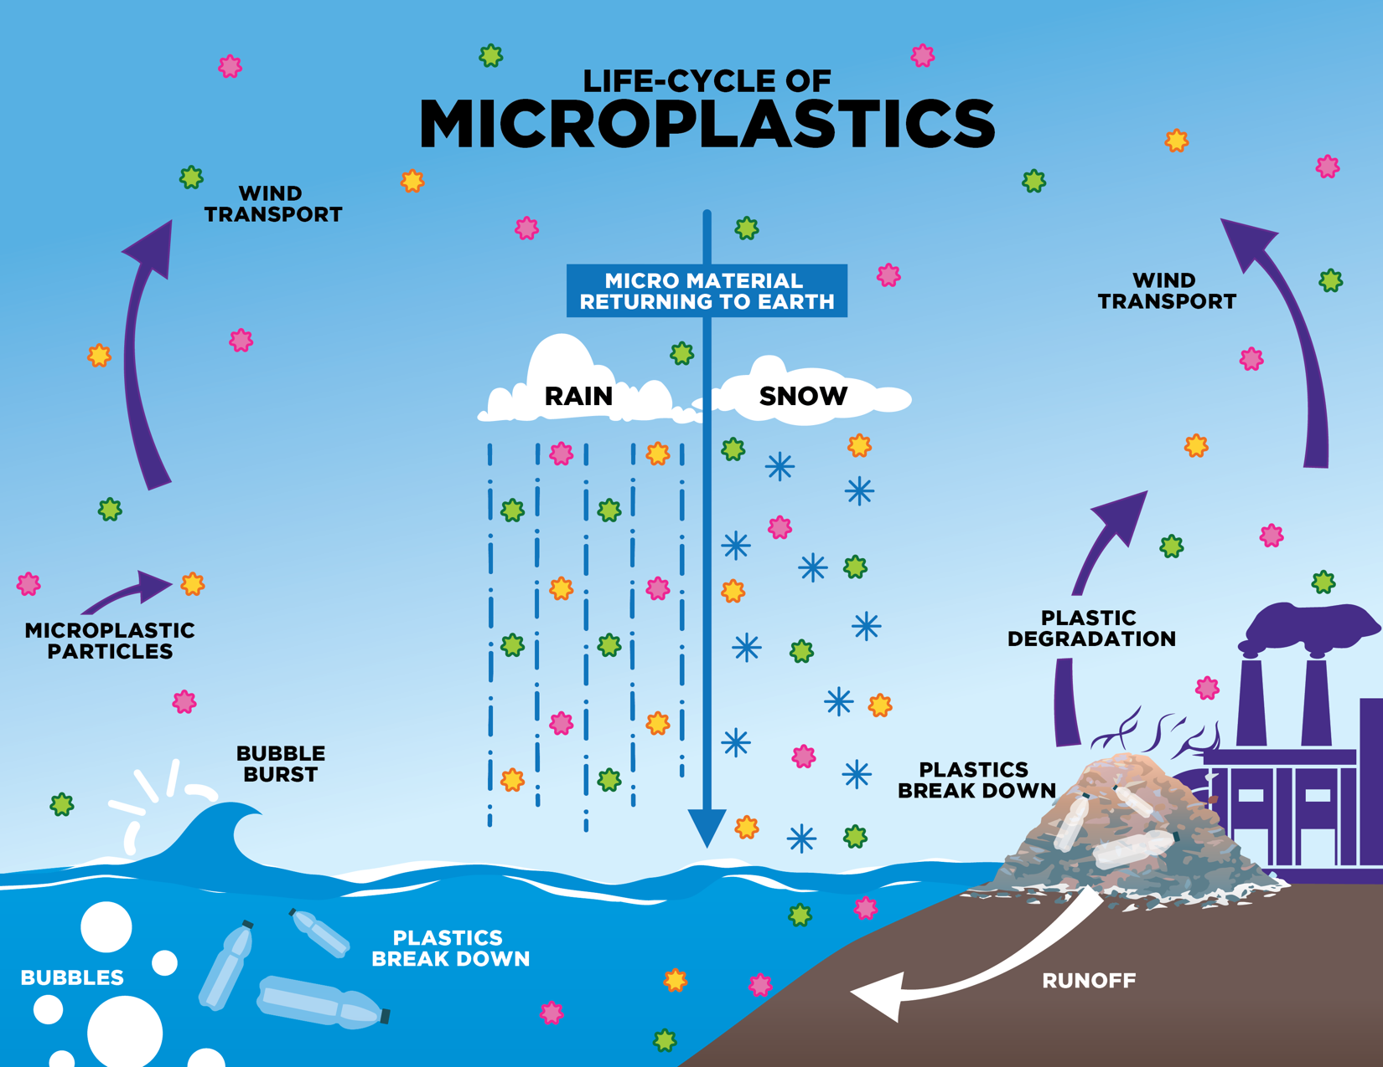
Notes:
Source: https://ysjournal.com/airborne-microplastics-a-global-issue-with-implications-for-human-health/

Slide 23
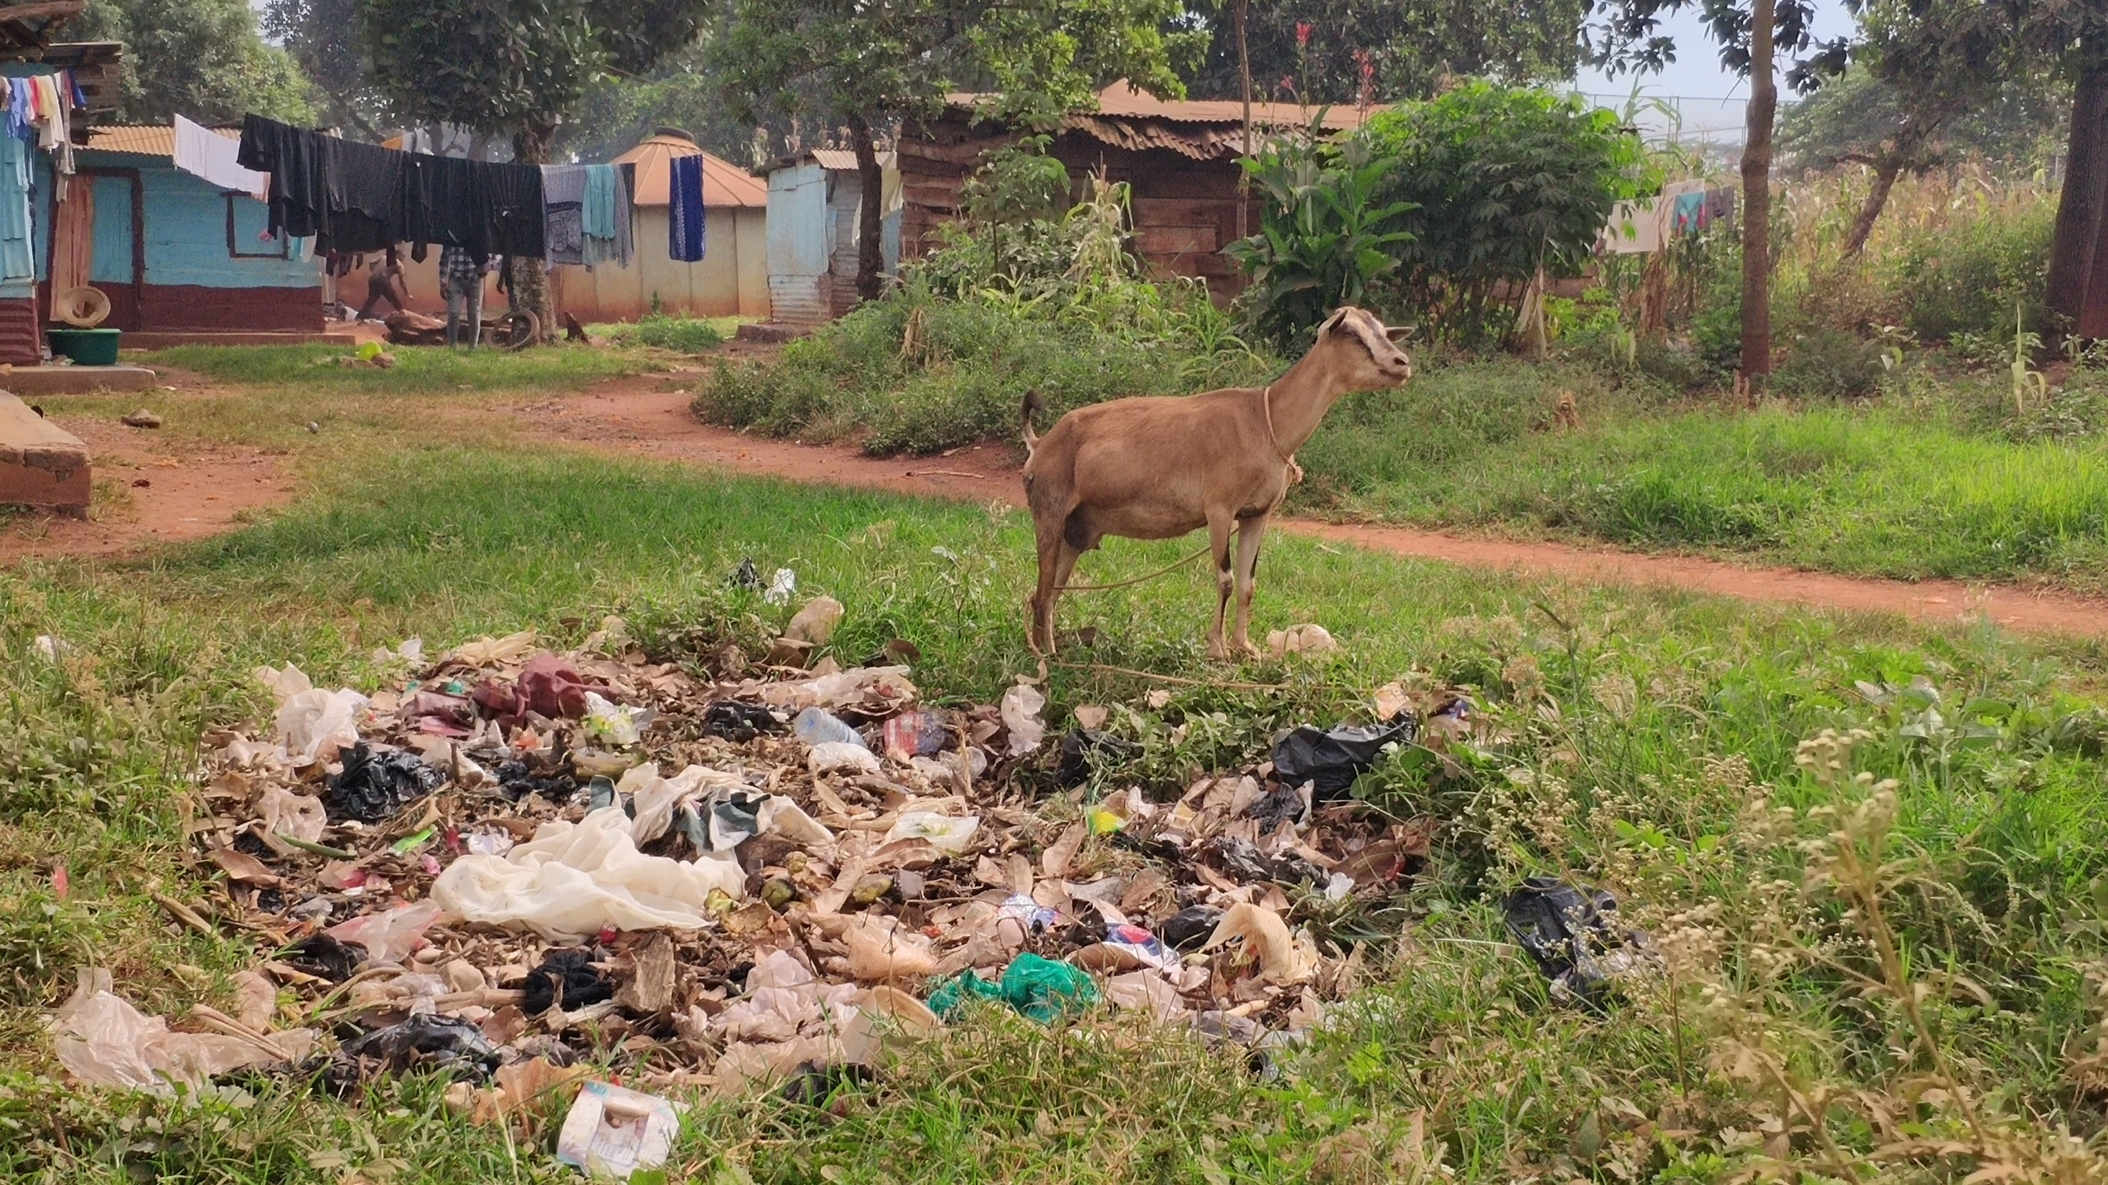
LESSON 3 – COMPRESSION MOULDING (PART 2)
Notes:
Picture from Uganda 2020

Slide 24
PREPARE MATERIAL AND MOULD 375X375 FOR NEXT LESSON
LESSON 3 – COMPRESSION MOULDING (PART 2)

Slide 25
VIDEO ABOUT SHEETPRESS
LESSON 3 – COMPRESSION MOULDING (PART 2)

Slide 26
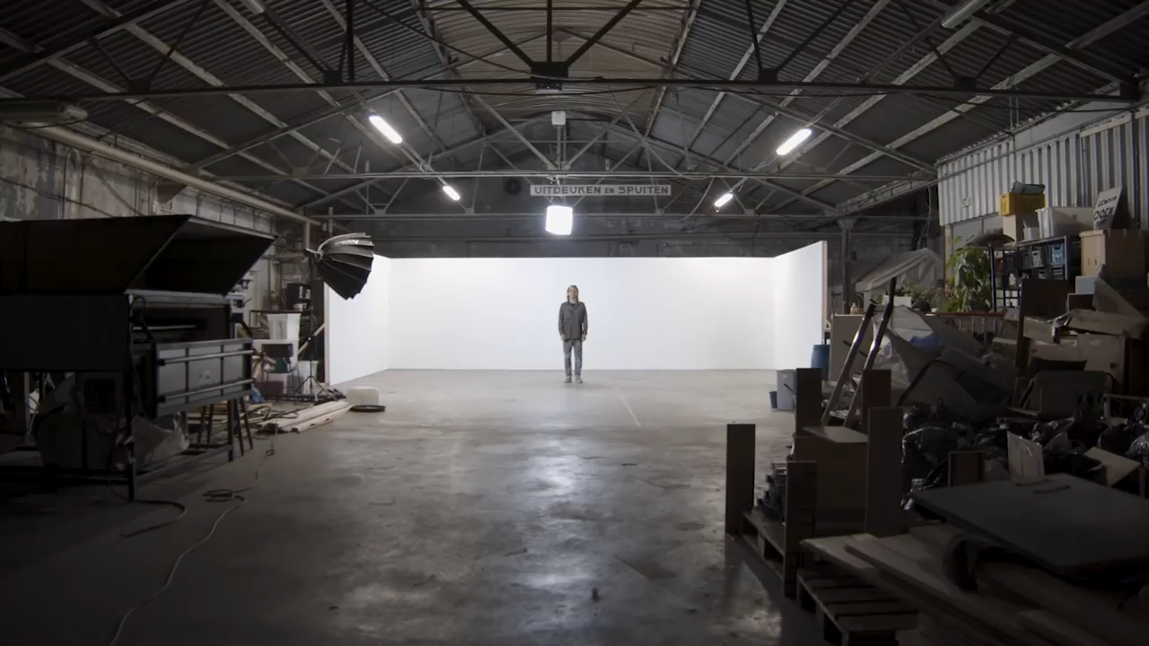
Notes:
Source: Precious Plastic – How to set up sheetpress workspace

Slide 27
OPEN SOURCE
LESSON 3 – COMPRESSION MOULDING (PART 2)

Slide 28
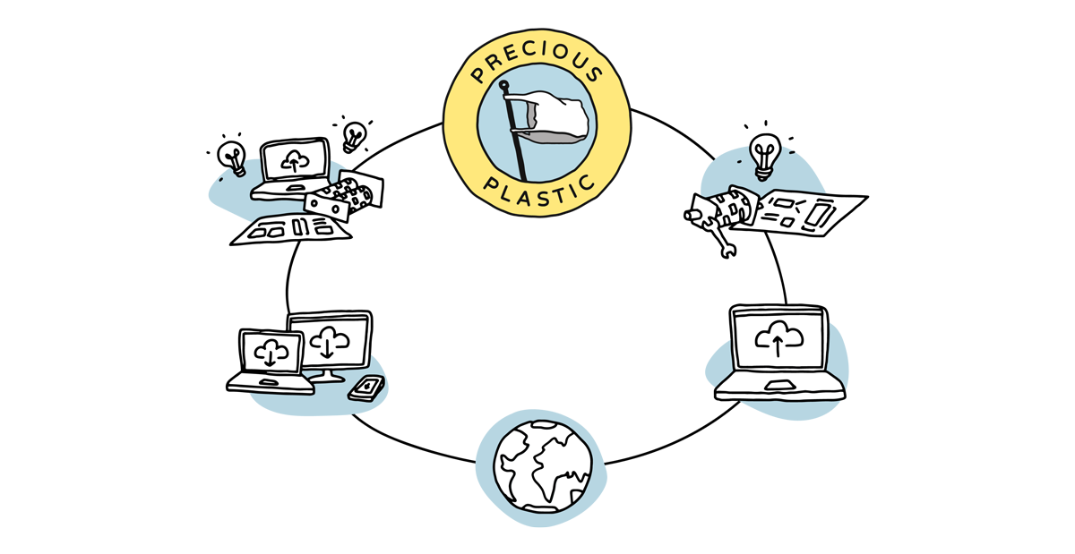
LESSON 3 – COMPRESSION MOULDING (PART 2)

Slide 29


CORPORATE
OPEN SOURCE
LESSON 3 – COMPRESSION MOULDING (PART 2)
Notes:
Name advantages and disadvantages of open source compared to corporate environment.

Slide 30




LESSON 3 – COMPRESSION MOULDING (PART 2)
Notes:
OTHER WELL KNOWN EXAMPLES OF OPEN SOURCE PROJECTS AROUND WORLD

Slide 31
SEE U NEXT TIME
LESSON 3 – COMPRESSION MOULDING (PART 2)
Notes:
MAKE A RECAP

Slide 32


ING. TOMAS KOLECAR
INFO@PLASTMAKERS.COM
WWW.PLASTMAKERS.COM
+420 739 122 662
CZECH REPUBLIC - EUROPE
CONTACT

