Slide 1


PLASTIC COMPRESSION
MOULDING (PART 1)
2/10
Notes:
Picture: Magda Ehlers, source: Pexels.com

Slide 2
DO YOU REMEMBER PREVIOUS LESSON?
LESSON 2 - PLASTIC COMPRESSION MOULDING (PART 1)

Slide 3
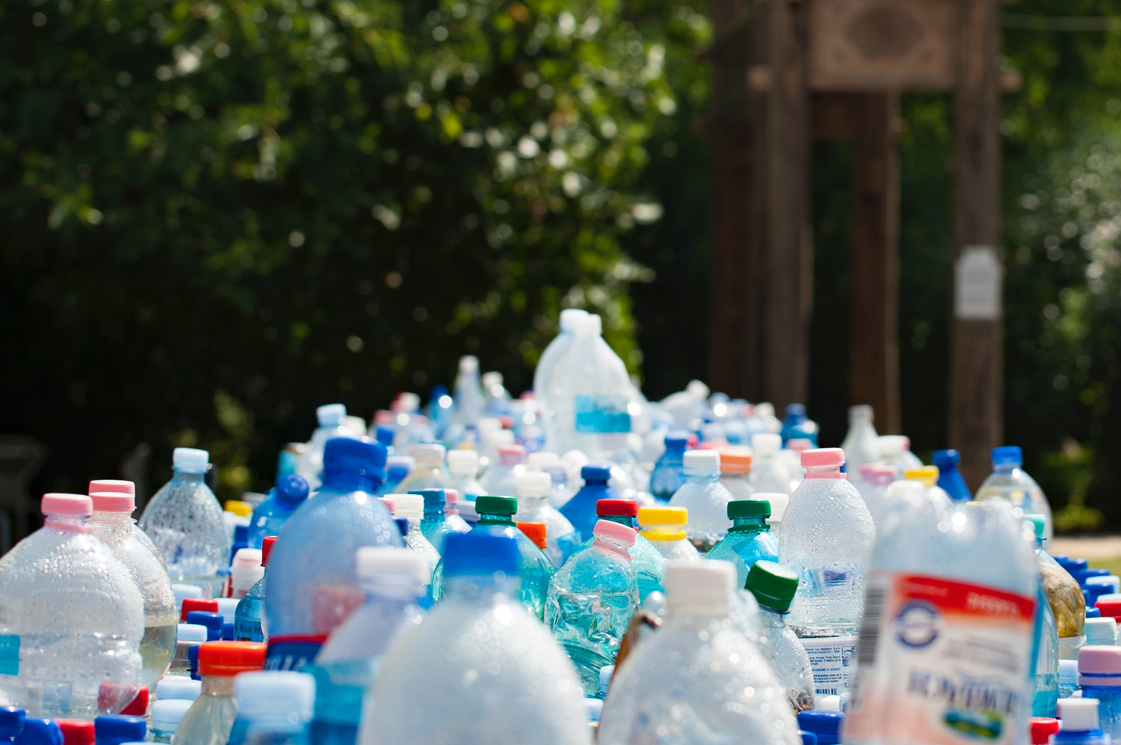
1/5 WHAT IS RAW MATERIAL FOR PLASTIC MATERIAL?
CRUDE OIL
STONE
SEA WEED
LESSON 2 - PLASTIC COMPRESSION MOULDING (PART 1)
Notes:
Source EKO KOM, Czech Republic, 2020

Slide 4
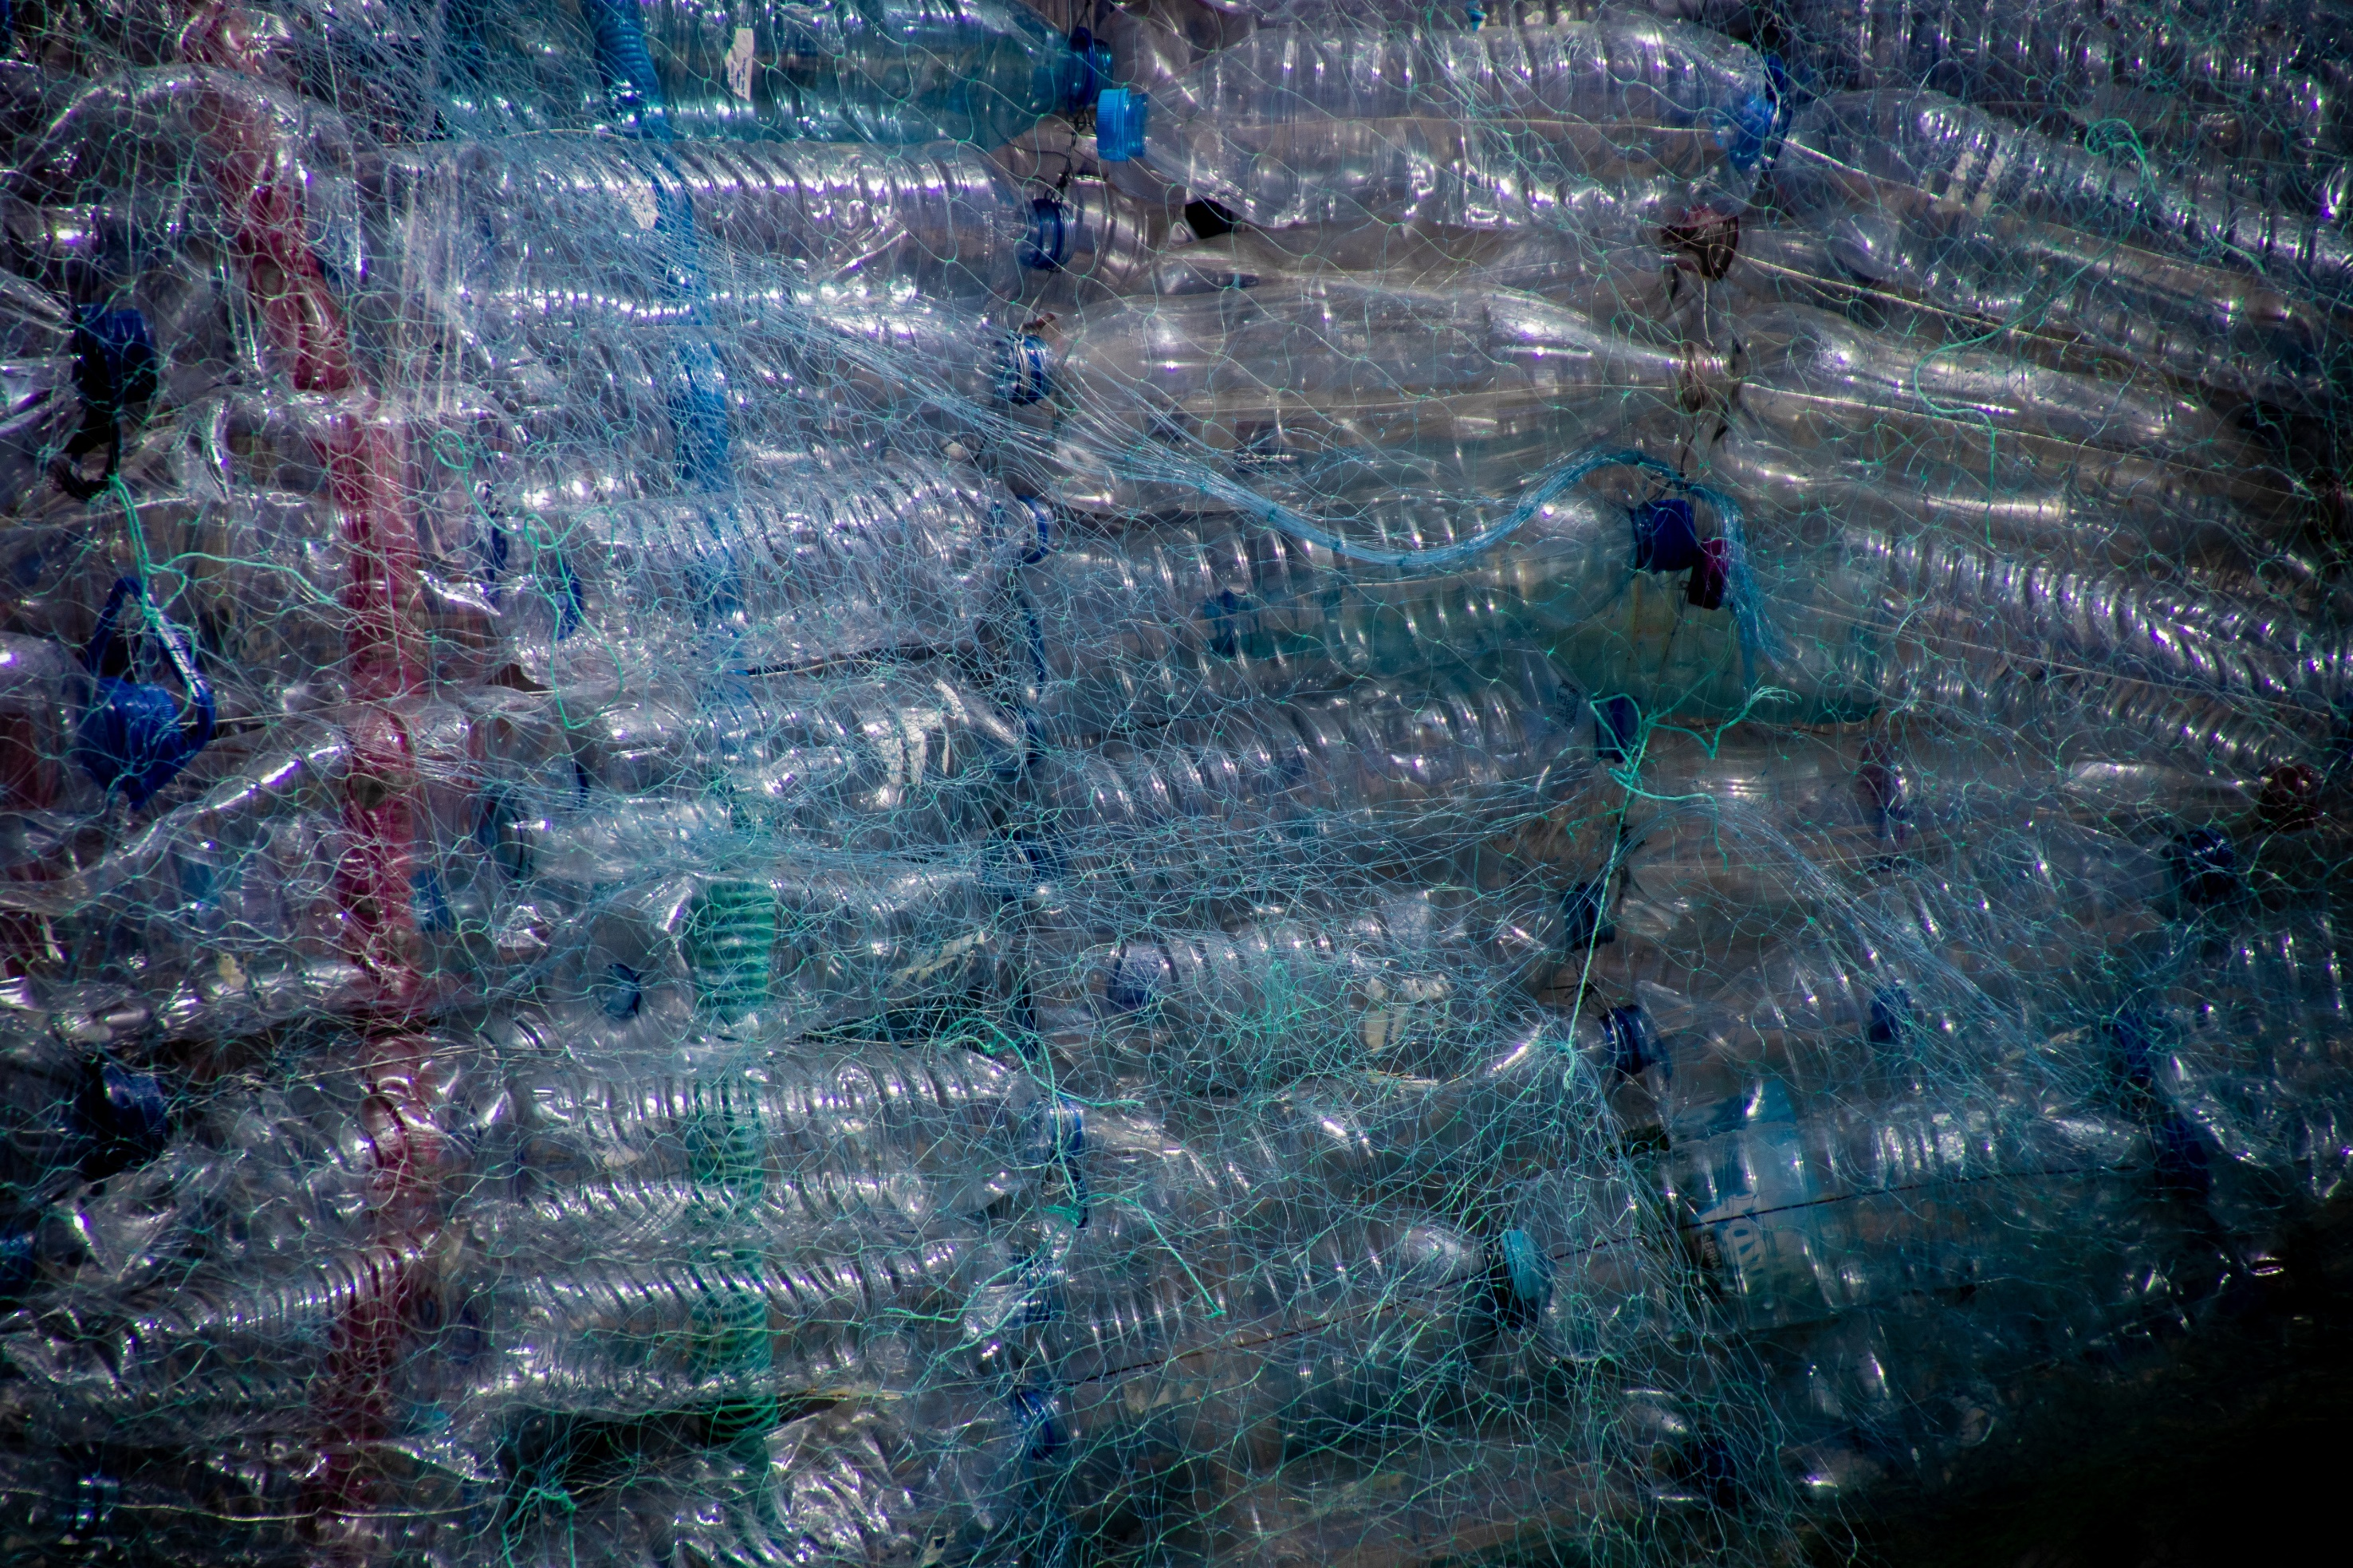
2/5 WHICH MATERIAL WILL SINK IN WATER?
PET
HDPE
PP
LESSON 2 - PLASTIC COMPRESSION MOULDING (PART 1)

Slide 5
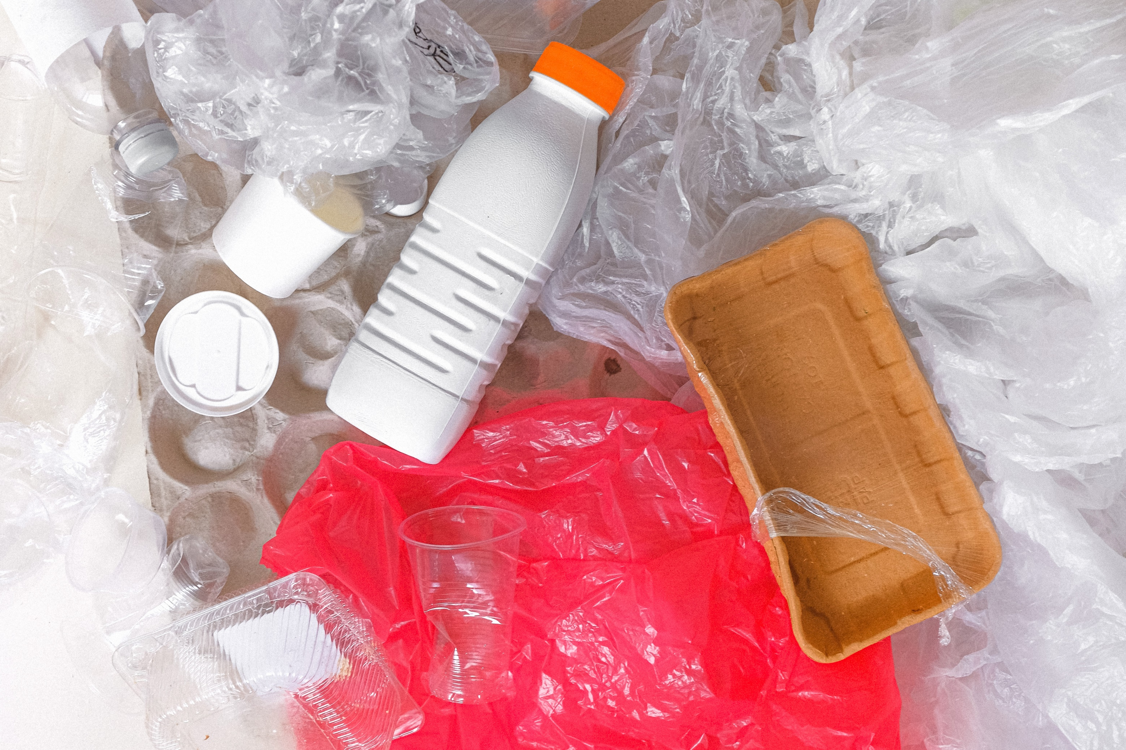
3/5 NAME AT LEAST 3 PLASTIC TYPES:
__________
__________
__________
LESSON 2 - PLASTIC COMPRESSION MOULDING (PART 1)

Slide 6
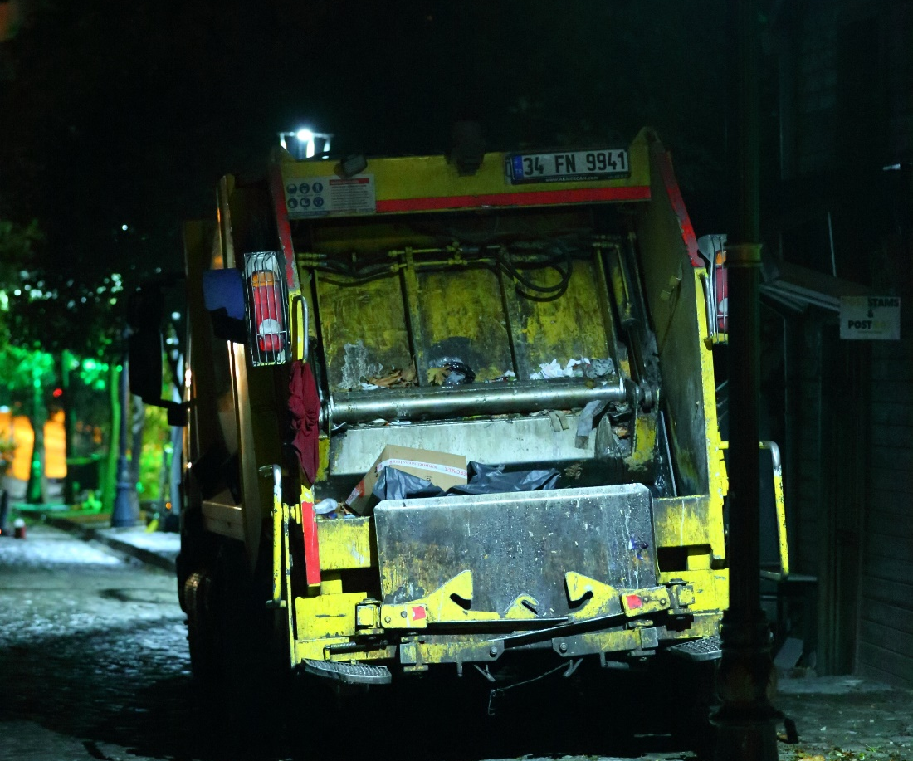
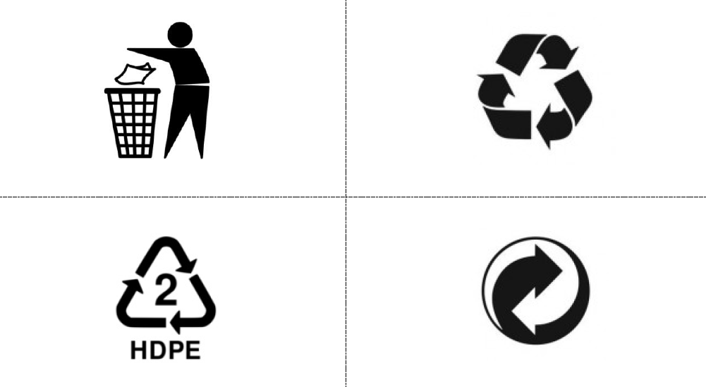
4/5 WHAT DO THESE SYMBOLS MEAN?
LESSON 2 - PLASTIC COMPRESSION MOULDING (PART 1)

Slide 7
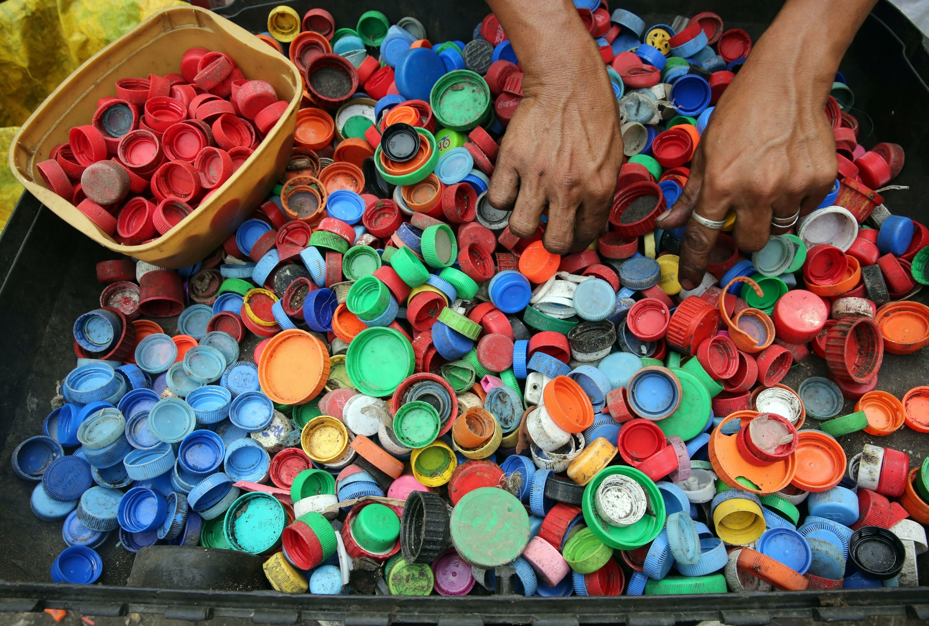
5/5 NAME 3 PRODUCTS WHERE USE OF PLASTIC MAKE A SENCE
____________
____________
____________
LESSON 2 - PLASTIC COMPRESSION MOULDING (PART 1)
Notes:
SOURCE: PLASTOŽROUT.CZ

Slide 8
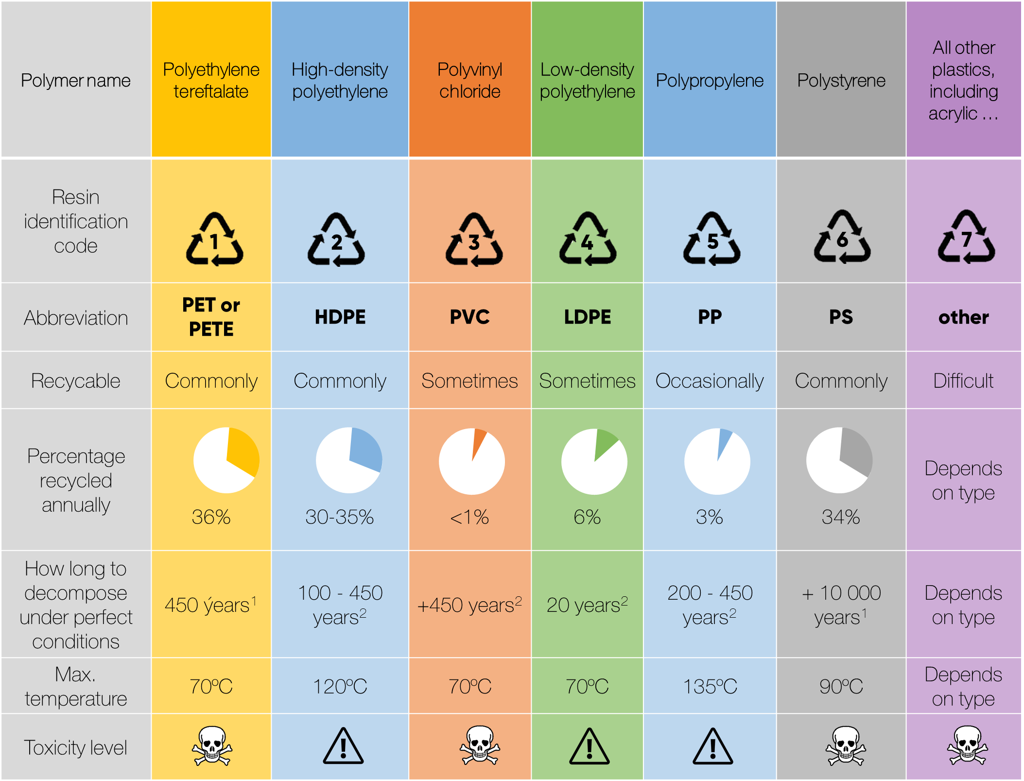
Notes:
Source: https://alansfactoryoutlet.com/7-types-of-plastics-their-toxicity-and-most-commonly-used-for/
[1] https://www.e15.cz/magazin/infografika-jak-dlouho-se-rozklada-odpad-pet-lahvi-to-trva-skoro-pul-tisicileti-1347264#
[2] https://maesindopaperpackaging.com/does-plastic-decompose-how-long-does-it-take/

Slide 9

PREPARATION OF MATERIAL AND TOOLS FOR COMPRESSION MOULDING
LESSON 2 - PLASTIC COMPRESSION MOULDING (PART 1)

Slide 10

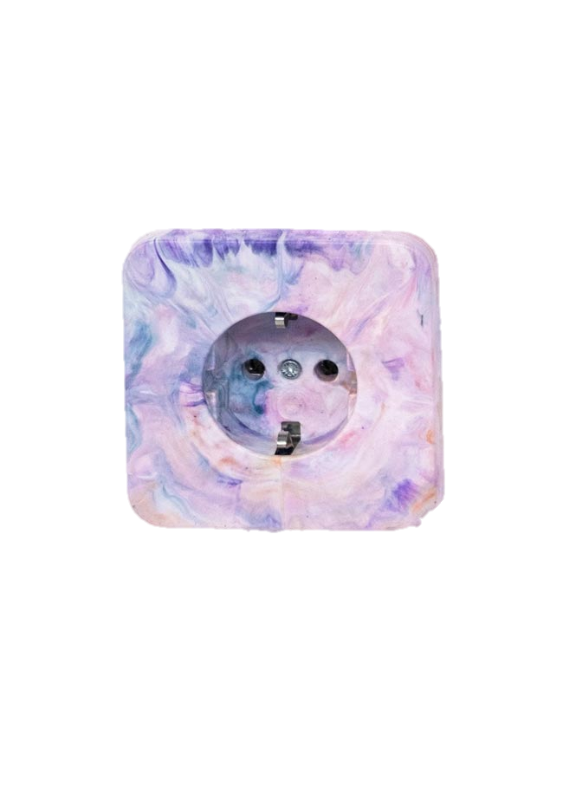

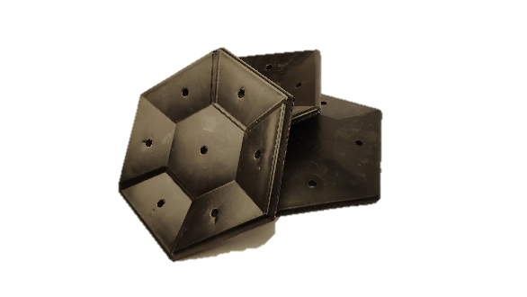



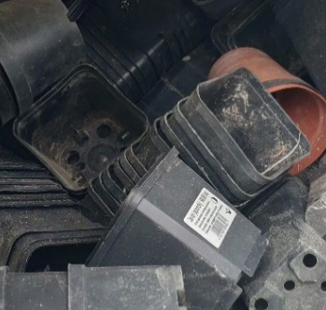
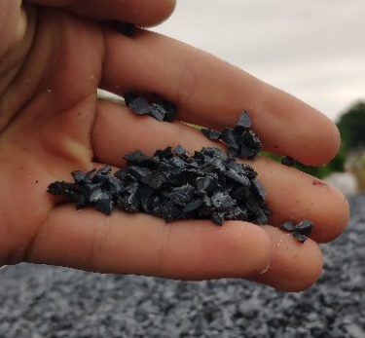
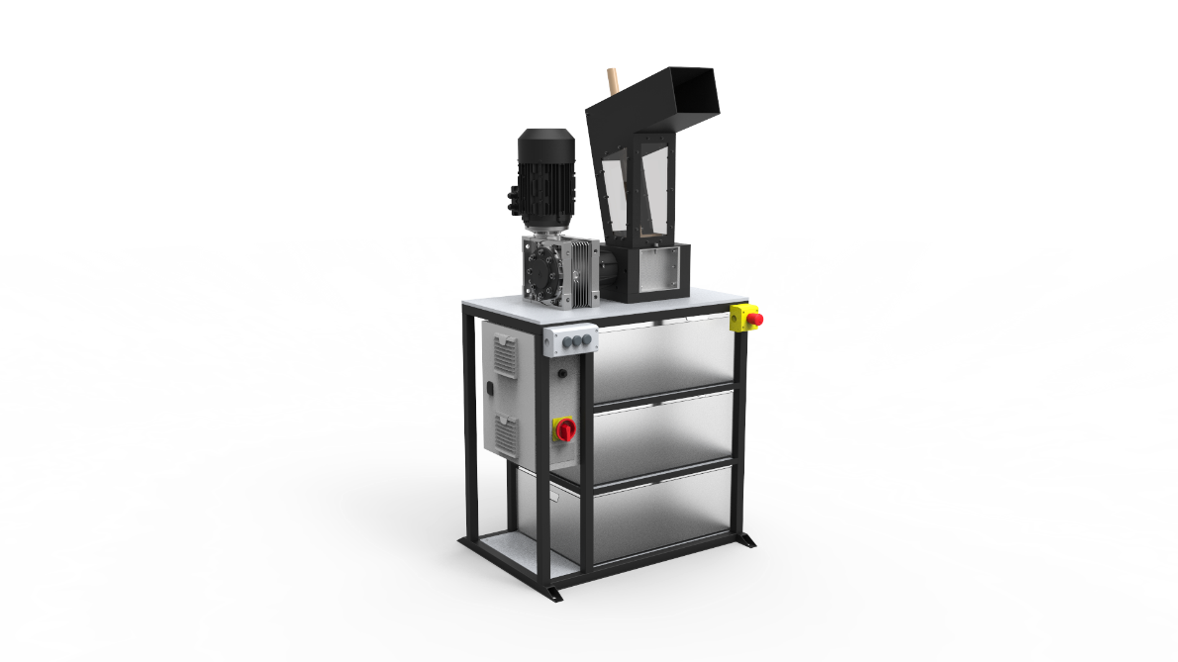
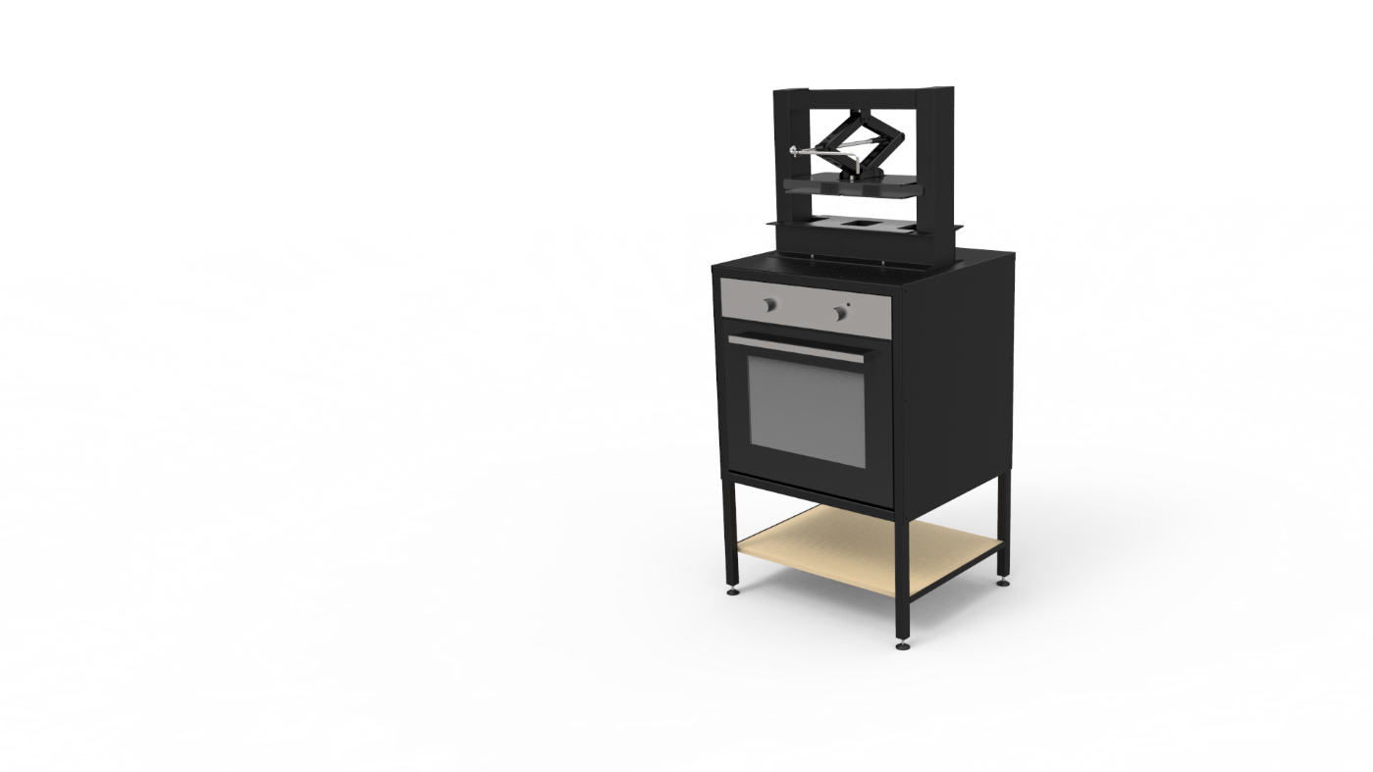
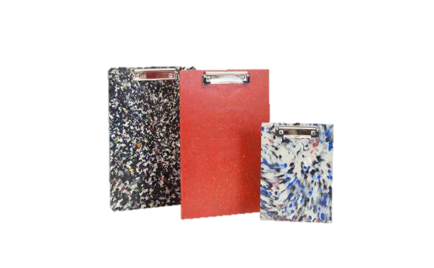



INJECTION
MOULDING
INDUSTRIAL SHREDDING
PLASTIC WASTE
CRUSHED PLASTIC
HOME SHREDDING
COMPRESSION MOULDING
Notes:
Explain principle of compression moulding

Slide 11
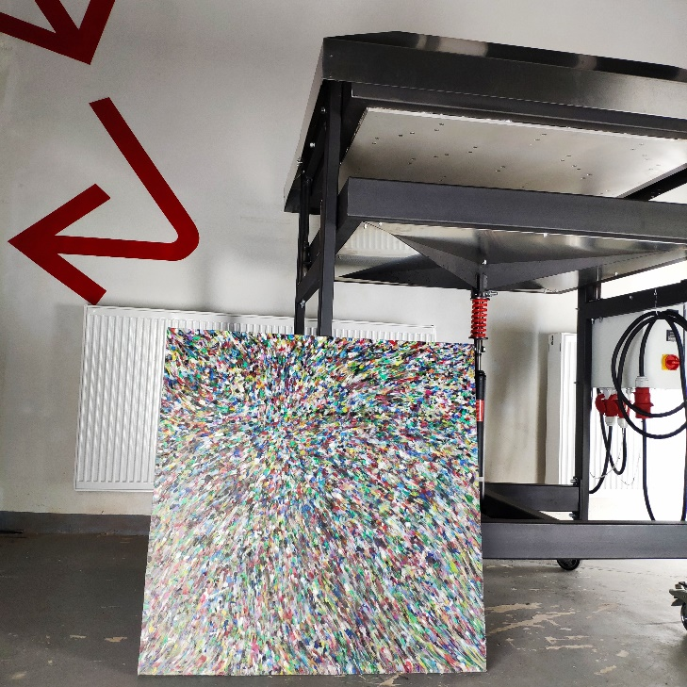
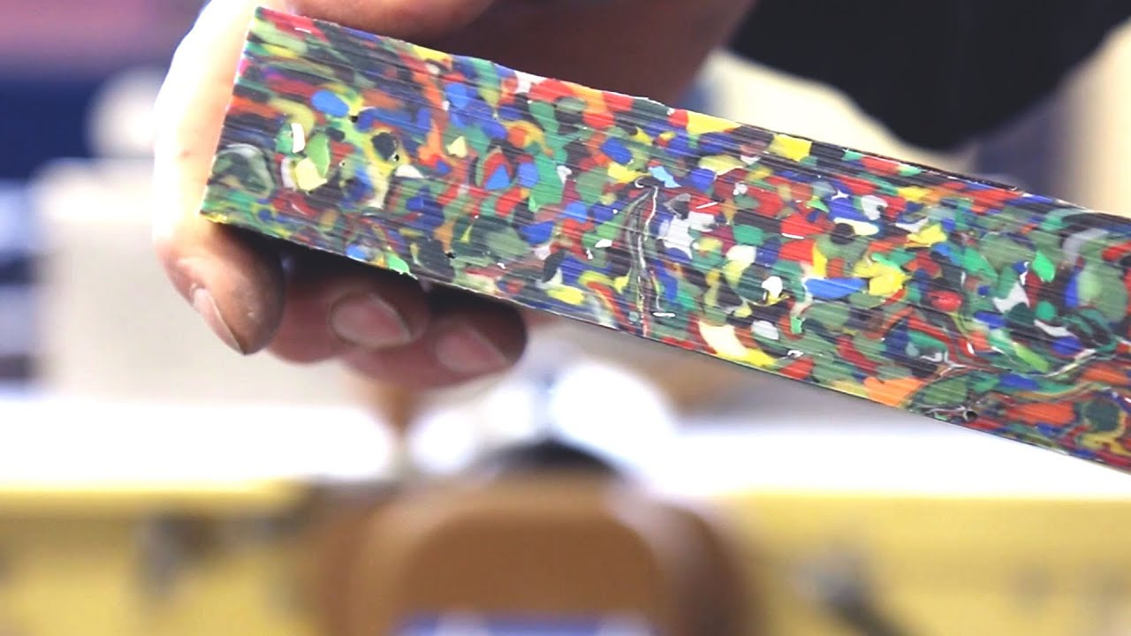

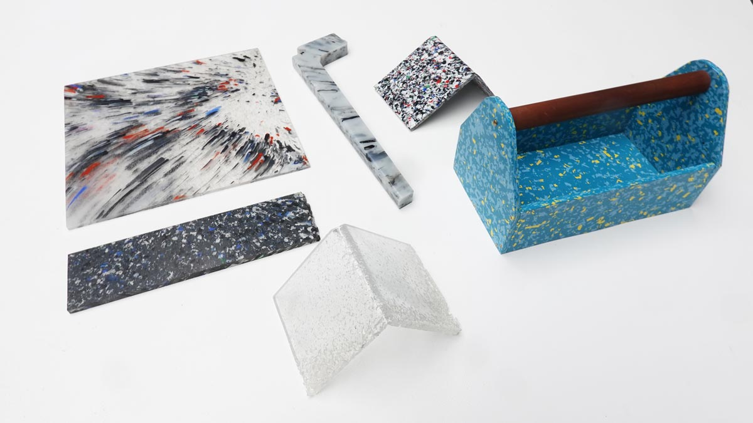
LESSON 2 - PLASTIC COMPRESSION MOULDING (PART 1)
Notes:
Principle of melting plastic
Electric oven + car jack
Sheetpress
Products that can be made with compression moulding

Slide 12
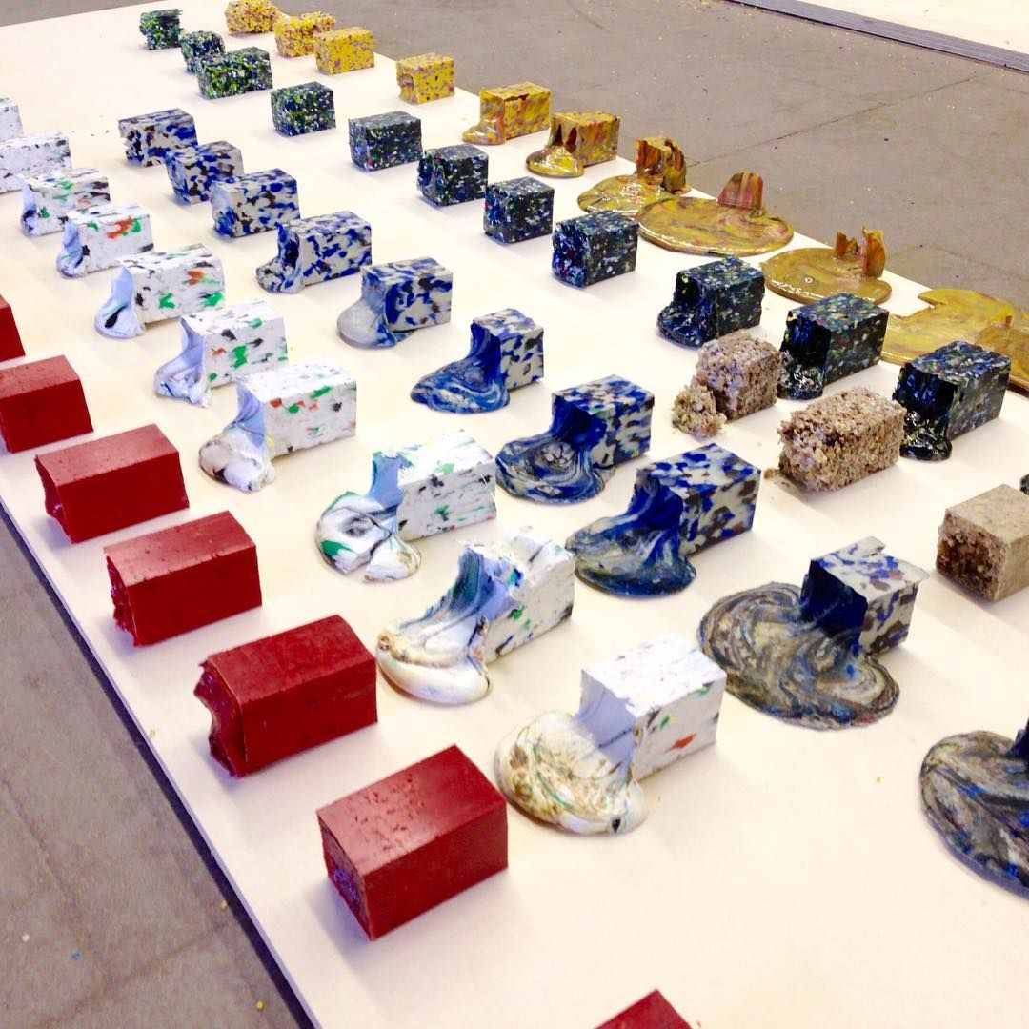
Notes:
Importance of melting temperatures
Explain temperature range
Source: David Hakkens

Slide 13
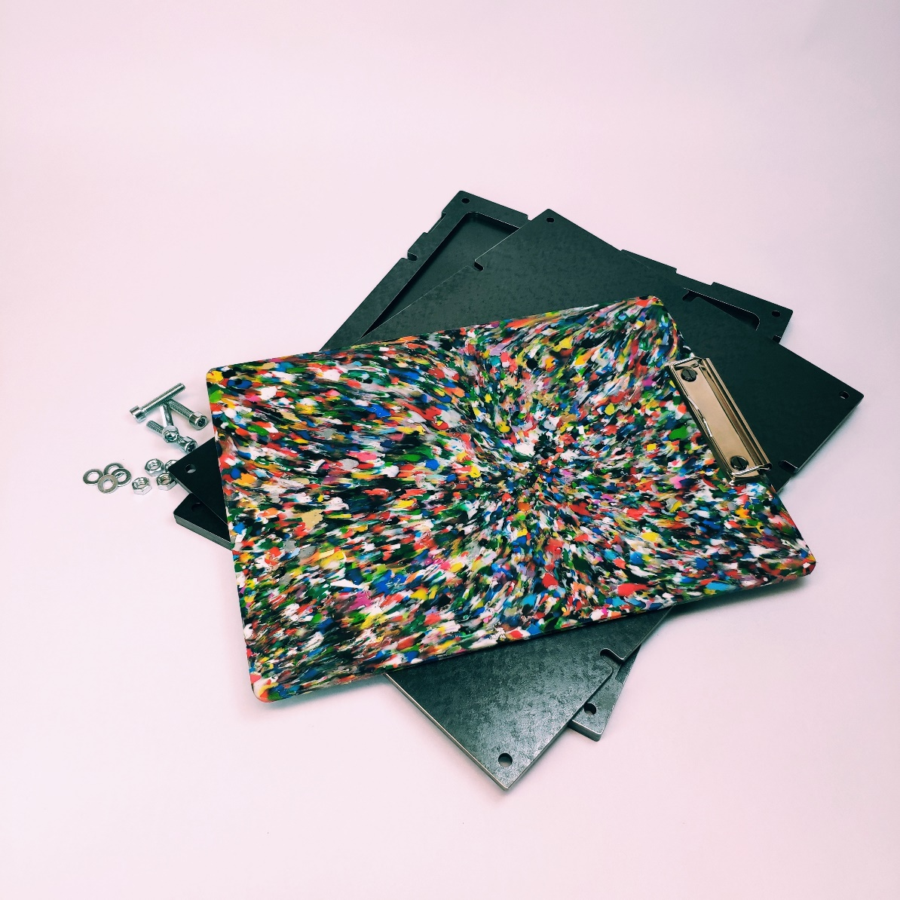
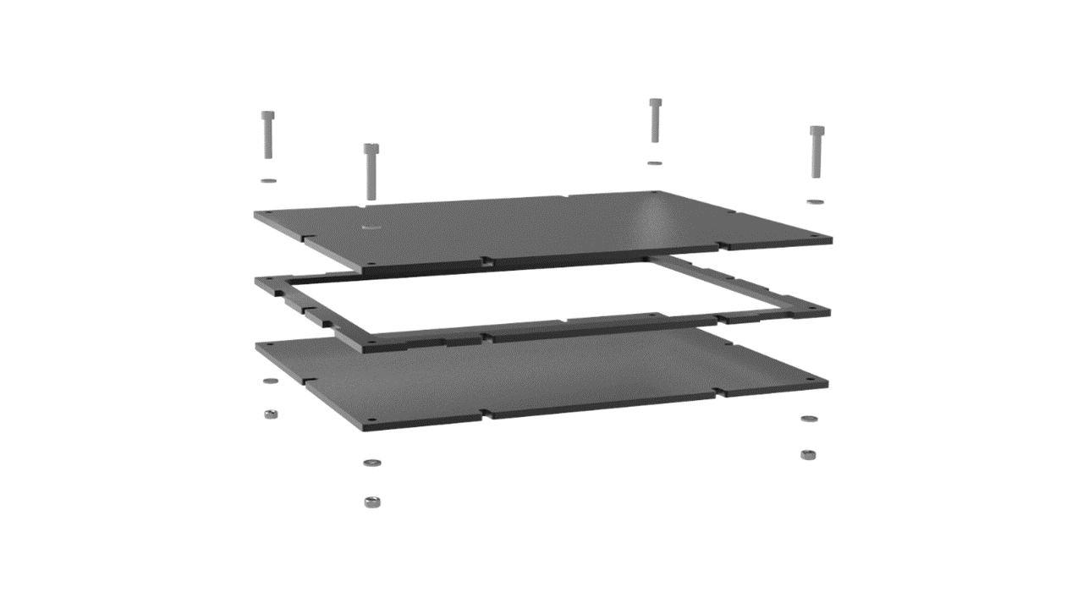
LESSON 2 - PLASTIC COMPRESSION MOULDING (PART 1)
Notes:
Example of clipboard compression mould

Slide 14
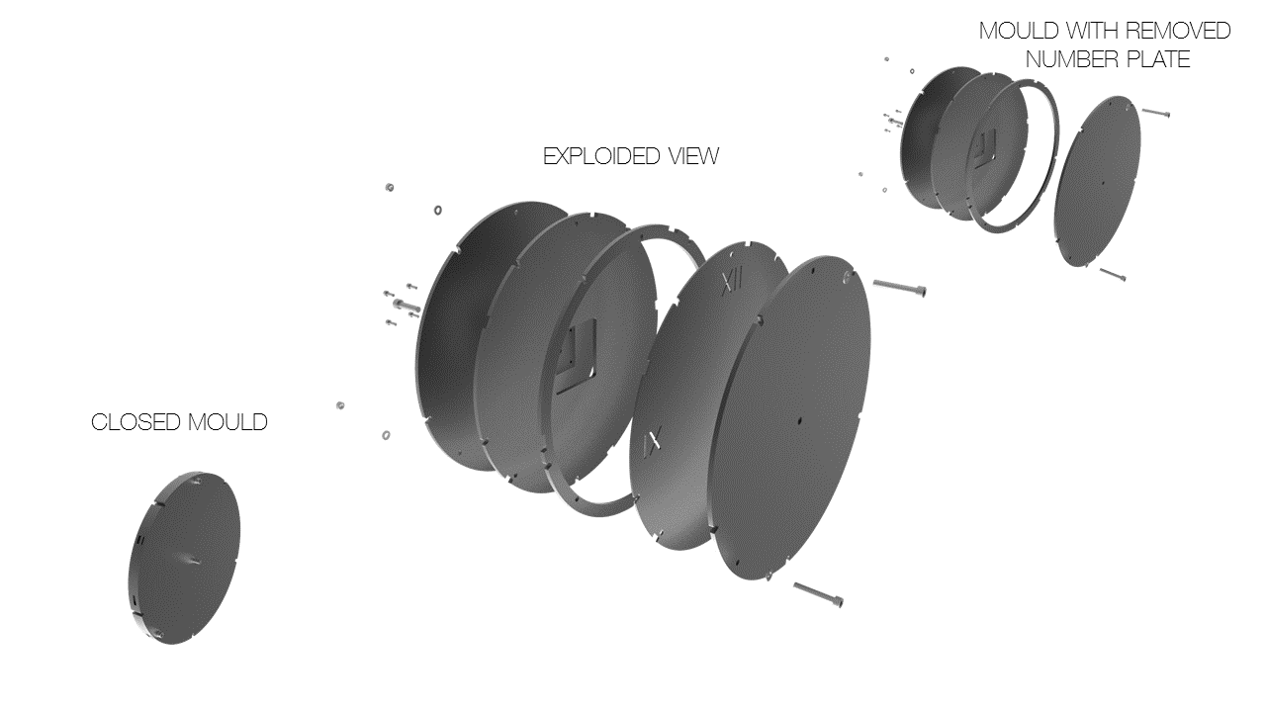
LESSON 2 - PLASTIC COMPRESSION MOULDING (PART 1)
Notes:
Example of clock compression mould

Slide 15
PROBLEMS DURING COMPRESSION MOULDING (SHOW SCRAP PARTS)
LESSON 2 - PLASTIC COMPRESSION MOULDING (PART 1)
Notes:
Parts that were not melt well,

Slide 16
POSTPROCESSING OF PRODUCTS
LESSON 2 - PLASTIC COMPRESSION MOULDING (PART 1)

Slide 17
SEE U NEXT TIME
LESSON 2 - PLASTIC COMPRESSION MOULDING (PART 1)
Notes:
MAKE A RECAP

Slide 18


ING. TOMAS KOLECAR
INFO@PLASTMAKERS.COM
WWW.PLASTMAKERS.COM
+420 739 122 662
CZECH REPUBLIC - EUROPE
CONTACT

