Slide 1
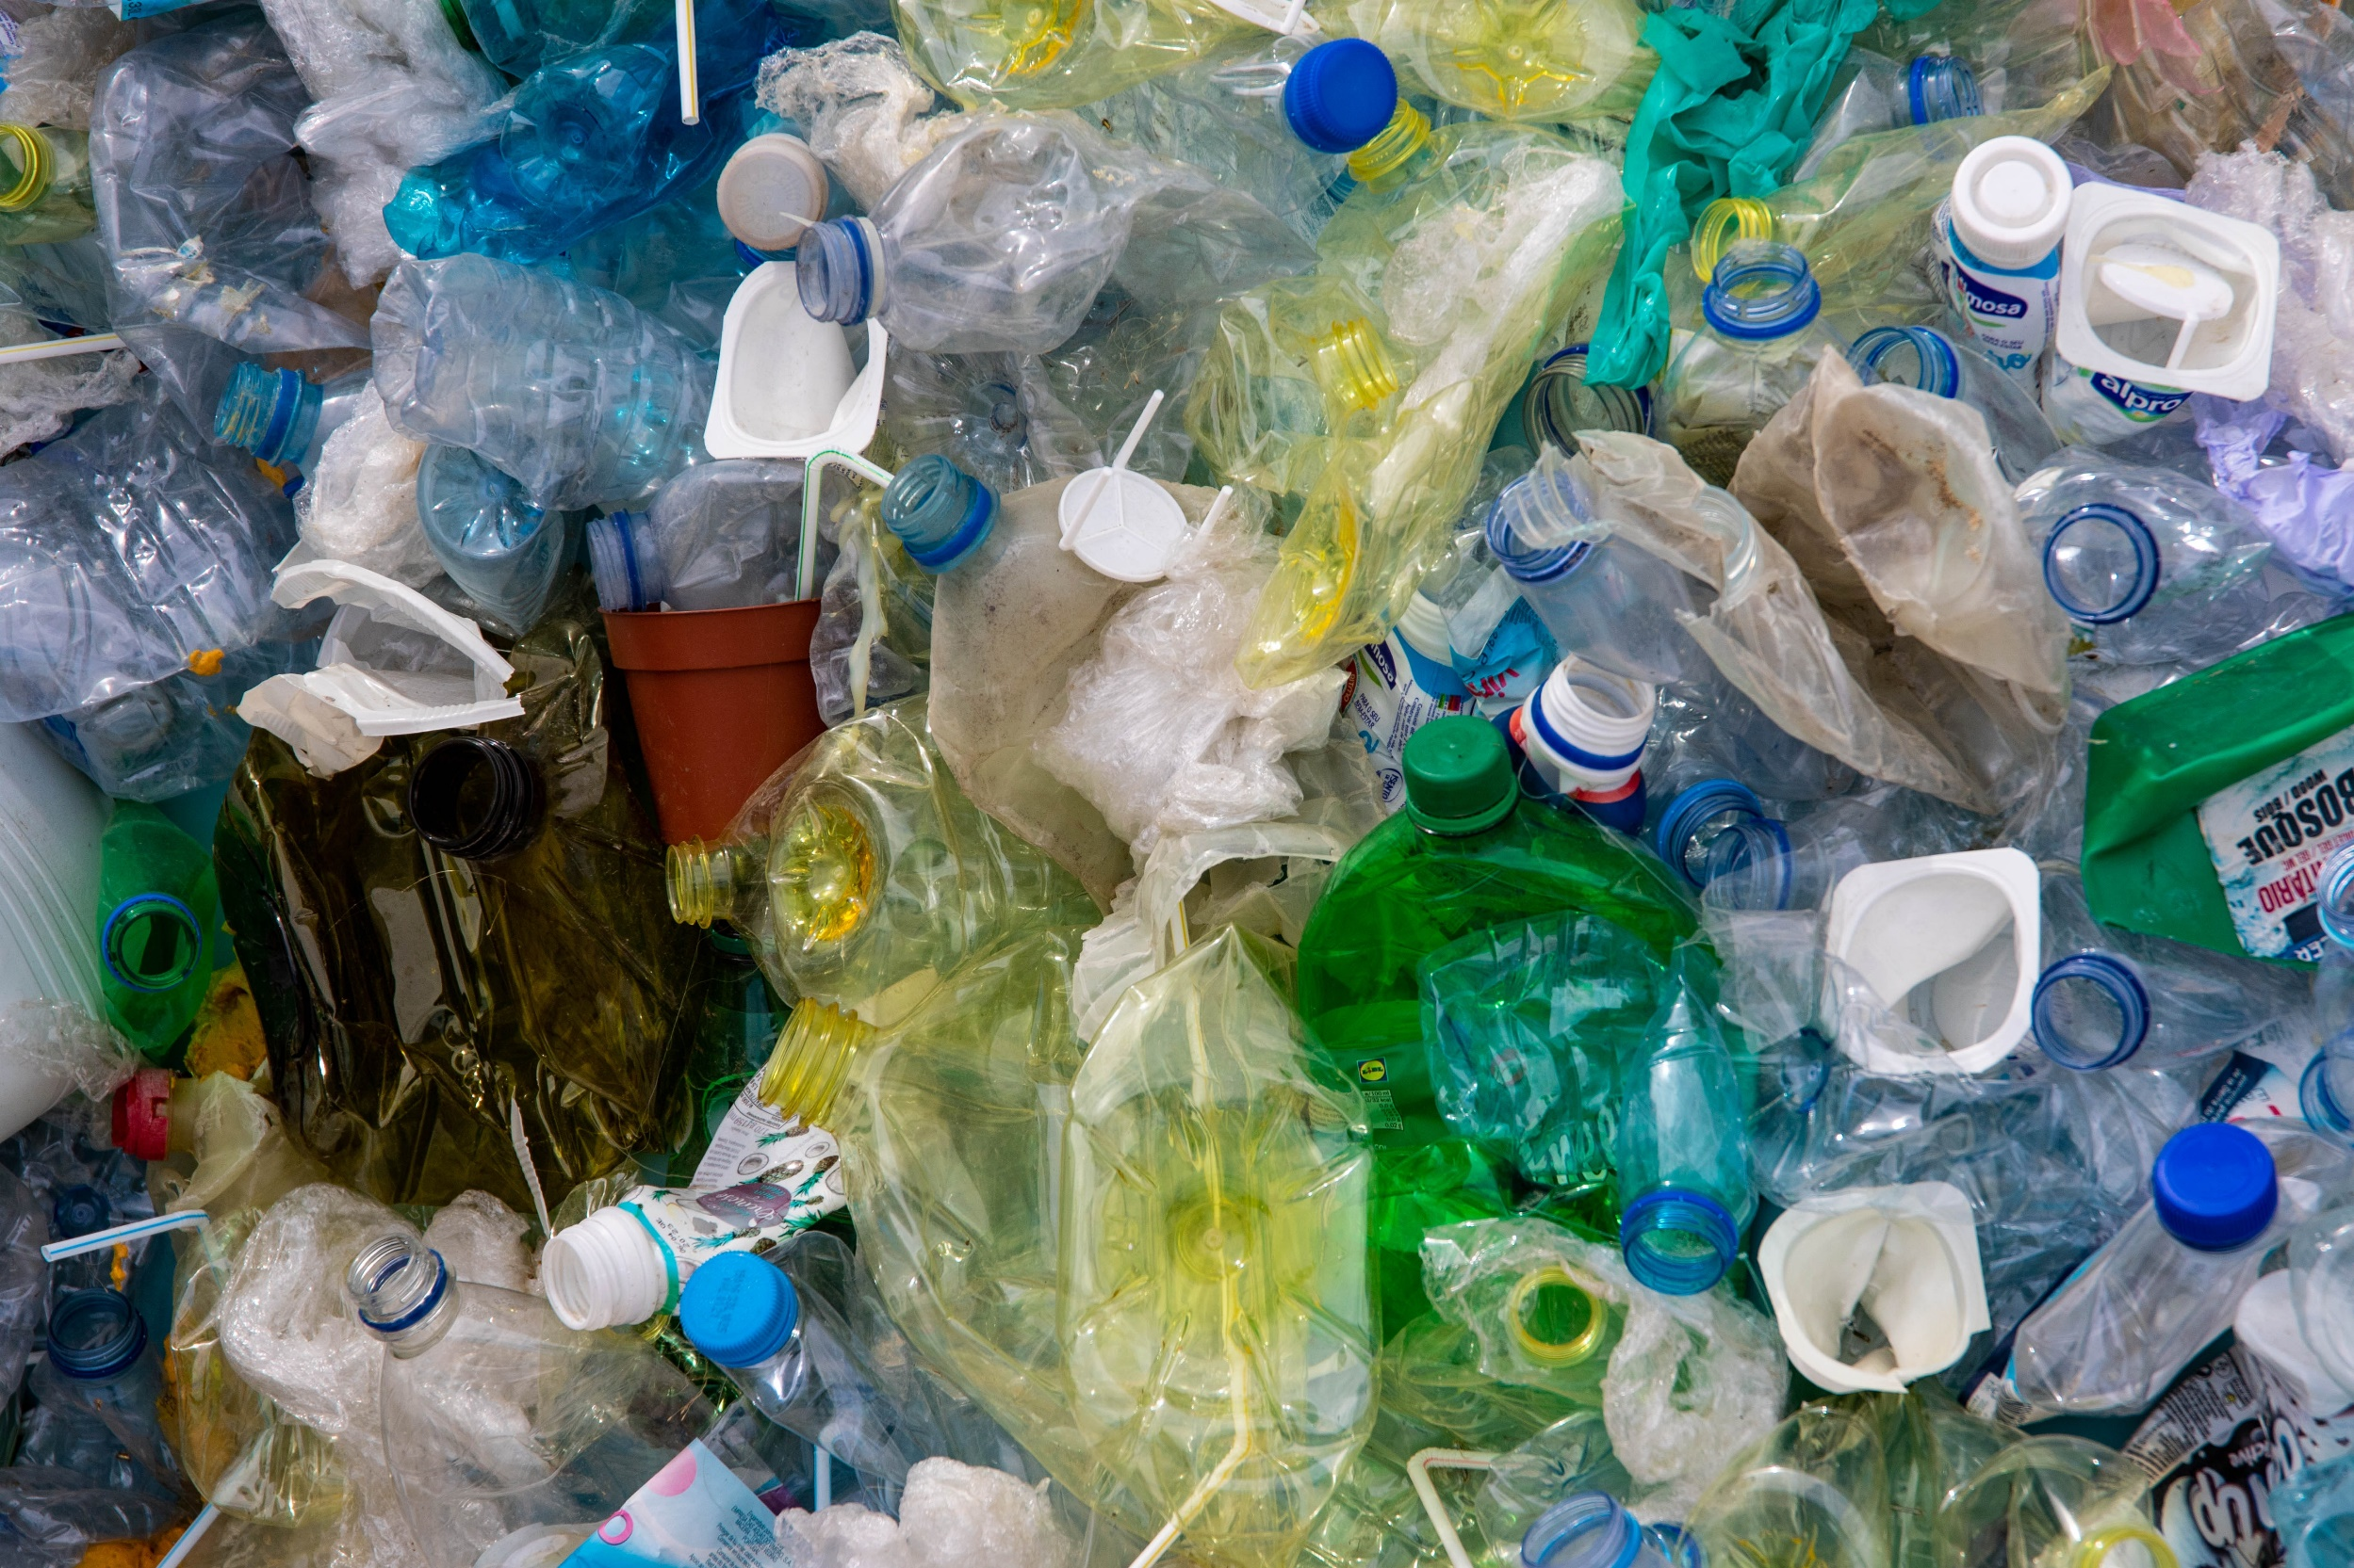

STORY OF PLASTIC
1/10
Notes:
Picture: Magda Ehlers, source: Pexels.com

Slide 2

INTRODUCTION OF TEACHER AND CHILDREN
LESSON 1 - STORY OF PLASTIC

Slide 3
WHAT DO YOU KNOW ABOUT PLASTIC?
LESSON 1 – STORY OF PLASTIC

Slide 4
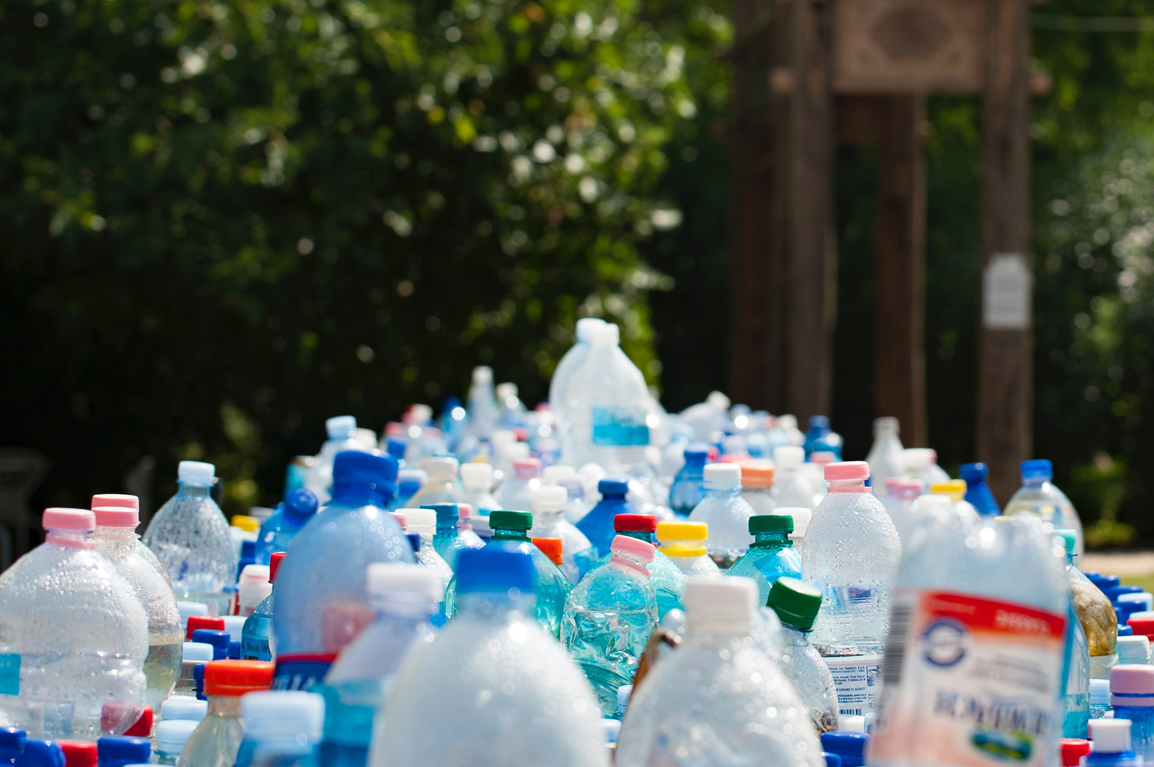
1/5 HOW MANY KGS OF PLASTIC WASTE PRODUCED AVERAGE PERSON IN CZECH REPUBLIC ANNUALY IN 2020?
5 kg
27 kg
114 kg
LESSON 1 – STORY OF PLASTIC
Notes:
Source EKO KOM, Czech Republic, 2020

Slide 5
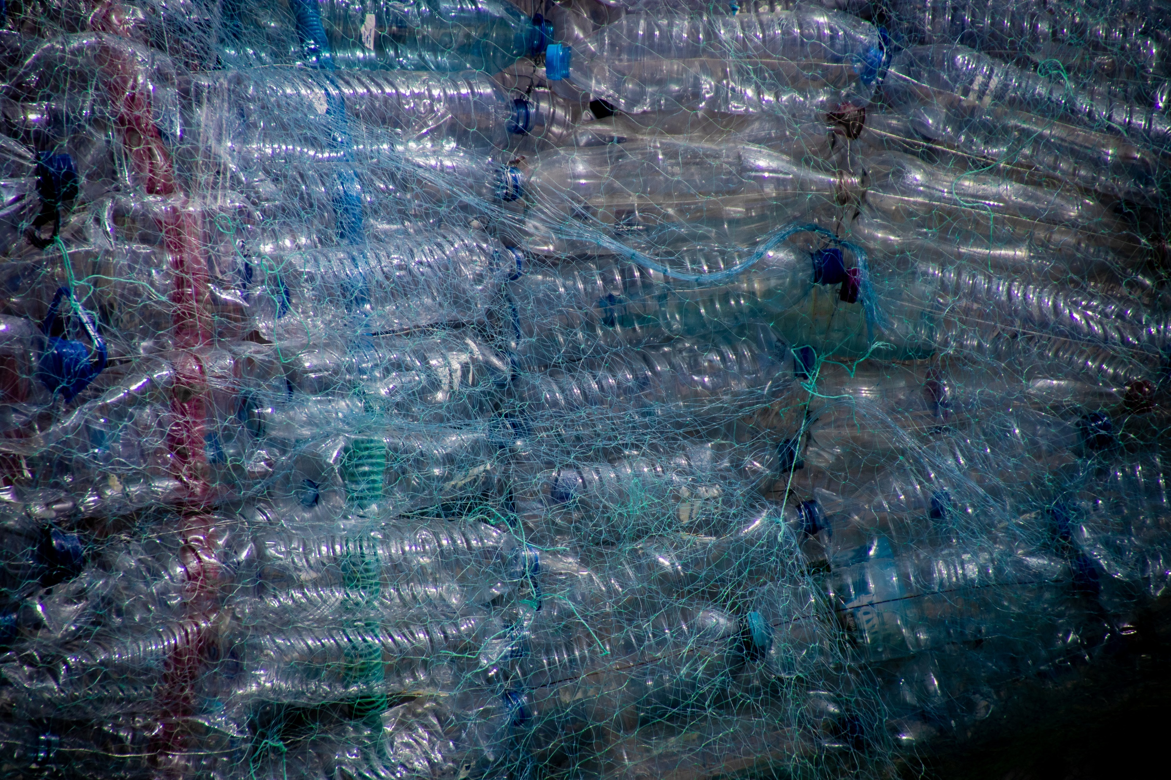
2/5 APPROX. HOW MANY % OF PLASTIC MATERIAL WAS RECYCLED (NOT BURNED) IN CZECH REPUBLIC IN 2020?
30%
60%
80%
LESSON 1 – STORY OF PLASTIC

Slide 6
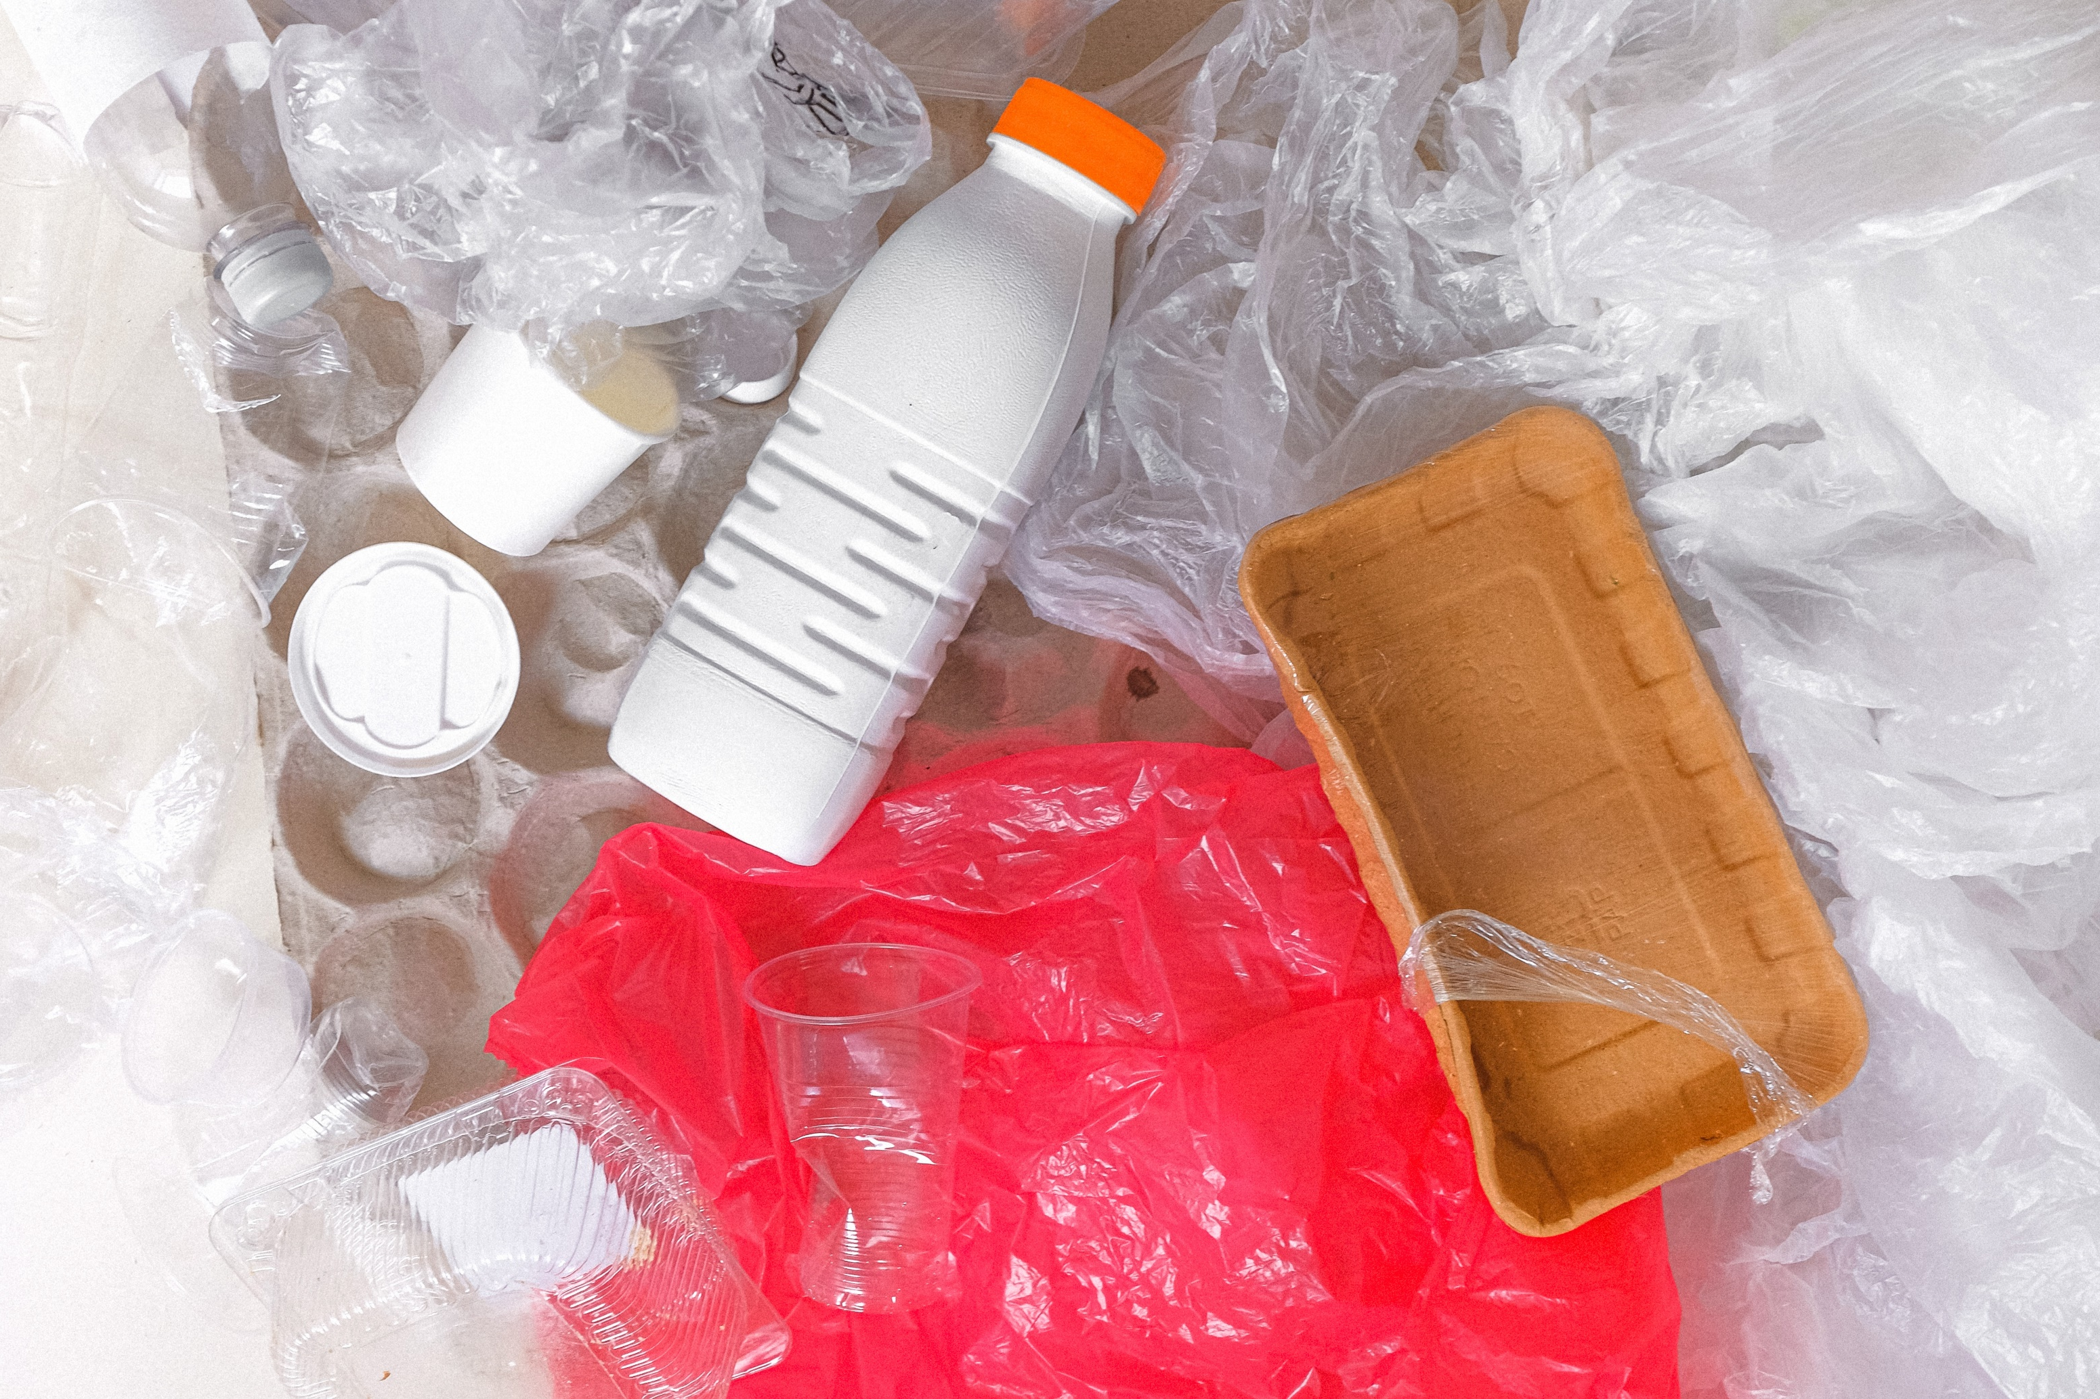
3/5 WHAT IS THE MOST WANTED TYPE OF PLASTIC MATERIAL FOR BIG RECYCLING COMPANIES IN CZECH REPUBLIC?
PET
HDPE
PP
LESSON 1 – STORY OF PLASTIC

Slide 7
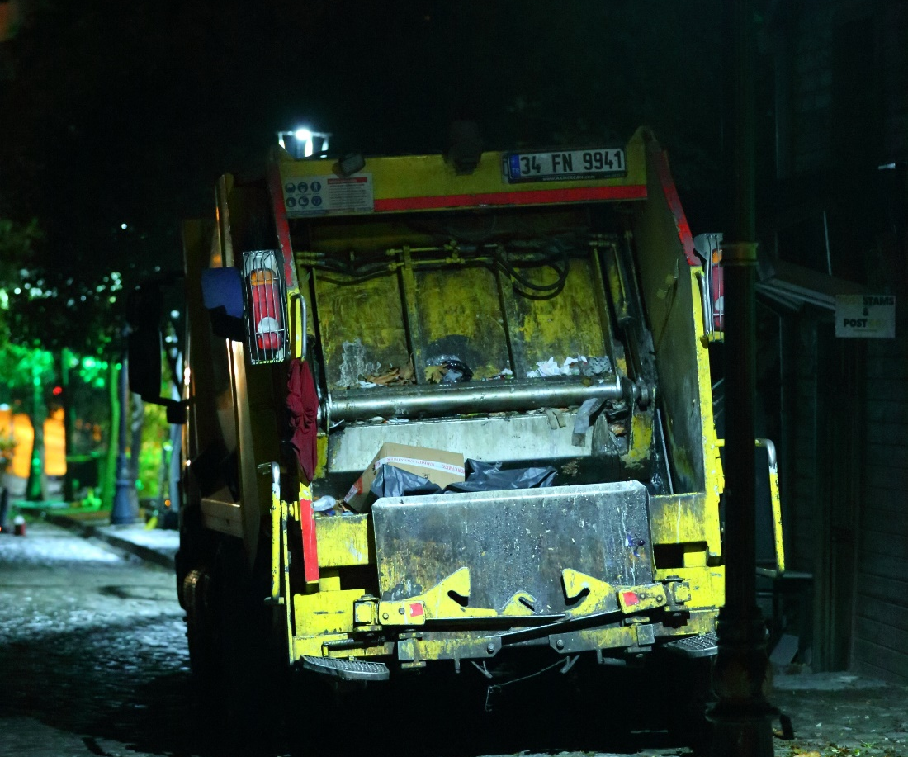
4/5 HOW MUCH DID IT COST ON AVERAGE TO TRANSPORT ONE FULL PLASTIC CONTAINER TO SORTING POINT IN THE CZECH REPUBLIC IN 2020?
2,5 EUR
12,5 EUR
25 EUR
LESSON 1 – STORY OF PLASTIC

Slide 8
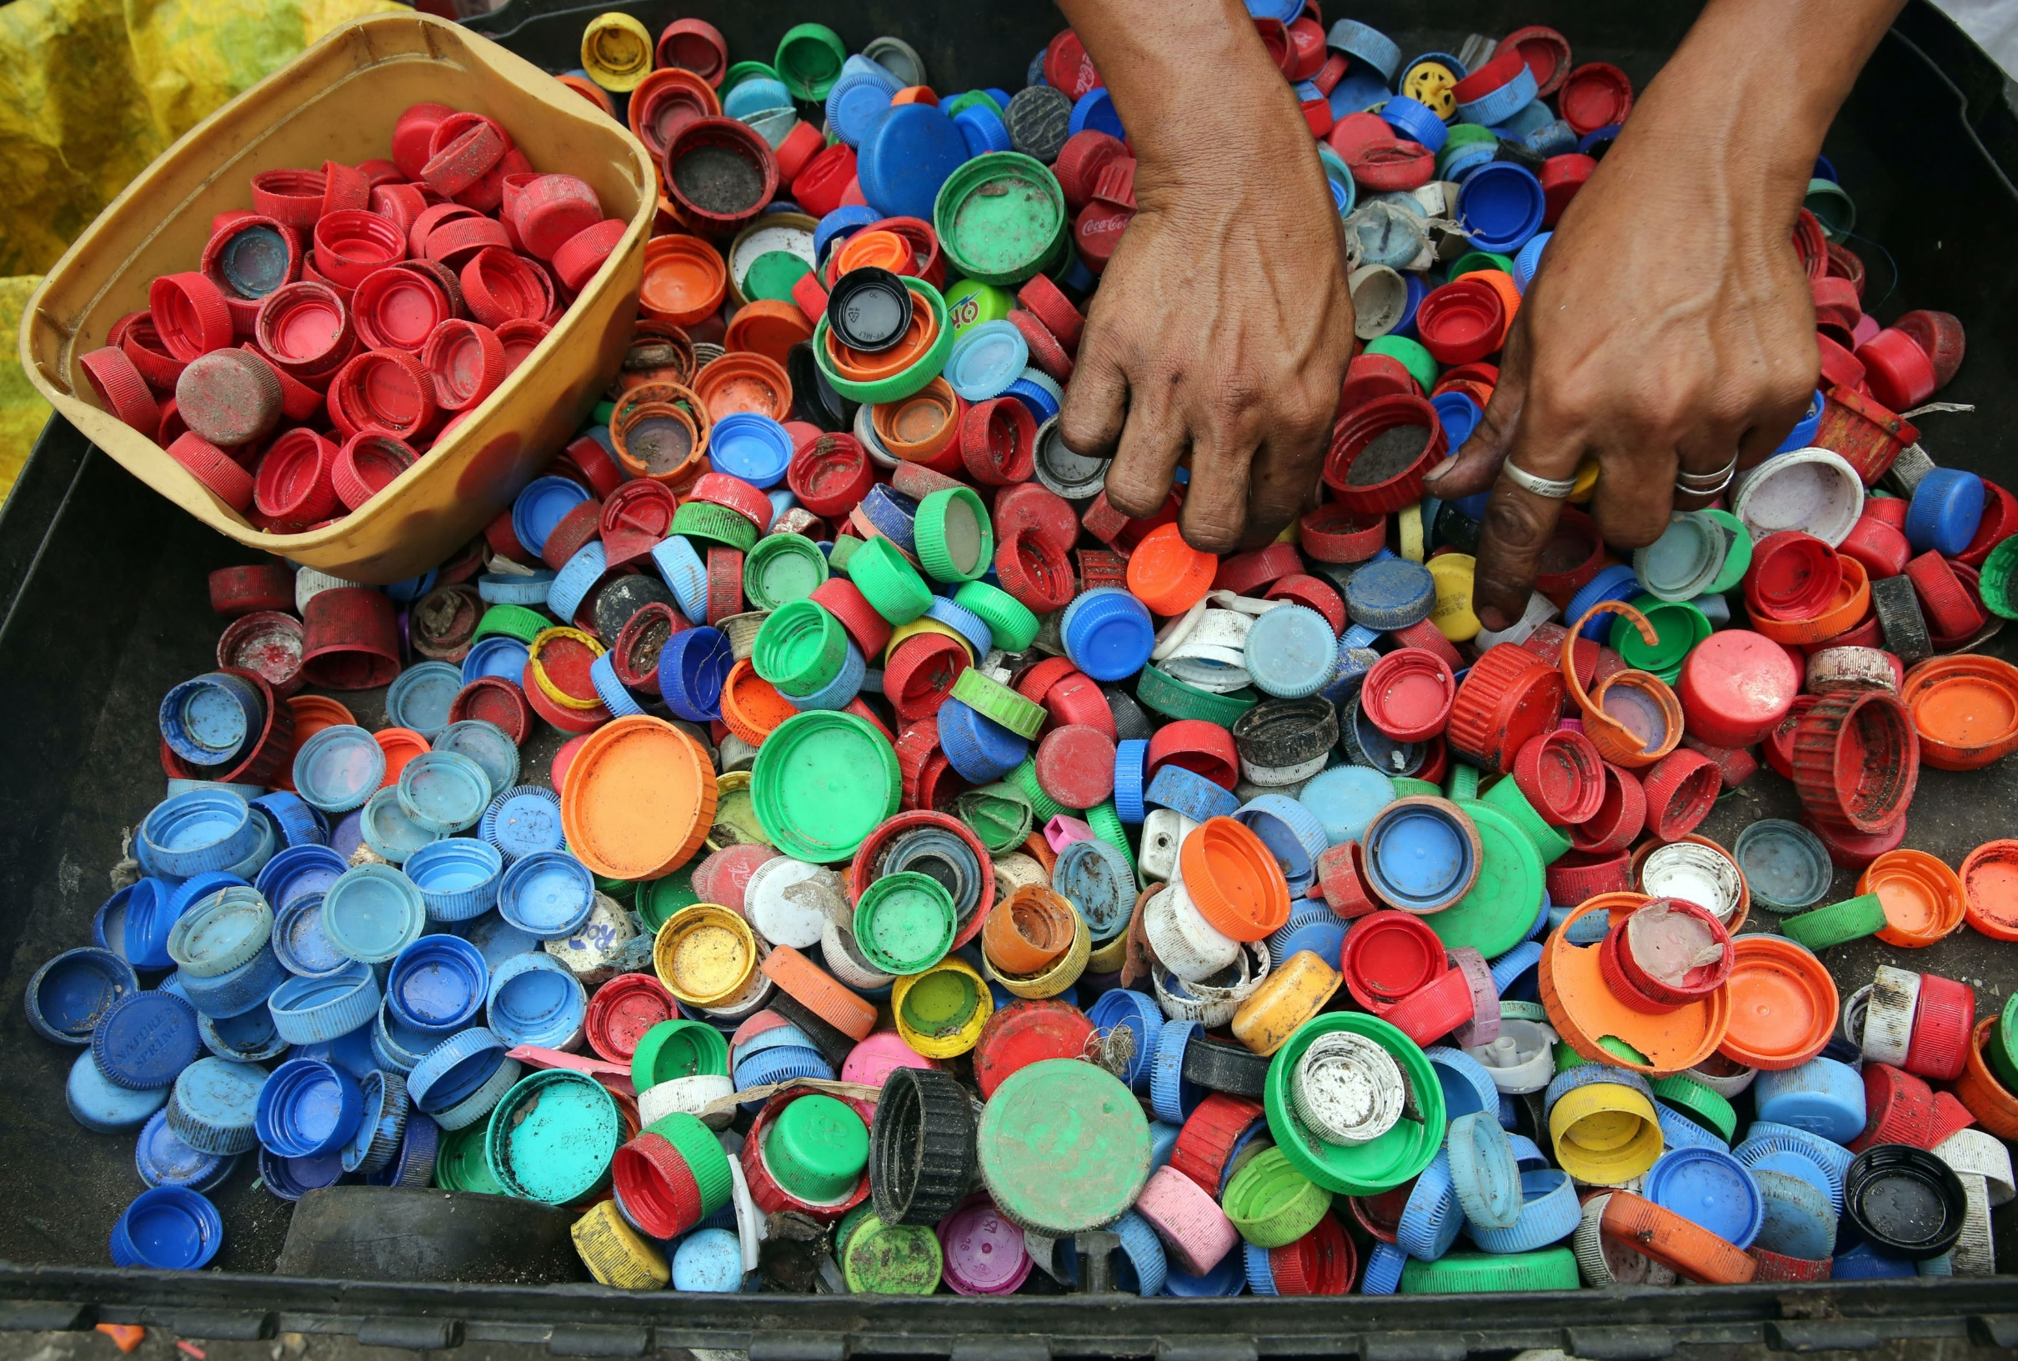
5/5 HOW MUCH WAS PURCHASE PRICE FOR 1KG COLLECTED HDPE BOTTLE CAPS IN 2021 IN CZECH REPUBLIC?
0.25 EUR
1 EUR
12 EUR
LESSON 1 – STORY OF PLASTIC
Notes:
SOURCE: PLASTOŽROUT.CZ

Slide 9
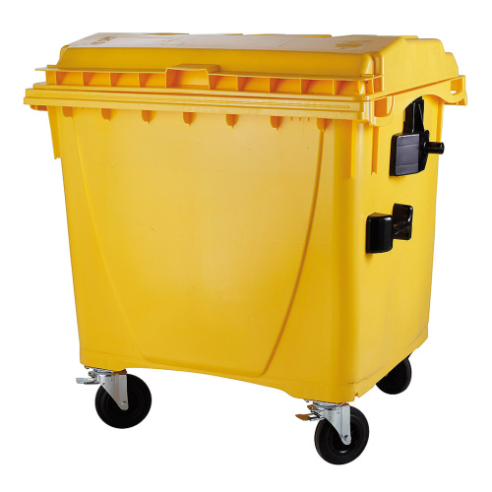


DATA FROM EKO-KOM IN CZECH REPUBLIC 2020
39% CERTIFIED FUEL
69% CLASIFIED AS RECYCLED
30% MATERIAL RECYCLING
LESSON 1 - STORY OF PLASTIC
Notes:
Source Czech TV: https://ct24.ceskatelevize.cz/ekonomika/3289301-recyklace-plastu-v-cesku-nefunguje-vetsina-odpadu-se-spali#:~:text=P%C5%99esto%C5%BEe%20zm%C4%9Bny%20v%20z%C3%A1kon%C4%9B%2C%20kter%C3%A9,roku%202030%20pak%2055%20procent.

Slide 10

Notes:
Source: Precious Plastic promo V2

Slide 11
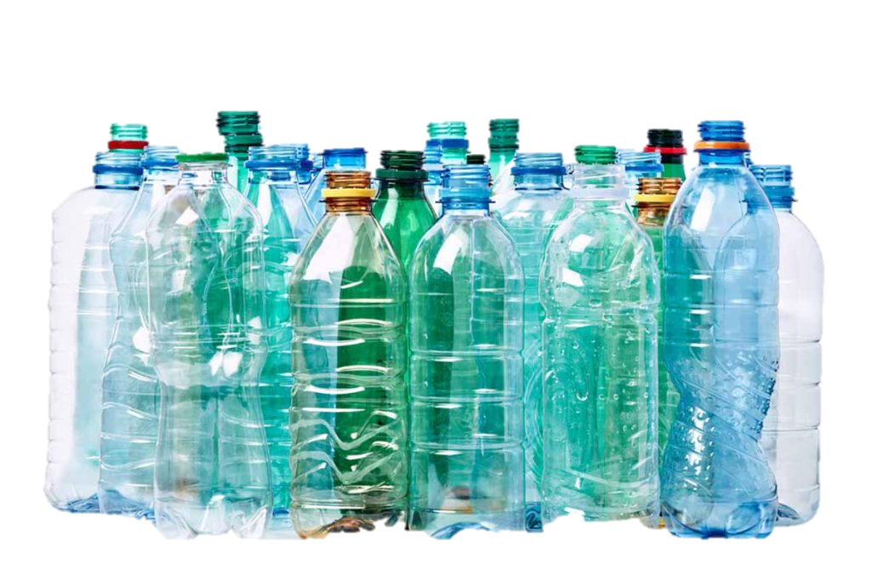
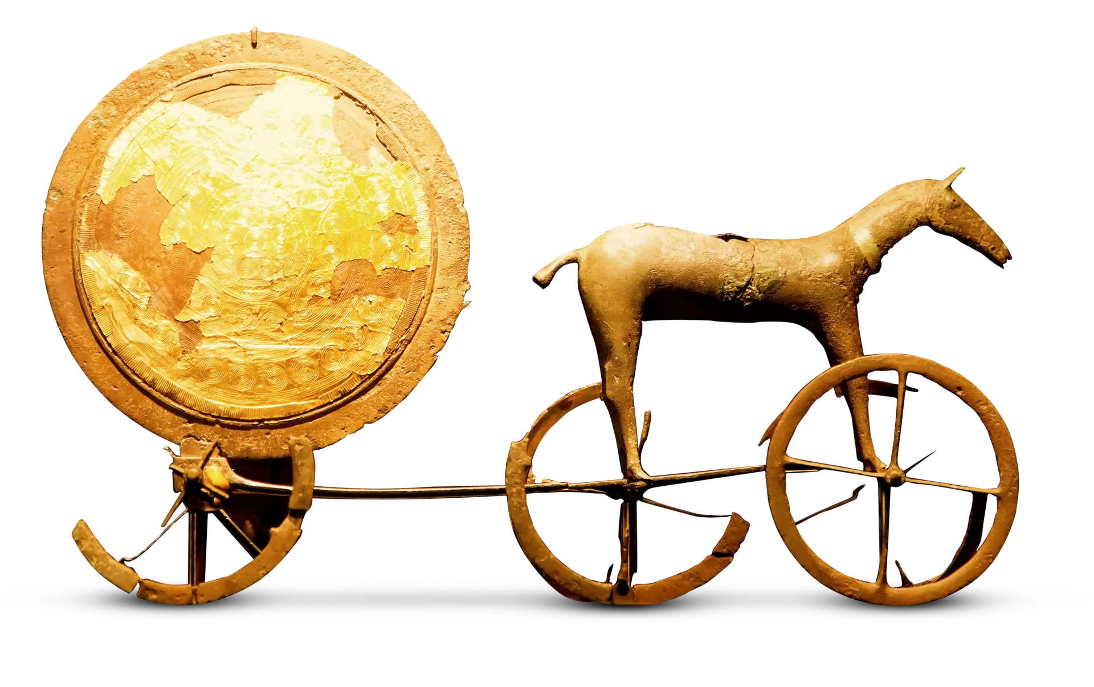
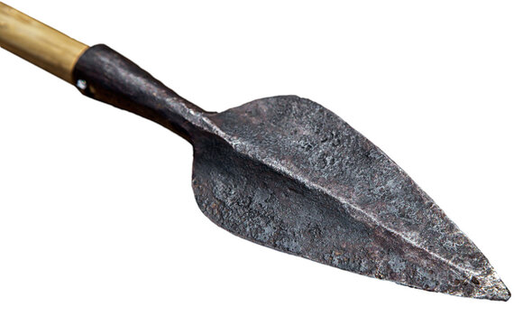
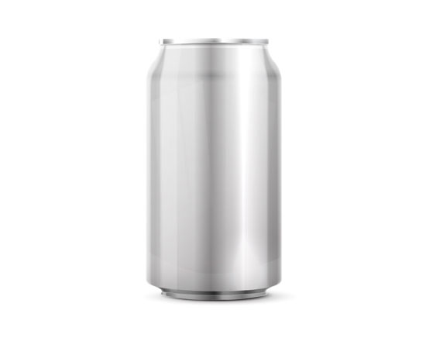
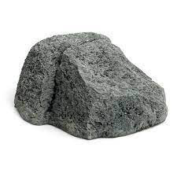
WHAT ABOUT PLASTIC?
STONE AGE
3 mil. - 4 000 BC
BRONZE AGE
4 000 – 3 200 BC
3500 – man made glass
IRON AGE
3 200 BC – 1 200 BC
3000s – first paper
STEEL AND ALUMINIUM
1800s – present
PLASTIC AGE
1900s - PRESENT
LESSON 1 - STORY OF PLASTIC
Notes:
where would you put plastics in human history?
Source: https://eandt.theiet.org/content/articles/2019/09/the-seven-ages-of-materials/

Slide 12
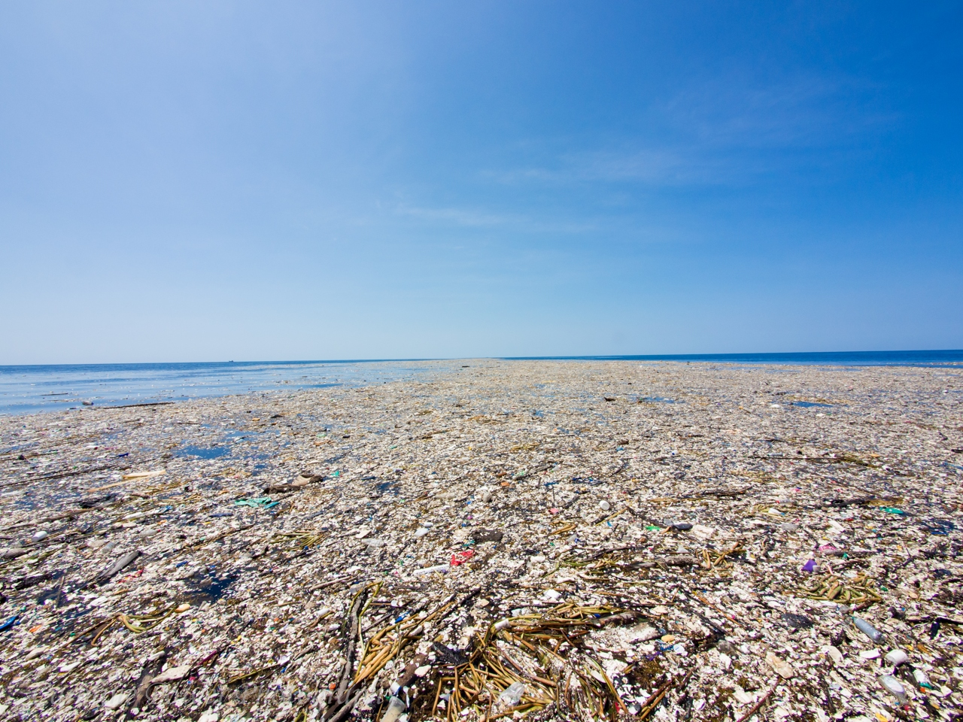



WHO WAS THE BIGGEST PLASTIC POLLUTER IN THE WORLD IN 2021?
LESSON 1 – STORY OF PLASTIC
Notes:
LOOK WHAT HAVE WE DONE IN LESS THEN 100 YEARS
Biggest plastic polluters source:
https://waste-management-world.com/artikel/the-top-plastic-polluters/#:~:text=The%20Coca%2DCola%20Company%20and,for%20fueling%20the%20climate%20crisis.

Slide 13
WHO WAS THE BIGGEST PLASTIC POLLUTER IN THE WORLD IN 2021?
LESSON 1 – STORY OF PLASTIC
Notes:
LOOK WHAT HAVE WE DONE IN LESS THEN 100 YEARS
Biggest plastic polluters source:
https://waste-management-world.com/artikel/the-top-plastic-polluters/#:~:text=The%20Coca%2DCola%20Company%20and,for%20fueling%20the%20climate%20crisis.

Slide 14
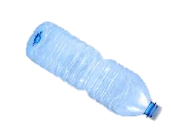
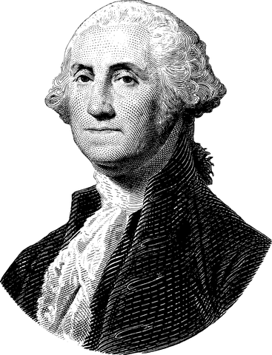
GEORGE WASHINGTON
1732 – 1799
LESSON 1 - STORY OF PLASTIC
Notes:
FUNNY FACT – IMAGINE – IF GEORGE WASHINGTON COULD DRINK WATER FROM PET BOTTLE, YOU COULD STILL FIND THIS BOTTLE :-D

Slide 15
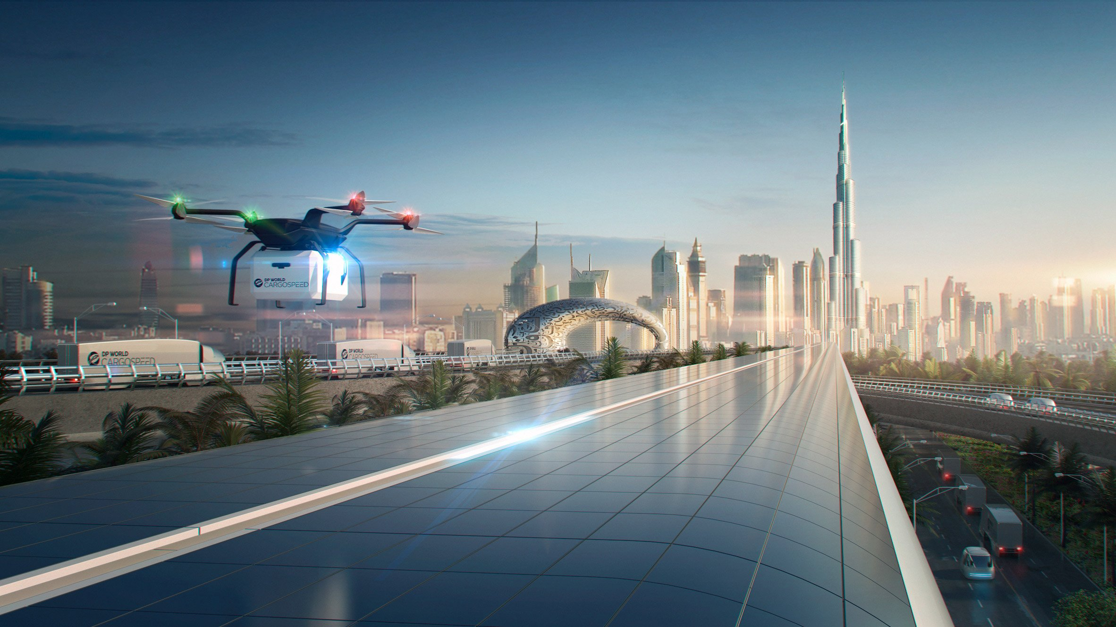
THE ACTIONS WE DO TODAY WILL AFFECT SEVERAL GENERATIONS AFTER US.
LESSON 1 – STORY OF PLASTIC
Notes:
Picture source: https://www.dezeen.com/2018/05/03/foster-partners-hyperloop-cargo-network-dp-world-cargospeed/

Slide 16
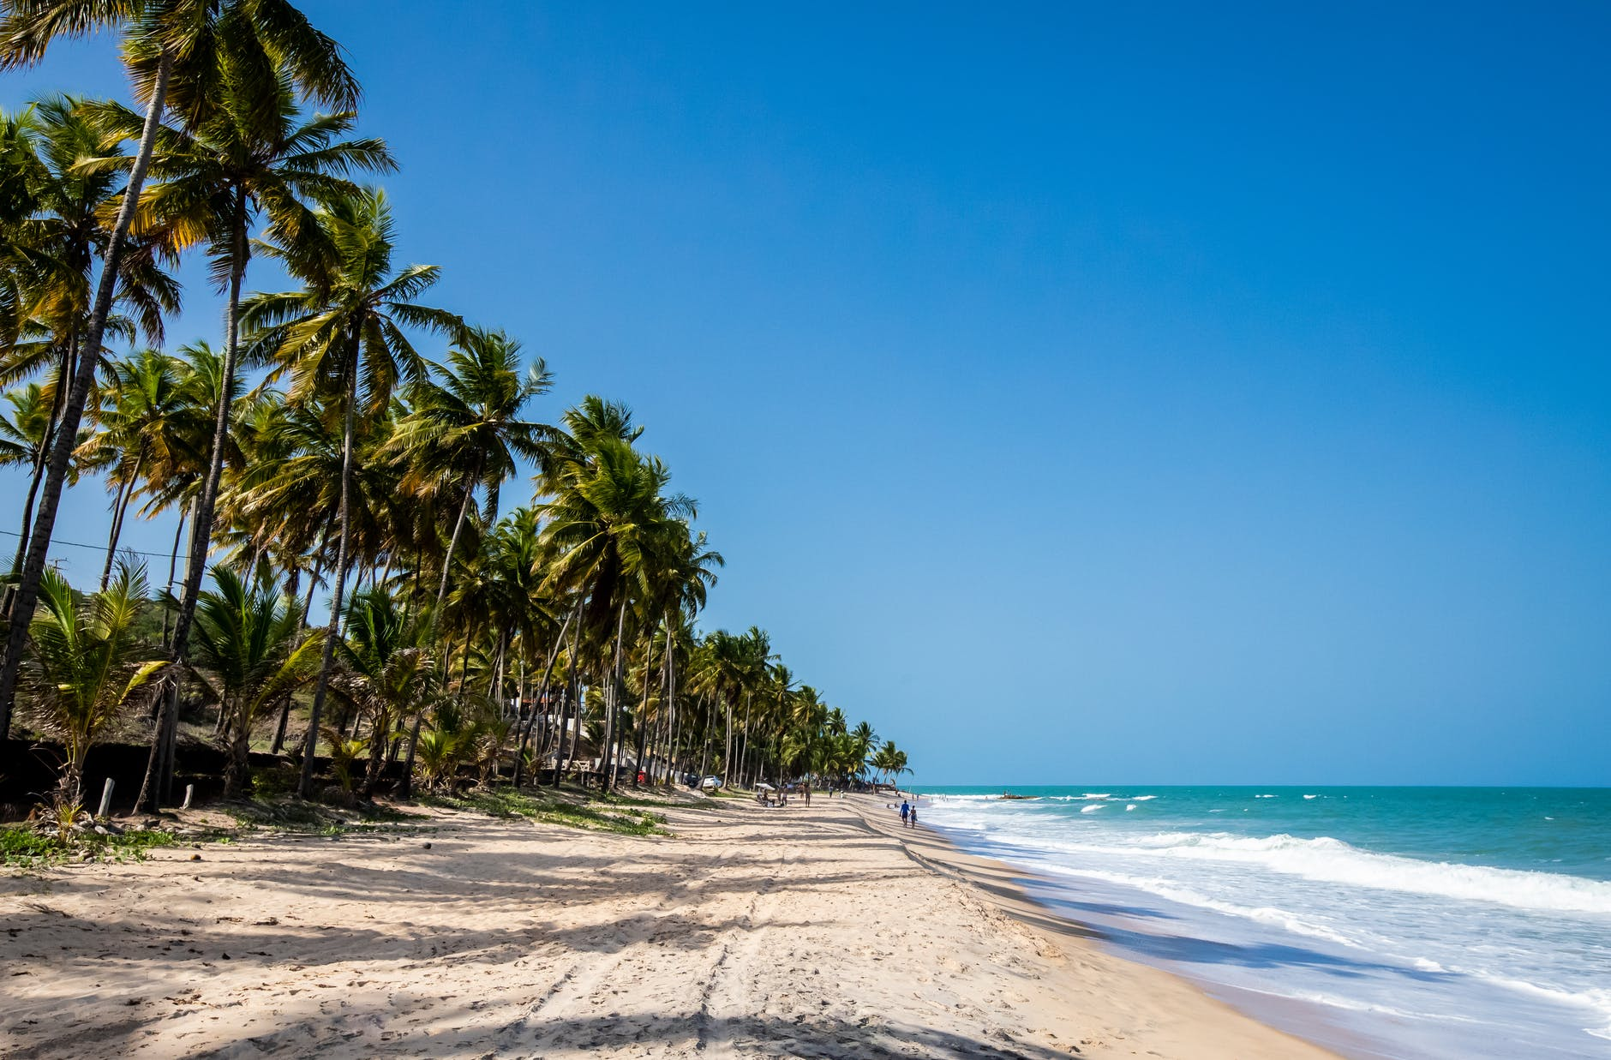
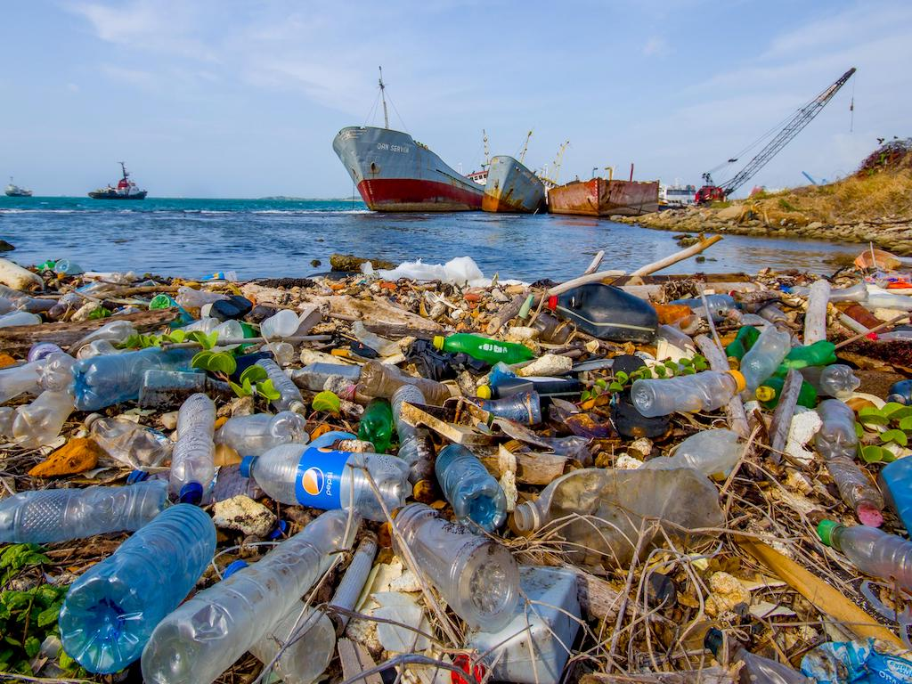
LESSON 1 – STORY OF PLASTIC
Notes:
Picture source: https://www.greenqueen.com.hk/u-s-top-contributor-to-global-coastal-plastic-pollution-new-study-finds/

Slide 17
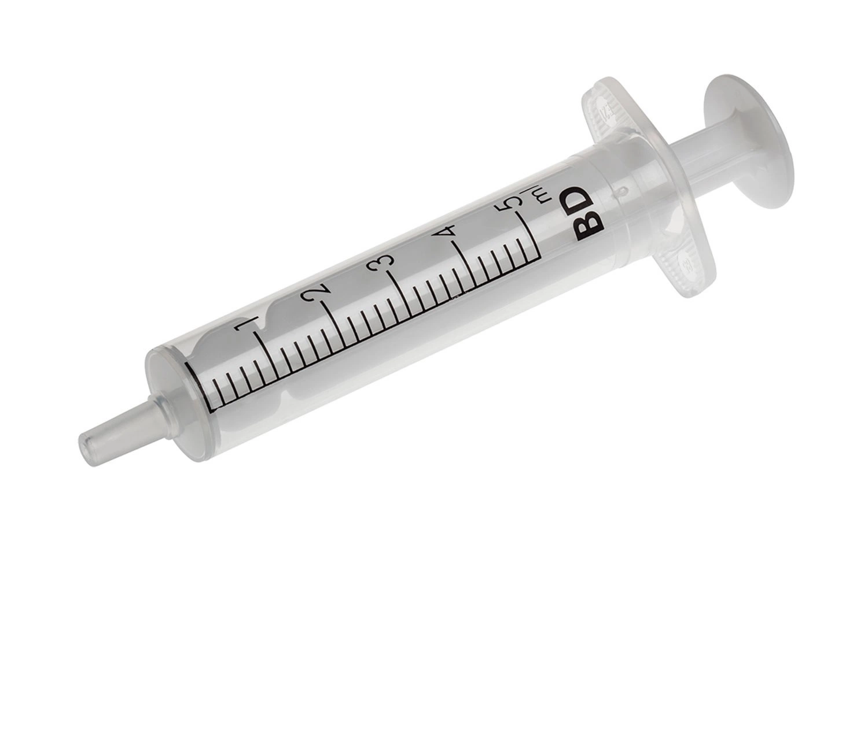
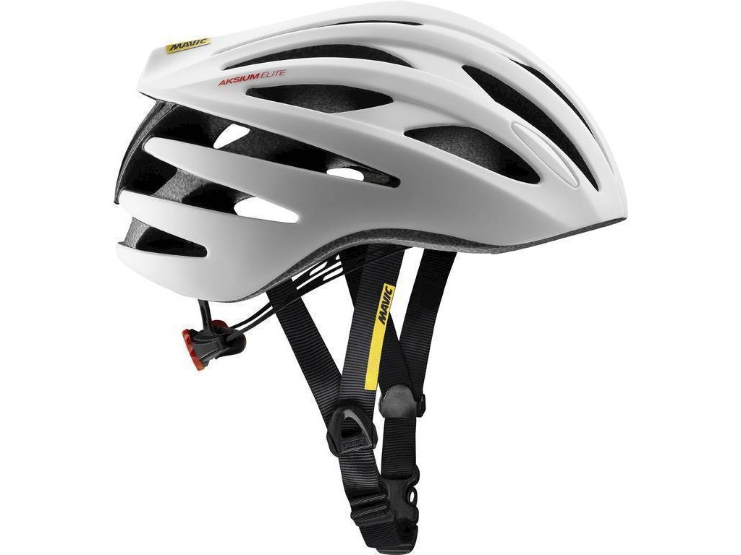
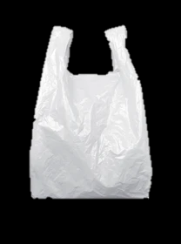


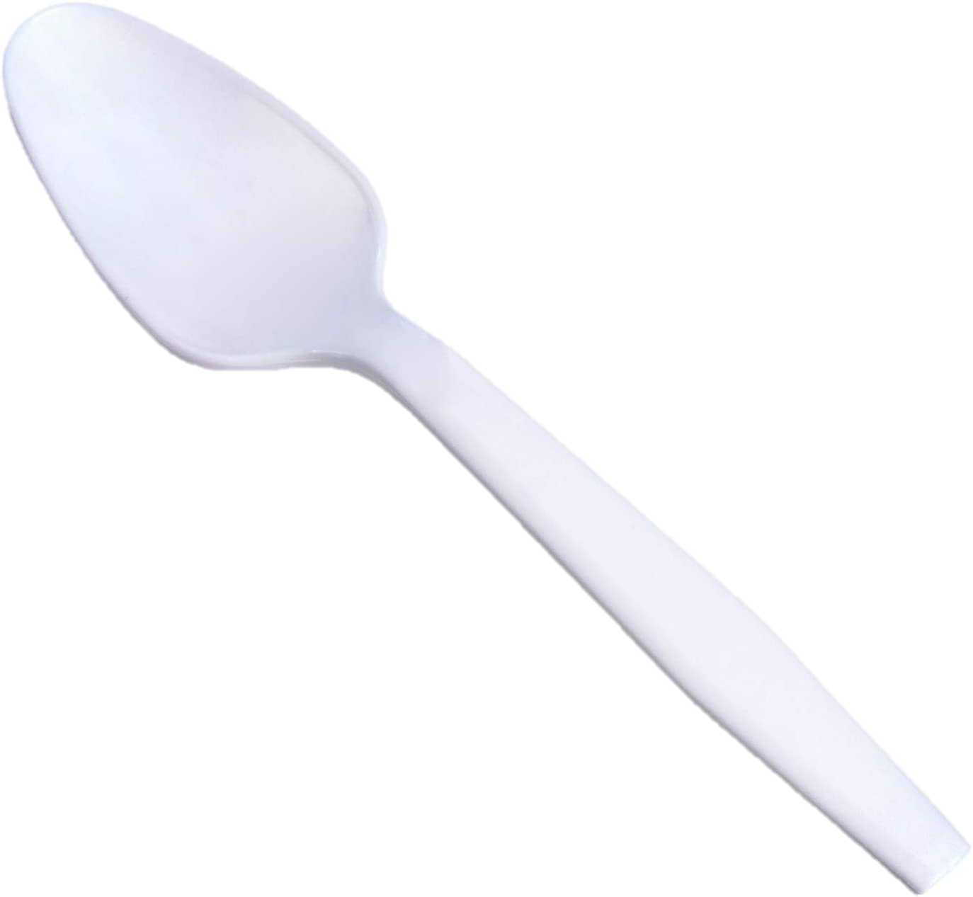
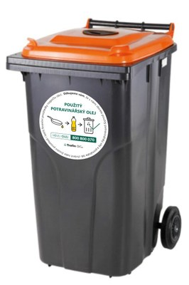
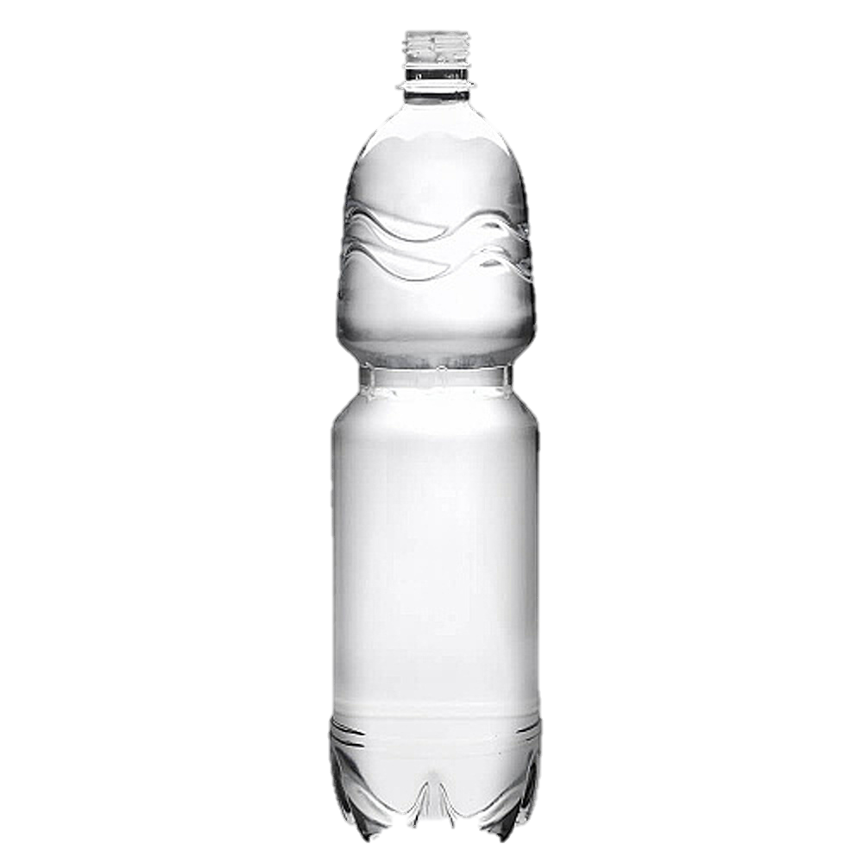
GOOD EXAMPLES OF PLASTIC PRODUCTS
BAD EXAMPLES OF PLASTIC PRODUCTS
LESSON 1 – STORY OF PLASTIC
Notes:
LET PUPILS NAME AT LEAST 3 GOOD AND 3 BAD EXAMPLES

Slide 18
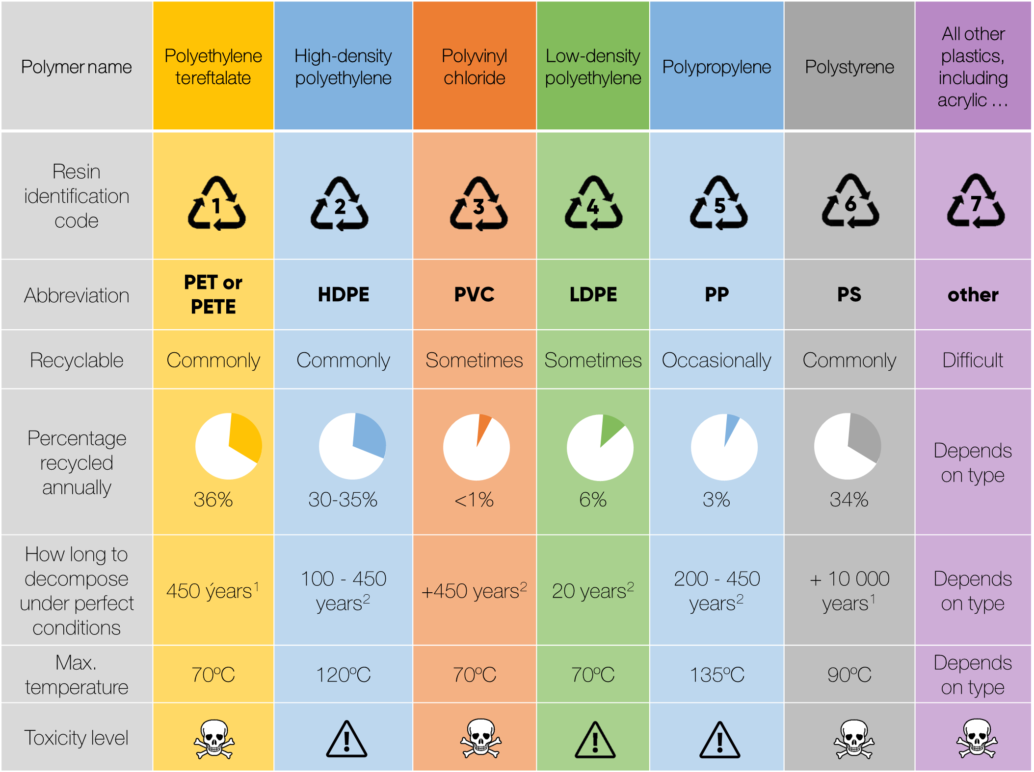
Notes:
Source: https://alansfactoryoutlet.com/7-types-of-plastics-their-toxicity-and-most-commonly-used-for/
[1] https://www.e15.cz/magazin/infografika-jak-dlouho-se-rozklada-odpad-pet-lahvi-to-trva-skoro-pul-tisicileti-1347264#
[2] https://maesindopaperpackaging.com/does-plastic-decompose-how-long-does-it-take/

Slide 19
REMEMBER:
PLASTIC MATERIAL ≠ PROBLEM.
PROBLEM IS FOR WHAT AND HOW WE USE PLASTIC.
LESSON 1 – STORY OF PLASTIC

Slide 20

HOW TO SEPARATE BOTTLE FROM ITS CAP ON LARGE SCALE?
ACTIVITY OF ASSIGNMENT OF PLASTIC TYPES
TO INDIVIDUAL PRODUCTS
LESSON 1 – STORY OF PLASTIC
Notes:
THERE ARE MANY PLASTIC PRODUCTS OUT THERE. CAN YOU IDENTIFY THEM? AND WHICH OF THEM ARE EASY TO RECYCLE AT HOME?

Slide 21
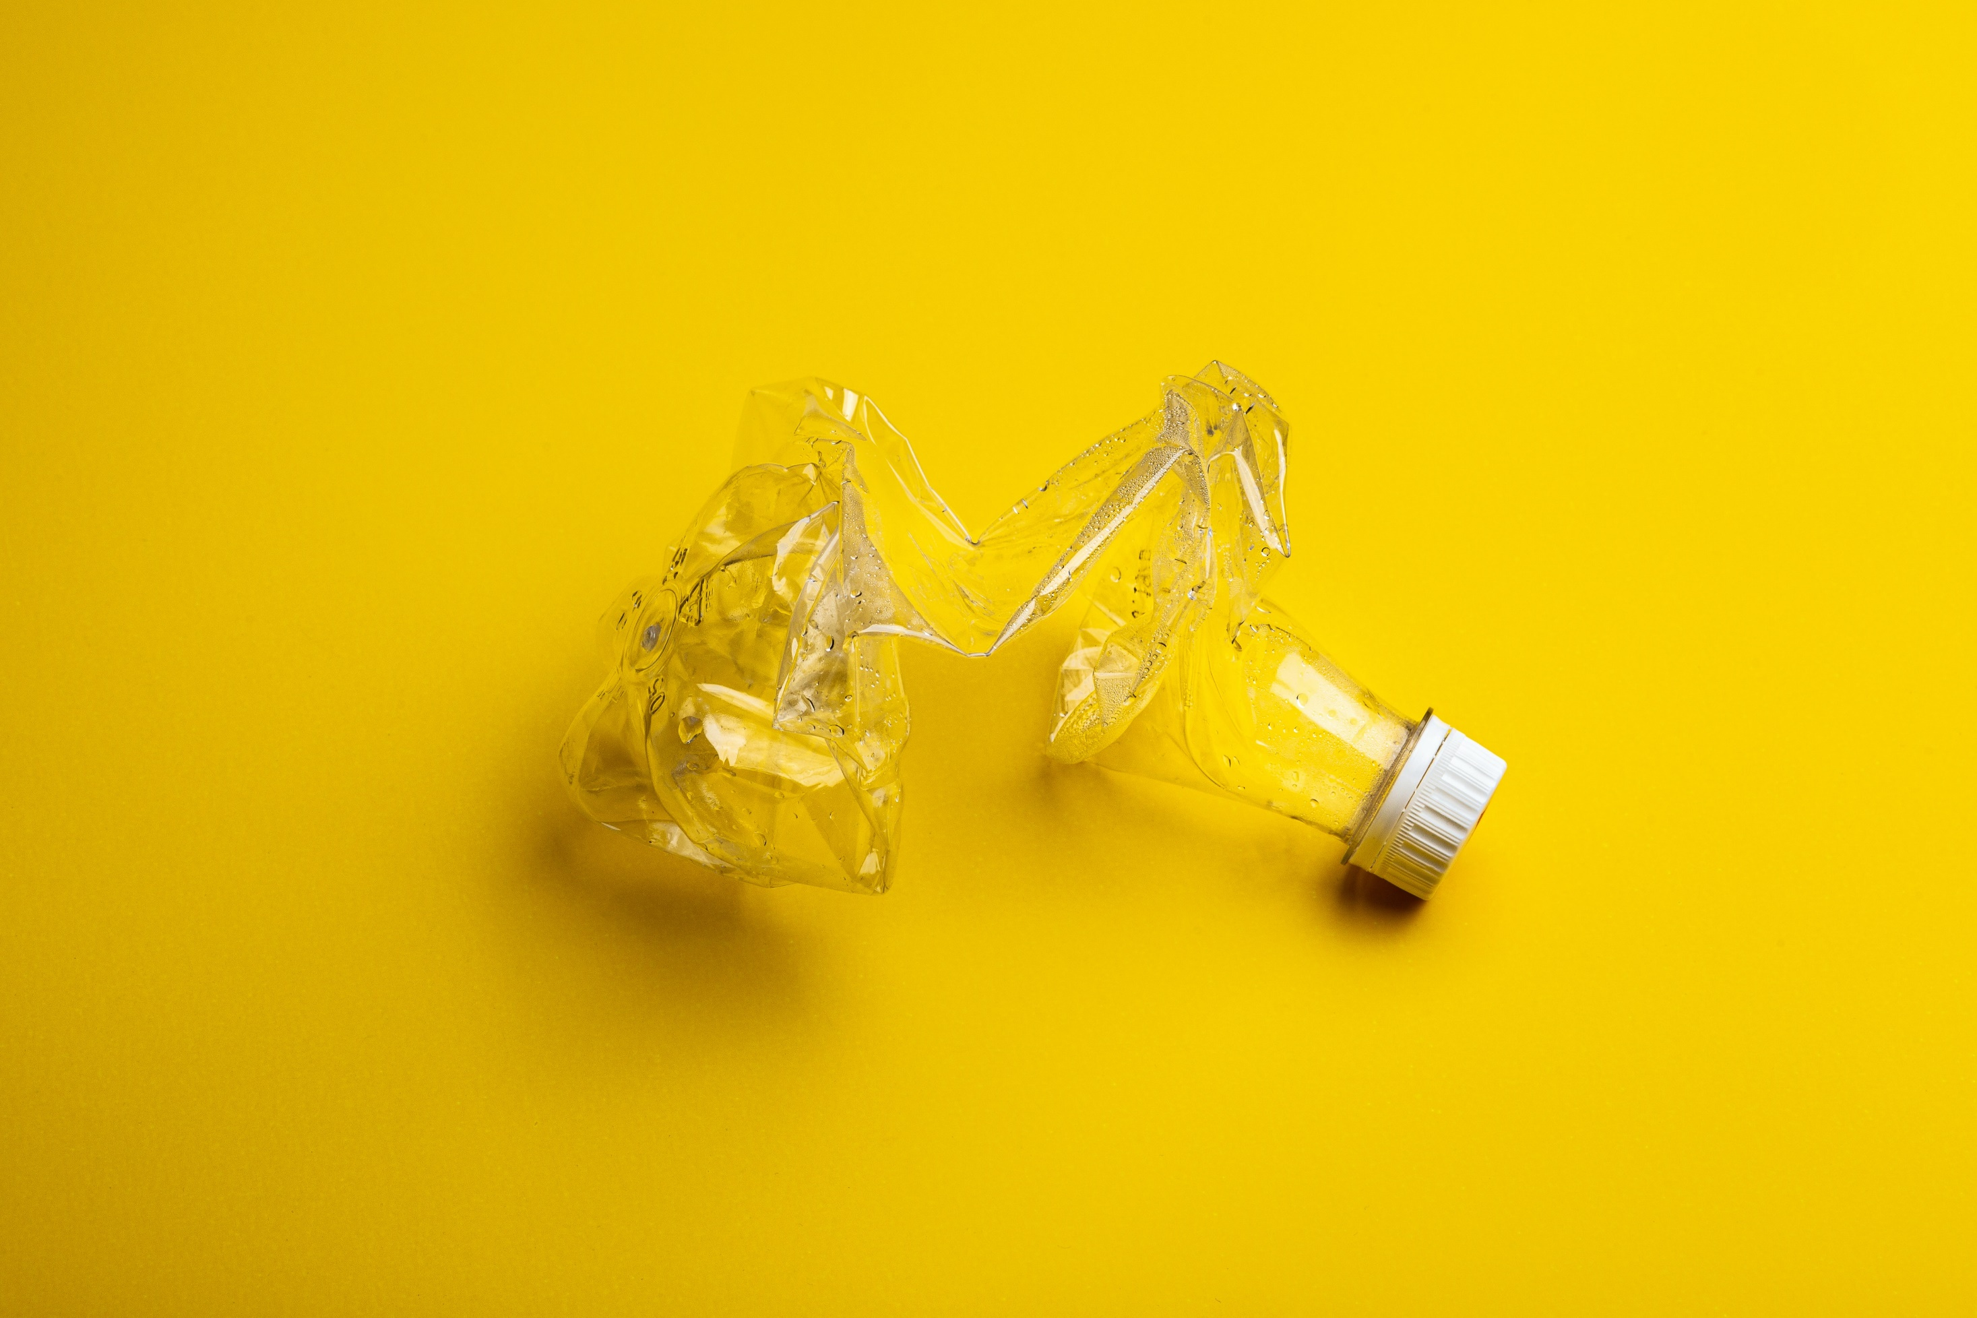
HOW TO SEPARATE BOTTLE FROM ITS CAP ON LARGE SCALE?
LESSON 1 – STORY OF PLASTIC
Notes:
EXPLAIN HOW TO SEPARATE PET FROM HDPE – ONLY BASED ON DIFFERENT MATERIAL DENSITY. SHREDDED PET WILL SINK, BUT HDPE WILL SWIM ON THE LEVEL

Slide 22
SAFETY INSTRUCTIONS
INTRODUCTION OF WORKSPACE
LESSON 1 - STORY OF PLASTIC

Slide 23

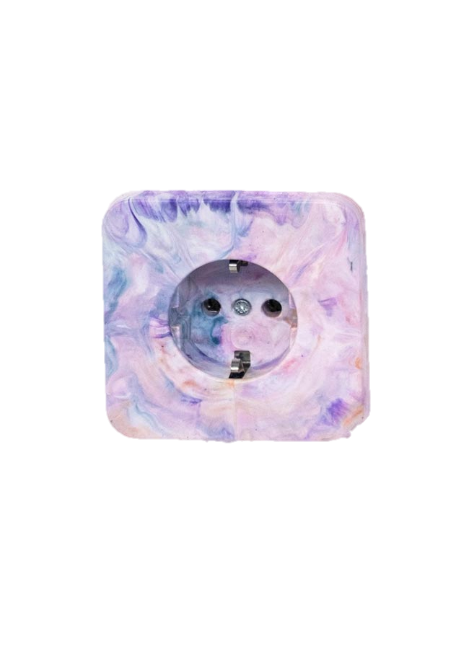

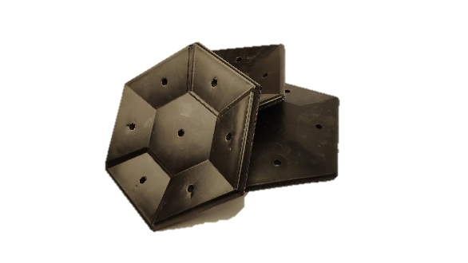



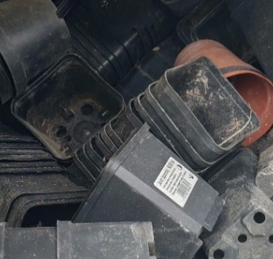
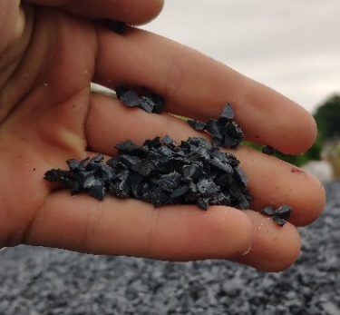
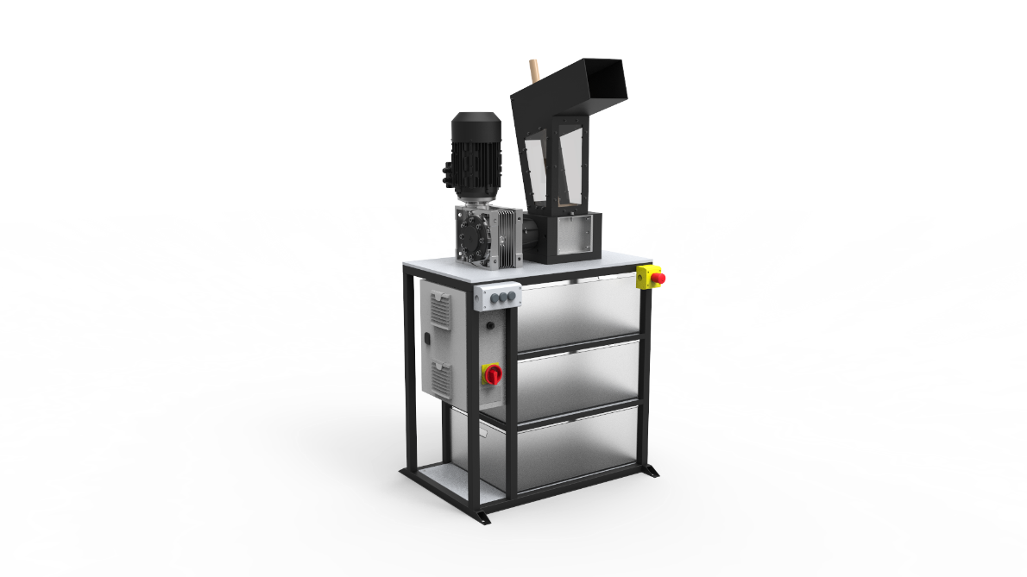
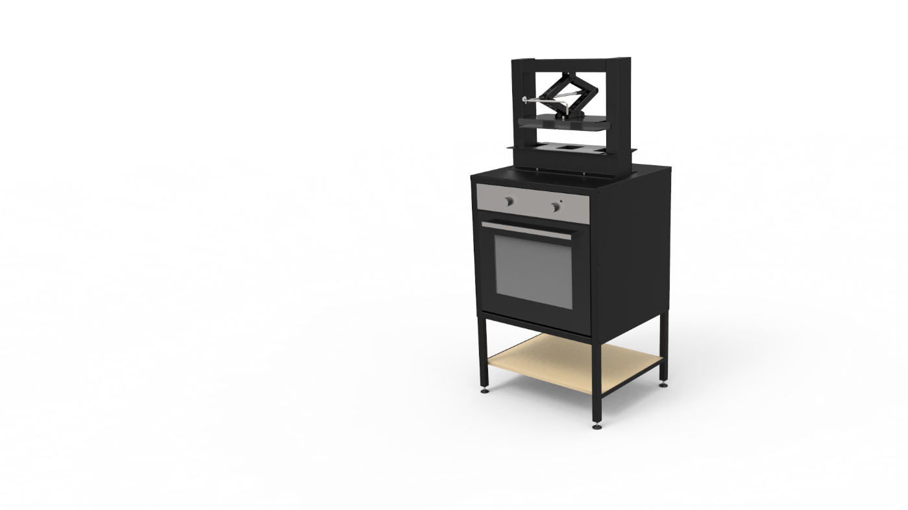
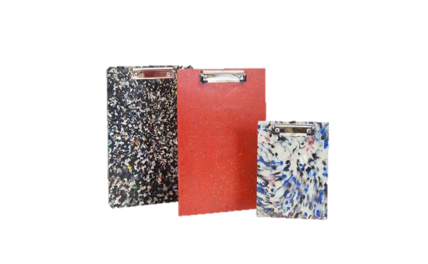



INJECTION
MOULDING
INDUSTRIAL SHREDDING
PLASTIC WASTE
CRUSHED PLASTIC
HOME SHREDDING
COMPRESSION MOULDING
Notes:
OK, SMALL RECAP. WE HAVE ALREADY TALKED ABOUT PLASTIC HISTORY, TYPES, ADVANTAGES AND DISADVANTAGES. NOW IT IS TIME TO DESCRIBE MATERIAL RECYCLING METHODS.

Slide 24
SHREDDING PLASTIC
LESSON 1 – STORY OF PLASTIC
Notes:
Demonstration of shredding technology.

Slide 25
PRACTICE LABLES ON PACKAGES
LESSON 1 - STORY OF PLASTIC

Slide 26
DIG INTO GROUND DIFFERERNT TYPES OF MATERIAL
LESSON 1 – STORY OF PLASTIC
Notes:
Demonstration of compression moulding

Slide 27
HOMEWORK SYSTEM
LESSON 1 - STORY OF PLASTIC
Notes:
Opinional

Slide 28

Notes:
Source: Studio Na Haku Brno (Czech Republic) upcycling empty PET bottles from Proseco into design lighting.
Upcycling can be beautiful.

Slide 29
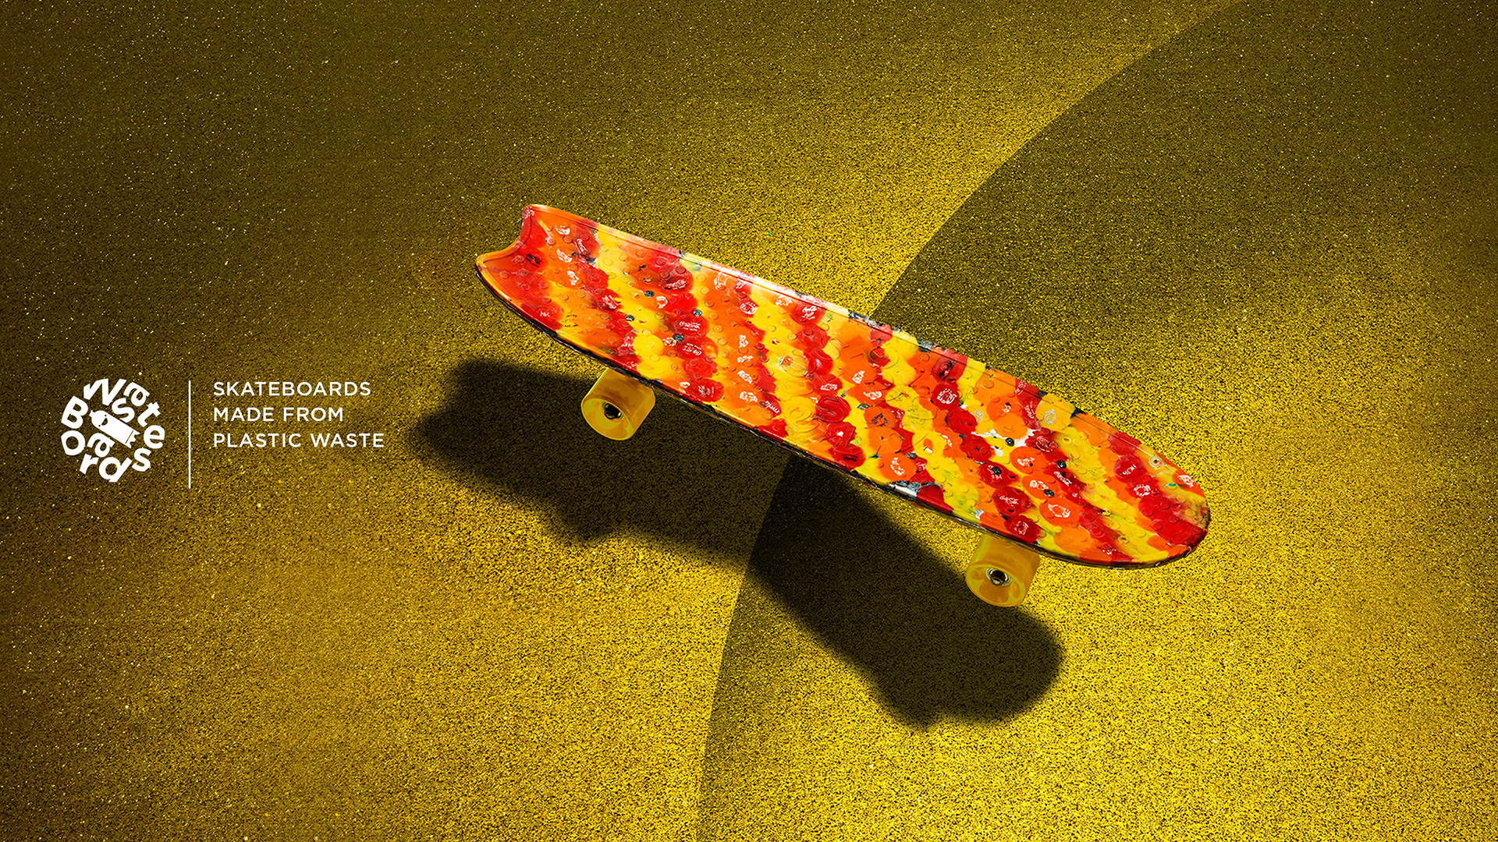
Notes:
Source: Wasteboard – company in Netherlands, recycling bottle caps

Slide 30
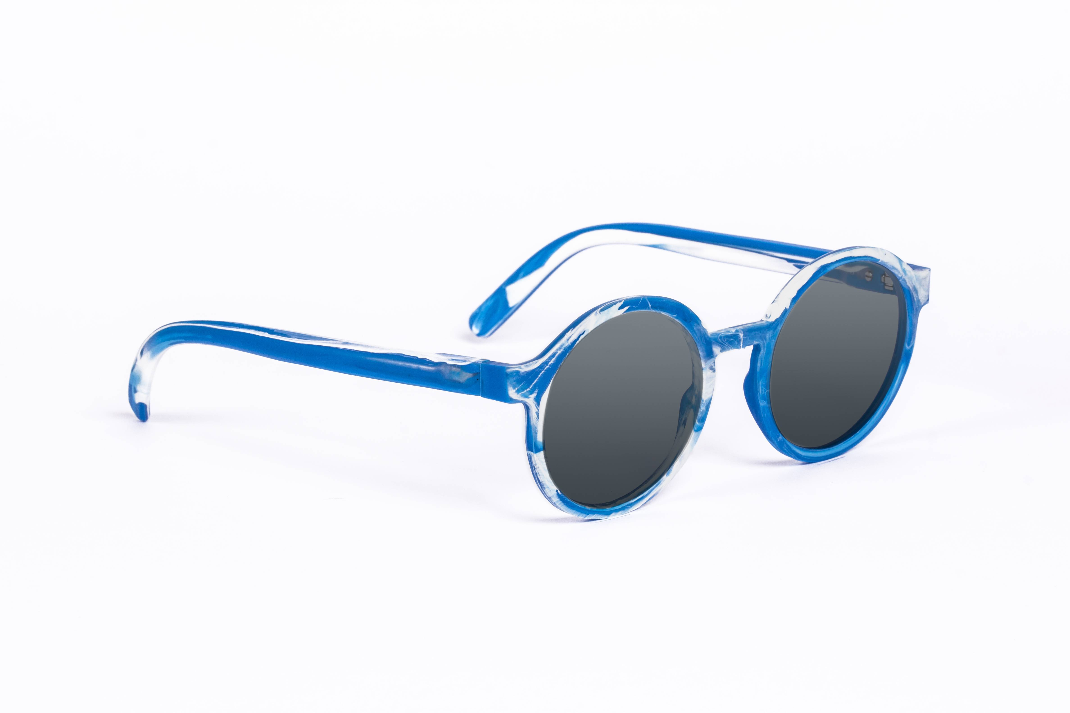
Notes:
Source: Precious Plastic bazar: Baiau - FOS Eyewear

Slide 31
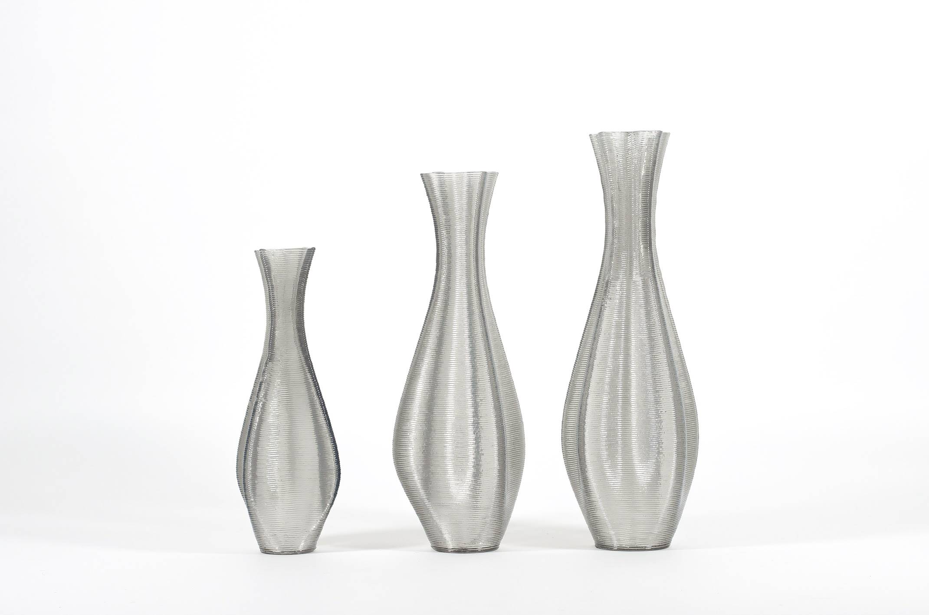
Notes:
3d printed vases from vanPlestik, source: Precious plastic bazar: Euler (medium) - 3D printed floorvase by vanPlestik

Slide 32
SEE U NEXT TIME
LESSON 1 – STORY OF PLASTIC
Notes:
MAKE RECAP

Slide 33


ING. TOMAS KOLECAR
INFO@PLASTMAKERS.COM
WWW.PLASTMAKERS.COM
+420 739 122 662
CZECH REPUBLIC - EUROPE
CONTACT

