Slide 1

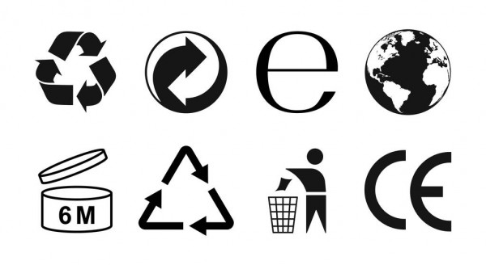


Slide 2


An optional symbol that basically only informs us not to pollute the environment and throw waste in the appropriate containers (bins, bins, containers).
Not only does it tell us that the packaging can be recycled. In addition, it tells us that this packaging has already been made from recycled material.
The numbers and letters below this symbol will tell us what material the packaging is made of. When sorting, we follow the same rules as for a triangle with solid arrows.
This symbol indicates that the packaging is intended for recycling and is accompanied by written abbreviations and numbers. Basic knowledge of recycling labels is important because it affects whether we can sort waste into the right waste sorting container.
This trademark - the so-called green dot - tells us that a financial contribution for the take-back and its further processing by recycling has been paid for this packaging.

Slide 3





Slide 4
The symbol means minimum durability after opening the product. The number means the number of months.
The symbol means that the product cannot be sorted into sorted waste containers or municipal waste. We must return it to the seller or for ecological disposal within the municipality. It occurs on products that must not end up in mixed waste - it is a variety of chemicals, paints, toxic and irritating substances, as well as electrical equipment and batteries.
Symbol for food contact materials. Symbol warning against the consumption of inedible parts of packaging (active and intelligent)
The symbol indicates that the product meets EU legislative requirements and can be placed on the market in the European Economic Area.
It also meets the basic requirements for safety, health or the environment.

